Slide 1


Python Chapter 7: Number
Peter H. Chen, PhDEE/EMBA

Slide 2

7 Number

Slide 3

7 Number
Introduction
https://www.tutorialspoint.com/python3/python_numbers.htm
Number data types store numeric values.
They are immutable data types, means that changing the value of a number data type results in a newly allocated object.
Number objects are created when you assign a value to them. For example:
var1 = 1
var2 = 10
You can also delete the reference to a number object by using the del statement.
The syntax of the del statement is
del var
del var_a, var_b
Python - CS596

Slide 4
7 Number
Introduction
https://www.tutorialspoint.com/python3/python_numbers.htm
Python supports four different numerical types −
int (signed integers): They are often called just integers or ints, are positive or negative whole numbers with no decimal point.
long (long integers ): Also called longs, they are integers of unlimited size, written like integers and followed by an uppercase or lowercase L.
float (floating point real values) : Also called floats, they represent real numbers and are written with a decimal point dividing the integer and fractional parts. Floats may also be in scientific notation, with E or e indicating the power of 10 (2.5e2 = 2.5 x 10² = 250).
complex (complex numbers) : are of the form a + bJ, where a and b are floats and J (or j) represents the square root of -1 (which is an imaginary number). The real part of the number is a, and the imaginary part is b. Complex numbers are not used much in Python programming.
Python - CS596

Slide 5
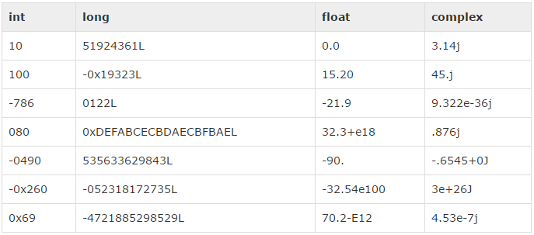
7 Number
Introduction
https://www.tutorialspoint.com/python3/python_numbers.htm
Here are some examples of numbers
Python - CS596

Slide 6
7 Number
Introduction
https://www.tutorialspoint.com/python3/python_numbers.htm
Python allows you to use a lowercase L with long, but it is recommended that you use only an uppercase L to avoid confusion with the number 1. Python displays long integers with an uppercase L.
A complex number consists of an ordered pair of real floating point numbers denoted by a + bj, where a is the real part and b is the imaginary part of the complex number.
Python - CS596

Slide 7
7.1 Number Type Conversion

Slide 8
7.1 Number Type Conversion
Introduction
https://www.tutorialspoint.com/python3/python_numbers.htm
Python converts numbers internally in an expression containing mixed types to a common type for evaluation. But sometimes, you need to coerce a number explicitly from one type to another to satisfy the requirements of an operator or function parameter.
Type int(x) to convert x to a plain integer.
Type long(x) to convert x to a long integer.
Type float(x) to convert x to a floating-point number.
Type complex(x) to convert x to a complex number with real part x and imaginary part zero.
Type complex(x, y) to convert x and y to a complex number with real part x and imaginary part y. x and y are numeric expressions
Python - CS596

Slide 9
7.2 Math Function

Slide 10
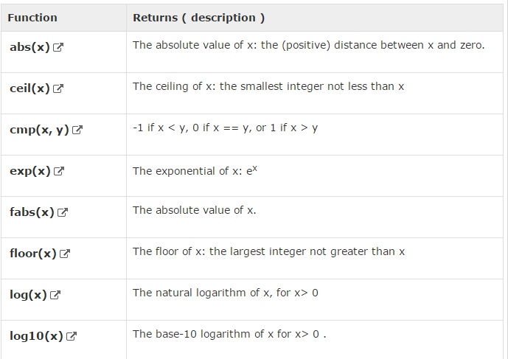
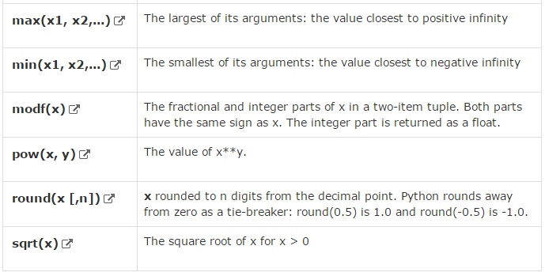
7.2 Math Function
Introduction
https://www.tutorialspoint.com/python3/python_numbers.htm
Python includes following functions that perform mathematical calculations.
Python - CS596

Slide 11
7.3 Random Number Function

Slide 12
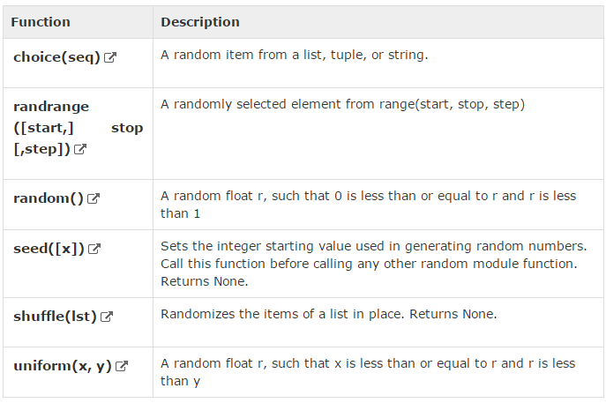
7.3 Random Number Function
Introduction
https://www.tutorialspoint.com/python3/python_numbers.htm
Random numbers are used for games, simulations, testing, security, and privacy applications.
Python includes following functions that are commonly used.
Python - CS596

Slide 13
7.4 Trigonometric Function

Slide 14
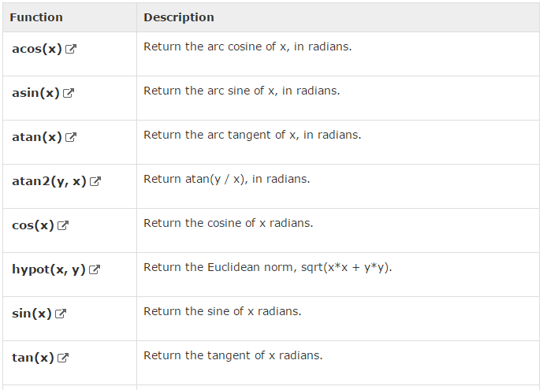
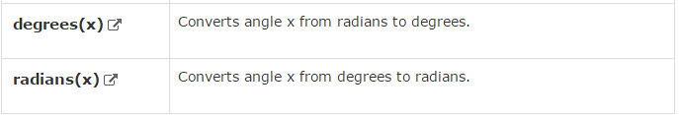
7.3 Random Number Function
Introduction
https://www.tutorialspoint.com/python3/python_numbers.htm
Python includes following functions that perform trigonometric calculations.
Python - CS596

Slide 15
7.5 Math Constant

Slide 16
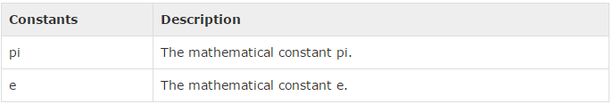
7.5 Math Constant
Introduction
https://www.tutorialspoint.com/python3/python_numbers.htm
The module also defines two mathematical constants.
Python - CS596

Slide 17

END of CHAPTER 7

