Slide 1


Python Chapter 8: String
Peter H. Chen, PhDEE/EMBA

Slide 2

8 String

Slide 3

8 String
Introduction
https://www.tutorialspoint.com/python/python_numbers.htm
Strings are amongst the most popular types in Python.
We can create them simply by enclosing characters in quotes.
Python treats single quotes the same as double quotes.
Creating strings is as simple as assigning a value to a variable. For example:
var1 = 'Hello World!'
var2 = "Python Programming"
Python - CS596

Slide 4
8.2 Update String

Slide 5
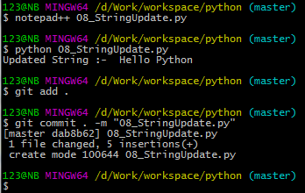
8.2 Update String
Introduction
https://www.tutorialspoint.com/python3/python_strings.htm
You can "update" an existing string by (re)assigning a variable to another string.
The new value can be related to its previous value or to a completely different string altogether. For example
#!/usr/bin/python
var1 = 'Hello World!'
print ("Updated String :- ", var1[:6] + 'Python')
Python - CS596

Slide 6
8.3 Escape Character

Slide 7
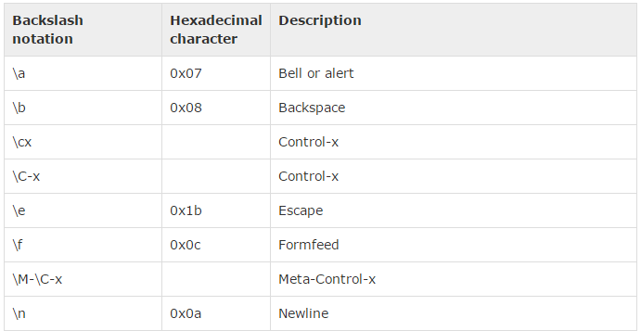
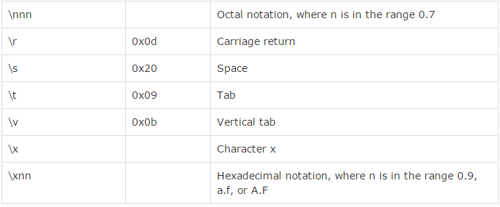
8.3 Escape Character
Introduction
https://www.tutorialspoint.com/python3/python_strings.htm
Following table is a list of escape or non-printable characters that can be represented with backslash notation.
An escape character gets interpreted; in a single quoted as well as double quoted strings.
Python - CS596

Slide 8
8.4 String Special Operator

Slide 9
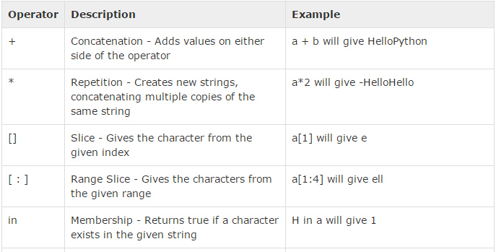
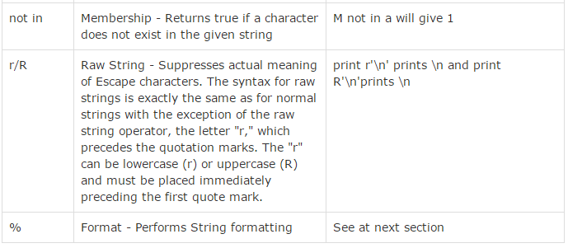
8.4 String Special Character
Introduction
https://www.tutorialspoint.com/python3/python_strings.htm
Assume string variable a holds 'Hello' and variable b holds 'Python', then
Python - CS596

Slide 10
8.5 String Format Operator

Slide 11
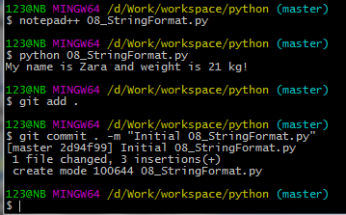
8.5 String Format Character
Introduction
https://www.tutorialspoint.com/python3/python_strings.htm
One of Python's coolest features is the string format operator %.
This operator is unique to strings and makes up for the pack of having functions from C's printf() family.
Following is a simple example:
#!/usr/bin/python
print ("My name is %s and weight is %d kg!" % ('Zara', 21))
Python - CS596

Slide 12
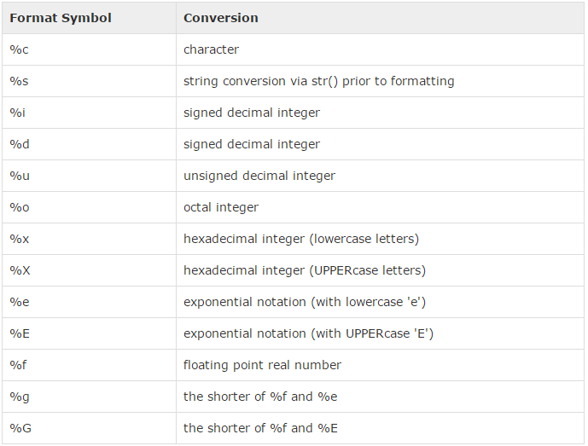
8.5 String Format Character
Introduction
https://www.tutorialspoint.com/python3/python_strings.htm
Here is the list of complete set of symbols which can be used along with %:
Python - CS596

Slide 13
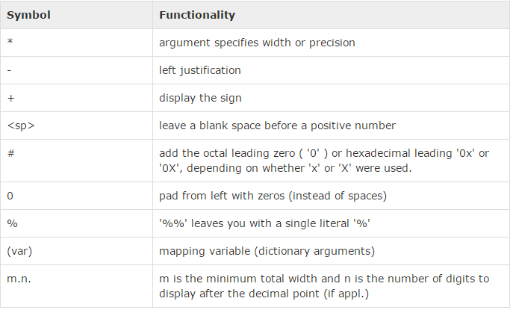
8.5 String Format Character
Introduction
https://www.tutorialspoint.com/python3/python_strings.htm
Other supported symbols and functionality are listed in the following table:
Python - CS596

Slide 14
8.6 Triple Quote

Slide 15
8.6 Triple Quote
Introduction
https://www.tutorialspoint.com/python3/python_strings.htm
Python's triple quotes comes to the rescue by allowing strings to span multiple lines, including verbatim NEWLINEs, TABs, and any other special characters.
The syntax for triple quotes consists of three consecutive single or double quotes.
#!/usr/bin/python3
para_str =
""“
this is a long string that is made up of
several lines and non-printable characters such as
TAB ( \t ) and they will show up that way when displayed.
NEWLINEs within the string, whether explicitly given like
this within the brackets [ \n ], or just a NEWLINE within
the variable assignment will also show up.
"""
print (para_str)
Python - CS596

Slide 16
8.7 Built-in String Method

Slide 17
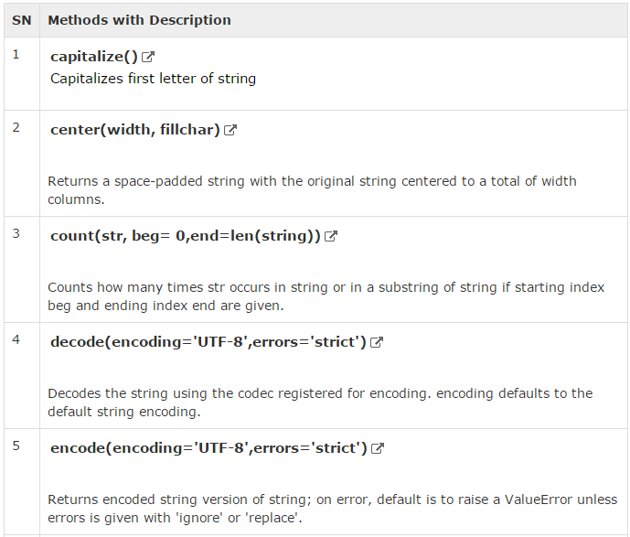
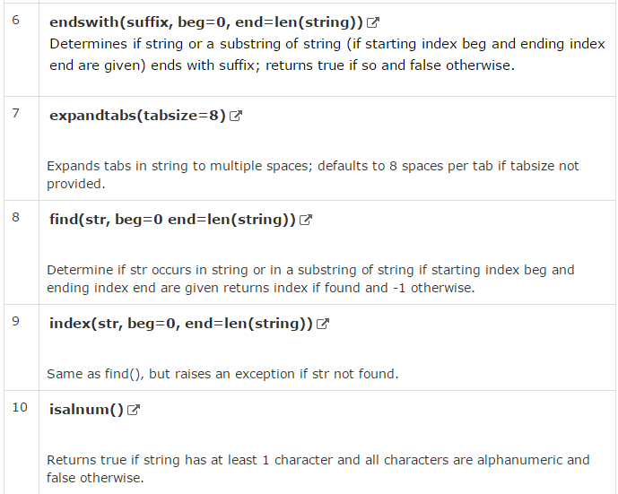
8.7 Built-in String Method (1)
Introduction
https://www.tutorialspoint.com/python3/python_strings.htm
Python includes the following built-in methods to manipulate string
Python - CS596

Slide 18
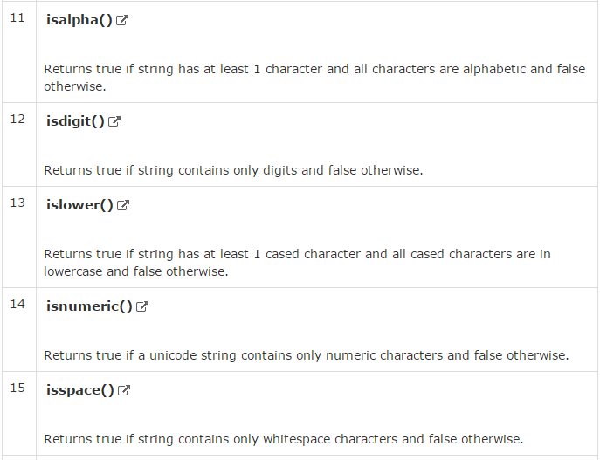
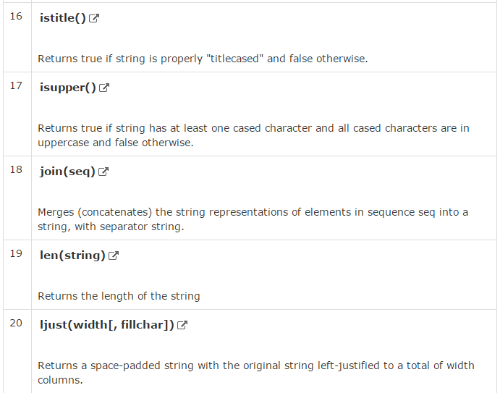
8.7 Built-in String Method (Continue-2)
Introduction
https://www.tutorialspoint.com/python3/python_strings.htm
Built-in String Method (Continue-2)
Python - CS596

Slide 19
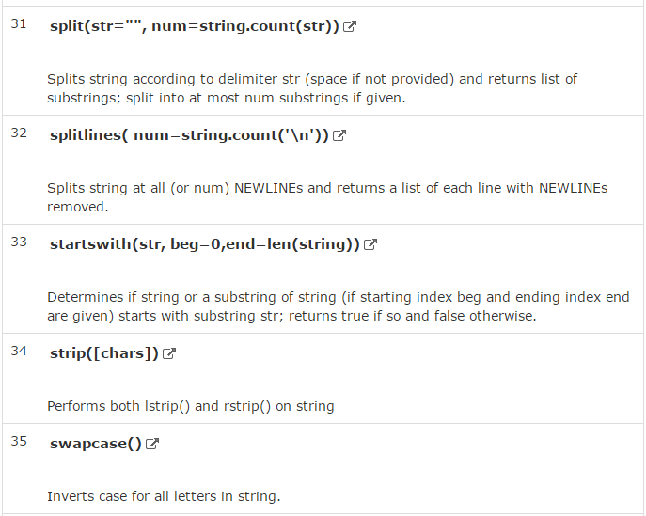
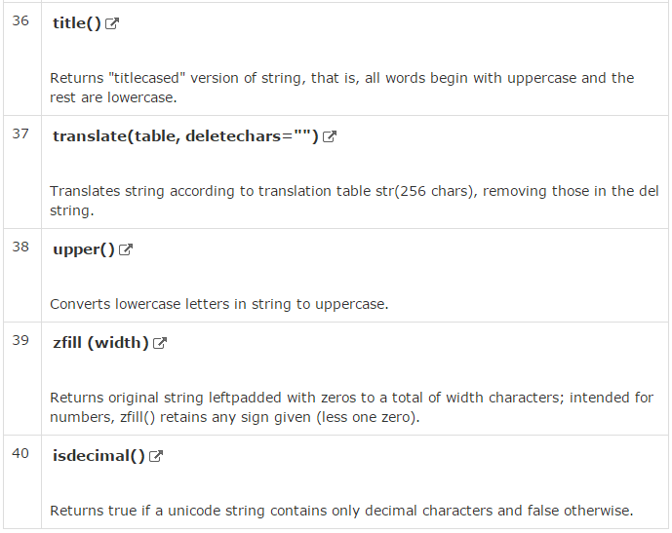
8.7 Built-in String Method (Continue-3)
Introduction
https://www.tutorialspoint.com/python3/python_strings.htm
Built-in String Method (Continue-3)
Python - CS596

Slide 20

END of CHAPTER 8

