Slide 1


Python Chapter 9: List
Peter H. Chen, PhDEE/EMBA

Slide 2

9 List

Slide 3

9 List
Introduction
https://www.tutorialspoint.com/python3/python_lists.htm
The most basic data structure in Python is the sequence. Each element of a sequence is assigned a number - its position or index. The first index is zero, the second index is one, and so forth.
Python has six built-in types of sequences, but the most common ones are lists and tuples.
There are certain things you can do with all sequence types. These operations include indexing, slicing, adding, multiplying, and checking for membership. In addition, Python has built-in functions for finding the length of a sequence and for finding its largest and smallest elements.
var1 = 'Hello World!'
var2 = "Python Programming"
Python - CS596

Slide 4
9.1 Python List

Slide 5
9.1 Python List
Introduction
https://www.tutorialspoint.com/python3/python_lists.htm
The list is a most versatile datatype available in Python which can be written as a list of comma-separated values (items) between square brackets. Important thing about a list is that items in a list need not be of the same type.
Creating a list is as simple as putting different comma-separated values between square brackets. For example:
list1 = ['physics', 'chemistry', 1997, 2000];
list2 = [1, 2, 3, 4, 5 ];
list3 = ["a", "b", "c", "d"]
Similar to string indices, list indices start at 0, and lists can be sliced, concatenated and so on.
Python - CS596

Slide 6
9.2 Access Values in List

Slide 7
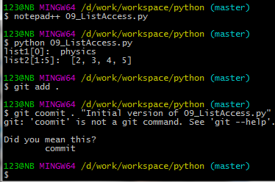
9.2 Access Values in List
Introduction
https://www.tutorialspoint.com/python3/python_lists.htm
To access values in lists, use the square brackets for slicing along with the index or indices to obtain value available at that index.
example −
#!/usr/bin/python
list1 = ['physics', 'chemistry', 1997, 2000];
list2 = [1, 2, 3, 4, 5, 6, 7 ];
print ("list1[0]: ", list1[0])
print ("list2[1:5]: ", list2[1:5])
Python - CS596

Slide 8
9.3 Update List

Slide 9
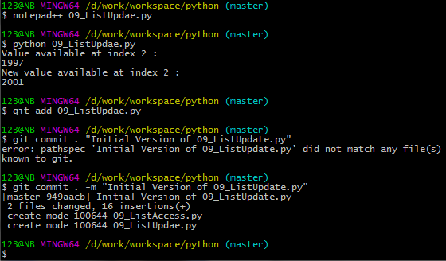
9.3 Update List
Introduction
https://www.tutorialspoint.com/python3/python_lists.htm
You can update single or multiple elements of lists by giving the slice on the left-hand side of the assignment operator, and you can add to elements in a list with the append() method.
For example:
#!/usr/bin/python
list = ['physics', 'chemistry', 1997, 2000];
print ("Value available at index 2 : ")
print (list[2])
list[2] = 2001;
print ("New value available at index 2 : ")
print (list[2])
Python - CS596

Slide 10
9.4 Delete Element in List

Slide 11
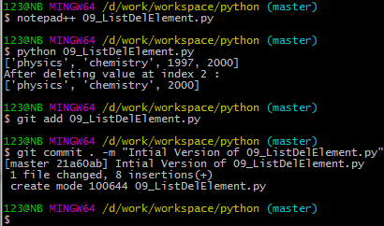
9.4 Delete Element in List
Introduction
https://www.tutorialspoint.com/python3/python_lists.htm
To remove a list element, you can use either the del statement if you know exactly which element(s) you are deleting or the remove() method if you do not know.
For example :
#!/usr/bin/python
list1 = ['physics', 'chemistry', 1997, 2000];
print (list1)
del list1[2];
print ("After deleting value at index 2 : ")
print (list1)
Python - CS596

Slide 12
9.5 Delete Element in List

Slide 13
9.5 Delete Element in List
Introduction
https://www.tutorialspoint.com/python3/python_lists.htm
To remove a list element, you can use either the del statement if you know exactly which element(s) you are deleting or the remove() method if you do not know. For example :
#!/usr/bin/python
list1 = ['physics', 'chemistry', 1997, 2000];
print (list1)
del list1[2];
print ("After deleting value at index 2 : ")
print (list1)
Python - CS596

Slide 14
9.6 List Operation

Slide 15
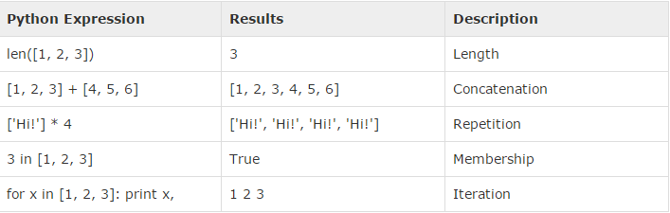
9.6 List Operation
Introduction
https://www.tutorialspoint.com/python3/python_lists.htm
Lists respond to the + and * operators much like strings; they mean concatenation and repetition here too, except that the result is a new list, not a string.
Python - CS596

Slide 16
9.7 Index, Slice, and Matrix

Slide 17
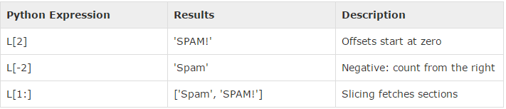
9.7 Index, Slice, and Matrix
Introduction
https://www.tutorialspoint.com/python3/python_lists.htm
Because lists are sequences, indexing and slicing work the same way for lists as they do for strings.
Assuming following input :
L = ['spam', 'Spam', 'SPAM!']
Python - CS596

Slide 18
9.8 Built-in List Function

Slide 19
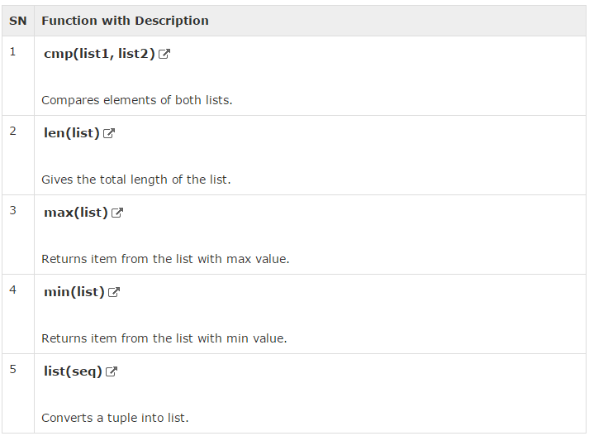
9.8 Built-in List Function
Introduction
https://www.tutorialspoint.com/python3/python_lists.htm
Python includes the following built-in list functions:
Python - CS596

Slide 20
9.9 List Method

Slide 21
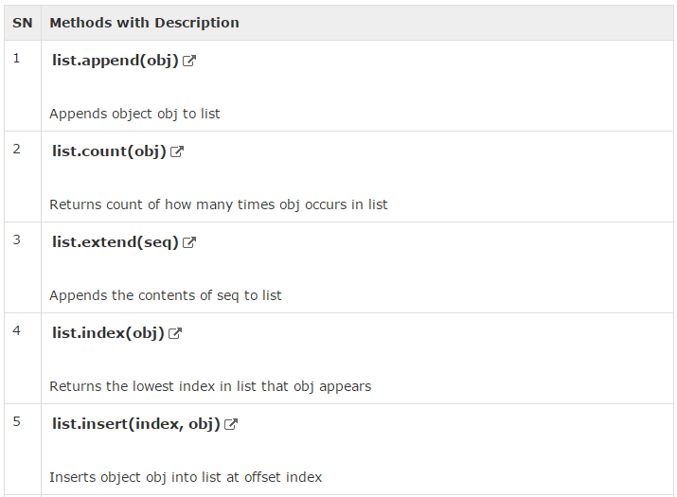
9.9 List Method (1)
Introduction
https://www.tutorialspoint.com/python3/python_lists.htm
Python includes the following methods for list class:
Python - CS596

Slide 22
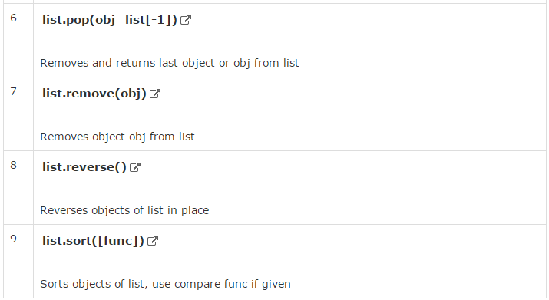
9.9 List Method (2)
Introduction
https://www.tutorialspoint.com/python3/python_lists.htm
Python - CS596

Slide 23
9.10 List Slicing

Slide 24
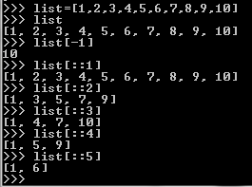
9.10 List Slicing
Introduction
http://stackoverflow.com/questions/509211/explain-pythons-slice-notation
Python Slicing syntax:
a[start:end] # items start through end-1
a[start:] # items start through the rest of the array
a[:end] # items from the beginning through end-1
a[:] # a copy of the whole array
a[start:end:step] # start through not past end, by step
Python - CS596

Slide 25

END of CHAPTER 9

