Slide 1


Python Chapter 10: Tuple
Peter H. Chen, PhDEE/EMBA

Slide 2

10 Tuple

Slide 3

10 Tuple
Introduction
https://www.tutorialspoint.com/python/python_lists.htm
A tuple is a sequence of immutable Python objects.
Tuples are sequences, just like lists.
The differences between tuples and lists are, the tuples cannot be changed unlike lists and tuples use parentheses, whereas lists use square brackets.
Creating a tuple is as simple as putting different comma-separated values. Optionally you can put these comma-separated values between parentheses also.
For example:
tup1 = ('physics', 'chemistry', 1997, 2000);
tup2 = (1, 2, 3, 4, 5 );
tup3 = "a", "b", "c", "d";
The empty tuple is written as two parentheses containing nothing −
tup1 = ()
To write a tuple containing a single value you have to include a comma, even though there is only one value −
tup1 = (50,);
Python - CS596

Slide 4
10.1 Access Value in Tuple

Slide 5
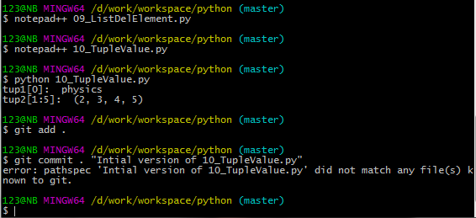
10.1 Access Value in Tuple
Introduction
https://www.tutorialspoint.com/python/python_lists.htm
To access values in tuple, use the square brackets for slicing along with the index or indices to obtain value available at that index. For example −
#!/usr/bin/python
tup1 = ('physics', 'chemistry', 1997, 2000);
tup2 = (1, 2, 3, 4, 5, 6, 7 );
print ("tup1[0]: ", tup1[0])
print ("tup2[1:5]: ", tup2[1:5])
Python - CS596

Slide 6
10.2 Tuple Update

Slide 7
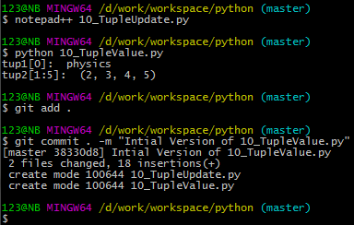
10.2 Tuple Update
Introduction
https://www.tutorialspoint.com/python/python_lists.htm
Tuples are immutable which means you cannot update or change the values of tuple elements. You are able to take portions of existing tuples to create new tuples as the following example demonstrates −
#!/usr/bin/python
tup1 = (12, 34.56);
tup2 = ('abc', 'xyz');
# Following action is not valid for tuples
# tup1[0] = 100;
# So let's create a new tuple as follows
tup3 = tup1 + tup2;
print (tup3)
Python - CS596

Slide 8
10.3 Tuple Delete Element

Slide 9
10.3 Tuple Delete Element
Introduction
https://www.tutorialspoint.com/python/python_lists.htm
Removing individual tuple elements is not possible. There is, of course, nothing wrong with putting together another tuple with the undesired elements discarded.
To explicitly remove an entire tuple, just use the del statement. For example:
#!/usr/bin/python
tup = ('physics', 'chemistry', 1997, 2000);
print (tup del tup);
print ("After deleting tup : " print tup)
This produces the following result. Note an exception raised, this is because after del tuptuple does not exist any more −
('physics', 'chemistry', 1997, 2000)
After deleting tup :
Traceback (most recent call last):
File "test.py", line 9, in <module>
print tup;
NameError: name 'tup' is not defined
Python - CS596

Slide 10
10.4 Tuple Operation

Slide 11
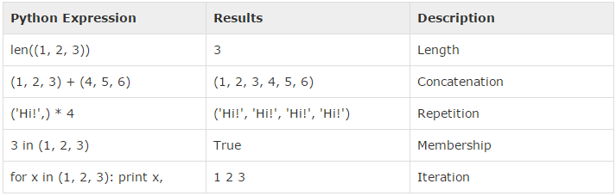
10.4 Tuple Operation
Introduction
https://www.tutorialspoint.com/python/python_lists.htm
Tuples respond to the + and * operators much like strings; they mean concatenation and repetition here too, except that the result is a new tuple, not a string.
In fact, tuples respond to all of the general sequence operations we used on strings in the prior chapter −
Python - CS596

Slide 12
10.5 Tuple Index, Slice, and Matrix

Slide 13
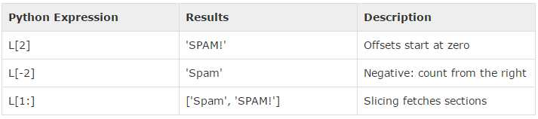
10.5 Tuple Index, Slice, and Matrix
Introduction
https://www.tutorialspoint.com/python/python_lists.htm
Because tuples are sequences, indexing and slicing work the same way for tuples as they do for strings. Assuming following input −
L = ('spam', 'Spam', 'SPAM!')
Python - CS596

Slide 14
10.6 Built-in Function

Slide 15
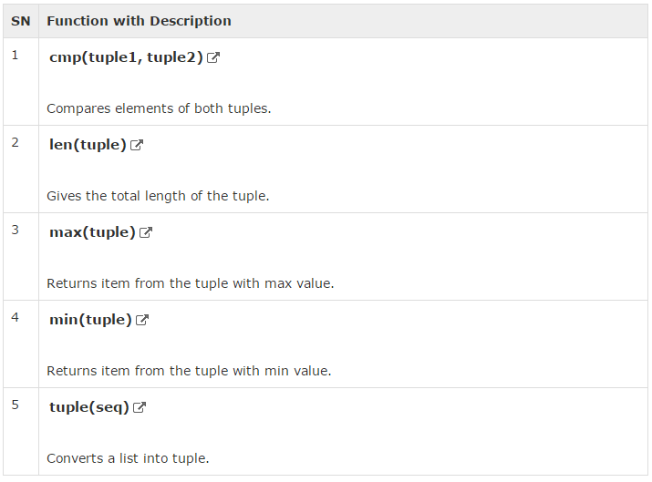
10.6 Built-in Function
Introduction
https://www.tutorialspoint.com/python/python_lists.htm
Python includes the following tuple functions −
Python - CS596

Slide 16

END of CHAPTER 10

