Slide 1


Python Chapter 11: Dictionary
Peter H. Chen, PhDEE/EMBA

Slide 2

11 Dictionary

Slide 3

11 Dictionary
Introduction
https://www.tutorialspoint.com/python/python_dictionary.htm
Each key is separated from its value by a colon (:), the items are separated by commas, and the whole thing is enclosed in curly braces.
An empty dictionary without any items is written with just two curly braces, like this: {}.
Keys are unique within a dictionary while values may not be.
The values of a dictionary can be of any type, but the keys must be of an immutable data type such as strings, numbers, or tuples.
Python - CS596

Slide 4
11.1 Access Value in Dictionary

Slide 5
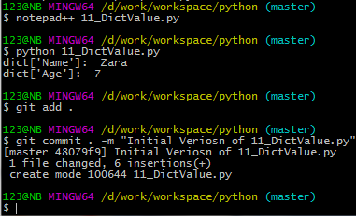
11.1 Access Value in Dictionary
Introduction
https://www.tutorialspoint.com/python/python_dictionary.htm
To access dictionary elements, you can use the familiar square brackets along with the key to obtain its value.
Following is a simple example:
#!/usr/bin/python
dict = {'Name': 'Zara', 'Age': 7, 'Class': 'First'}
print ("dict['Name']: ", dict['Name'])
print ("dict['Age']: ", dict['Age'])
Python - CS596

Slide 6
11.2 Update Value in Dictionary

Slide 7
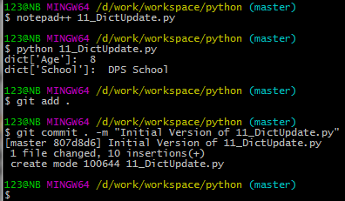
11.2 Update Value in Dictionary
Introduction
https://www.tutorialspoint.com/python/python_dictionary.htm
You can update a dictionary by adding a new entry or a key-value pair, modifying an existing entry, or deleting an existing entry as shown below in the simple example:
#!/usr/bin/python
dict = {'Name': 'Zara', 'Age': 7, 'Class': 'First'}
dict['Age'] = 8; # update existing entry
dict['School'] = "DPS School"; # Add new entry
print ("dict['Age']: ", dict['Age'])
print ("dict['School']: ", dict['School'])
Python - CS596

Slide 8
11.3 Delete Element in Dictionary

Slide 9
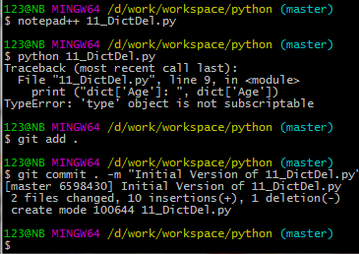
11.3 Delete Element in Dictionary
Introduction
https://www.tutorialspoint.com/python/python_dictionary.htm
You can either remove individual dictionary elements or clear the entire contents of a dictionary.
You can also delete entire dictionary in a single operation.
To explicitly remove an entire dictionary, just use the del statement.
Following is a simple example:
#!/usr/bin/python
dict = {'Name': 'Zara', 'Age': 7, 'Class': 'First'}
del dict['Name']; # remove entry with key 'Name'
dict.clear(); # remove all entries in dict
del dict ; # delete entire dictionary
print ("dict['Age']: ", dict['Age'])
print ("dict['School']: ", dict['School'])
Python - CS596

Slide 10
11.4 Built-in Dictionary Function

Slide 11
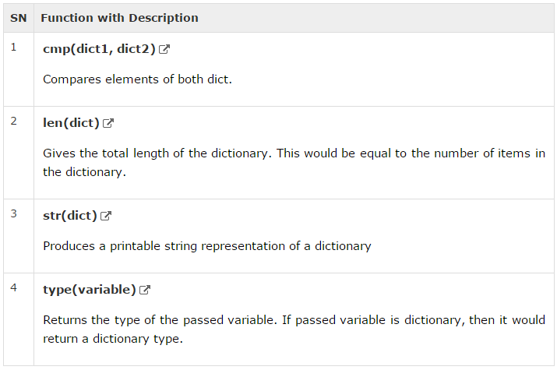
11.4 Built-in Dictionary Function
Introduction
https://www.tutorialspoint.com/python/python_dictionary.htm
Python includes the following dictionary functions −
Python - CS596

Slide 12
11.5 Method of Dictionary

Slide 13
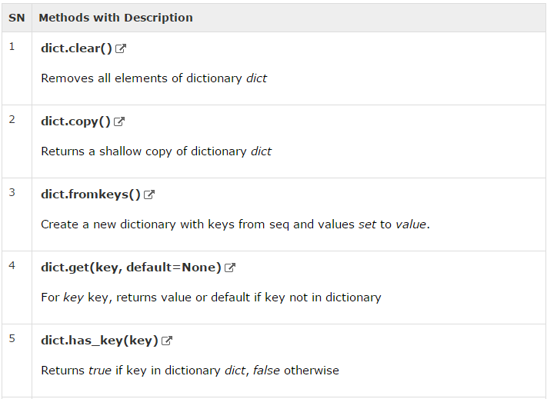
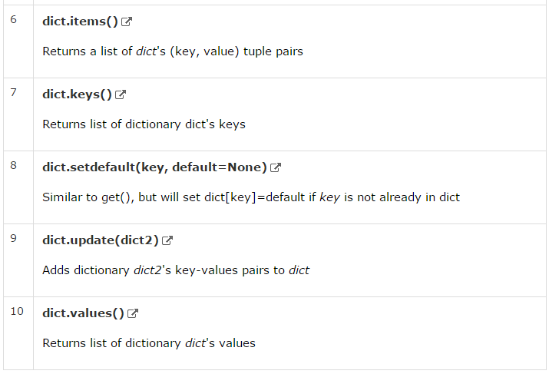
11.5 Method of Dictionary
Introduction
https://www.tutorialspoint.com/python/python_dictionary.htm
Python includes following dictionary methods −
Python - CS596

Slide 14
11.6 Convert Tuple to Dictionary

Slide 15



11.5 Method of Dictionary
Introduction
http://stackoverflow.com/questions/6586310/python-convert-list-of-key-value-tuples-into-dictionary
Convert the list of key-value tuples into dictionary:
Given a list of tuple:
[(‘A’, 1), (‘B’, 2), (‘C’, 3)]
Convert into Dictionary:
{‘A’: 1, ‘B’: 2, ‘C’: 3}
More exactly: [(A, 12937012397), (BERA, 2034927830), (CE, 2349057340)]
>>> dict ([(‘A’, 1), (‘B’, 2), (‘C’, 3)])
>>> list = [(‘A’, 1), (‘B’, 2), (‘C’, 3)]
>>> d1 = dict(list)
Python - CS596

Slide 16

END of CHAPTER 11

