Slide 1


Python Chapter 12: Time/Date
Peter H. Chen, PhDEE/EMBA

Slide 2

12 Time/Date

Slide 3

12 Time/Date
Introduction
https://www.tutorialspoint.com/python3/python_date_time.htm
A Python program can handle date and time in several ways.
Converting between date formats is a common chore for computers.
Python's time and calendar modules help track dates and times.
Python - CS596

Slide 4
12.1 Tick

Slide 5
12.1 Tick
Introduction
https://www.tutorialspoint.com/python3/python_date_time.htm
Time intervals are floating-point numbers in units of seconds.
Particular instants in time are expressed in seconds since 12:00am, January 1, 1970 (epoch).
There is a popular time module available in Python which provides functions for working with times, and for converting between representations.
The function time.time() returns the current system time in ticks since 12:00am, January 1, 1970 (epoch).
Note:
epoch: a period of time in history or a person's life, typically one marked by notable events or particular characteristics
#!/usr/bin/python
import time; # This is required to include time module.
ticks = time.time()
print ("Number of ticks since 12:00am, January 1, 1970:", ticks)
Python - CS596

Slide 6
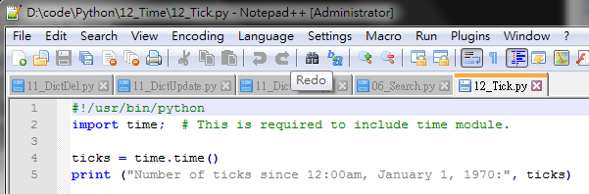
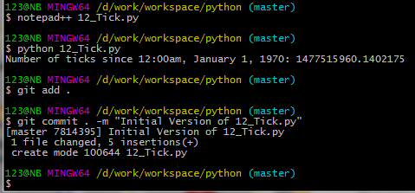
12.1 Tick
Introduction
https://www.tutorialspoint.com/python3/python_date_time.htm
Run 12_Tick.py
Python - CS596

Slide 7
12.2 Get Current Time

Slide 8
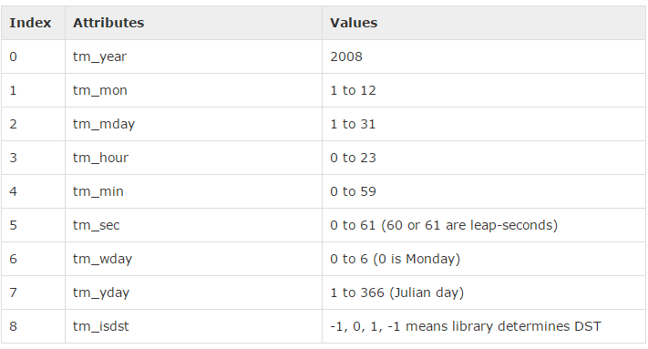
12.2 Python Tuple Time
Introduction
https://www.tutorialspoint.com/python3/python_date_time.htm
The above tuple is equivalent to struct_time structure.
This structure has following attributes:
Python - CS596

Slide 9
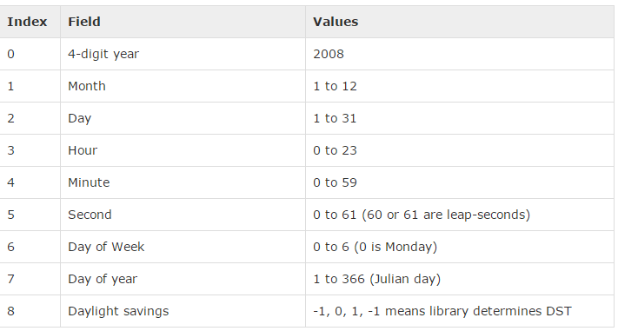
12.2 Python Tuple Time
Introduction
https://www.tutorialspoint.com/python3/python_date_time.htm
Many of Python's time functions handle time as a tuple of 9 numbers, as shown below −
Python - CS596

Slide 10
12.3 Get Current Time

Slide 11
12.3 Get Current Time
Introduction
https://www.tutorialspoint.com/python3/python_date_time.htm
To translate a time instant from a seconds since the epoch floating-point value into a time-tuple, pass the floating-point value to a function (e.g., localtime) that returns a time-tuple with all nine items valid.
#!/usr/bin/python
import time;
localtime = time.localtime(time.time())
print ("Local current time:", localtime)
print ("Year:", localtime.tm_year)
print ("Month:", localtime.tm_mon)
print ("Day:", localtime.tm_mday)
print ("Week Day:", localtime.tm_wday)
print ("Year Day:", localtime.tm_yday)
print ("Hour:", localtime.tm_hour)
print ("Minute:", localtime.tm_min)
print ("Second:", localtime.tm_sec)
Python - CS596

Slide 12
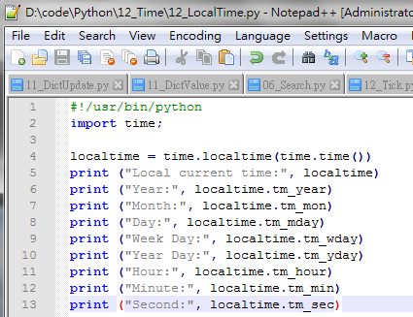
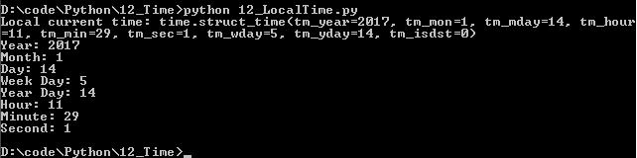
12.3 Get Current Time
Introduction
https://www.tutorialspoint.com/python3/python_date_time.htm
Run Time, Year, Day, Week Day, Year Day, Hour, Minute, Second.
Python - CS596

Slide 13
12.4 Get Format Time

Slide 14
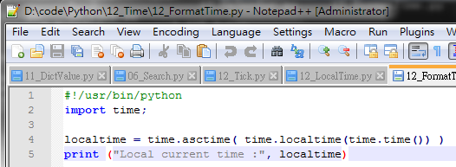
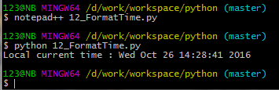
12.4 Get Format Time
Introduction
https://www.tutorialspoint.com/python3/python_date_time.htm
You can format any time as per your requirement, but simple method to get time in readable format is asctime():
#!/usr/bin/python
import time;
localtime = time.asctime( time.localtime(time.time()) )
print ("Local current time :", localtime)
Python - CS596

Slide 15
12.5 Get Month Calendar

Slide 16
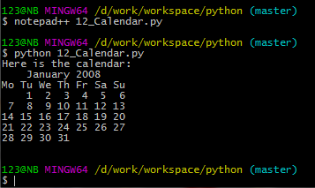
12.5 Get Month Calendar
Introduction
https://www.tutorialspoint.com/python3/python_date_time.htm
The calendar module gives a wide range of methods to play with yearly and monthly calendars.
Here, we print a calendar for a given month ( Jan 2008 ) −
#!/usr/bin/python
import calendar
cal = calendar.month(2008, 1)
print ("Here is the calendar:")
print (cal)
Python - CS596

Slide 17
12.5 Get Month Calendar
Introduction
http://www.guru99.com/calendar-in-python.html
The output shows the date for the first Monday that falls in that month.
#!/usr/bin/python
import calendar
#calculate days based on a rule: For instance an audit day on the second Monday of every month
#Figure out what days that would be for each month, we can use the script as shown here
for month in range(1,13):
# It retrieves a list of weeks that represent the month
mycal = calendar.monthcalendar(2020, month)
# The second MONDAY has to be within the first two weeks
week1 = mycal[1]
week2 = mycal[2]
if week1[calendar.MONDAY] != 0:
auditday = week1[calendar.MONDAY]
# print ("week1 auditday: %d " % auditday)
else:
# if the second MONDAY isn't in the first week, it must be in the second week
auditday = week2[calendar.MONDAY]
print ("week2 auditday: %d " % auditday)
print ("%10s %2d" % (calendar.month_name[month], auditday))
Python - CS596

Slide 18
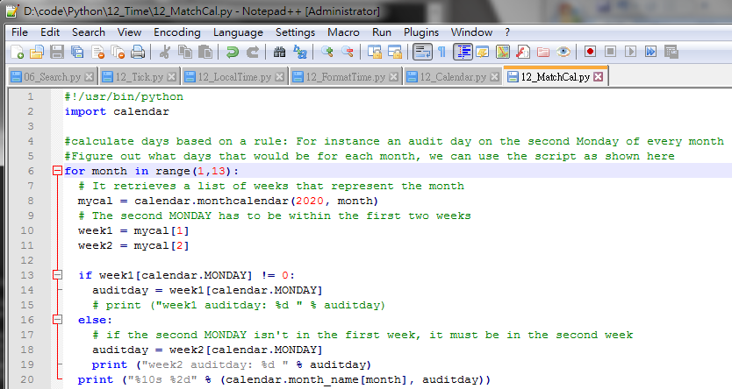
12.5 Get Month Calendar
Introduction
http://www.guru99.com/calendar-in-python.html
Run First Day of Month.
Python - CS596

Slide 19
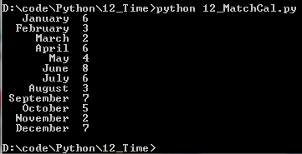
12.5 Get Month Calendar
Introduction
http://www.guru99.com/calendar-in-python.html
Run First Day of Month.
Python - CS596

Slide 20
12.6 Time Module

Slide 21
12.6 Time Module
Introduction
https://www.tutorialspoint.com/python3/python_date_time.htm
There is a popular time module available in Python which provides functions for working with times and for converting between representations.
Here is the list of all available methods (1):
SN | Function with Description
1 | time.altzone The offset of the local DST timezone, in seconds west of UTC, if one is defined. This is negative if the local DST timezone is east of UTC (as in Western Europe, including the UK). Only use this if daylight is nonzero.
2 | time.asctime([tupletime]) Accepts a time-tuple and returns a readable 24-character string such as 'Tue Dec 11 18:07:14 2008'.
3 | time.clock( ) Returns the current CPU time as a floating-point number of seconds. To measure computational costs of different approaches, the value of time.clock is more useful than that of time.time().
Python - CS596

Slide 22
12.6 Time Module
Introduction
https://www.tutorialspoint.com/python3/python_date_time.htm
Here is the list of all available methods (2):
SN | Function with Description
4 | time.ctime([secs]) Like asctime(localtime(secs)) and without arguments is like asctime( )
5 | time.gmtime([secs]) Accepts an instant expressed in seconds since the epoch and returns a time-tuple t with the UTC time. Note : t.tm_isdst is always 0
6 | time.localtime([secs]) Accepts an instant expressed in seconds since the epoch and returns a time-tuple t with the local time (t.tm_isdst is 0 or 1, depending on whether DST applies to instant secs by local rules).
7 | time.mktime(tupletime) Accepts an instant expressed as a time-tuple in local time and returns a floating-point value with the instant expressed in seconds since the epoch.
Python - CS596

Slide 23
12.6 Time Module
Introduction
https://www.tutorialspoint.com/python3/python_date_time.htm
Here is the list of all available methods (3):
SN | Function with Description
8 | time.sleep(secs) Suspends the calling thread for secs seconds.
9 | time.strftime(fmt[,tupletime]) Accepts an instant expressed as a time-tuple in local time and returns a string representing the instant as specified by string fmt.
10 | time.strptime(str,fmt='%a %b %d %H:%M:%S %Y') Parses str according to format string fmt and returns the instant in time-tuple format.
11 | time.time( ) Returns the current time instant, a floating-point number of seconds since the epoch.
Python - CS596

Slide 24
12.6 Time Module
Introduction
https://www.tutorialspoint.com/python3/python_date_time.htm
Here is the list of all available methods (3):
SN | Function with Description
12 | time.tzset() Resets the time conversion rules used by the library routines. The environment variable TZ specifies how this is done.
Python - CS596

Slide 25
12.6 Time Module
Introduction
https://www.tutorialspoint.com/python3/python_date_time.htm
Let us go through the functions briefly:
There are following two important attributes available with time module
SN | Attribute with Description
1 | time.timezone: Attribute time.timezone is the offset in seconds of the local time zone (without DST) from UTC (>0 in the Americas; <=0 in most of Europe, Asia, Africa).
2 | time.tzname: Attribute time.tzname is a pair of locale-dependent strings, which are the names of the local time zone without and with DST, respectively.
Python - CS596

Slide 26
12.7 Calendar Module

Slide 27
12.7 Calendar Module
Introduction
https://www.tutorialspoint.com/python3/python_date_time.htm
The calendar module supplies calendar-related functions, including functions to print a text calendar for a given month or year.
By default, calendar takes Monday as the first day of the week and Sunday as the last one. To change this, call calendar.setfirstweekday() function.
Python - CS596

Slide 28
12.7 Calendar Module
Introduction
https://www.tutorialspoint.com/python3/python_date_time.htm
Here is a list of functions available with the calendar module (1):
SN | Function with Description
1 | calendar.calendar(year,w=2,l=1,c=6)Returns a multiline string with a calendar for year year formatted into three columns separated by c spaces. w is the width in characters of each date; each line has length 21*w+18+2*c. l is the number of lines for each week.
2 | calendar.firstweekday( )Returns the current setting for the weekday that starts each week. By default, when calendar is first imported, this is 0, meaning Monday.
3 | calendar.isleap(year)Returns True if year is a leap year; otherwise, False.
4 | calendar.leapdays(y1,y2)Returns the total number of leap days in the years within range(y1,y2).
Python - CS596

Slide 29
12.7 Calendar Module
Introduction
https://www.tutorialspoint.com/python3/python_date_time.htm
Here is a list of functions available with the calendar module (2):
SN | Function with Description
5 | calendar.month(year,month,w=2,l=1)Returns a multiline string with a calendar for month month of year year, one line per week plus two header lines. w is the width in characters of each date; each line has length 7*w+6. l is the number of lines for each week.
6 | calendar.monthcalendar(year,month)Returns a list of lists of ints. Each sublist denotes a week. Days outside month month of year year are set to 0; days within the month are set to their day-of-month, 1 and up.
7 | calendar.monthrange(year,month)Returns two integers. The first one is the code of the weekday for the first day of the month month in year year; the second one is the number of days in the month. Weekday codes are 0 (Monday) to 6 (Sunday); month numbers are 1 to 12.
8 | calendar.prcal(year,w=2,l=1,c=6)Like print calendar.calendar(year,w,l,c).
Python - CS596

Slide 30
12.7 Calendar Module
Introduction
https://www.tutorialspoint.com/python3/python_date_time.htm
Here is a list of functions available with the calendar module (3):
SN | Function with Description
9 | calendar.prmonth(year,month,w=2,l=1)Like print calendar.month(year,month,w,l).
10 | calendar.setfirstweekday(weekday)Sets the first day of each week to weekday code weekday. Weekday codes are 0 (Monday) to 6 (Sunday).
11 | calendar.timegm(tupletime)The inverse of time.gmtime: accepts a time instant in time-tuple form and returns the same instant as a floating-point number of seconds since the epoch.
12 | calendar.weekday(year,month,day)Returns the weekday code for the given date. Weekday codes are 0 (Monday) to 6 (Sunday); month numbers are 1 (January) to 12 (December).
Python - CS596

Slide 31
12.8 Other Module and Function

Slide 32
12.8 Other Module and Function
Introduction
https://www.tutorialspoint.com/python3/python_date_time.htm
There are some other important modules and functions to play with date & time in Python:
The datetime Module
The pytz Module
The dateutil Module
Python - CS596

Slide 33

END of CHAPTER 12

