Slide 1

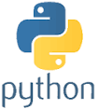
Python Chapter 14: Module
Peter H. Chen, PhDEE/EMBA

Slide 2

14 Module

Slide 3

14 Module
Introduction
https://www.tutorialspoint.com/python3/python_modules.htm
A module allows you to logically organize your Python code.
Grouping related code into a module makes the code easier to understand and use.
A module is a Python object with arbitrarily named attributes that you can bind and reference.
Simply, a module is a file consisting of Python code. A module can define functions, classes and variables.
A module can also include runnable code.
Python - CS596

Slide 4
14.1 Module Syntax

Slide 5
14.1 Module Syntax
Introduction
https://www.tutorialspoint.com/python3/python_modules.htm
The Python code for a module named aname normally resides in a file named aname.py.
Here's an example of a simple module, support.py
def print_func( par ):
print "Hello : ", par
return
Python - CS596

Slide 6
14.2 The import Statement

Slide 7
14.2 The import Statement
Introduction
https://www.tutorialspoint.com/python3/python_modules.htm
You can use any Python source file as a module by executing an import statement in some other Python source file.
The import has the following syntax:
import module1[, module2[,... moduleN]
When the interpreter encounters an import statement, it imports the module if the module is present in the search path.
A search path is a list of directories that the interpreter searches before importing a module.
For example, to import the module 14_Support.py, you need to put the following command at the top of the script:
Python - CS596

Slide 8
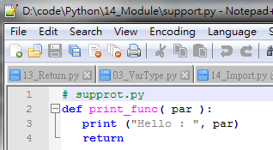
14.2 Create Test Program 14_Import.py
Introduction
https://www.tutorialspoint.com/python3/python_modules.htm
For example, to import the module supprt.py, you need to put the following command at the top of the script:
# supprt.py
def print_func( par ):
print ("Hello : ", par)
return
Python - CS596

Slide 9
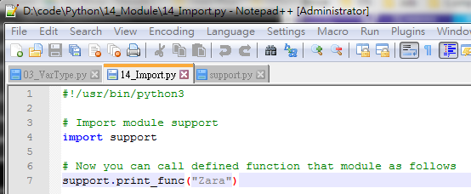
14.2 Create Test Program 14_Import.py
Introduction
https://www.tutorialspoint.com/python3/python_modules.htm
Create 14_Import.py
#!/usr/bin/python3
# Import module support
import support
# Now you can call defined function that module as follows
support.print_func("Zara")
Python - CS596

Slide 10

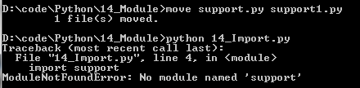
14.2 Create Test Program 14_Import.py
Introduction
https://www.tutorialspoint.com/python3/python_modules.htm
Run 14_Import.py
Note:
If you change support.py into support1.py.
When you “import support” , you will get error message: No module named ‘support’.
Python - CS596

Slide 11
14.3 Create Test Program 14_Module.py

Slide 12
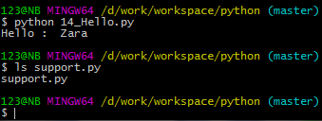
14.3 Create Test Program 14_Module.py
Introduction
https://www.tutorialspoint.com/python3/python_modules.htm
Create the 14_Module.py as follow.
#!/usr/bin/python
# Import module support
import support
# Now you can call defined function that module as follows
support.print_func("Zara")
Python - CS596

Slide 13
14.4 The From … Import Statement

Slide 14
14.4 The From … Import Statement

Slide 15
14.4 The from …Import Statement
Introduction
https://www.tutorialspoint.com/python3/python_modules.htm
Python's from statement lets you import specific attributes from a module into the current namespace.
The from...import has the following syntax
from modname import name1[, name2[, ... nameN]]
Python - CS596

Slide 16
14.4 The from …Import Statement
Introduction
https://www.tutorialspoint.com/python3/python_modules.htm
The from … Import Example:
To import the function fibonacci from the module fib, use the following statement:
from modname import name1[, name2[, ... nameN]]
Python - CS596

Slide 17
14.4 The from …Import Statement
Introduction
https://www.tutorialspoint.com/python3/python_modules.htm
The from … Import Example:
# from fib.py modules
# input fibonacci function
from fib import fibonacci
i=100
res = fibonacci(i)
print ('fibonacci:', i, res)
print ('fibonacci: {0:2d}'.format (i))
for i1 in res:
print ("res:", i1)
#!/usr/bin/python3
# function name: fibonacci
# module name: fib.py
def fibonacci(n): # return Fibonacci series up to n
result = []
a, b = 0, 1
while b < n:
result.append(b)
a, b = b, a+b
return result
Python - CS596

Slide 18
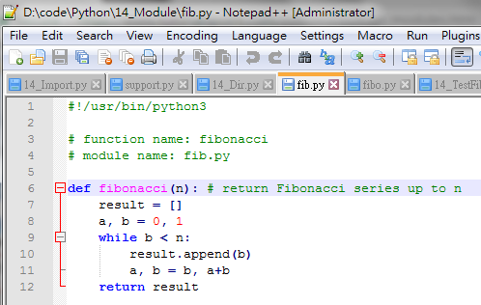
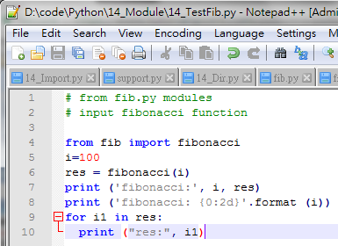
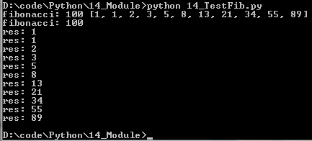
14.4 The from …Import Statement
Introduction
https://www.tutorialspoint.com/python3/python_modules.htm
Run the from … Import Example:
Python - CS596

Slide 19
14.5 The from … import * Statement

Slide 20
14.5 The from … import *
Introduction
https://www.tutorialspoint.com/python3/python_modules.htm
It is also possible to import all names from a module into the current namespace by using the following import statement:
from modname import *
This provides an easy way to import all the items from a module into the current namespace; however, this statement should be used sparingly.
Note:
http://softwareengineering.stackexchange.com/questions/187403/import-module-vs-from-module-import-function
‘import module’ vs. ‘from module import function’
The import just mean input something from outside.
The import does not always used to import module. In ‘from … import …’., the import is used to input the function.
Python - CS596

Slide 21
14.5 Locate Module

Slide 22
14.5 Locate Module
Introduction
https://www.tutorialspoint.com/python3/python_modules.htm
When you import a module, the Python interpreter searches for the module in the following sequences −
The current directory.
If the module isn't found, Python then searches each directory in the shell variable PYTHONPATH.
If all else fails, Python checks the default path. On UNIX, this default path is normally /usr/local/lib/python/.
The module search path is stored in the system module sys as the sys.path variable. The sys.path variable contains the current directory, PYTHONPATH, and the installation-dependent default.
Python - CS596

Slide 23
14.6 PYHTONPATH Variable

Slide 24
14.6 PYTHONPATH Variable
Introduction
https://www.tutorialspoint.com/python3/python_modules.htm
The PYTHONPATH is an environment variable, consisting of a list of directories.
The syntax of PYTHONPATH is the same as that of the shell variable PATH.
Here is a typical PYTHONPATH from a Windows system:
set PYTHONPATH=c:\python20\lib;
And here is a typical PYTHONPATH from a UNIX system:
set PYTHONPATH=/usr/local/lib/python
Python - CS596

Slide 25
14.7 Namespace and Scope

Slide 26
14.7 Namespace and Scope
Introduction
https://www.tutorialspoint.com/python3/python_modules.htm
Variables are names (identifiers) that map to objects.
A namespace is a dictionary of variable names (keys) and their corresponding objects (values).
A Python statement can access variables in a local namespace and in the global namespace.
If a local and a global variable have the same name, the local variable shadows the global variable.
Each function has its own local namespace.
Class methods follow the same scoping rule as ordinary functions.
Python makes educated guesses on whether variables are local or global.
It assumes that any variable assigned a value in a function is local.
Therefore, in order to assign a value to a global variable within a function, you must first use the global statement.
The statement global VarName tells Python that VarName is a global variable.
Python stops searching the local namespace for the variable.
Python - CS596

Slide 27
14.7 Namespace and Scope
Introduction
https://www.tutorialspoint.com/python3/python_modules.htm
For example, we define a variable Money in the global namespace.
Within the function Money, we assign Money a value, therefore Python assumes Money as a local variable.
However, we accessed the value of the local variable Money before setting it, so an UnboundLocalError is the result. Uncommenting the global statement fixes the problem.
#!/usr/bin/python
Money = 2000
def AddMoney(): # Uncomment the following line to fix the code:
# global Money
Money = Money + 1
print (Money AddMoney())
print (Money)
Python - CS596

Slide 28
14.8 The dir() Function

Slide 29
14.7 The dir() Function
Introduction
https://www.tutorialspoint.com/python3/python_modules.htm
The dir() built-in function returns a sorted list of strings containing the names defined by a module.
The list contains the names of all the modules, variables and functions that are defined in a module.
Following is a simple example
#!/usr/bin/python
# Import built-in module math
import math
content = dir(math)
print (content)
Python - CS596

Slide 30
14.7 The dir() Function
Introduction
https://www.tutorialspoint.com/python3/python_modules.htm
When the above code is executed, it produces the following result −
['__doc__', '__file__', '__name__', 'acos', 'asin', 'atan', 'atan2', 'ceil', 'cos', 'cosh', 'degrees', 'e', 'exp', 'fabs', 'floor', 'fmod', 'frexp', 'hypot', 'ldexp', 'log', 'log10', 'modf', 'pi', 'pow', 'radians', 'sin', 'sinh', 'sqrt', 'tan', 'tanh']
Here, the special string variable __name__ is the module's name, and __file__ is the filename from which the module was loaded.
Python - CS596

Slide 31
14.8 The globals() and locals() Function

Slide 32
14.8 The globals() and locals() Function
Introduction
https://www.tutorialspoint.com/python3/python_modules.htm
The globals() and locals() functions can be used to return the names in the global and local namespaces depending on the location from where they are called.
If locals() is called from within a function, it will return all the names that can be accessed locally from that function.
If globals() is called from within a function, it will return all the names that can be accessed globally from that function.
The return type of both these functions is dictionary. Therefore, names can be extracted using the keys() function.
Python - CS596

Slide 33
14.9 The reload() Function

Slide 34
14.9 The reload () Function
Introduction
https://www.tutorialspoint.com/python3/python_modules.htm
When the module is imported into a script, the code in the top-level portion of a module is executed only once.
Therefore, if you want to re-execute the top-level code in a module, you can use the reload() function.
The reload() function imports a previously imported module again. The syntax of the reload() function is this −
Python - CS596

Slide 35
14.10 Module Example

Slide 36
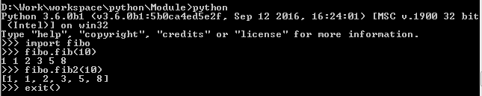

14.10 Module Example
Introduction
https://docs.python.org/2/tutorial/modules.html
Create fibo.py as below.
For Interactive Mode
$ python
>>> import fibo
>>> fibo,fib (10)
1 1 2 3 5 8
>>> fibo.lib2(10)
[1, 1, 2, 3, 5, 8]
>>> exit ()
# Fibonacci numbers module
def fib(n): # write Fibonacci series up to n
a, b = 0, 1
while b < n:
print (b, end=" "),
a, b = b, a+b
print ()
def fib2(n): # return Fibonacci series up to n
result = []
a, b = 0, 1
while b < n:
result.append(b)
a, b = b, a+b
return result
if __name__ == "__main__":
import sys
fib(int(sys.argv[1]))
For Command Mode:
$ python fibo.py 50
Python - CS596

Slide 37
14.11 Package Example

Slide 38
14.11 Package Example
Introduction
http://stackoverflow.com/questions/7948494/whats-the-difference-between-a-python-module-and-a-python-package
A package is a collection of Python modules: while a module is a single Python file, a package is a directory of Python modules containing an additional __init__.py file, to distinguish a package from a directory that just happens to contain a bunch of Pythonscripts.
Python will search all module files in current directory or environment variable PYTHONPYH.
In the following example,
Put a test program under D:\Work\workspace\python\Package14_Package.py
Put all module files (e.g., Pots.py, Isdn.py, and G3.py) in Package directory.
Note:
If environment variable PYTHONPATH is not setup, you have to all module files (e.g., Pots.py, Isdn.py, and G3.py) in current (i.e., Package) directory.
If you set environment variable PYTHONPATH setup (e.g., D:\Work\workspace\python\Package\Phone), you can you have to all module files (e.g., Pots.py, Isdn.py, and G3.py) in Phone directory.
Python - CS596

Slide 39
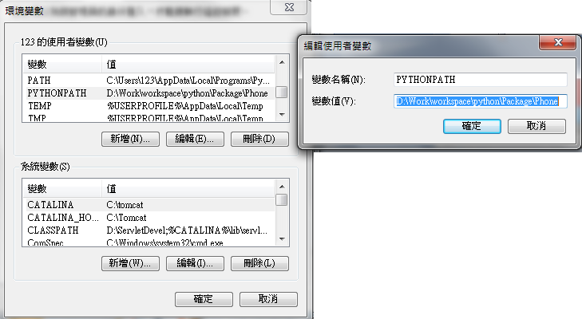
14.11 Package: Setup PYTHONPATH
Introduction
http://stackoverflow.com/questions/7948494/whats-the-difference-between-a-python-module-and-a-python-package
On desktop, right-click mouse on “Computer” > “Setup Property” > “Advanced Setup” > “Environment Variable” > “User Variable” > Create “PYTHONPATH” (D:\Work\workspace\python\Package\Phone)
Python - CS596

Slide 40
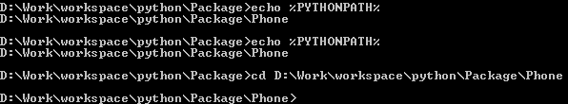
14.11 Package: Verify the PYTHOPATH
Introduction
https://www.microsoft.com/resources/documentation/windows/xp/all/proddocs/en-us/windows_dos_copy.mspx?mfr=true
Use “echo %PYTHONPATH%” to verify the path. Then, “cd <copy and paste the directory path>” to verify the setup is correct or not.
To copy text from a command prompt windo
Open Command Prompt
Right-click the title bar of the command prompt window, point to Edit, and then click Mark.
Click the beginning of the text you want to copy.
Press and hold down the SHIFT key, and then click the end of the text you want to copy (or you can click and drag the cursor to select the text).
Right-click the title bar, point to Edit, and then click Copy.
Position the cursor where you want the text to be inserted:
In an MS-DOS-based program, or in a command prompt window, right-click the title bar, point to Edit, and then click Paste.
In a Windows-based program, click the Edit menu, and then click Paste.
Python - CS596

Slide 41
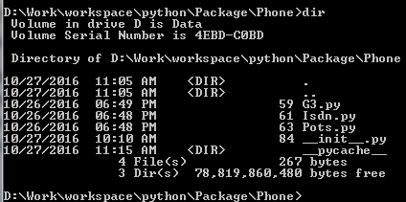
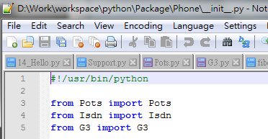
14.11 Package: Create __init__.py
Introduction
http://stackoverflow.com/questions/7948494/whats-the-difference-between-a-python-module-and-a-python-package
Under the Phone directory, we need to create three modules (Pots.py, Isdn.py, and G3.py) and __init__.py
import Phone
from Pots import Pots
from Isdn import Isdn
from G3 import G3
Create __init__.py
$ notepad++ __init__.py
Python - CS596

Slide 42
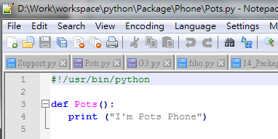
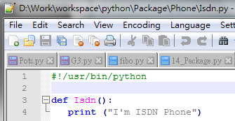
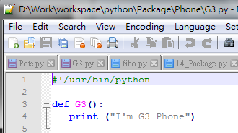
14.11 Package: Create Modules
Introduction
http://stackoverflow.com/questions/7948494/whats-the-difference-between-a-python-module-and-a-python-package
Create Pots.py
$ notepad++ Pots.py
Create Isdn.py
$ notepad++ Isdn.py
Create G3.py
$ notepad++ G3.py
Python - CS596

Slide 43
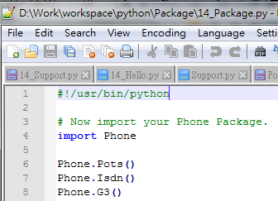
14.11 Package: Create Test Program
Introduction
http://stackoverflow.com/questions/7948494/whats-the-difference-between-a-python-module-and-a-python-package
Go up to Package directory, bring up notepad++ and create 14_Package.py
$ notepad++ 14_Package.py
import Phone
from Pots import Pots
from Isdn import Isdn
from G3 import G3
Python - CS596

Slide 44
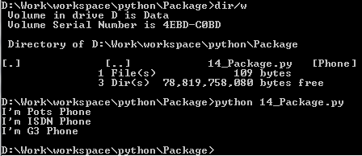
14.11 Package: Execute all Modules in Package
Introduction
http://stackoverflow.com/questions/7948494/whats-the-difference-between-a-python-module-and-a-python-package
When the above code is executed, it produces the following result
$ python 14_Package.py
I'm Pots Phone
I'm 3G Phone
I'm ISDN Phone
Python - CS596

Slide 45

END of CHAPTER 14

