Slide 1


Python Chapter 15: File IO
Peter H. Chen, PhDEE/EMBA

Slide 2

15 File IO

Slide 3

15 File IO
Introduction
https://www.tutorialspoint.com/python3/python_files_io.htm
The I/O functions available in Python.
For more functions, please refer to standard Python documentation.
Python3 - CS596

Slide 4
15.1 Print to Screen

Slide 5
15.1 Print to Screen
Introduction
https://www.tutorialspoint.com/python3/python_files_io.htm
The simplest way to produce output is using the print statement where you can pass zero or more expressions separated by commas.
This function converts the expressions you pass into a string and writes the result to standard output as follows
#!/usr/bin/python3
print ("Python is really a great language,", "isn't it?")
Python3 - CS596

Slide 6
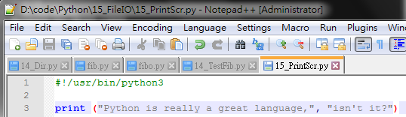

15.1 Print to Screen
Introduction
https://www.tutorialspoint.com/python3/python_files_io.htm
Run Print Screen.
Python3 - CS596

Slide 7
15.2 Read Keyboard Input

Slide 8
15.2 Read Keyboard Input
Introduction
https://www.tutorialspoint.com/python3/python_files_io.htm
Python 2 has two built-in functions to read data from standard input, which by default comes from the keyboard.
These functions are input() and raw_input().
In Python 3, raw_input() function is deprecated.
Moreover, input() functions reads data from keyboard as string, irrespective of whether it is enclosed with quotes ('' or "" ) or not.
Python3 - CS596

Slide 9
15.3 Input() Function

Slide 10
15.3 The input() Function
Introduction
https://www.tutorialspoint.com/python3/python_files_io.htm
The input([prompt]) function is equivalent to raw_input, except that it assumes the input is a valid Python expression and returns the evaluated result to you.
#!/usr/bin/python3
>>> x=input("something:")
something:10
>>> x
'10'
>>> x=input("something:")
something:'10' #entered data treated as string with or without ''
>>> x "'10'"
Python3 - CS596

Slide 11
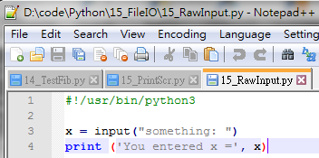
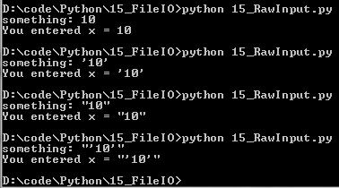
15.3 The input() Function
Introduction
https://www.tutorialspoint.com/python3/python_files_io.htm
Input and Print with 10, ‘10’, and “10”.
Python3 - CS596

Slide 12
15.4 Open and Close File

Slide 13
15.4 Open and Close Files
Introduction
https://www.tutorialspoint.com/python3/python_files_io.htm
Until now, you have been reading and writing to the standard input and output.
Now, we will see how to use actual data files.
Python provides basic functions and methods necessary to manipulate files by default.
You can do most of the file manipulation using a file object.
Python3 - CS596

Slide 14
15.5 Open Function

Slide 15
15.5 Open Function
Introduction
https://www.tutorialspoint.com/python3/python_files_io.htm
Before you can read or write a file, you have to open it using Python's built-in open() function.
This function creates a file object, which would be utilized to call other support methods associated with it.
Python3 - CS596

Slide 16
15.5 Open Function
Syntax
https://www.tutorialspoint.com/python3/python_files_io.htm
file object = open(file_name [, access_mode][, buffering]).
Here are parameter details:
file_name: The file_name argument is a string value that contains the name of the file that you want to access.
access_mode: The access_mode determines the mode in which the file has to be opened, i.e., read, write, append, etc. A complete list of possible values is given below in the table. This is optional parameter and the default file access mode is read (r).
buffering: If the buffering value is set to 0, no buffering takes place. If the buffering value is 1, line buffering is performed while accessing a file. If you specify the buffering value as an integer greater than 1, then buffering action is performed with the indicated buffer size. If negative, the buffer size is the system default(default behavior).
Python3 - CS596

Slide 17
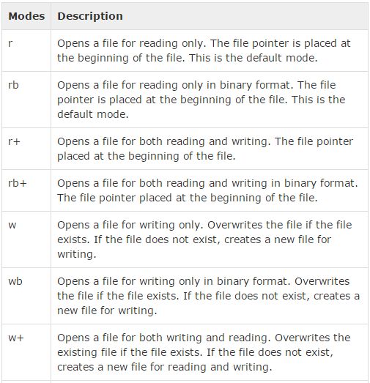
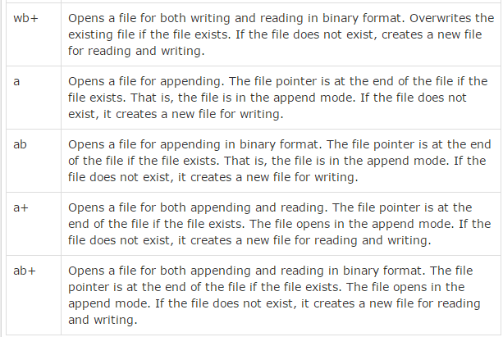
15.5 Open Function
Introduction
https://www.tutorialspoint.com/python3/python_files_io.htm
Here is a list of the different modes of opening a file −
Python3 - CS596

Slide 18
15.6 File Object

Slide 19
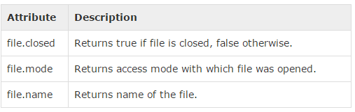
15.6 File Object
Introduction
https://www.tutorialspoint.com/python3/python_files_io.htm
Once a file is opened and you have one file object, you can get various information related to that file.
Here is a list of all attributes related to file object:
Python3 - CS596

Slide 20
15.6 File Object
Introduction
https://www.tutorialspoint.com/python3/python_files_io.htm
Note: softspace attribute is not supported in Python 3.x
#!/usr/bin/python3
# Open a file
fo = open("foo.txt", "wb")
print ("Name of the file: ", fo.name)
print ("Closed or not : ", fo.closed)
print ("Opening mode : ", fo.mode)
fo.close()
Python3 - CS596

Slide 21
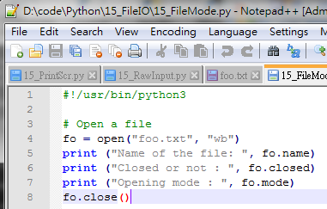

15.6 File Object
Introduction
https://www.tutorialspoint.com/python3/python_files_io.htm
Run 15_FileMode.
Python3 - CS596

Slide 22
15.7 The close() Method

Slide 23
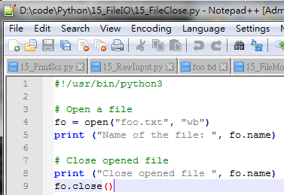

15.7 The close() Method
Introduction
https://www.tutorialspoint.com/python3/python_files_io.htm
Run Close Opened File.
Python3 - CS596

Slide 24
15.7 The close() Method
Introduction
https://www.tutorialspoint.com/python3/python_files_io.htm
The close() method of a file object flushes any unwritten information and closes the file object, after which no more writing can be done.
Python automatically closes a file when the reference object of a file is reassigned to another file. It is a good practice to use the close() method to close a file.
#!/usr/bin/python3
# Open a file
fo = open("foo.txt", "wb")
print ("Name of the file: ", fo.name)
# Close opened file
print ("Close opened file ", fo.name)
fo.close()
Python3 - CS596

Slide 25
15.8 Read and Write File

Slide 26
15.8 Read and Write File
Syntax
https://www.tutorialspoint.com/python3/python_files_io.htm
The file object provides a set of access methods to make our lives easier.
We would see how to use read() and write() methods to read and write files.
Python3 - CS596

Slide 27
15.9 The write() Method

Slide 28
15.9 The write() Method
Introduction
https://www.tutorialspoint.com/python3/python_files_io.htm
The write() method writes any string to an open file. It is important to note that Python strings can have binary data and not just text.
The write() method does not add a newline character ('\n') to the end of the string.
Syntax:
fileObject.write(string)
Python3 - CS596

Slide 29
15.10 The write() Example

Slide 30
15.10 The Write () Example
Introduction
https://www.tutorialspoint.com/python3/python_files_io.htm
The write() method writes any string to an open file.
It is important to note that Python strings can have binary data and not just text.
The write() method does not add a newline character ('\n') to the end of the string:
fileObject.write(string);
Here, passed parameter is the content to be written into the opened file.
Python3 - CS596

Slide 31
15.10 The Write () Example
Introduction
https://www.tutorialspoint.com/python3/python_files_io.htm
Here, passed parameter is the content to be written into the opened file
#!/usr/bin/python3
# Open a file
fo = open("foo_Write.txt", "w")
print("Writing File:", fo.name)
str="\nPython is a great language.\nYeah its great!!\n"
print("Writing string:", str)
fo.write(str)
# Close opend file
fo.close()
Python3 - CS596

Slide 32
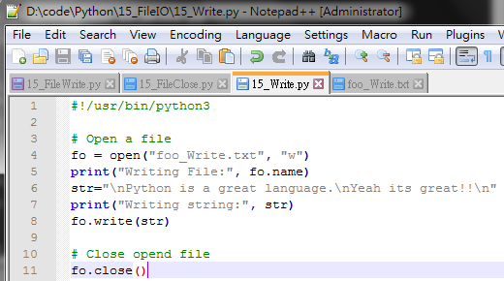
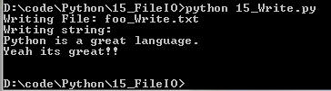
15.10 The Write () Example
Introduction
https://www.tutorialspoint.com/python3/python_files_io.htm
Run Write File Example:
Python3 - CS596

Slide 33
15.10 The read() Method

Slide 34
15.10 The read() Method
Introduction
https://www.tutorialspoint.com/python3/python_files_io.htm
The read() method reads a string from an open file.
It is important to note that Python strings can have binary data or text data.
Syntax:
fileObject.read([count]);
Python3 - CS596

Slide 35
15.10 The read() Method
Introduction
https://www.tutorialspoint.com/python3/python_files_io.htm
Here, passed parameter is the number of bytes to be read from the opened file. This method starts reading from the beginning of the file and if count is missing, then it tries to read as much as possible, maybe until the end of file.
#!/usr/bin/python3
# Open a file
fo = open("foo_Write.txt", "r+")
str = fo.read(1000)
print ("Read String is : ", str)
# Close opened file
fo.close()
Python3 - CS596

Slide 36
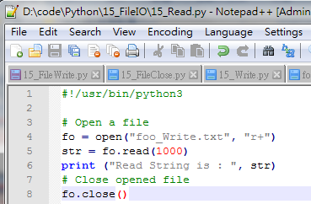

15.10 The read() Method
Introduction
https://www.tutorialspoint.com/python3/python_files_io.htm
Run 15_Read.py Example:
Python3 - CS596

Slide 37
15.10 The read() Method
Introduction
https://www.tutorialspoint.com/python3/python_files_io.htm
Read Line Example:
#!/usr/bin/python3
# Open a file
fo = open("foo_Write.txt", "r+")
i = 0;
for line in fo:
print ("Line ", i)
print (line)
i += 1
Python3 - CS596

Slide 38
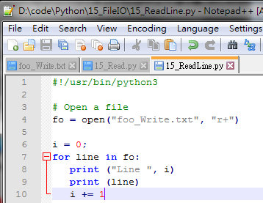
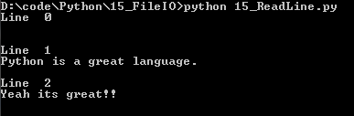
15.10 The read() Method
Introduction
https://www.tutorialspoint.com/python3/python_files_io.htm
Run Read Line Example:
Python3 - CS596

Slide 39
15.11 File Position

Slide 40
15.11 File Position: Seek and Tell
Introduction
https://www.tutorialspoint.com/python3/python_files_io.htm
The tell() method tells you the current position within the file; in other words, the next read or write will occur at that many bytes from the beginning of the file.
The seek(offset[, from]) method changes the current file position. The offset argument indicates the number of bytes to be moved. The from argument specifies the reference position from where the bytes are to be moved.
If from is set to 0, it means use the beginning of the file as the reference position and 1 means use the current position as the reference position and if it is set to 2 then the end of the file would be taken as the reference position.
Python3 - CS596

Slide 41
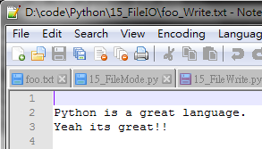
15.11 File Position
Introduction
https://www.tutorialspoint.com/python3/python_files_io.htm
Read a file foo_Write.txt
#!/usr/bin/python3
# Open a file
fo = open("foo_Write.txt", "r+")
str = fo.read(1000)
print ("Read String is : ", str)
# Check current position
position = fo.tell()
print ("Current file position : ", position)
# Reposition pointer at the beginning once again
position = fo.seek(0, 0)
position = fo.tell()
print ("Current file position : ", position)
str = fo.read(10)
print ("Again read String is : ", str)
# Close opened file
fo.close()
Python3 - CS596

Slide 42
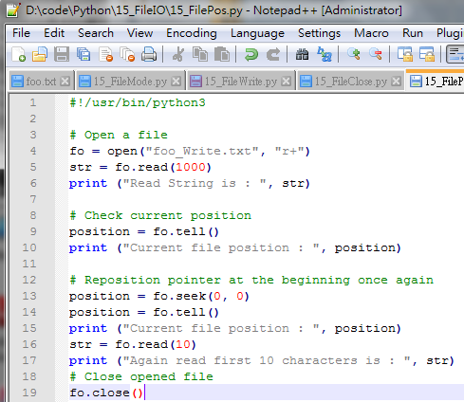
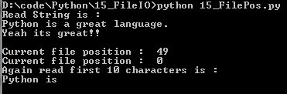
15.11 File Position
Introduction
https://www.tutorialspoint.com/python3/python_files_io.htm
Run Read a file foo_Write.txt
Python3 - CS596

Slide 43
15.12 The rename() Method

Slide 44
15.12 The rename() Method
Introduction
https://www.tutorialspoint.com/python3/python_files_io.htm
Let us take a file foo.txt, which we created above.
#!/usr/bin/python3
import os
# Rename a file from test1.txt to test2.txt
os.rename( "test1.txt", "test2.txt" )
Python3 - CS596

Slide 45
15.13 The remove() Method

Slide 46
15.13 The remove() Method
Introduction
https://www.tutorialspoint.com/python3/python_files_io.htm
Example to delete an existing file test2.txt
#!/usr/bin/python3
import os
# Delete file test2.txt
os.remove("text2.txt")
Python3 - CS596

Slide 47
15.14 Directory Operation

Slide 48
15.14 Directory Operation
Introduction
https://www.tutorialspoint.com/python3/python_files_io.htm
All files are contained within various directories, and Python has no problem handling these too. The os module has several methods that help you create, remove, and change directories.
Syntax
#!/usr/bin/python3
import os
os.mkdir("newdir")
Python3 - CS596

Slide 49
15.14 Directory Operation
Introduction
https://www.tutorialspoint.com/python3/python_files_io.htm
Example.
Following is the example to create a directory test in the current directory:
#!/usr/bin/python3
import os
# Create a directory "test"
os.mkdir("test")
Python3 - CS596

Slide 50
15.15 Change Directory

Slide 51
15.15 Change Directory
Introduction
https://www.tutorialspoint.com/python3/python_files_io.htm
You can use the chdir() method to change the current directory.
The chdir() method takes an argument, which is the name of the directory that you want to make the current directory.
Syntax
#!/usr/bin/python3
import os
os.chdir("newdir“)
Python3 - CS596

Slide 52
15.15 Change Directory
Introduction
https://www.tutorialspoint.com/python3/python_files_io.htm
Example.
Following is the example to go into "/home/newdir" directory:
#!/usr/bin/python3
import os
# Changing a directory to "/home/newdir“
os.chdir("/home/newdir")
Python3 - CS596

Slide 53
15.16 Get Current Directory

Slide 54
15.16 Get Current Directory
Introduction
https://www.tutorialspoint.com/python3/python_files_io.htm
The getcwd() method displays the current working directory..
Syntax
#!/usr/bin/python3
import os
os.getcwd()
Python3 - CS596

Slide 55
15.16 Get Current Directory
Introduction
https://www.tutorialspoint.com/python3/python_files_io.htm
Example.
Following is the example to give current directory.
#!/usr/bin/python3
import os
# This would give location of the current directory
os.getcwd()
Python3 - CS596

Slide 56
15.17 Remove Directory

Slide 57
15.17 Remove Directory
Introduction
https://www.tutorialspoint.com/python3/python_files_io.htm
The rmdir() method deletes the directory, which is passed as an argument in the method.
Before removing a directory, all the contents in it should be removed.
Syntax
#!/usr/bin/python3
import os
os.rmdir('dirname')
Python3 - CS596

Slide 58
15.18 File and Directory Related Method

Slide 59
15.18 File and Directory Related Method
Introduction
https://www.tutorialspoint.com/python3/python_files_io.htm
There are important sources, which provide a wide range of utility methods to handle and manipulate files & directories on Windows and Unix operating systems.
They are as follows:
File Object Methods: The file object provides functions to manipulate files.
OS Object Methods: This provides methods to process files as well as directories.
Python3 - CS596

Slide 60

END of CHAPTER 15

