Slide 1


Advanced Python Chapter 3: CGI
Peter H. Chen, PhDEE/EMBA

Slide 2

3 CGI

Slide 3

3 CGI
Introduction
https://www.tutorialspoint.com/python3/python_cgi_programming.htm
The Common Gateway Interface, or CGI, is a set of standards that define how information is exchanged between the web server and a custom script.
The CGI specs are currently maintained by the NCSA and NCSA.
Python - CS596

Slide 4
3.1 What is CGI?

Slide 5
3.1 What is CGI?
Introduction
https://www.tutorialspoint.com/python3/python_cgi_programming.htm
The Common Gateway Interface, or CGI, is a standard for external gateway programs to interface with information servers such as HTTP servers.
The current version is CGI/1.1 and CGI/1.2 is under progress.
Python - CS596

Slide 6
3.2 Web Browsing

Slide 7
3.3 CGI Architecture
Introduction
https://www.tutorialspoint.com/python3/python_cgi_programming.htm
To understand the concept of CGI, let us see what happens when we click a hyper link to browse a particular web page or URL. Your browser contacts the HTTP web server and demands for the URL, i.e., filename.
Web Server parses the URL and looks for the filename. If it finds that file then sends it back to the browser, otherwise sends an error message indicating that you requested a wrong file.
Web browser takes response from web server and displays either the received file or error message.
However, it is possible to set up the HTTP server so that whenever a file in a certain directory is requested that file is not sent back; instead it is executed as a program, and whatever that program outputs is sent back for your browser to display.
This function is called the Common Gateway Interface or CGI and the programs are called CGI scripts.
These CGI programs can be a Python Script, PERL Script, Shell Script, C or C++ program, etc.
Python - CS596

Slide 8
3.3 CGI Architecture

Slide 9
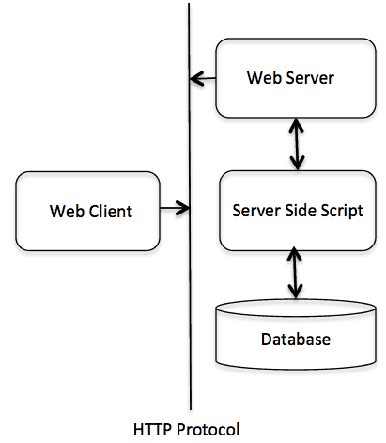
3.3 CGI Architecture
Introduction
https://www.tutorialspoint.com/python3/python_cgi_programming.htm
CGI Architecture:
Python - CS596

Slide 10
3.4 Web Server Support and Configuration

Slide 11
3.4 Web Server Support and Configuration
Introduction
https://www.tutorialspoint.com/python3/python_cgi_programming.htm
Before you proceed with CGI Programming, make sure that your Web Server supports CGI and it is configured to handle CGI Programs.
All the CGI Programs to be executed by the HTTP server are kept in a pre-configured directory.
This directory is called CGI Directory and by convention it is named as /var/www/cgi-bin.
By convention, CGI files have extension as.cgi, but you can keep your files with python extension .py as well.
By default, the Linux server is configured to run only the scripts in the cgi-bin directory in /var/www.
If you want to specify any other directory to run your CGI scripts, comment the following lines in the httpd.conf file.
Python - CS596

Slide 12
3.4 Web Server Support and Configuration
Introduction
https://www.tutorialspoint.com/python3/python_cgi_programming.htm
If you want to specify any other directory to run your CGI scripts, comment the following lines in the httpd.conf file.
<Directory "/var/www/cgi-bin">
AllowOverride None
Options ExecCGI
Order allow,deny
Allow from all
</Directory>
<Directory "/var/www/cgi-bin">
Options All
</Directory>
Python - CS596

Slide 13
3.4 Web Server Support and Configuration
Introduction
https://www.tutorialspoint.com/python3/python_cgi_programming.htm
Following line should also be added for apache server to treat .py file as cgi script.
AddHandler cgi-script .py
Here, we assume that you have Web Server up and running successfully and you are able to run any other CGI program like Perl or Shell, etc.
Python - CS596

Slide 14
3.5 First CGI Program

Slide 15
3.5 First CGI Program
Introduction
https://www.tutorialspoint.com/python3/python_cgi_programming.htm
Here is a simple link, which is linked to a CGI script called hello.py.
This file is kept in /var/www/cgi-bin directory and it has following content.
Before running your CGI program, make sure you have change mode of file using chmod 755 hello.py UNIX command to make file executable.
#!/usr/bin/python3
print ("Content-type:text/html")
print()
print ("<html>")
print ('<head>')
print ('<title>Hello Word - First CGI Program</title>')
print ('</head>')
print ('<body>')
print ('<h2>Hello Word! This is my first CGI program</h2>')
print ('</body>')
print ('</html>')
Python - CS596

Slide 16
3.5 First CGI Program

Slide 17
3.5 First CGI Program
Introduction
https://www.tutorialspoint.com/python3/python_cgi_programming.htm
Here is a simple link, which is linked to a CGI script called hello.py.
This file is kept in /var/www/cgi-bin directory and it has following content.
Before running your CGI program, make sure you have change mode of file using chmod 755 hello.py UNIX command to make file executable.
#!/usr/bin/python3
print ("Content-type:text/html")
print()
print ("<html>")
print ('<head>')
print ('<title>Hello Word - First CGI Program</title>')
print ('</head>')
print ('<body>')
print ('<h2>Hello Word! This is my first CGI program</h2>')
print ('</body>')
print ('</html>')
Python - CS596

Slide 18

END of CHAPTER 3

