Slide 1

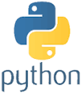
Advanced Python Chapter 4: MySQL Database Access
Peter H. Chen, PhDEE/EMBA

Slide 2

4 MySQL Database Access

Slide 3

4 MySQL Database Access
Introduction
https://www.tutorialspoint.com/python3/python_database_access.htm
The Python standard for database interfaces is the Python DB-API. Most Python database interfaces adhere to this standard.
You can choose the right database for your application. Python Database API supports a wide range of database servers such as −
GadFly
mSQL
MySQL
PostgreSQL
Microsoft SQL Server 2000
Informix
Interbase
Oracle
Sybase
SQLite
Python - CS596

Slide 4
4 MySQL Database Access
Introduction
https://www.tutorialspoint.com/python3/python_database_access.htm
Here is the list of available Python database interfaces − Python Database Interfaces and APIs.
You must download a separate DB API module for each database you need to access. For example, if you need to access an Oracle database as well as a MySQL database, you must download both the Oracle and the MySQL database modules.
The DB API provides a minimal standard for working with databases using Python structures and syntax wherever possible. This API includes the following:
Importing the API module.
Acquiring a connection with the database.
Issuing SQL statements and stored procedures.
Closing the connection
Python - CS596

Slide 5
4 MySQL Database Access
Introduction
https://www.tutorialspoint.com/python3/python_database_access.htm
Python has an in-built support for SQLite.
In this section, we would learn all the concepts using MySQL.
MySQLdb module, a popular interface with MySQL is not compatible with Python 3.
Instead, we shall use PyMySQL module.
Python - CS596

Slide 6
4.1 What is PyMySQL?

Slide 7
4.1 What is PyMySQL?
Introduction
https://www.tutorialspoint.com/python3/python_database_access.htm
PyMySQL is an interface for connecting to a MySQL database server from Python.
PyMySQL implements the Python Database API v2.0 and contains a pure-Python MySQL client library.
The goal of PyMySQL is to be a drop-in replacement for MySQLdb .
Python - CS596

Slide 8
4.2 How to Install PyMySQL?

Slide 9
4.2 How to Install PyMySQL?
Introduction
https://www.tutorialspoint.com/python3/python_database_access.htm
Before proceeding furthur, you make sure you have PyMySQL installed on your machine.
Just type the following in your Python script and execute it
#!/usr/bin/python3
import PyMySQL
If it produces the following result, then it means MySQLdb module is not installed:
Traceback (most recent call last):
File "test.py", line 3, in <module>
Import PyMySQL
ImportError: No module named PyMySQL
Python - CS596

Slide 10
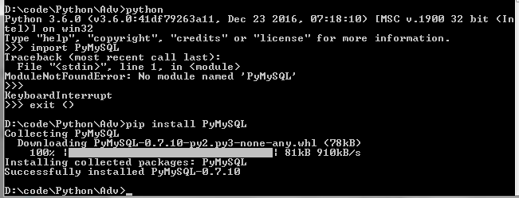
4.2 How to Install PyMySQL?
Introduction
https://www.tutorialspoint.com/python3/python_database_access.htm
The last stable release is available on PyPI and can be installed with pi
$ pip install PyMySQL
Python - CS596

Slide 11
4.2 How to Install PyMySQL?
Introduction
https://www.tutorialspoint.com/python3/python_database_access.htm
Alternatively (e.g. if pip is not available), a tarball can be downloaded from GitHub and installed with Setuptools as follows:
$ # X.X is the desired PyMySQL version (e.g. 0.5 or 0.6).
$ curl -L https://github.com/PyMySQL/PyMySQL/tarball/pymysql-X.X | tar xz $ cd PyMySQL*
$ python setup.py install
$ # The folder PyMySQL* can be safely removed now.
Note − Make sure you have root privilege to install the above module.
Python - CS596

Slide 12
4.3 Database Connection

Slide 13
4.3 Database Connection
Introduction
https://www.tutorialspoint.com/python3/python_database_access.htm
Before connecting to a MySQL database, make sure of the following points:
You have created a database TESTDB.
You have created a table EMPLOYEE in TESTDB.
This table has fields FIRST_NAME, LAST_NAME, AGE, SEX and INCOME.
User ID "testuser" and password "test123" are set to access TESTDB.
Python module PyMySQL is installed properly on your machine.
You have gone through MySQL tutorial to understand MySQL Basics.
Python - CS596

Slide 14

END of CHAPTER 4

