Slide 1


Python Chapter 1: Python API
Peter H. Chen, PhDEE/EMBA

Slide 2

1 Python API

Slide 3

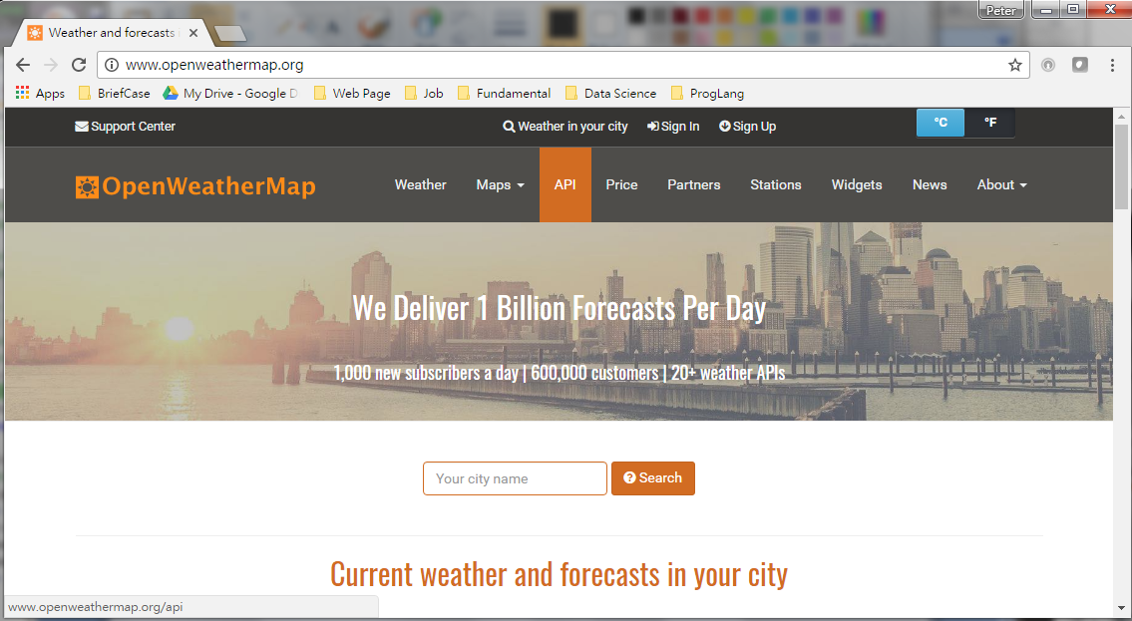
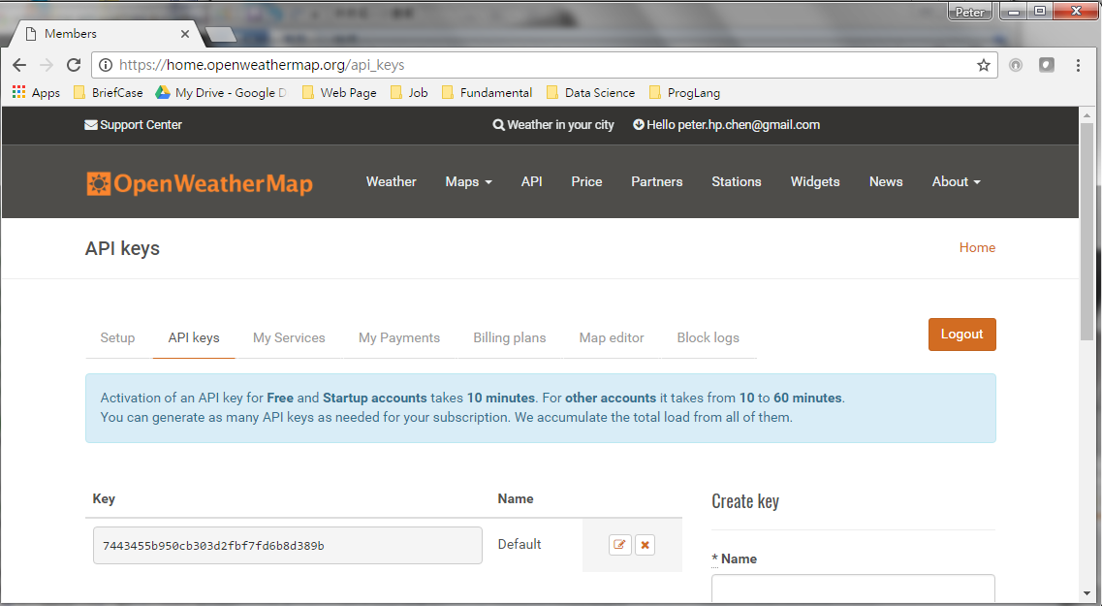
1 Python API
Introduction
https://www.youtube.com/watch?v=G8s0KVh2ePY
Click the Sign up: name, email, and password.
You will get API key.
Python - CS596

Slide 4
1.1 Default Degree K

Slide 5
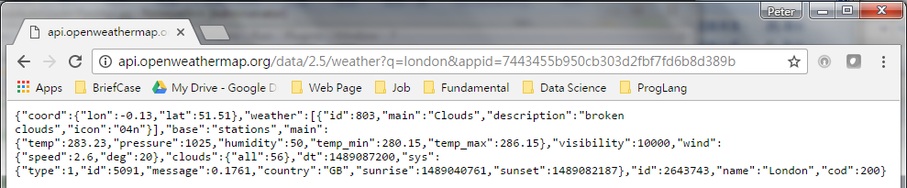
1.1 Default Degree K
Introduction
https://www.youtube.com/watch?v=G8s0KVh2ePY
Enter:
api.openweather.org/data/2.5/weather?q=london&appid= 7443455b950cb303d2fbf7fd6b8d389b
Temperature: 283.23 is Kelvin
Python - CS596

Slide 6
1.2 degree K, F, C

Slide 7
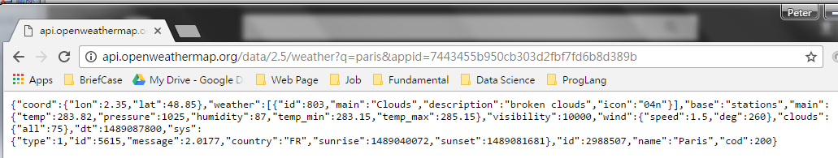
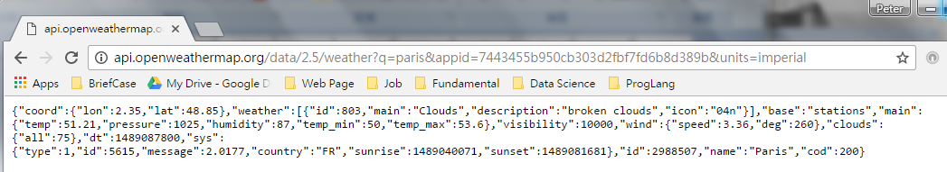
1.2 Degree K, F, and C
Introduction
https://www.youtube.com/watch?v=G8s0KVh2ePY
Enter:
api.openweather.org/data/2.5/weather?q=london&appid= 7443455b950cb303d2fbf7fd6b8d389b
Temperature: 283.23 is Kelvin
Degree C + 273 = degree K . 51.23 is the degree F (imperial Unit) = (283-273) *9/5+32 = 51
Python - CS596

Slide 8
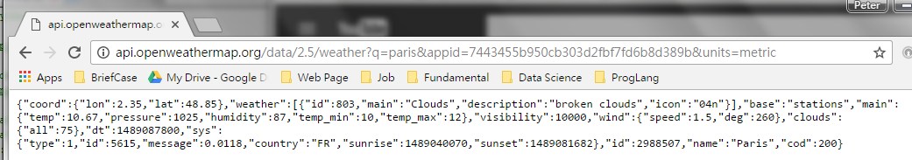
1.2 Degree K, F, and C
Introduction
https://www.youtube.com/watch?v=G8s0KVh2ePY
Enter:
api.openweather.org/data/2.5/weather?q=london&appid= 7443455b950cb303d2fbf7fd6b8d389b
Temperature: 283.23 is Kelvin
Degree C + 273 = degree K . Degree C = 283-273 = 10.
Python - CS596

Slide 9
1.3 JSON Format

Slide 10
1.3 JSON Format
Introduction
https://www.youtube.com/watch?v=G8s0KVh2ePY
The JSON format is (Key:Value) format. It is same as Python Dictionary format.
Python - CS596

Slide 11
1.4 Install Module Requests

Slide 12
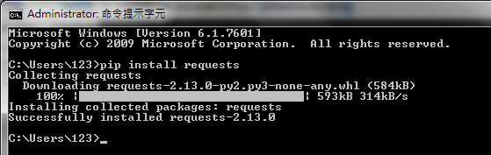
1.4 Install Module Requests
Introduction
https://www.youtube.com/watch?v=G8s0KVh2ePY
Install Module requests.
$ pip install requests
Python - CS596

Slide 13
1.5 Write Python API

Slide 14
1.5 Write Python API
Introduction
https://www.youtube.com/watch?v=G8s0KVh2ePY
Write Python API as below:
#!/usr/bin/python
# url = 'http://master/api/run'
# Youtube video: https://www.youtube.com/watch?v=G8s0KVh2ePY
# http://openweathermap.org/current
# API call:
# api.openweathermap.org/data/2.5/weather?q={city name}
# api.openweathermap.org/data/2.5/weather?q={city name},{country code}
# Parameters:
# q city name and country code divided by comma, use ISO 3166 country codes
# Examples of API calls:
# api.openweathermap.org/data/2.5/weather?q=London
# api.openweathermap.org/data/2.5/weather?q=London,uk
url = 'http://api.openweathermap.org/'
APIKEY = '7443455b950cb303d2fbf7fd6b8d389b'
import requests
from pprint import pprint
def main():
city = "New York"
#response = requests.get("http://api.openweathermap.org/data/2.5/weather?q=paris&appid=7443455b950cb303d2fbf7fd6b8d389b&units=metric")
response = requests.get(url + "data/2.5/weather?q=" + city
+ "&appid=" + APIKEY + "&units=metric")
#response = requests.get(url + "data/2.5/weather?q=" + city + "&appid=" + APIKEY)
# response patch into data for Python format.
weather = response.json()
print ("The weather for", weather['name'])
# { ... ,"main":{"temp":10.67,"pressure":1025,"humidity":87,"temp_min":10,"temp_max":12},...}
print (weather['main']['temp'])
print (weather['weather'][0]['description'])
if __name__ == '__main__':
main()
Python - CS596

Slide 15
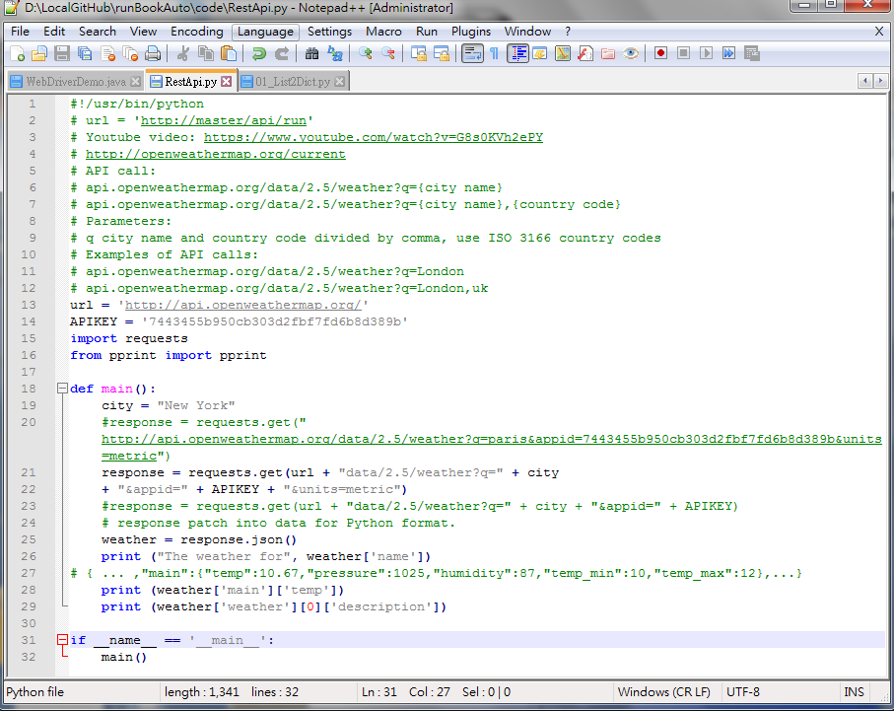
1.5 Write Python API
Introduction
https://www.youtube.com/watch?v=G8s0KVh2ePY
Write Python API as below:
Python - CS596

Slide 16
1.6 Run Python API

Slide 17

1.6 Run Python API
Introduction
https://www.youtube.com/watch?v=G8s0KVh2ePY
Run Python API as below:
Python - CS596

Slide 18
1.7 Update to GitHub

Slide 19
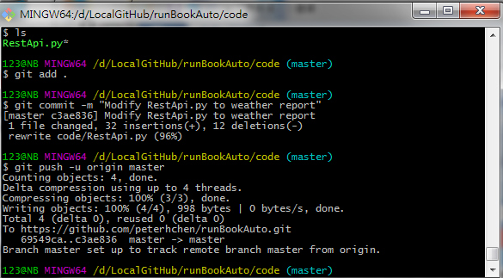
1.7 Push into GitHub
Introduction
https://www.youtube.com/watch?v=G8s0KVh2ePY
Push into GitHub:
$ git add .
$ git commit –m “Modify RestApi.py to weather report”
$ git push –u origin master
Python - CS596

Slide 20
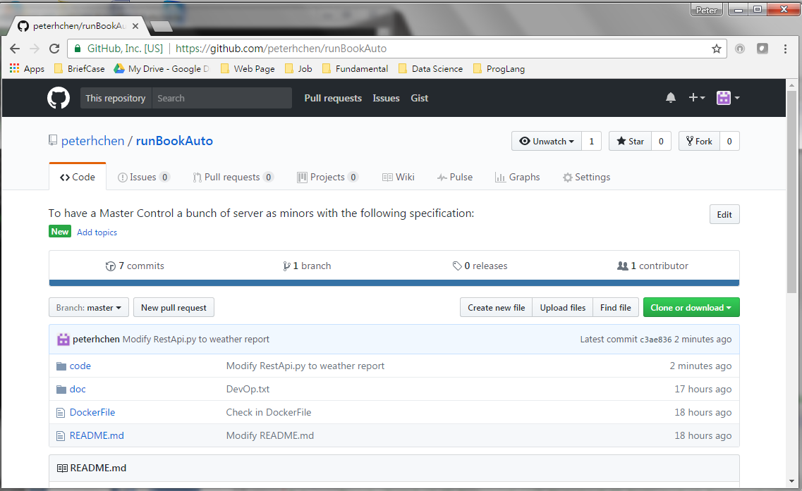
1.6 Run Python API
Introduction
https://www.youtube.com/watch?v=G8s0KVh2ePY
Go to: www.github.com
Search for “runBookAuto”. Click into and RestApi.py is updated.
Python - CS596

Slide 21

END of CHAPTER 1

