Slide 1
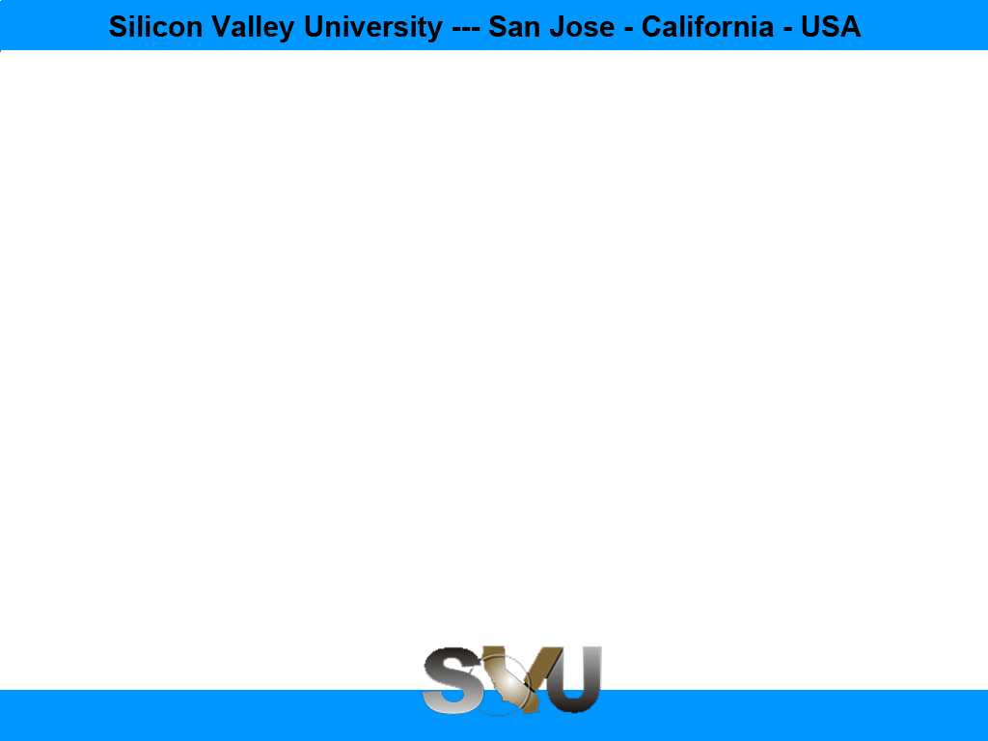
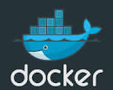
Docker Chapter 1: Docker
Peter H. Chen, PhDEE/EMBA

Slide 2

1 What is Docker?

Slide 3

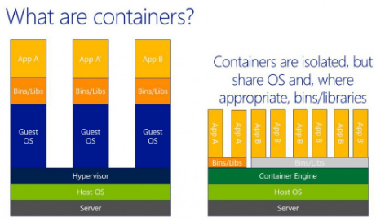
1 Docker Containers
Introduction
https://www.docker.com/what-docker
Docker Containers are
Lightweight:
Docker Containers run on a single machine share the same operating system kernel.
Docker Container starts instantly and use less RAM.
Images are constructed from layered filesystems and share common files, making disk usage and image downloads much more efficient.
Open Source:
Docker containers are based on open standards, enabling containers to run on all Linux distributions, Microsoft Windows, and any infrastructure.
Secure
Docker Containers isolate applications from one another and the underlying infrastructure.
Docker Containers added layer of protection for the application.
Docker - CS596

Slide 4
1.1 Run Docker on Windows

Slide 5
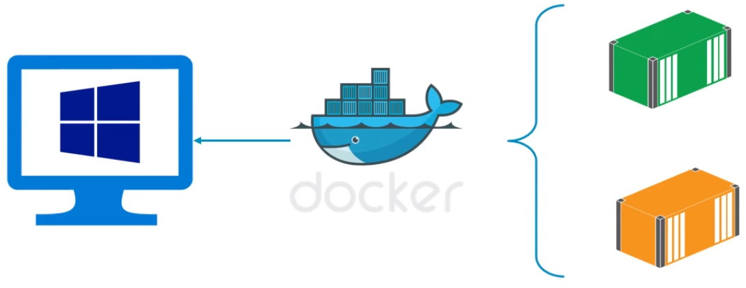
1.1 Run Docker on Windows
Introduction
https://www.youtube.com/watch?v=S7NVloq0EBc
Run Docker on Window
Docker - CS596

Slide 6
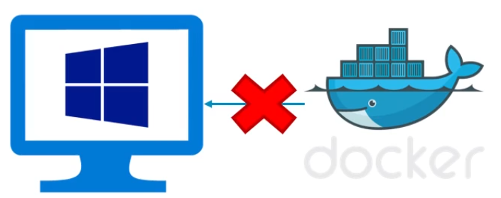
1.1 Docker on Windows
Introduction
https://www.youtube.com/watch?v=S7NVloq0EBc
Docker on Window is different since Docker come from Linux Machine.
Window and Docker are not competible.
Docker - CS596

Slide 7
1.2 Docker Toolbox on Windows

Slide 8
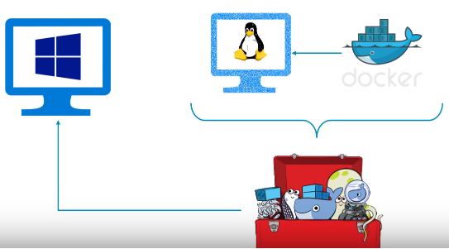
1.2 Docker Toolbox on Windows
Introduction
https://www.youtube.com/watch?v=S7NVloq0EBc
Docker on Windows has to go through the Docker toolbox.
Docker requires Docker Toolbox to run on Window.
Hypervisor
Docker - CS596

Slide 9
1.3 Download Docker Toolbox

Slide 10
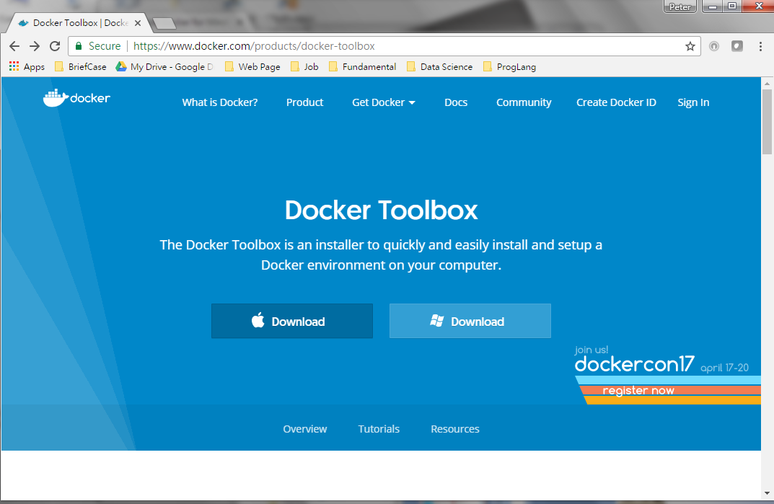
1.3 Download Docker Toolbox
Introduction
https://www.youtube.com/watch?v=S7NVloq0EBc
Download Docker toolbox. This is the Hypervisor of Docker.
Click Download
Docker - CS596

Slide 11
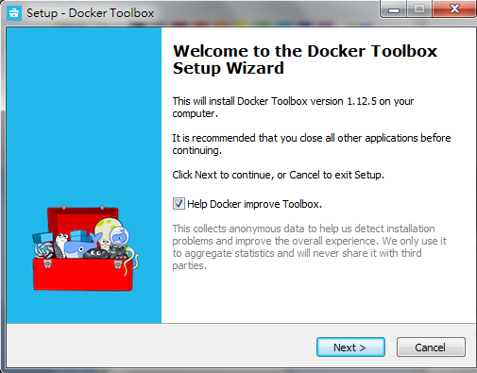
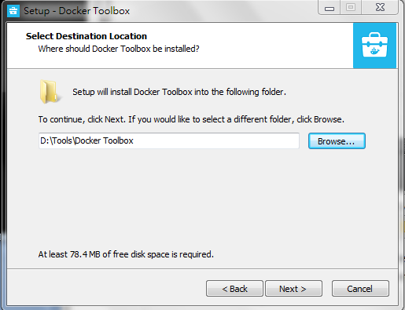
1.3 Download Docker Toolbox
Introduction
https://www.youtube.com/watch?v=S7NVloq0EBc
Setup Wizard of Docker toolbox.
Docker - CS596

Slide 12
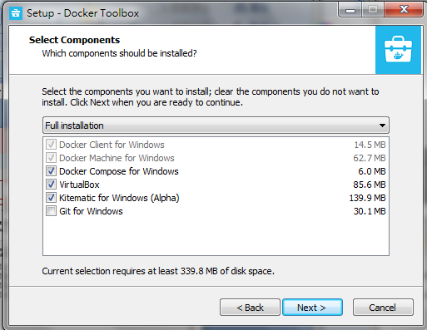
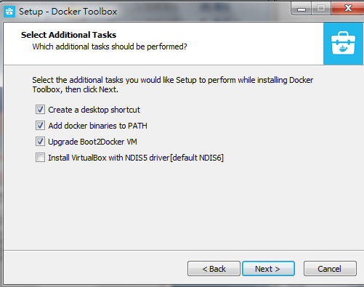
1.3 Download Docker Toolbox
Introduction
https://www.youtube.com/watch?v=S7NVloq0EBc
Keep default selection.
Docker - CS596

Slide 13
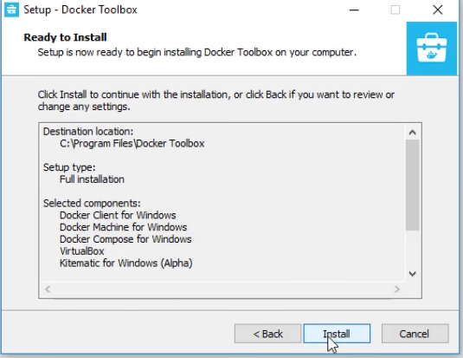
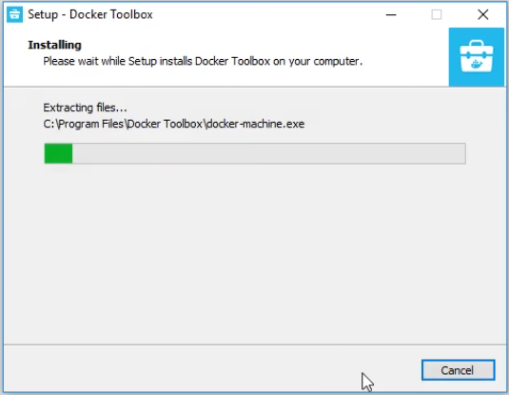
1.3 Download Docker Toolbox
Introduction
https://www.youtube.com/watch?v=S7NVloq0EBc
Installing Docker.
Docker - CS596

Slide 14
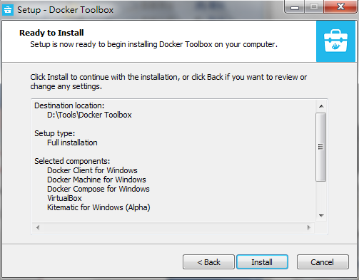
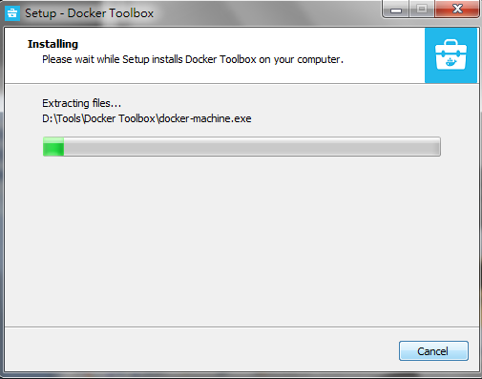
1.3 Download Docker Toolbox
Introduction
https://www.youtube.com/watch?v=S7NVloq0EBc
Ready to Install.
Installing.
Docker - CS596

Slide 15
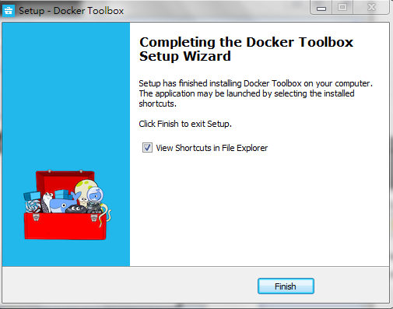
1.3 Download Docker Toolbox
Introduction
https://www.youtube.com/watch?v=S7NVloq0EBc
Finished Docker installation.
Docker - CS596

Slide 16
1.4 Start Kitematic

Slide 17
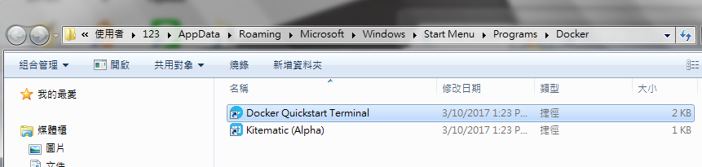

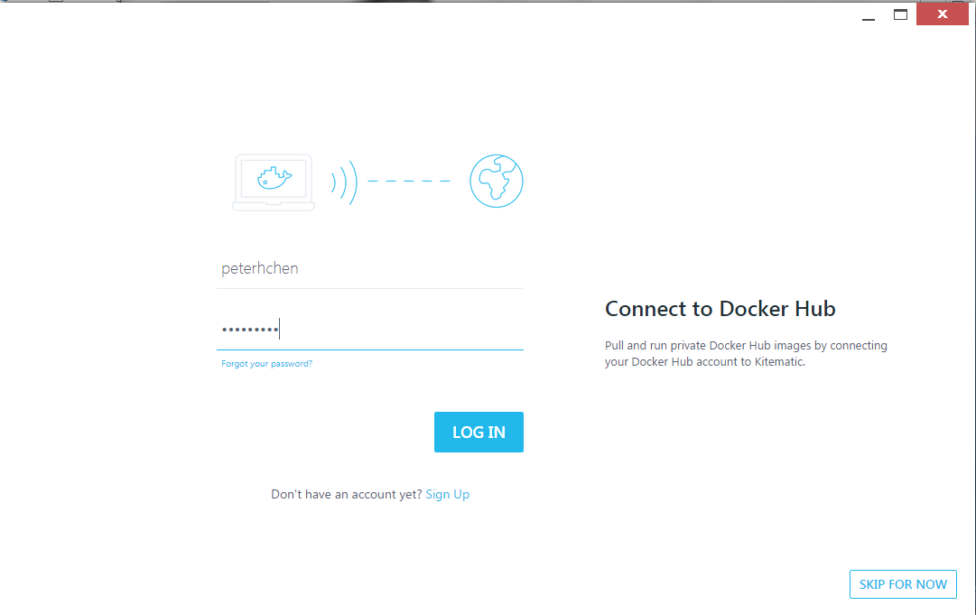
1.4 Start Kitamatic
Introduction
https://www.youtube.com/watch?v=S7NVloq0EBc
Start Kitematic (Alpha)
1
Double Click
2
Start Kitematic Hypervisor
3
Register and log into Docker Hub
Docker - CS596

Slide 18
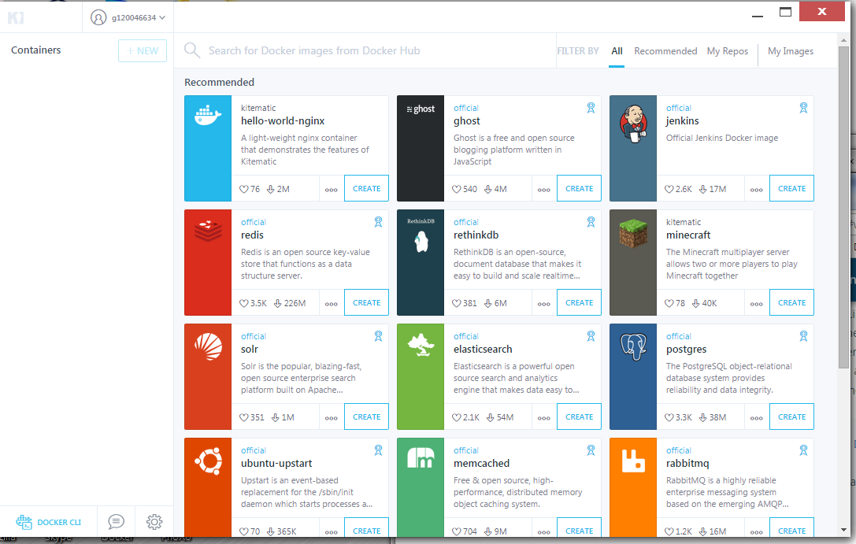
1.4 Start Docker Toolbox
Introduction
https://www.youtube.com/watch?v=S7NVloq0EBc
Start Kitematic (Alpha)
Docker - CS596

Slide 19
1.5 Start Quickstart Terminal

Slide 20
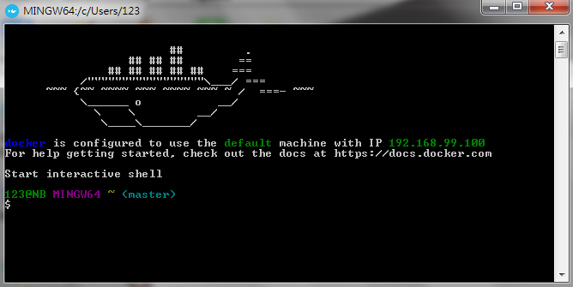
1.5 Start Quickstart Terminal
Introduction
https://www.youtube.com/watch?v=S7NVloq0EBc
Docker Quickstart Terminal.
1
Docker Quickstart Terminal
Docker - CS596

Slide 21
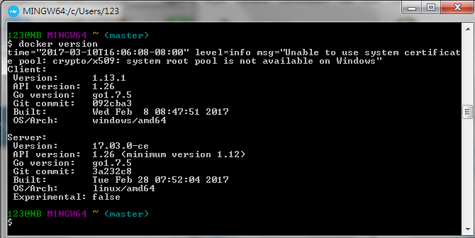
1.5 Start Quickstart Terminal
Introduction
https://www.youtube.com/watch?v=S7NVloq0EBc
Verify the Docker version.
$ docker version
Docker - CS596

Slide 22
1.6 Run Docker hello-world

Slide 23
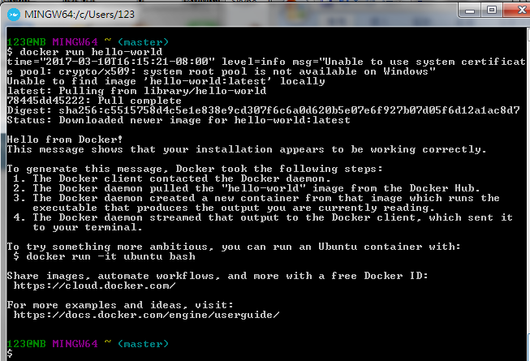
1.6 Run Docker hello-world
Introduction
https://www.youtube.com/watch?v=S7NVloq0EBc
Run “docker run hello-world” from Docker Library.
“hello-world” is a public image file for docker testing.
$ docker run hello-world
Find “hello-world” from Docker Library.
Docker - CS596

Slide 24
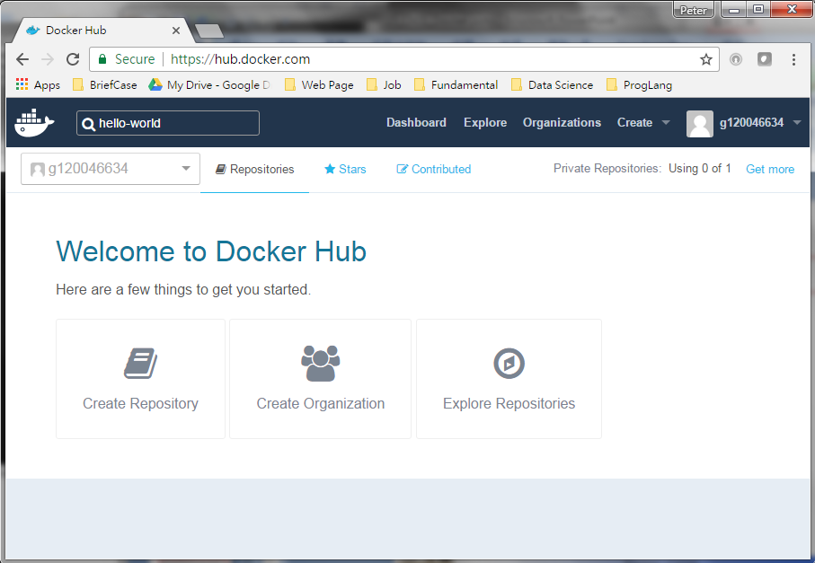
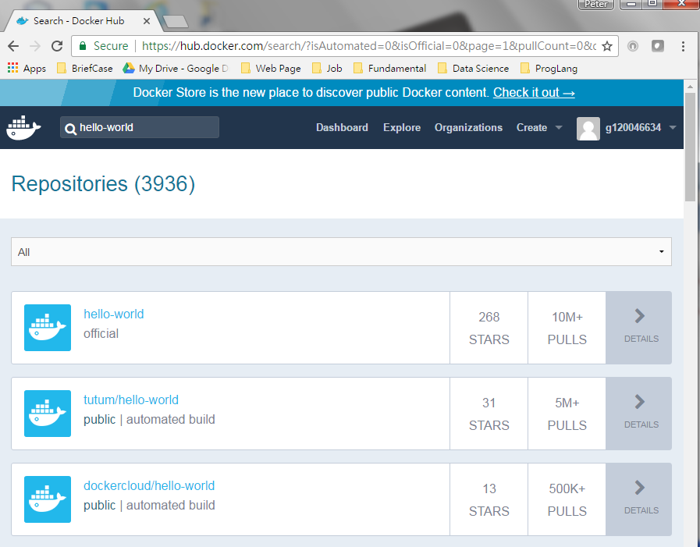
1.6 Run Docker hello-world
Introduction
https://www.youtube.com/watch?v=S7NVloq0EBc
“hello-world” is the image on the public docker hub repository https://hub.docker.com”.
Find “hello-world” from “https://hub.docker.com”
Docker - CS596

Slide 25
1.7 Run Docker seqvence

Slide 26
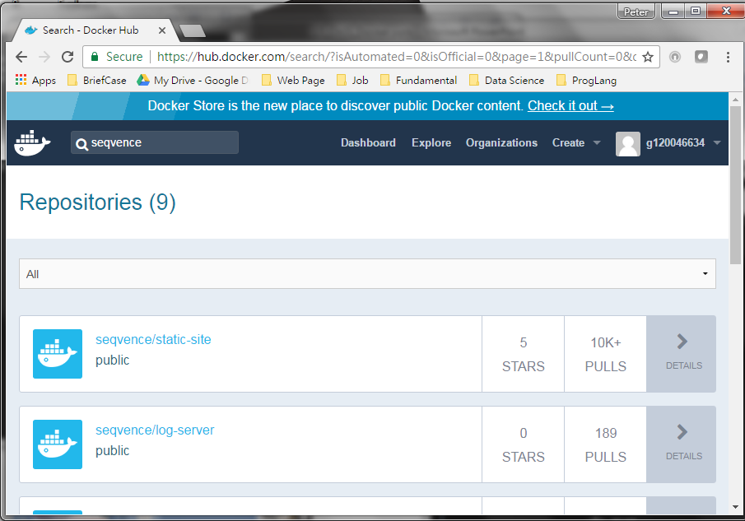
1.7 Run Docker seqvence
Introduction
https://www.youtube.com/watch?v=S7NVloq0EBc
Find seqvence public Project on Docker hub
Find “seqvence” from “https://hub.docker.com”
Docker - CS596

Slide 27
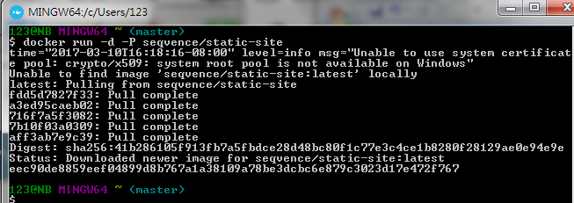
1.7 Run Docker -seqvence
Introduction
https://www.youtube.com/watch?v=S7NVloq0EBc
Run Docker public project seqvence with -P (Public) Option
# -d: Run Docker on back ground and print ID.
# -P: Publish (Communicate with third party) to network ports for container.
# sevennce: Docker image for Linux Webserver and display single page.
$ docker run –d –P seqvence/static-site
Find static-site
Docker - CS596

Slide 28
1.8 Docker Command

Slide 29
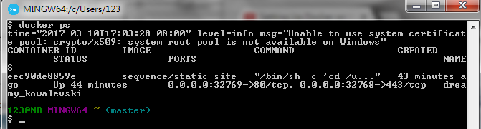
1.8 Docker Command
Introduction
https://www.youtube.com/watch?v=S7NVloq0EBc
Docker command: ps
The port number is random port number is 32773 (Port number can be between 0-65535).
$ docker ps
Docker urn port 80 inside the container.
Docker uses Random Port Number port 32727 outside the container.
Docker - CS596

Slide 30

END of CHAPTER 1

