Slide 1


Docker Chapter 2: Docker for Python Api
Peter H. Chen, PhDEE/EMBA

Slide 2

2 Docker for Python API

Slide 3

2 Docker for Python API
Introduction
https://www.youtube.com/watch?v=Fxsq3BciYdo
This document shows how to generate Dockerfile for Python.
Docker - CS596

Slide 4
2.1 Docker Run Python

Slide 5
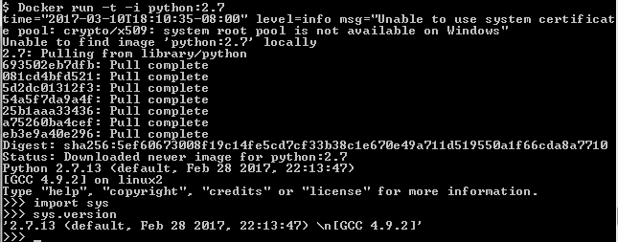
2.1 Docker Run Python
Introduction
https://www.youtube.com/watch?v=Fxsq3BciYdo
The Docker command to run Python 2.7.
$ docker run -t -i pyhton:2.7
Note:
-t => terminal
-i =>interactive
Python:2.7 => Image:tag
Docker - CS596

Slide 6

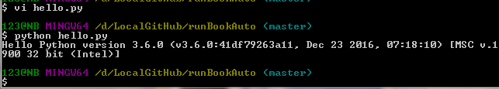
2.1 Docker Run Python
Introduction
https://www.youtube.com/watch?v=Fxsq3BciYdo
Run Python 3.6 on Docker.
$ vi hellp.py
$ python hello.py
Docker - CS596

Slide 7
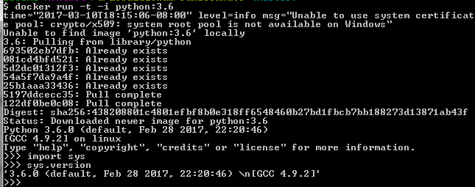
2.1 Docker Run Python
Introduction
https://www.youtube.com/watch?v=Fxsq3BciYdo
The Docker command to run Python 3.6.
$ docker run -t -i pyhton:3.6
Note:
-t => terminal
-i =>interactive
Python:3.6 => Image:tag
Docker - CS596

Slide 8
2.2 Create Dockerfile

Slide 9
2.2 Create Dockerfile
Introduction
https://www.youtube.com/watch?v=Fxsq3BciYdo
Create Dockerfile as follow:
$ docker run -t -i pyhton:2.7
Docker - CS596

Slide 10
2.3 Build Image File

Slide 11
2.2 Create Dockerfile
Introduction
https://www.youtube.com/watch?v=Fxsq3BciYdo
Create Dockerfile as follow:
$ docker run -t -i pyhton:2.7
Docker - CS596

Slide 12
2.4 Delete Image Files

Slide 13
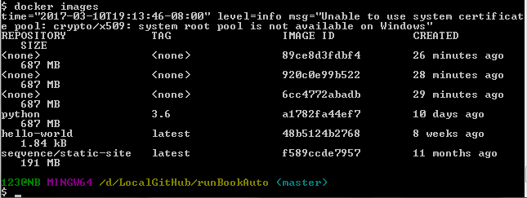
2.4 Delete Image Files
Introduction
https://www.youtube.com/watch?v=Fxsq3BciYdo
Display the image Files you created.
$ docker images
Docker - CS596

Slide 14
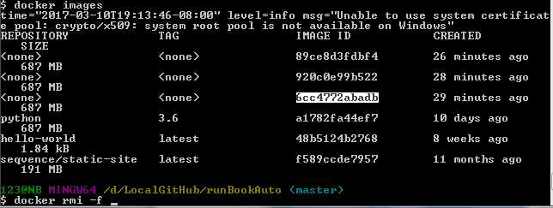
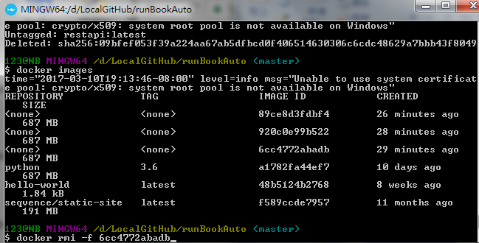
2.4 Delete Image Files
Introduction
https://www.youtube.com/watch?v=Fxsq3BciYdo
Delete image files with –f (forced to delete) option.
Marked the image id and double right mouse click to paste.
$ docker rim -f <image-id>
Docker - CS596

Slide 15
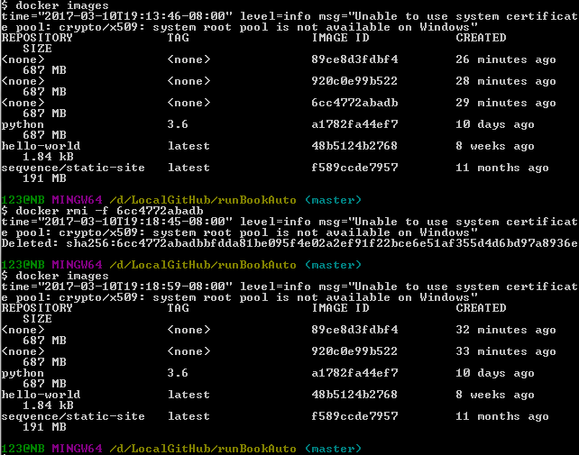
2.4 Delete Image Files
Introduction
https://www.youtube.com/watch?v=Fxsq3BciYdo
Make sure the image file is deleted.
$ docker images
Docker - CS596

Slide 16
2.5 Run Image Files

Slide 17
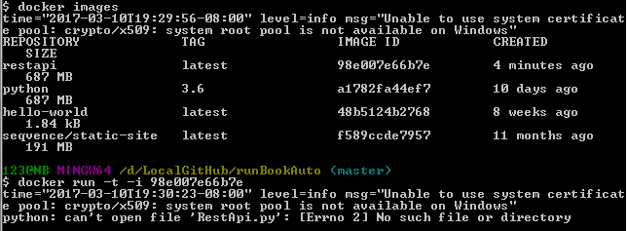
2.5 Run Image Files
Introduction
http://stackoverflow.com/questions/18497688/run-a-docker-image-as-a-container
Run Image Files.
Note: Cannot open file?
$ docker run –t –i <image-id>
Docker - CS596

Slide 18
2.6 Run Python

Slide 19

2.5 Run Image Files
Introduction
http://stackoverflow.com/questions/18497688/run-a-docker-image-as-a-container
Run python under Docker
$ python RestAPi.py
Docker - CS596

Slide 20

END of CHAPTER 2

