Slide 1
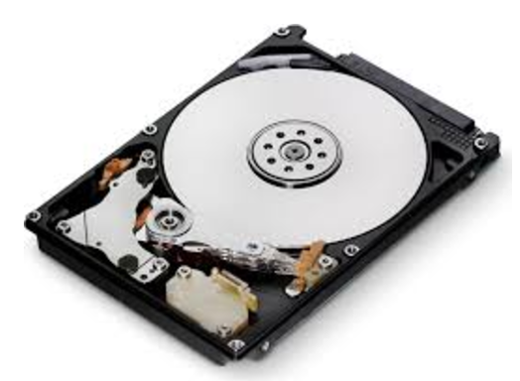


Volume
Velocity
Big Data
Variety

Slide 2
Revolution
Data Driven Solution
Potential
Start (a)
Potential
Start (b)
Potential
Start (c)

