Slide 1
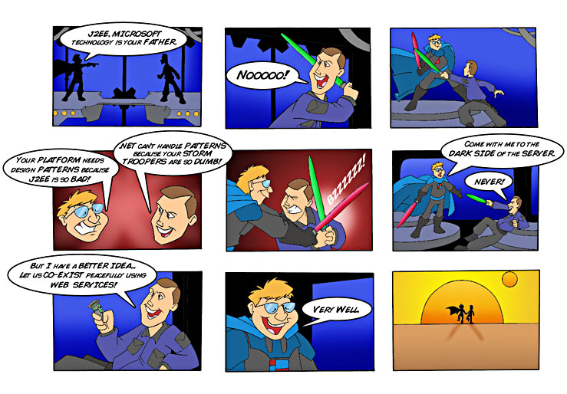
The evolution of Web Services
Magnus Larsson and Mats Ekhammar
Notes:
Jag och Mats skall prata om hur vi ser att Web Services tekniken håller på att mogna.
När WS lanserades för några år sedan så tedde ju sig allting så väldigt enkelt och de olika leverantörernas plattformar skulle tack vare WS kunna gå hand i hand (ur ett integrationsperspektiv) mot en ljusnande framtid.
Vad man missade var att 10m framför de första WS ansatserna så befann sig Grand Canyon...
Ansatsen höll inte, då den var allt för ”lättviktig”.
...Vår presentation handlar om hur vi ser att man nu håller på att ta sig upp igen tillbaka till den plana ytan igen!

Slide 2
Overview
In the beginning it was so simple…
WSDL
UDDI
SOAP

Slide 3
Overview
…then something happened
We need a map that can bring some order!!!
WS-Reliable Messaging
WS-Security
BPEL
WS-Trust
WS-Events
WS-Reliability
WSDL
UDDI
WS-Notification
SOAP
WS-Agreements
WS-Addressing
WS-Policy
WS-Atomic Transactions

Slide 4
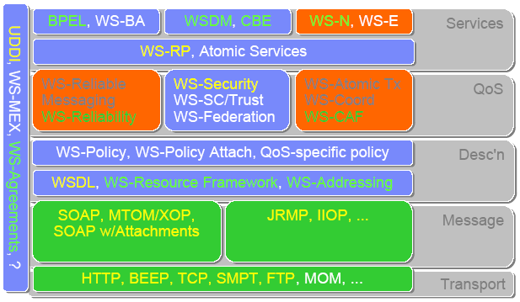
The WS Stack with Specs...
w
WS - I

Slide 5
Overview
Let’s look closer on a few of the most interesting...
  Interoperability (WS-I)
    They better talk each other...
  Security (WS-Security)
    …in a secure way...
  Business Process Orchestration (BPEL)
    This should really add some value...
    ...and not just more plumbing

Slide 6
Interoperability
Current problems
  Implementation ”A” can not talk to implementation ”B” over Web Services...
    Existing WS specifications leaves many open options…
  Examples of known problems
  (if not only sending single strings back and forth)
    “Non string” primitive types: Integer, Float and Date
    Complex types: DTO, Arrays of DTO, Graphs of DTO
    Null values
    Binding and Use
      Document vs. RPC
      Encoded vs. Literal (with and w/o Wrapped)
    Exceptions
    Attachments

Slide 7
Interoperability
WS-I (Web Services Interoperability) to the rescue...
  www.ws-i.org
  Overview
    Details usage of HTTP, SOAP, WSDL, XML Schema, UDDI
      E.g. Binding: Document/Literal
      Usage of datatypes as defined by “XML Schema Part 2: Datatypes”
  Current Version
    Basic Profile v1.0 (BP 1.0)
      HTTP 1.1
      SOAP 1.1
      WSDL 1.1
      XML 1.0
      XML Schema Part 1 “Structures” and Part 2 “Datatypes”
      UDDI v2.0
Notes:
JWSDP 1.4 impl WS-I BP 1.1 with attachments?
Axis contains an example of fault handling?
Java och WS-I AP kör på SOAP with Attachments
MS kör på DIME… på väg mot MTOM
AXIS kan ev köra DIME?

Slide 8
Interoperability
WS-I to the rescue...
  Next Version:
    Basic Profile v1.1 (BP 1.1)
      Include ”Binding Profile 1.0” and ”Attachments Profile 1.0”
    “Security Profile” on its way…
Vendor support (examples)
    BP 1.0
      Microsoft .NET 2.0
      J2EE v1.4 servers (e.g. IBM WebSphere 6.0 and JBoss 4.0)
      Apache Axis v1.2 (Currently only in RC2 - stage)
    BP 1.1
      Sun JWSDP 1.4
Notes:
JWSDP 1.4 impl WS-I BP 1.1 with attachments?
Axis contains an example of fault handling?
Java och WS-I AP kör på SOAP with Attachments
MS kör på DIME… på väg mot MTOM
AXIS kan ev köra DIME?

Slide 9
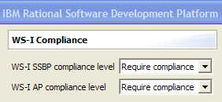
Interoperability
WS-I in Microsoft .NET 2.0
[WebServiceBinding(
ConformanceClaims=WsiClaims.BP10,
EmitConformanceClaims = true
)]
public class Service : System.Web.Services.WebService {
WS-I in IBM Rational SDP and WebSphere 6.0
WS-I in Sun JWSDP 1.4
wscompile -f:wsi ...
Notes:
JWSDP 1.4 impl WS-I BP 1.1 with attachments?
Axis contains an example of fault handling?

Slide 10
Interoperability - Demo
WS-I BP 1.0
  Server
    J2EE 1.4 server – WebSphere 6.0
    IBM Rational Software Development Platform 6.0
  Client
    Microsoft .NET 2.0
    Visual Studio 2005 Team System
Notes:
How to ensure and verify WS-I compliance?
Run some WS-I Tool that listen on the WS traffic?

Slide 11
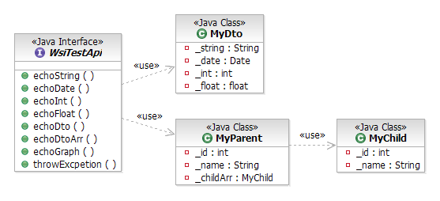
Interoperability - Demo
Web Services Operations
Notes:
How to ensure and verify WS-I compliance?
Run some WS-I Tool that listen on the WS traffic?

Slide 12
Interoperability - Summary
WS-I Basic Profile 1.0 is a major step forward!
  The list of known problems addressed by BP1.0!
    Except for attachments, see below…
What is still missing in WS-I BP 1.0 and 1.1?
  Attachments…
    WS-I BP 1.1 contain ”Attachments Profile 1.0”
      Based on ”SOAP Messages with attachments”
      Supported by Java but not by Microsoft .NET…
        Microsoft .NET supports “WS Attachments”
      Work is ongoing with new standards: “MTOM” and “XOP”
    Only old “Base64 encoding” will do as of today…
Recommendation
  Use WS-I BP Compliant tools now whenever possible
    Use “Base64 encoding” for attachments for now…
Notes:
How to ensure and verify WS-I compliance?
Run some WS-I Tool that listen on the WS traffic?

Slide 13
Security
A Web Service must be able to handle
    Identification
    Integrity
    Confidentiality
A Web Service must be able to support
(I.e. supplying the service implementation
with authentication tokens)
    Authentication
    Authorization
    Auditing
    Non-repudiation
Notes:
Id-information
Verifiering
Rättigheter
Information ej ändrad av extern part
Information skyddad för extern insyn
Granskning
Icke-förnekelse

Slide 14
Security
Current problems
  Today we secure our Web Services with SSL/HTTPS
    SSL/HTTP only gives security on the protocol level...
  We need security on application level
    Multiple hops
      Middle servers might not be allowed to read the content
      HTTP is maybe not the protocol in all hops
    Encryption for Confidentiality cost performance
      In most cases we only need to encrypt parts of a message
    Authentication, Authorization, Auditing and Non-repudiation need access to the authentication tokens
    Different parts of a message might need different Digital Signatures

Slide 15
Security
WS-Security to the rescue...
  http://www.oasis-open.org/committees/tc_home.php?wg_abbrev=wss
  Overview
    Identification through Authentication Tokens
      Username/Password and X509 Certificates
    Integrity through XML Digital Signing
    Confidentiality through XML Encryption
    Infrastructure
      Asymmetric Private/Public Keys + CA
  Current Version
    WS-Security 1.0 released by OASIS in April 2004
  Coming versions
    WS-I “Security Profile 1.0” is on its way…
Notes:
Username/Password or X.509 Certificates
SAML and Kerberos profiles on its way…

Slide 16
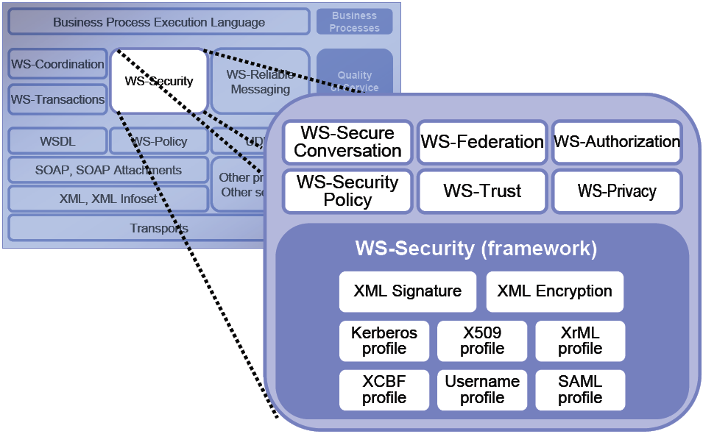
Security
WS – Security is not a single specification...

Slide 17
Security
Vendor support (examples)
  Microsoft .NET 1.1 + WSE 2.0
  Sun JWSDP 1.4
  IBM WebSphere 6.0
Limited Java vendor support
  J2EE does currently not support WS-Security
  Apache WSS4J (Security for Axis) is a new project with as of today no deliverables

Slide 18
Security
XML Digital Signature
  Stored in a <Signature> - element in the SOAP - Header
  It has three main parts
    <SignedInfo> – Information about what is signed
    <SignatureValue> – The value of the digital signature itself
    <KeyInfo> – The public key used to verify the signature

Slide 19
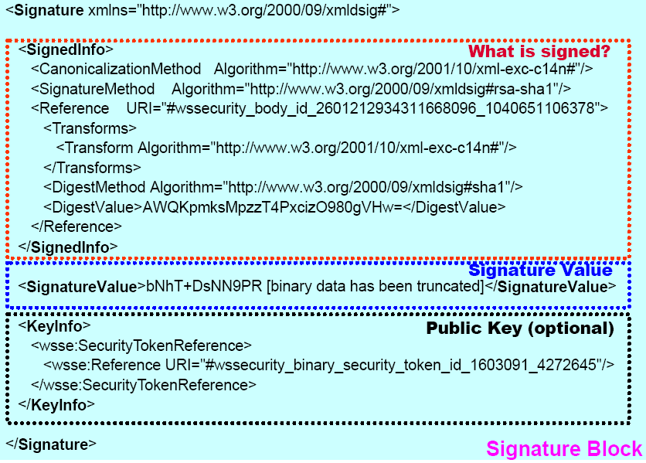
Security
XML Digital Signature Example

Slide 20
Security
XML Encryption
  Replace the encrypted information with a
  <EncryptedData> - element
    <EncryptionMethod>
      The algorithm used to encrypt the data
    <KeyInfo>
      Information about the key used to encrypt the data
    <CipherData>
      <CipherValue>
        Contains the actual encrypted data

Slide 21
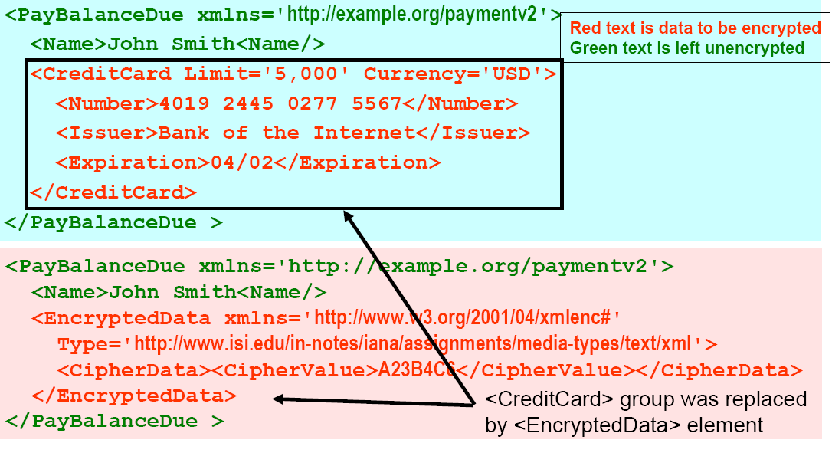
Security
Encryption Example: Only a part of the message encrypted

Slide 22
Security - Demo
With WS-Security
  Environment
    Server: Apache Tomcat 5.0 + Sun JWSDP 1.4
    Client: Microsoft .NET 1.1 + WSE 2.0
  Tests
    SOAP Message without security
    SOAP Message with XML Signature
    SOAP Message with XML Encryption
  Security is declared in WSE 2.0 using WS Policy

Slide 23
Security - Summary
How far does WS-Security take us today?
  It works, but…
    It takes a lot of detailed knowledge to get .NET and Java to interoperate over WS-Security
      Encryption algorithms
      Certificate protocols
      Certificate handling
    We need a WS-I “Security Profile”!
  No J2EE-spec support today
    Limited J2EE vendor support
Recommendation
  If HTTPS/SSL doesn’t meet your security requirements look into WS-Security before you start to develop your own digital signing and encryption…

Slide 24
BPEL
BPEL stands for Business Process Execution Language.
  It is used for composing multiple web services into process flows (orchestration).
  BPEL is a cornerstone of SOA (Service Oriented Architecture)
Service C
Service A
BPEL Process
Service B
Service D
Notes:
BPEL definierar en modell och en grammatik för att beskriva beteendet hos en affärsprocess baserat på växelverkan mellan processen och dess partners.
Växelverkan med varje partner sker genom Web Service gränssnitt och strukturen av sambandet vid gränssnittnivån är kapslat som en sk partner link

Slide 25
BPEL
A BPEL process is called from a client as a normal Web Service.
The process can by synchronous or asynchronous.
The process flow is described with XML
  The resulting flow file will be a BPEL WSDL file.
  BPEL tools provides graphical flow programming.
  Based on WSDL, XML Schema, XPath and WS-Adressing.
Notes:
BPEL baseras på WSDL 1.1, XML Schema 1.0, XPath 1.0 och WS-Addressing. WSDL har störst inverkan på BPEL då BPEL ligger som ett lager ovanpå service modellen som definieras av WSDL.
I hjärtat av BPEL processen finns är beskrivningen av peer-to-peer kommunikationen mellan tjänster beskrivna i WSDL, både processen och partners(partnerlink) modelleras som WSDL tjänster.
En BPEL process definierar hur man koordinerar påverkan mellan en process instans och dess partners.

Slide 26
BPEL – demo 1
Test external Web Service (.NET)
Create a new BPEL process
Call an external Web Service from our BPEL process
Test our new BPEL process
Show Process Flow

Slide 27
BPEL
Anatomy of a Web Service call
  Define a partnerlink
  Add an invoke
    Create variables
  Add two assigns
    Bind variables
  Define a scope

Slide 28
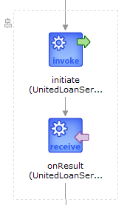
BPEL
An asynchronous call consists of one invoke and one receive activity.
Invoke will call the Web Service as before
Receive will get the callback from the service called in invoke.

Slide 29
BPEL
Other Language constructs
  Correlation Sets
  Fault Handlers
  Compensation Handlers
  Sequence, flow
  Switch, pick
  While
  Link
  ...

Slide 30
BPEL – demo 2
Second demo will show a more complex process flow.
This demo requires some manual interaction before the flow can complete.

Slide 31
BPEL - Demo
ad
start
1
User
Call Credit
Rating Service
Negative credit rating
Yes
Fault Handling
End
No
2
Call United Loan
Call Star Loan
Service
Service
(synchronously)
(asynchronously)
Clerk
Select Lowest
3
Offer
User
End

Slide 32
BPEL - Links
Specification
  http://www-128.ibm.com/developerworks/webservices/library/ws-bpel/index.html
Oracle
  http://www.oracle.com/technology/products/ias/bpel/index.html
IBM
  http://www-130.ibm.com/developerworks/webservices
Microsoft
  http://www.microsoft.com/biztalk

Slide 33
BPEL - Summary
Try it !
It is very easy to use from the beginning.
BUT ! Everything depends of the services that you wish to call.
If you dont have a consistent service architecture, BPEL won’t save your day!

Slide 34
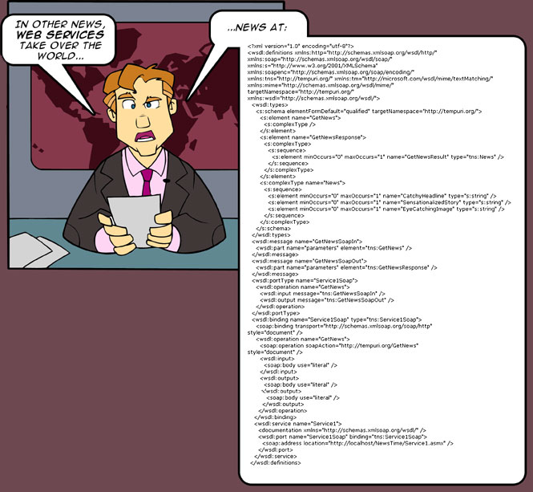
Questions?

Slide 35
EXTRA MATERIAL

Slide 36
Outline
Overview
Interoperability
  WS-I
  Demo
Security
  WS-Security
  Demo
Business Processes Orchestration
  BPEL
  Demo

Slide 37
Sammanfattning (Abstract)
The evolution of Web Services
Mognaden har ökat avsevärt sedan Web Services introducerades för några år sedan. Samtidigt som Web Services används flitigt runt om i olika projekt finns det fortfarande en mängd oklarheter inom området. En mängd specifikationer har framkommit för att lösa olika delproblem, vissa har blivit accepterade som standarder. Under denna presentation kommer vi att gå igenom några utvalda områden såsom interoperabilitet (WS-I), säkerhet (WS-Security), och affärsprocesser (BPEL). Vi kommer att sätta in dessa områden i sina sammanhang och samtidigt demonstrera användandet i ett exempelscenario.

Slide 38
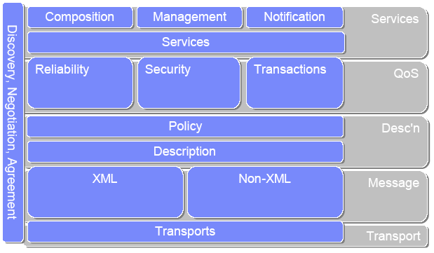
The Web Services Stack

Slide 39
Let’s us look closer at...
w
WS - I

Slide 40
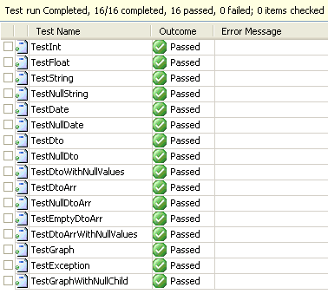
Interoperability - Demo
Unit Tests
Notes:
How to ensure and verify WS-I compliance?
Run some WS-I Tool that listen on the WS traffic?

Slide 41
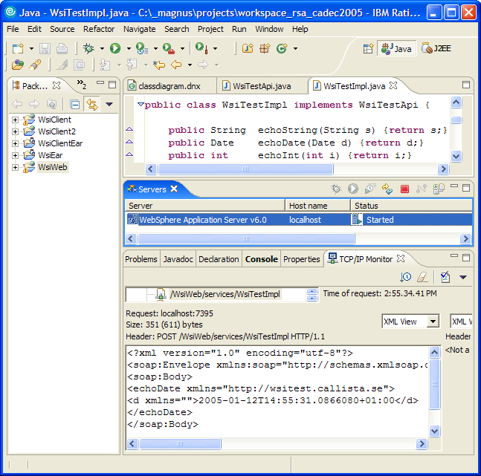
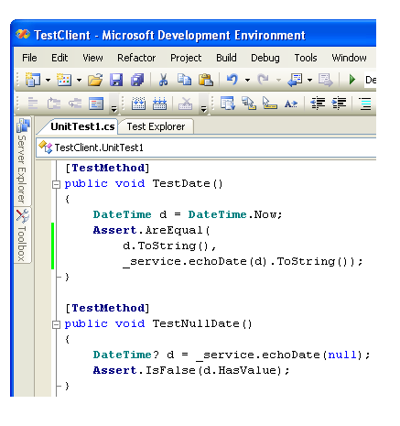
Interoperability - Demo
Some Code…

Slide 42
Security
What do we mean?
  Seven ISO Security Requirements
    Identification: who are you?
    Authentication: how do I know your identity is true?
    Authorization: are you allowed to perform this transaction?
    Integrity: is the data you sent the same as the data I received?
    Confidentiality: are we sure no one read the data you sent me?
    Auditing: record of all transactions so we can look for security problems after the fact
    Non-repudiation: both sender and receiver can provide legal proof to a third party (e.g. judge) that
      the sender did send the transaction, and
      the receiver received the identical transaction
Notes:
Id-information
Verifiering
Rättigheter
Information ej ändrad av extern part
Information skyddad för extern insyn
Granskning
Icke-förnekelse

Slide 43
Security
How does this apply to Web Services?
  A Web Service must be able to handle
    Identification
    Integrity
    Confidentiality
  A Web Service must be able to support
  (I.e. supplying the service implementation with authentication tokens)
    Authentication
    Authorization
    Auditing
    Non-repudiation
Notes:
Id-information
Verifiering
Rättigheter
Information ej ändrad av extern part
Information skyddad för extern insyn
Granskning
Icke-förnekelse

Slide 44
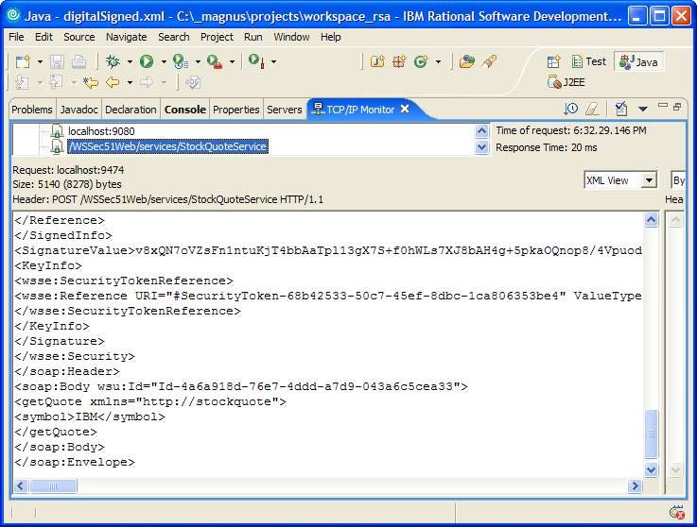
Security
Sample Digitally Signed SOAP message

Slide 45
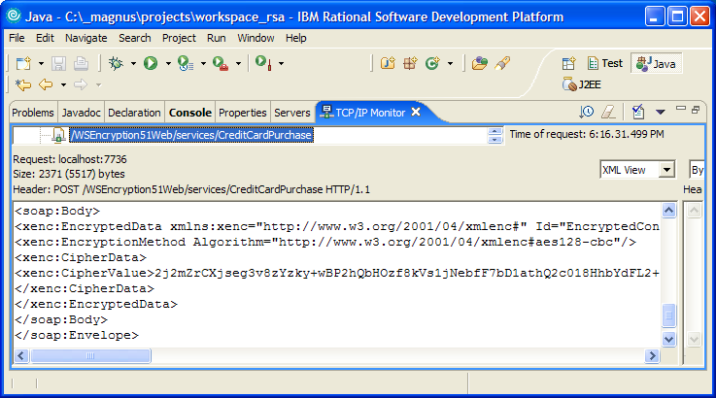
Security
Sample SOAP message with Encrypted body

Slide 46
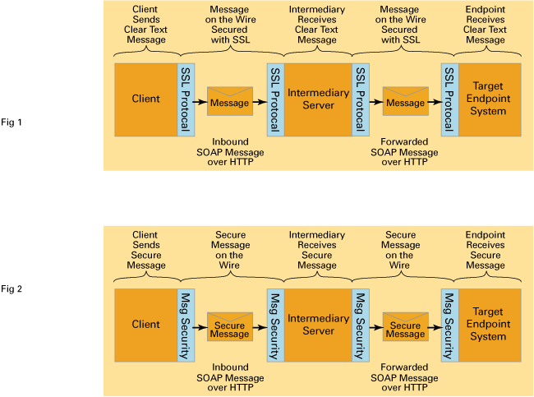
Security
Protocol level security
what if the second hop is not over HTTP?
(e.g. WebSphere MQ)
Application level security
- authentication tokens from the client reaches the target system!

Slide 47
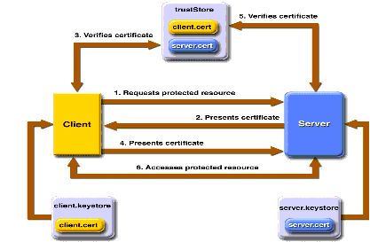
Security
Private/Public Keys and Certificates
  Similar infrastructure as for SSL/HTTPS
  Client, Server and CA

Slide 48
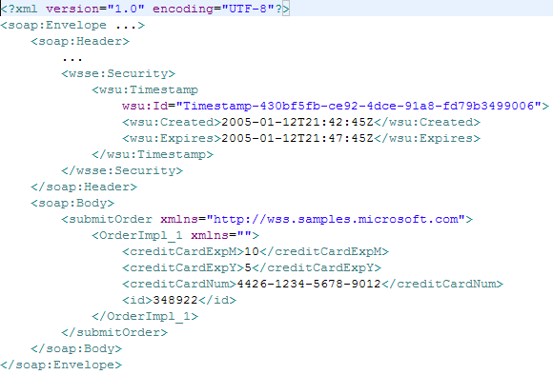
Security – Demo
SOAP Message without security
Nothing here!
Easy to read!

Slide 49
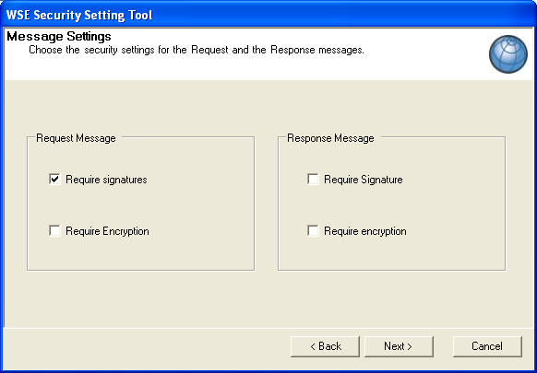
Security – Demo
SOAP Message with XML Signature

Slide 50
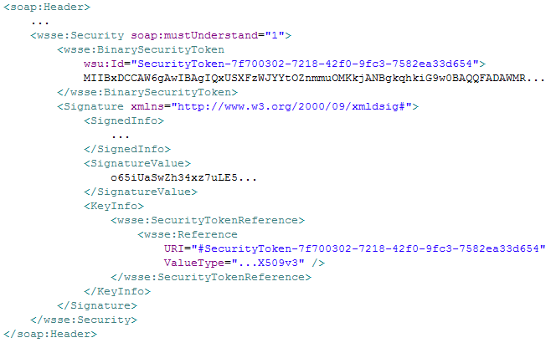
Security – Demo
SOAP Message with XML Signature
Our Digital
Signature!

Slide 51
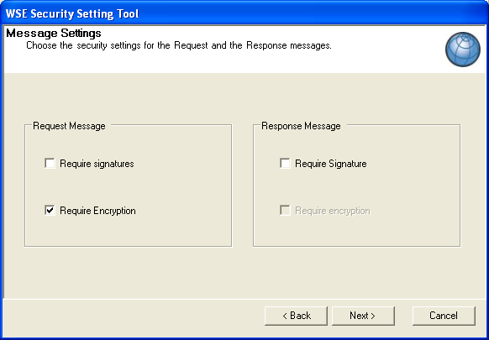
Security – Demo
SOAP Message with XML Encryption

Slide 52
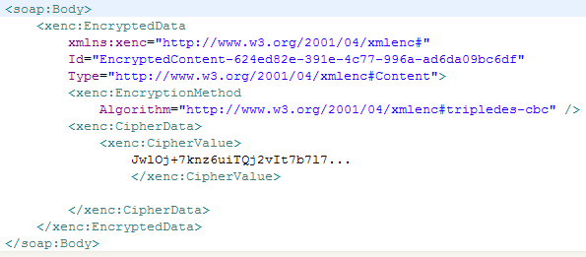
Security – Demo
SOAP Message with XML Encryption

