Slide 1
AJAX
The new hot technology for building Rich Internet Applications?
Mikael Hammarlund

Slide 2
What is AJAX?
AJAX = Asynchronous JavaScript and XML
JavaScript
  Document Object Model (DOM)
XMLHttpRequest object
  asynchronous
  encapsulated to handle browser differences
(X)HTML
CSS
Any language and platform on the server
Notes:
Coined by Jesse James Garrett of Adaptive Path, in an article Feb 18, 2005. Previously known as Dynamic HTML and remote scripting.
1998, Microsoft created XMLHttpRequest in IE 5. Other browsers have followed. Few used it or new about it, until Google presented Google Maps, GMail and Google Suggest.
Skillnad: hela sidan uppdateras inte med Ajax

Slide 3
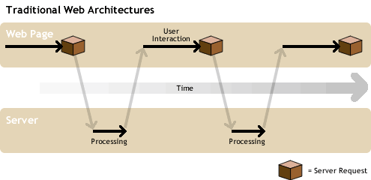
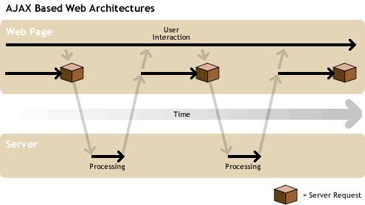
Traditional vs. AJAX Web Architectures
Web Page
Server
Web Page
Server

Slide 4
Demo
Rico Framework
  http://openrico.org
Demo
Response
Notes:
Enkel applikation som anropar en Struts action när man väljer ett nytt namn i listan.
Action klassen svarar med ett XML meddelande. Visa! Notera att man inte måste skicka XML.
Förtydliga på nästa slide

Slide 5
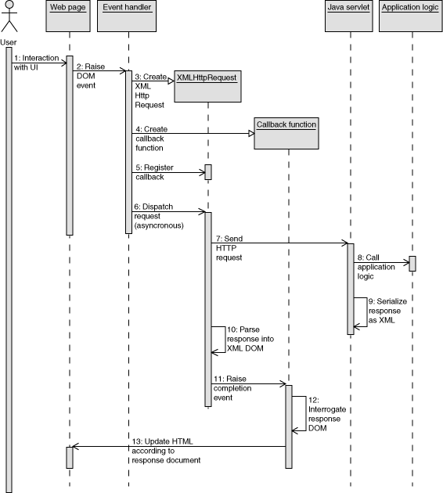
AJAX Sequence Diagram
Diagram from IBM
Notes:
Vad skickas till servern?
Vad kommer tillbaka?
Återkoppla till första exemplet

Slide 6
Frameworks and toolkits
Frameworks are under heavy development
A few examples:
  Client-tier frameworks
    Prototype http://prototype.conio.net/
    Dojo http://dojotoolkit.org/
  Server-tier frameworks and web frameworks with AJAX support
    DWR (Java) http://getahead.ltd.uk/dwr/
    AjaxTags (JSP) http://ajaxtags.sourceforge.net/
    AjaxAnywhere (JSP/JSF/Struts/…) http://ajaxanywhere.sourceforge.net/
    WebWork http://www.opensymphony.com/webwork/
    Tacos (Tapestry) http://tacos.sourceforge.net/
    Ruby on Rails http://www.rubyonrails.org/
Notes:
Frameworks/toolkits: erbjuder inkapsling, förenkling. Man behöver inte tänka på skillnaden mellan browsers – så länge allt funkar som det ska
Prototype: Ruby on Rails, OpenRico, Script.aculo.us (unit testing), Zimbra
DWR : Direct Web Remoting
AjaxTags: set of JSP tags; uses Prototype
AjaxAnywhere turns any set of existing JSP/JSF/Struts/Spring/etc.. components into AJAX-aware components without JavaScript coding
WebWork 2.2 Dojo, DWR, Struts Action Framework
Tacos: Tapestry, dojo

Slide 7
Weaknesses and Strengths
-
+
JavaScript
AJAX requires strong JavaScript coding competence
Browser differences
Back button, Bookmarks
More simultaneous TCP/IP connections required on the server
More complex interaction between client and server code
Improves the end-users experience and productivity
Low barrier to entry
No vendor lock-in
Can reduce bandwidth
Web sites can adopt it incrementally
Lots of frameworks and toolkits
Suitable for SOA business services
Notes:
JavaScript
Properties
Dynamically typed scripting language
Object based
Inefficient
Hard to debug
Source code visible
Writing an AJAX app needs nothing more than a text editor and a web browser, although a serious AJAX professional will probably want a whole array of debuggers, IDEs and DOM Inspectors up their sleeves too.
If you compare AJAX to, say, Java Web Start, then Web Start wins on sheer power and what you can do with it. But AJAX is good enough for most situations, and it's ready to run on most people's computers without installing any client software.
Venkman, Microsoft Script Debugger
DOM Inspectors
HTTP sniffers

Slide 8
Summary
AJAX is a new name for a way of using technologies that have been around for a few years
AJAX has become extremely popular in a short time
  increases user experience
  easy to get started
Lots of frameworks and toolkits under development
  knowledge is shared
JavaScript competence is essential
To early to tell to what extreme AJAX can be used

