Slide 1

Catching the Web Flow
Have you got the Flow?
Björn Beskow

Slide 2

The Problem
Web Development is still messy
  Request-centric, low-level
  Difficult to express overall structure
  “Application transactions” that spans several steps are particularly difficult
  Browser issues a pain
  Reuse is a pain

Slide 3
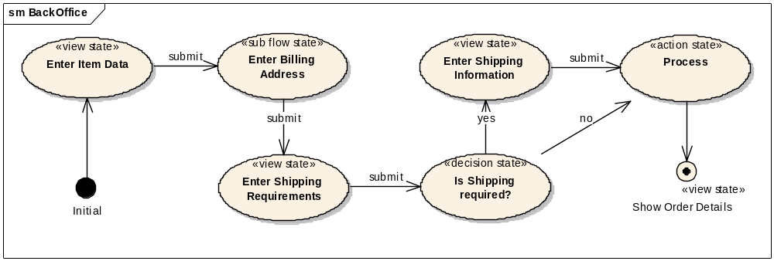
The “BackOffice” Flow Definition
Notes:
Visa demo!

Slide 4

Current, Struts-based approach
/step1.do
storeForm
HTTP
Session
page1
Controller 1
/step2.do
updateForm
page2
Controller 2
Business
Service
/lastStep.do
processTx
confirmationPage
Controller 3

Slide 5

Consequences
Many lines of custom code are written to capture the interaction
As an application grows more complex maintainability breaks down
Fundamentally, a key abstraction is missing: the Flow
A Flow is typically longer than a single request but shorter than a session, i.e. a conversation

Slide 6
Spring Web Flow
Spring sub-project founded in 2005, based on Ervacon Web Flows
Adds the missing abstraction: The Flow

Slide 7
Spring WebFlow approach
start “backOffice”
firstPage
store
Flow
Execution
Storage
submit
nextPage
load
submit
confirmationPage
“BackOffice”
FlowExecution

Slide 8
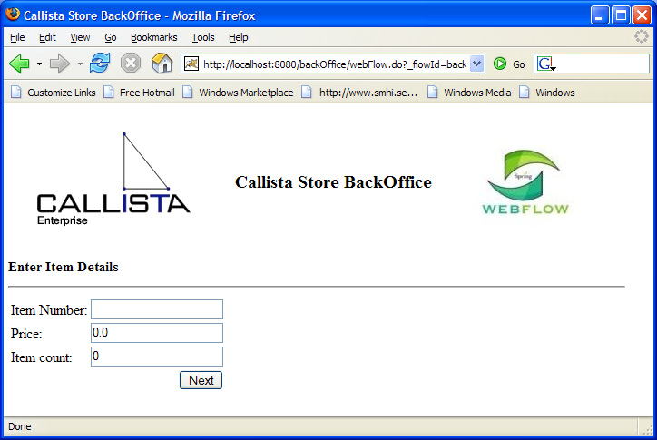
Demo
Notes:
Applikationen
Flow-definition
Flow-editor
Spring config
FlowAction
Struts config
JSP sida
Enhets-test
Sub Flows

Slide 9

Advantages
The logical flow is clearly defined, readable
Navigation rules are encapsulated in one place
Navigation is strictly enforced
State management is automatic
Controller logic is clearly decoupled from command logic
HTTP independent
No dependency on any request URLs

Slide 10

Integration with Web frameworks
Integrating into other environments
  Create a specialized FlowController for that environment
    The FlowAction for Struts
    The FlowNavigationHandler for JSF
    The PortletFlowController for Portlets
Spring Web Flow is not tightly coupled with any web framework

Slide 11
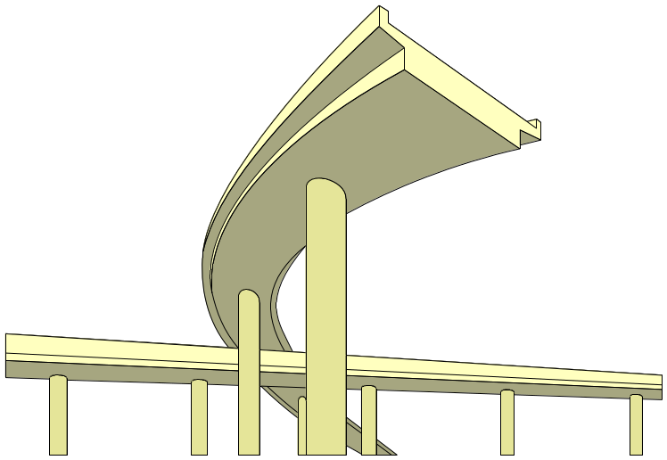
Spring WebFlow Road Map
First official release for production use scheduled for Q1 2006
Version 1.x enhancements
  Tighter JSF integration
  JMX-enabled flow management
  Ajax support (Asynchronous View State Actions)
www.springframework.org

Slide 12

Time for Questions!

