Slide 1
Dependency Injection in Action
Jan Västernäs

Slide 2

Agenda (DI=Dependency Injection)
Background
What is DI ?
What is the DI value promise ?
Experiences
  Using Spring DI container
Does DI live up to the promise ?
Future & Others

Slide 3
Background
Using spring framework for one year
Limited by policy to some parts only
Large industrial project
My role : Application architect
Architecture & method team
Mix of very experienced developers and new-to-java developers

Slide 4
Spring usage
Dependency Injection
  480 spring beans
  680 SQL statements as beans/properties
JDBC support
  JDBC Template
  Exception Hierarchy
JMS Support
  JMS Template
Using ”factory beans” to intercept calls for
  Out-of-container transaction/connection support
  Declarative transaction demarcation
Test classes

Slide 5
What is Dependency Injection ?
Dont call us - we’ll call you
Referenced object are declared
References are injected into an object
  By calling setter method
Need some kind of runtime support ( DI container )
Enables call interceptors to be used
Opposite of ”Dependency Lookup”

Slide 6
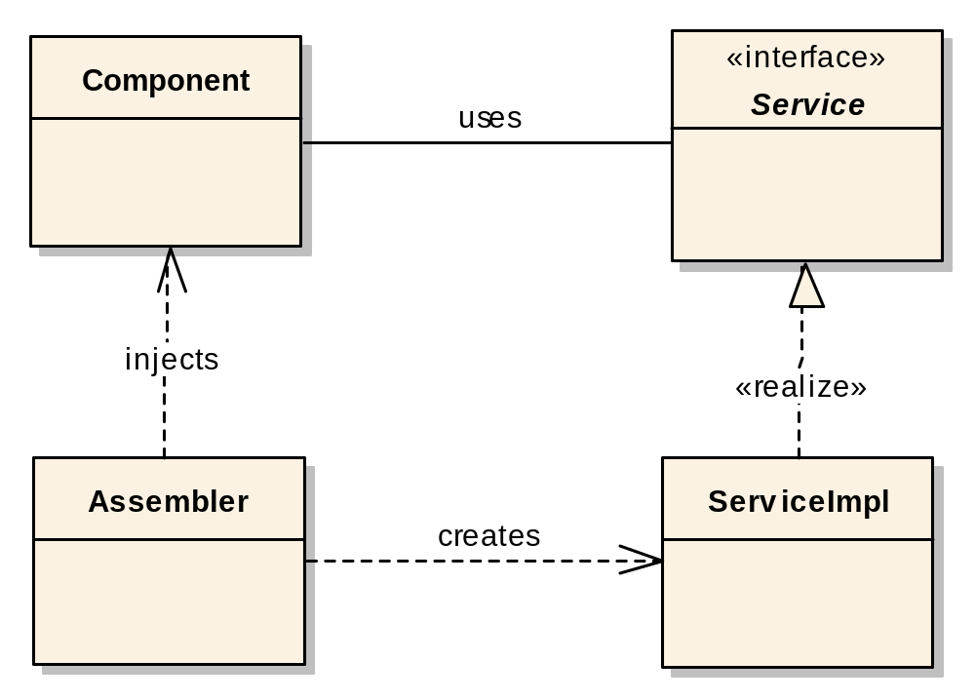
Dependency Injection
public void setDao(CustomerDao dao) {
this.dao = dao;
}
Notes:
Och det är här Springs konfigurationsramverk kommer in i bilden.
Spring är ett s.k. Lättviktsramverk som använder sig av Dependency Injection. Inversion of Control är ett annat begrepp som används. Det innebär att du överlåter ansvaret till din Container att fylla i beroenden mellan komponenterna. Komponenten behöver inte begära att få en tjänst.
Med ett s.k. Dependency Injection ramverk så är du inte beroende av din klasser är beroende av ett ramverk och därmed kan det köra i vilken container som helst.
Assembler = Spring Bean Container, konfigurera och hanterar komponenter.

Slide 7
What is the DI value promise ?
No energy waisted nor code needed to find other objects
  No JNDI, singletons, factories etc
Unit Test easier by mocking dependencies
  May even make it possible without workarounds !
Non-intrusive
  In our project : Business code independant/unaware of technical infrastructure (including DI container).
”Lighter” than EJB

Slide 8
Experiences
Typical scenario
Setup
Configuration
Bootstrapping
Namespaces
Programming model
Integration
Test
Interceptors

Slide 9
Typical scenario
Layered architecture
Thin clients – request/response
J2EE
Web-apps
EJB module only for MessageDriven EJB:s
JDBC - generated and handwritten

Slide 10
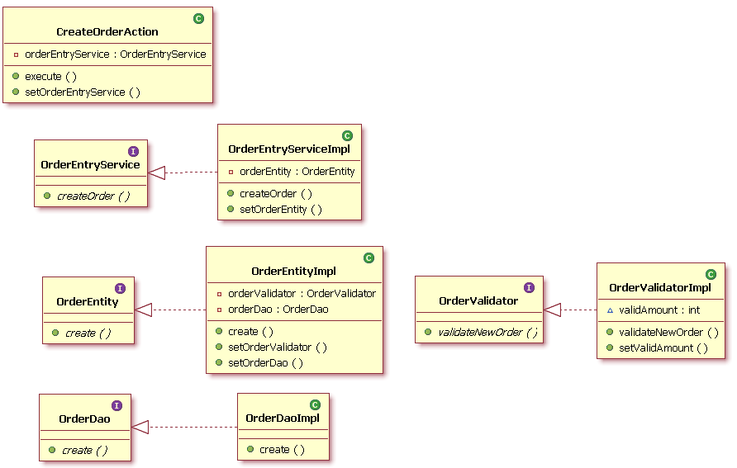

Slide 11
Spring setup
1 hour to get started with basic DI container functionality

Slide 12
Spring DI Configuration
Overhead writing Xml config is acceptable
  Use classnames as bean id and reference name
  Copy-paste - nobrainer
<bean id="orderEntryService" class="se.cadec.impl.OrderEntryServiceImpl">
<property name="orderEntity" ref="orderEntity"/>
</bean>
<bean id="orderEntity" class="se.cadec.impl.OrderEntityImpl">
<property name="orderDao" ref="orderDao"/>
<property name="orderValidator" ref="orderValidator"/>
</bean>
private OrderEntity orderEntity;
public void setOrderEntity(OrderEntity orderEntity) {
this.orderEntity = orderEntity;

Slide 13
Spring DI Configuration
Debugging configuration errors is OK
Plugin helps
org.springframework.beans.NotWritablePropertyException: Invalid property 'dao' of bean class [se.cadec.impl.OrderEntityImpl]: Bean property 'dao' is not writable or has an invalid setter method: Does the parameter type of the setter match the return type of the getter?

Slide 14
Bootstrapping – modularization
Ear
  Web module
    Bootstrapping servlet
    spring-config.xml
  Xxx.jar
    spring-config.xml
  Yyy.jar
    spring-config.xml
      spring-config1.xml
      spring-config2.xml
  Zzz.jar
    spring-config.xml

Slide 15
Solution – Custom Bootstrapping
A help class that finds all spring configuration files on the classpath following a naming convention
The bootstrapping servlet calls this help class
Each file has references to the actual files used in that jar/war with the import function

Slide 16
No namespace support
All configuration in one file – no problem
Each module has its own configuration file – may cause collisions
Solution
  componentname:beanname
  <bean id=“ordercomponent:orderEntryService”

Slide 17
HiveMind solution is better
Unlike Spring, HiveMind has built-in namespace support, and fundamentally assumes that the graph of related services will be built from multiple locations (that is, each JAR on the classpath will be packaged with its own XML descriptor).
Howard Lewis Ship, the creator of HiveMind and Tapestry explains why tapestry does not use Spring.

Slide 18
Programming model
Which objects should be injected ?
What are the alternatives ?
  new
  static
  Factory
  JNDI
“Stateless Session” Bean obvious, Works very well with stateless singleton-style service-oriented beans.
Data Transfer Objects:s - never
In the middle – try to singletonize
One consistent way makes it easier

Slide 19
Programming model 2
Static methods
  Can not be injected with bean
  Can not be mocked
new
  Can not be injected with beans
  Can not be mocked

Slide 20
Programming model 3
private void doIt() {
MyStatefulObject myobj = getANewMyStatefulObject();
myobj.init(thisandthat, somethingelse);
myobj.doSomething();
myobj.saveResult();
}
private MyStatefulObject getANewMyStatefulObject() {
return null;
}

Slide 21
Get new instance on each call
Method Injection (Lookup method).
Uses bytecode modification
We did not use this
Solution was to design service-style instead and use singleton beans
Non-singleton beans has been used rarely

Slide 22
Integration
The DI container must create all beans
Other objects can not have injected references

Slide 23
Struts Integration
DelegatingTilesRequestProcessor
One tag in struts config
A spring configuration file listing all actions
  Action-mapping to bean
Works well

Slide 24
Message Driven Beans
EJB:s that is activated by incoming JMS messages
Generic MDB class that
  Gets the bean id from JNDI
  Gets the bean instance by calling the spring applicationContext
  Return to Dependency Lookup
MDB bean can be injected with references

Slide 25
Succesfull usage
Action, service, entity, dao, helpers, utilities
  Everything is injected
Properties like
  SQL
  Config parameters
Current time
Map
Inheritance
JNDI to find datasource
Reuse action class with parameters

Slide 26
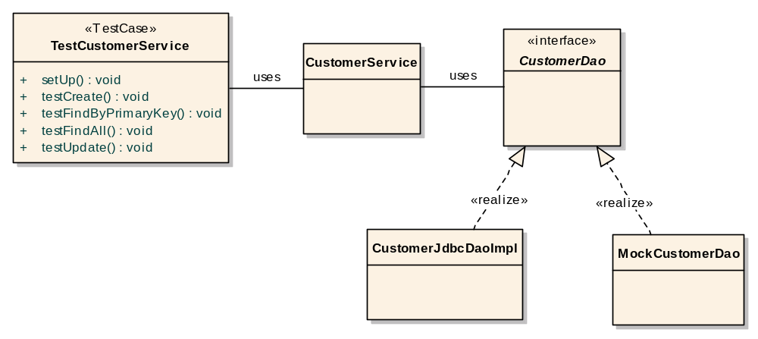
Testability – Unit test
<<creates>>
<<injects>>
<<creates>>
Notes:
Björn

Slide 27
Unit Test
new to create implemention class
”inject” mock objects for dependencies
  By calling setters
Dont neew the full environment
Creating exceptional conditions easy
Unit Testing and mocking is not trivial
  Which test to write ?
  Create a lot of dto:s
  Some classes are ”perfect” for testing – some not
DI makes it less painful

Slide 28
Integration Test
Including
  DI container
  Config xml files
  All dependencies as real classes
  Database etc
Get Class to test from DI container
  beanFactory.getBean(”beanName”)
  Introduces a binding to Spring
  Return to Dependency Lookup

Slide 29
Interceptor usage
DI enables interceptors out of the box
  Requires own ”bean”-factory in non-DI setup
Typically NOT application development
  More complex requirements
  Insert a proxy betwen the calling and called object
Sample
  Out-of-container transaction/connection support
  Declarative transaction demarcation
Implemented by using spring Factory Bean concept & explicit proxy class definition

Slide 30
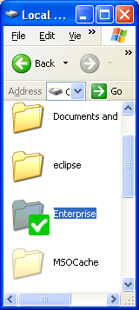
What about the promises ?
No energy waisted to find objects
  xml format is simple
Unit Test easier by mocking dependencies
  YES !
Non-intrusive
  DI invisible in beans
  struts/junit etc integration not easy to replace
”Lighter” than EJB
  Absolutely

Slide 31
Future & Others

Slide 32
Spring vs EJB3
EJB3 has dependency injection
EJB:s are POJOs
Non-EJB classes can NOT be injected
  Except resurces and other JNDI items
  Many of our beans must be made EJB:s
Injection into struts action classes ?
In our case – 250 local EJB:s
How does a appserver handle 250 EJB:s ?
  Websphere ? JBoss/Geronimo/Glassfish etc ?
  A appserver must be able to deliver services for an EJB, can it ever be as light-weight ?

Slide 33
Migration between Spring – EJB3
Least common denominator
  No annotations
  Setter injection
  Everything in xml
  Production code platform independent

Slide 34
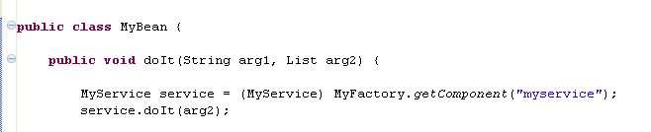
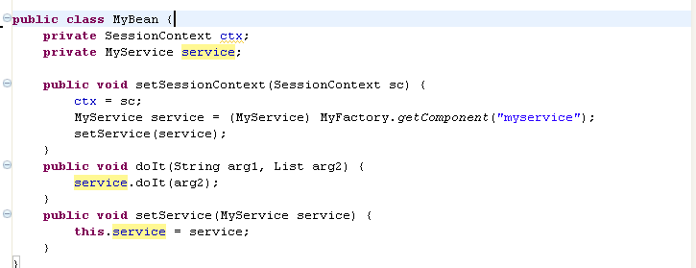
EJB2 -> Spring/EJB3

Slide 35
Spring 2.0
Message-driven POJO:s
Enhanced xml configuration
AOP, AspectJ integration
Others ....
Are we moving away from ”simple” ??

Slide 36
DI future
Dependency Injection as a concept is here to stay
John Rodson “J2EE without DI”
  A title we will probably not see
Why bother about simplicity ? We are all professionals right ?

Slide 37
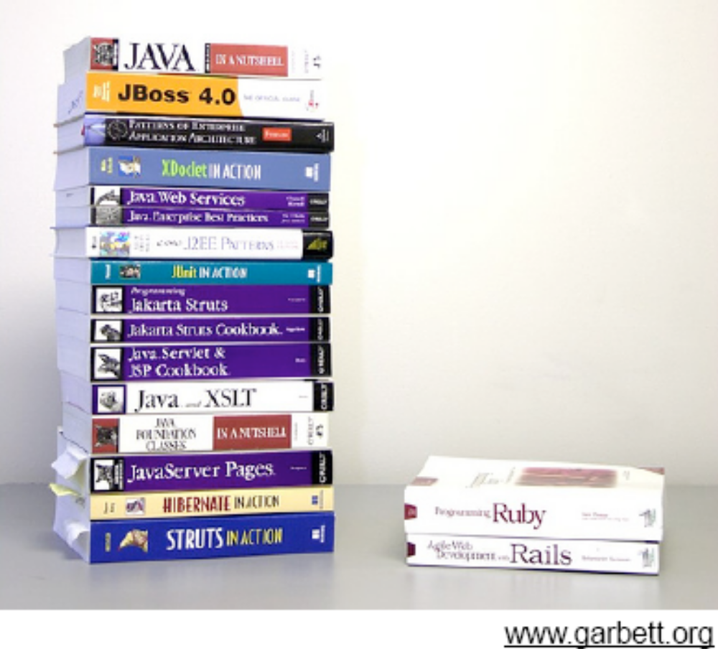
Is Java too complicated ?

Slide 38
Ruby sample syntax
# Check for pre-formatted string given
check=Regexp.new('^'+Regexp.escape
(format).gsub(/\\#/,'.')+'$')
return string if string =~ check

Slide 39

Time for Questions!

