Slide 1
JavaPolis 2005
Mats Ekhammar

Slide 2

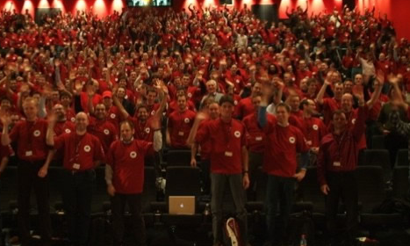
JAVAPOLIS 2005
The European Java Climax of the Year!
Antwerpen
Belgien

Slide 3
What is it?
Largest Java gathering in Europe!
Arranged by Belgian Java User Group (BeJUG) since 2002.
Cheap! 300 Euro
2300 attendes this year
Held in a cinema complex!
5 days – University, Conference

Slide 4
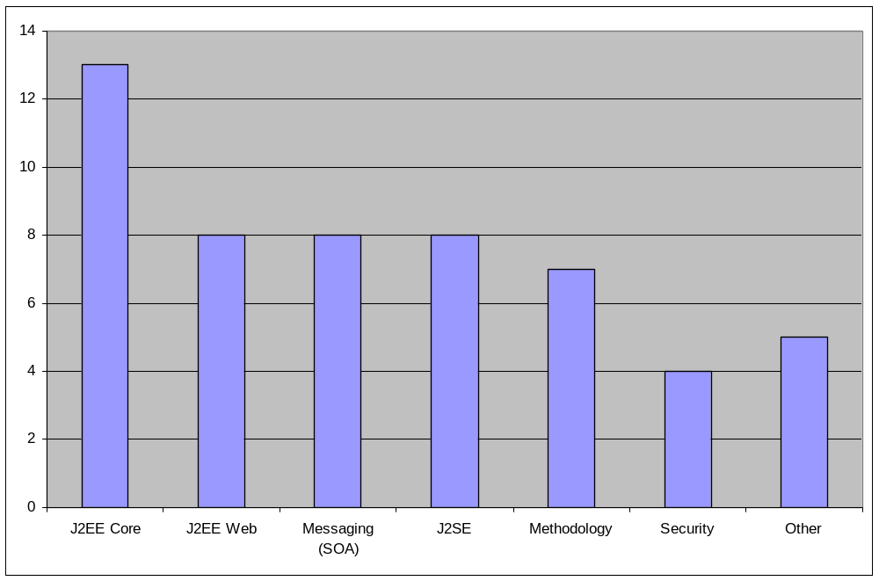
Topics Overview

Slide 5
Interesting Topics!
Java EE 5
GlassFish
JSF/Ajax
Shale
Mule
Maven
Spring
See: http://wiki.javapolis.com/confluence/display/JP05/Home

Slide 6
Java Puzzle
public class AnimalFarm {
public static void main(String[] args) {
final String pig = "length: 10";
final String dog = "length: " + pig.length();
System.out.println("Animals are equal:" + pig == dog);
}
}
What does it print?
Animals are equal: true
Animals are equal: false
None of the above

Slide 7
Java Puzzle
The + operator binds tighter than ==
  System.out.println("Animals are equal: " + pig == dog);
will be interpreted as
  System.out.println( ("Animals are equal: " + pig) == dog);
Prints: false

Slide 8
Java EE 5
Java EE 5 Major Features
  • Significant Ease of Development Enhancements
  • New POJO-based Java Persistence API
  • Simplified Web services support
  • Greatly simplified EJB development
  • Drag and drop Web application development with JavaServer Faces

Slide 9
Glassfish
Open Source Development Project that builds a Java EE 5 app server (Sun, Oracle + community)
Based on code from
  Sun Java System Application Server PE 8 (J2EE 1.4)
  Toplink persistence from Oracle
When released
  Sun Java System Application Server PE 9.0
  Java EE 5 SDK
Sun Application stack
  Platform Edition -> Standard Edition -> Enterprise Edition
  (compare IBM’s Geronimo -> WebSphere Application Server ... )
Source code: http://glassfish.dev.java.net
Samples: https://blueprints.dev.java.net/

Slide 10
JSF 1.2
JavaServer™ Faces (JSF) 1.2
  A server side user interface (UI) component framework for web applications.
  Not quite a new feature release but more then a maintenace release.
  Unified JSF and JSP expression language
  XML Schema instead of DTD
  See: http://www.jcp.org/en/jsr/detail?id=252
Development Tools
  Sun Java Studio Creator
  Sun Java Studio Enterprise

Slide 11
Struts Project
The Apache Struts project is comprised of two distinct frameworks:
The Struts Action Framework, the original request-based framework
The Struts Shale Framework, the component-based framework based on JavaServer Faces.

Slide 12
Shale
Major Features
  View Controller, 1:1 relationship between JSP page and JavaBean class (backing bean)
  Dialog Manager, heavily inspired by Spring Webflow
  Application Manager, application level controller
  Spring Integration
  Reusable Views
  Test Framework
See: http://struts.apache.org/struts-shale/index.html

Slide 13
SOA
Much talk about SOA like
  JBI
  WS-BPEL 2.0
  Pragmatic SOA
  ESB
  SOA blueprints
  ...
But the best show of actual doing something in the SOA area was a MULE demonstration!

Slide 14
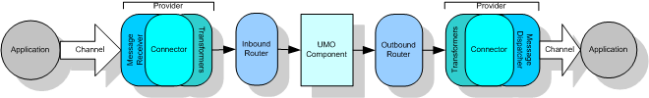
MULE
Mule's ultimate goal is to provide a unified method of interacting with data from disparate sources without encumbering the developer with the details about how the data is sent or received or the protocols involved.
UMO component is your client code that actually does something with the events received.
Mule makes Enterprise level service architectures possible for smaller projects.
See: http://mule.codehaus.org

Slide 15
Maven 2.0
Maven is really a process of applying patterns to a build infrastructure in order to provide a coherent view of software projects.
Faster and smaller - Core no longer uses Ant, Jelly or Xerces.
Defined build lifecycle – Well defined phases.
Built-in multiple project handling
No more properties files - All configured from pom.xml.
No more maven.xml - Plugins easier to build and integrate, and the only way to script your builds.
No more Jelly - Plugins are primarily written in Java.
See: http://maven.apache.org

Slide 16
Spring 2.0
XML Configuration enhancements
  <bean id="dataSource" class="...JndiObjectFactoryBean">
  <property name="jndiName" value="jdbc/StockData"/></bean>
  becomes
<jndi:lookup id="dataSource" jndiName="jdbc/StockData"/>
AOP enhancements
  Closer AspectJ integration
Scoped Beans
  Transparent scoping for Spring beans
Message-driven POJOs
    “Closes off one of the remaining corner cases
    justifying EJB usage”
See: http://www.springframework.org

Slide 17
JavaPolis Summary
Delivers normal conference output.
OK mix of speakers.
All major Java topics are addressed.
There are still some ”aha moments” out there!
Cheap conference fee and easy travelling.
Notes:
Attend!

