Slide 1
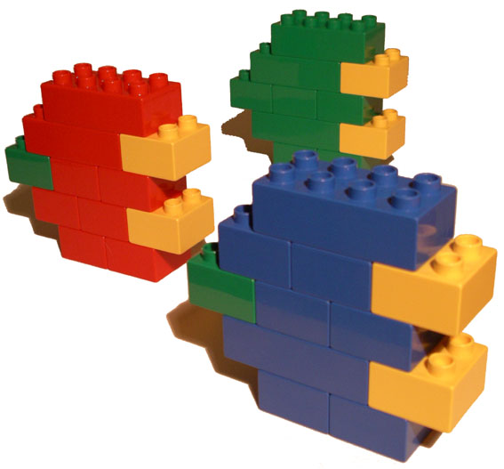
Service Component Architecture
“A reference architecture for SOA”
Cadec 2006
Håkan Dahl, Johan Eltes

Slide 2
Agenda
The evolution of SOA infrastructure
  from SOAP to ESB
Service Component Architecture (SCA)
  Takes SOA from infrastructure to service modelling
SCA in practice
  Large-scale SOA within manufacturing
Tooling
  Demo of high-end SCA tooling (WebSphere Integration Developer)
Standardization
  Status of SCA standardization efforts
Conclusions
  Lego re-use and composition has finally arrived!
Notes:
SOA är en förkortning florerar i så vitt skilda sammanhang som IT-strategier för “the agile enterprise” och XML-baserad client/server.

Slide 3
The Evolution of SOA infrastructure
Dry and boring:
Definition of a SOA and Service…
SOA is an architectural style of loose coupling among interacting software agents
…which requires…
  A small set of simple and ubiquitous interfaces to all participating software agents.
    The interfaces should be universally available for all providers and consumers.
  Descriptive messages constrained by an extensible schema delivered through the interfaces
    An extensible schema allows new versions of services to be introduced without breaking existing services

Slide 4
The Evolution of SOA infrastructure
2001: SOA is distributed computing…
Distributed computing…
Complexity
Too complex
Ideal
Over-simplified
Time
3270 screenscraping
APPC
ODBC
CORBA
SOAP
2005

Slide 5
The Evolution of SOA infrastructure
2001: SOAP (Simple Object Access Protocol) - The Holy Grail
Describe
Distribute
XML
C/S
SOAP
Web
EAI
Access
Orchestrate

Slide 6
The Evolution of SOA infrastructure
2005: Web Services - Not so simple any more
Distributed computing…
Complexity
Web Services
Too complex
Specmania....
SOAP +
WS-Security,
WS transaction,
WS-Authenication,
WS-Atachment,
WSRP,
WS-Addressing etc.
Ideal
Over-simplified
Time
3270 screenscraping
APPC
ODBC
CORBA
SOAP
2005

Slide 7
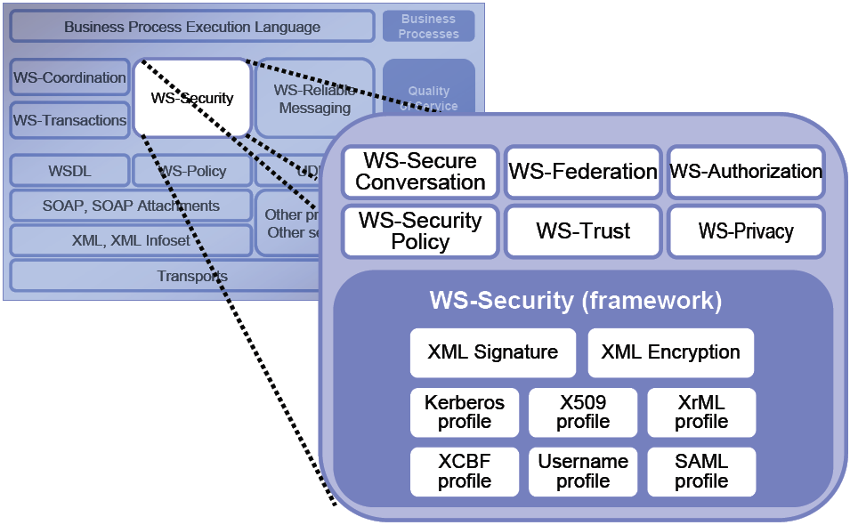
The Evolution of SOA infrastructure
2005: Web Services - Not so simple any more…

Slide 8
The Evolution of SOA infrastructure
SOA on WebServices - Were would it take us?
SOA
Process
Process
A
A
A
Domain
Domain
S
s
s
s
s
s

Slide 9
The Evolution of SOA infrastructure
The Enterprise Service Bus:
SOA has learned from EAI (hub, mix of new and legacy protocols)
S
A
S
S
A
Enterprise Service Bus
Color = Message Format (different XML schemas, legacy formats…)
Shape = Protocol (FTP, JMS, Native MQSeries, SOAP…)

Slide 10
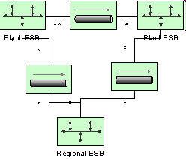
The Evolution of SOA infrastructure
EAI Message Broker = Central Infrastructure
ESB Architecture = Distributed infrastructure

Slide 11
The Evolution of SOA infrastructure
ESB: Everything is a service - business functionality, formatting services, process orchestration…
Application function
Message mapper
FTP poller
SAP adapter
BPEL engine
S
S
S
S
S
Enterprise Service Bus

Slide 12
The Evolution of SOA infrastructure
Service characteristics
A service participates in a message exchange
  A service consumes ONE message and may return ONE message
  A service exports its functionality on a protocol
    Not necessarily networked
A service is identified by a infrastructure-dependent endpoint URI
  With WSDL, A method name is part of the URI
  With queuing, the queue and eventually a message selector is the endpoint
A service MAY be aware of quality-of-service contracts
  Transaction scope
  Security

Slide 13
The Evolution of SOA infrastructure
So, how does the new world of SOA look?
Application development and integration are two aspects of the same thing
  They depends on the same infrastructure
  The ESB infrastructure is a container for applications (as services) and integration glue (as services)
The ESB infrastructure supports transparent, distributed deployment
  Application services can execute anywhere
  Integration glue services can execute anywhere
Same tooling for application development and integration glue
  Some integration glue requires full-scale Java development
  Some application services are best realized through code generation from process models (e.g. BPEL)

Slide 14
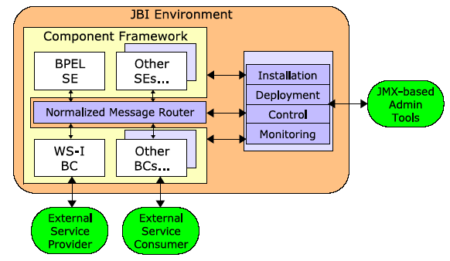
The Evolution of SOA infrastructure
ESB standardization
JBI - Java Business Integration
JBI defines a container for service implementation containers and protocol bindings
May replace J2EE as SOA infrastructure standard
Limited support - All vendors implement an ESB, but differently

Slide 15
The Evolution of SOA infrastructure
ESB - what are we missing?
S
S
S
S
S
Enterprise Service Bus
Decommissioning of middleware
Interoperate with new services through new protocols

Slide 16
The Evolution of SOA infrastructure
The ESB is here. Where does that leave us?
Plumbing, plumbing, plumbing…
  We have tooling and concepts to get interoperability across existing platforms and systems
  We know the platform and infrastructure landscape will continue to change
What would the next step be?
  To model, develop and compose services independent of SOA infrastructure
  What does it take to make the vision of “software Lego” become a reality?

Slide 17
>Service Component Architecture (SCA)
The evolution of SOA infrastructure
  from SOAP to ESB
Service Component Architecture (SCA)
  Takes SOA from infrastructure to service modelling
SCA in practice
  Large-scale SOA within manufacturing
Tooling
  Demo of high-end SCA tooling (WebSphere Integration Developer)
Standardization
  Status of SCA standardization efforts
Conclusions
  Lego re-use and composition has finally arrived!

Slide 18
Service Component Architecture (SCA)
SCA is a reference architecture for building a SOA, covering new development and integrating existing applications
Architectural style of recursive composition of services out of services into a SOA (-system)
…without building any assumptions of protocols or deployment topology into the service implementations
Dependency Injection is the implied mechanism for bridging the gap between SCA services and SOA infrastructure

Slide 19
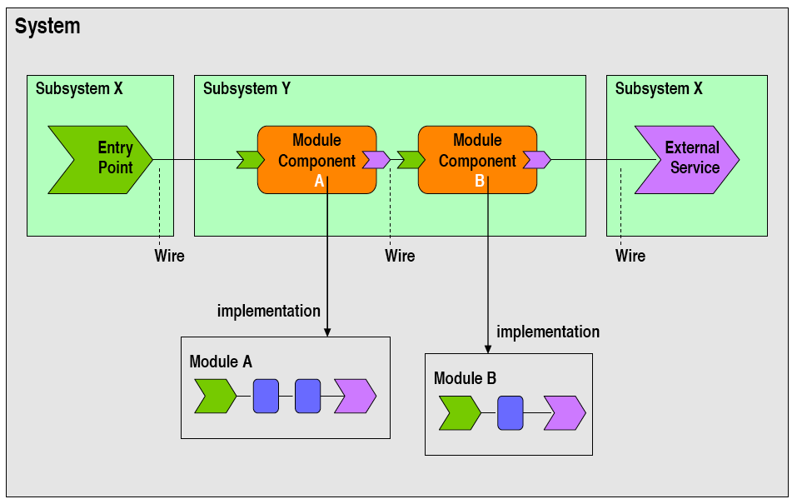
SCA Core concepts
Interface
reference

Slide 20
> SCA in practice
The evolution of SOA infrastructure
  from SOAP to ESB
Service Component Architecture (SCA)
  Takes SOA from infrastructure to service modelling
SCA in practice
  Large-scale SOA within manufacturing
Tooling
  Demo of high-end SCA tooling (WebSphere Integration Developer)
Standardization
  Status of SCA standardization efforts
Conclusions
  Lego re-use and composition has finally arrived

Slide 21
Large-scale SCA within automotive
Mission
  Replace a large number of plant-specific systems (20 plants) with a common (global) portfolio of systems
Business case
  Disarm the legacy bomb
  Reduce cost of maintenance and operations
  Improve business agility and business process support
Business areas
  Part manufacturing
  Vehicle Assembly
System domains
  Material ordering
  Quality control
  Material Distribution
  Customer order slotting
  Production control
  Production planning
  Device communication
Integration of Packaged
Solutions
New development

Slide 22
Architectural non-functional goals
Minimize impact on plant operations
Avoid redundant implementation of business logic
SOA without trading performance
Investment in business logic must sustain 20 years of technology evolution
Quality (automated server-side build, test, integration, deploy)
Support light-weight (low-cost) deployment (20 plants)
  Support deployment virtualization (run multiple plants in a single deployment)

Slide 23
Minimize impact on plant operations
The system architecture need to be comprised of small,
asynchronously integrated services. Only services that depends on a new feature should need to be stopped and re-installed. Xml schema upgrades must be possible without upgrading every consumer and provider of a service built on previous version of a schema.
SCA contributions
  Support for asynchronous service invocations (business events)
  Separation of service implementation and service modules
  Mediation service module may be introduced to resolve versioning issues
Gaps
  Versioning strategy for backwards / forwards compatibility of XML schemas / service interfaces.
  Binary versioning of service modules
    Dependency management of versioned modules
Notes:
SCA Contributions:
-------------------------
The separation of service components from modules / deployments allows service components to be re-used “in process” in multiple service modules. Only service modules that depend on the new version need to be re-built / re-deployed.
Gaps
--------
Project needs to define schema versioning startegy, that works well with selected binding technology (SDO or JAXB)

Slide 24
Avoid redundant implementation of business logic
Each piece of business logic should only be coded once.
SCA contribution
  Remote / service deployment not required for re-use
  A component can be wired into multiple modules
  A module can be wired into multiple subsystems
Gaps
  None identified

Slide 25
SOA without trading performance
The goals of a SOA need to be achieved without depending on networked deployment of individual services.
SCA contribution
  Dependency injection allows service modules to be deployed “in process” within each consuming subsystem, instead of independent networked agents.
Gaps
  None identified

Slide 26
Investment in business logic should sustain 20 years of technology evolution
Protocols, technologies, middleware has and will change over time. Minimal platform footprint: J2SE (->Java SE). Unlike .Net, J2SE has a proven track record of platform stability (backwards compatibility). Not a guarantee, but we need some platform.
SCA contribution
  Infrastructure abstractions through Dependency injection
  Standard simplifies container/vendor migration
  SCA itself *can* have zero footprint in business logic
Gaps
  SCA introduces APIs that may be tempting to use, which creates binding to SCA itself

Slide 27
Quality
Upgrade deployment in with minimal impact on shop floor activities. High quality essential. Even with global maintenance team (change code you didn’t code your self)
SCA contribution
  Dependency injection makes component-, module- and subsystem test scripting efficient
  Lightweight infrastructure can be “injected” to minimize time for running tests (1000:ths of tests are run for each build)
Gaps
  Excuses need to be sought elsewhere…

Slide 28
Applied SCA best-practice
Corporate module repository
Business modules internally structured / wired in layers
Modules within a subsystem are wired at build-time
Subsystems (SOA services) within an SCA system are wired at- or after deploy-time via a system-internal ESB mediator
SCA systems are wired at- or after deploy time by connecting system-internal ESB:s
Integration object model (“business objects) represented as XML schemas, re-used in multiple WSDL files through “import”

Slide 29
Module repository
Corporate repository of versioned modules (jar files)
  Unit of re-use and version base-lining
Three types of modules:
  Business modules, binding modules and schema modules
Business modules
  Business logic
  Jar files with spring config files
Binding modules
  Protocol binding (WS, JMS etc), data binding (message payload -> java classes) and service activation (invoke referenced services in various business modules)
  WAR archives (for WS binding) and EJB-JAR archives (MDB:s for JMS binding)
Schema modules
  XML Schemas defining business objects
  Generated binding classes (we use JAXB - not SDO)
  (WID: “Library module”)

Slide 30
Module Repository example
The Maven build system is used to manage a repository of versioned binary modules including runtime dependencies between modules
Module names are unique across the business
production_object_svc-2.1.0.jar
production_object_ws-2.1.0.war
production_object_svc-1.5.2.jar
plantstructure_svc-1.0.1.jar
process_equipment_event_svc-3.0.0.jar
process_equipment_event_mdb-1.0.0.jar
equipment_event_schema-1.1.0.jar
Business module
binding module
schema module

Slide 31
Business module composition
(Layered model)
A business
module
services
Dependency injection (wiring) is conducted by the Spring framework.
Simplified migration to SCA spec, by standardizing on map able spring features.
Another business module
businessmodel
Integration tier services (e.g. DAO:s) are local to module
persistence
connservices

Slide 32
Binding module composition
Publishes a service to the ESB
  Explicitly defines a networked coarse-grained service (in the sense of SOA)
Wiring of service components:
  Entry point binding (generic component per protocol)
  (Operation binding: WSDL -> Java stub)
  Data binding (generic component for JAXB)
  Service activator (custom component)
Binding module
  Listens to an ESB protocol
  Conducts data binding
  Invokes service activator
Archive depends on type of binding
  WS binding: WAR
  JMS binding: EJB-JAR with MDB:s only
A binding
module
Entry point binding
Data binding
Operation binding*
Service Activator
* Only needed for WS binding

Slide 33
Binding module example - JMS entry point
Generic JMS binding
A binding
module
Entry point binding
Data binding
Operation binding*
Service Activator
Properties:
retryPolicy
errorDestination

Slide 34
Binding module example - JAXB data binding
Data Binding service interfaces
Generic component (implementation) for JAXB
  Injected with generated JAXB-factory
A binding
module
Entry point binding
Data binding
Operation binding*
Service Activator

Slide 35
Binding module example - Service Activator
Custom ServiceActivator component
  Processes inbound JAXB message
  Uses data from message to invoke wired business module services
  Declares transaction boundary (“requires new”) or uses UserTransaction to conduct “batch processing”
A binding
module
Entry point binding
Data binding
Operation binding*
Service Activator
ServiceActivator
(from serviceactivator)
processMessage(message : Object) : Object

Slide 36
Schema module
Models business object types
  XML schema ComplexType
  E.g. Production order, Production Object Event
Used to compose messages
  Root element for JMS payload
  WSDL message for WS / SOAP (document/literal)
Applies versioning strategy
  Backwards- and forwards interface compatibility through the “any”-strategy
  Schema + generated JAXB classes in versioned jar-file
    E.g. production_object_schema-1.1.0.jar
    Build system automatically generates JAXB classes and builds snapshot jar when schema file is updated
A schema of a schema module may import schemas from other schema modules
  Integrated into build system!

Slide 37
Example subsystem assembly
System X Subsystem A
Service activator defines unit-of-work (JTA transaction). TX context propagates within a subsystem.
A JMS binding
module
System X
Subsystem B
A schema
module
A business
module
ESB with pub/sub mediation and protocol switching (JMS <-> WS)
Another business module
Another schema
module

Slide 38
Federation of systems
SOA domains are linked by connecting the ESB:s
System X
System Y
Subsystem X.B
Subsystem Y.C
Subsystem X.A

Slide 39
> Tooling
The evolution of SOA infrastructure
  from SOAP to ESB
Service Component Architecture (SCA)
  Takes SOA from infrastructure to service modelling
SCA in practice
  Large-scale SOA within manufacturing
Tooling
  Demo of high-end SCA tooling (WebSphere Integration Developer)
Standardization
  Status of SCA standardization efforts
Conclusions
  Lego re-use and composition has finally arrived!

Slide 40
Why use SCA tooling ?
Power of abstraction
hides complexity and implementation details
allows complex service composition
top-down or meet-in-the-middle model
Service infrastructure
”plumbing” components in toolbox
service runtime
Orchestration support (BPEL)
Notes:
intro to DEMO
DEMO: showcase of SCA tooling, the development model and artifacts
focus on interface and interactions at a high level
more aspects – but these are the most prominent

Slide 41
Demo tooling
  Graphical design
  WebSphere Integration Developer 6.0 (WID)
deploy
  Runtime
  WebSphere Process Server 6.0 (WPS)
  Upcoming open source tools:
  Apache Tuscany (in incubator)
  Eclipse SOA Tools Platform
Notes:
WID ontop of Eclipse 3.0
WID + WPS supports early version of the SCA spec (com.ibm... namespaces instead of org.osoa...)
no annotations support (JDK 1.4, J2EE 1.4)
Apache Tuscany (in incubator, staffed mainly by IBM and BEA) - http://incubator.apache.org/projects/tuscany.html

Slide 42
Demo overview
ProductCatalogModule
InOut
Entry
Point
ProductCatalog
Service
WebClientOrderModule
External
Service
WebApp
External
Service
OrderModule
oneWay
Entry
Point
Order
Service
Focus on assembly!
Notes:
Simple example: show products and order products
add OrderModule + implement it!
show how ”simple” it is when we don’t need to focus on infrastructure/binding aspects!

Slide 43
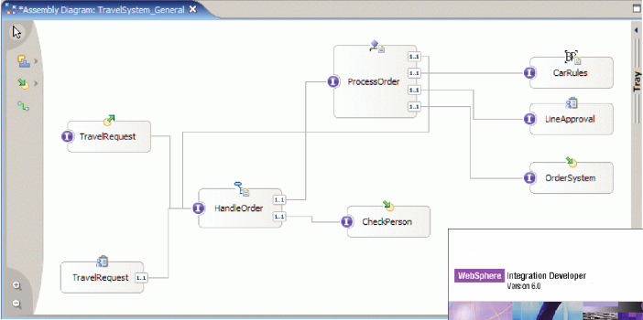
Demo!

Slide 44
> Standardization
The evolution of SOA infrastructure
  from SOAP to ESB
Service Component Architecture (SCA)
  Takes SOA from infrastructure to service modelling
SCA in practice
  Large-scale SOA within manufacturing
Tooling
  Demo of high-end SCA tooling (WebSphere Integration Developer)
Standardization
  Status of SCA standardization efforts
Conclusions
  Lego re-use and composition has finally arrived!
SCA-get-started kit
  Jump-start your SCA-based reference architecture

Slide 45
SCA specification – ongoing work ...
Specified by the leading vendors (IBM, BEA, Oracle, ...)
  architecture comes from top-of-the-line products
  builds on common core concepts
  tools available (WID/WPS early implementation)
Specification provides common model and API’s to support
  portability
  mix-and-match use of builders and runtimes
Currently: version 0.9 for public review
  immature but shows direction
Implementation support: Java, BPEL, C++ and defines extension points
Notes:
SCA higher abstraction concept than J2EE – which can be a supporting technology
Supported by vendors: IBM, BEA, Oracle, SAP, Iona, Sybase
Sun – satisfied with the aquisition of SeeBeyond ?
Microsoft – have their own thing
JCP (Java Community Process) submission?

Slide 46
SCA spec - dependency injection
@Remotable
public interface MyService {
public void serviceMethod(String s);
}
public class MyServiceImpl implements MyService {
@Property
private String configProperty;
@Reference
private AnotherService anotherService;
public void serviceMethod(String s) {
// ...
}
}
Notes:
supported on JDK1.4 but obvious bias towards Java 5
interface: Java, WSDL 1.1, WSDL 2.0
local (Java only) OR remote
remote semantics apply (by default)
BUT annotations are SCA specific! use config files instead

Slide 47
SCA spec – assembly configuration
Subsystem
Deployment unit
Module
Entry
Point
Component
Component
External
Service
sca.subsystem
sca.module
<ImplName>.componentType
Notes:
Property override/delegation mechanism – supports composition by LATE BINDING!

Slide 48
SCA spec - bindings
<binding.sca/>
  not vendor interoperable
  might be implemented as EJB-remote binding
<binding.ws port=”http://www.../SomeService#
wsdl.endpoint(SomeService/SomeServiceSOAP)”/>
<binding.ejb/>
  stateless session EJB
Notes:
Binding not needed within module (invocation native to impl language)

Slide 49
SCA spec – asynch support
Asynch support
  callback to Java-interface
  for WebServices: pass callback endpoint
  conversational

Slide 50
SCA spec - infrastructure capabilities
Declaratively assign as Policies [Proposal]
  Security
  Transactions
  Reliable messaging – property of the transport

Slide 51
> Conclusions
The evolution of SOA infrastructure
  from SOAP to ESB
Service Component Architecture (SCA)
  Takes SOA from infrastructure to service modelling
SCA in practice
  Large-scale SOA within manufacturing
Tooling
  Demo of high-end SCA tooling (WebSphere Integration Developer)
Standardization
  Status of SCA standardization efforts
Conclusions
  Lego re-use and composition has finally arrived!

Slide 52
Conclusions
Lego - At last!
SCA is the result of several maturing concepts merging into a sound, simple reference architecture
Shields our investment from the fast-paced infrastructure evolution
  Corba, RMI, JMS, EJB, JBI, SOAP, WS-*
SCA could provide value to .Net investments as well
  DCOM, .Net Remoting, Indigo…
Disclaimer:
  A usual, it needs a tuned context of modelling, CCM, test, build, project management, operations, service management…and…SOA infrastructure…

Slide 53
Core values
Isolates service implementations from the infrastructure that binds them together
    Services, Components, References - not java calls, JMS, EJB, WS etc
Realizes the Lego vision of composing business services from reusable business modules
    Recursive composition (Component m:m Module m:m Subsystem)
Unifies adapter, integration glue and core service development within a single concept
    Language bindings (BPEL, Java, C++, Interface Map, Rule Engine, Human Task) for component implementations.
service
Component
references

Slide 54
As a side-affect…
SCA is bootstrapped from Dependency Injection and a set of structuring principles
…so…
The core architecture specified by SCA actually makes SCA itself pluggable
(if you resist from using some shortcuts provided by the SCA Java language binding)

Slide 55
SCA get-started kit
Would you like to build on our experience?
Packaged SCA best-practice
  Introductory workshop
  Service modelling
  Business Object / Schema / WSDL management and Versioning strategy, internal versus external interface strategy
  Test automation / TDD integration
  SCA Build System set-up (binary version / dependency management)
  Change Control structure
  Reference application
  Training program
Open Source- or High-End tooling best-practice
  Guidelines for applying Spring in an SCA context
  WebSphere Process Server and WID

