Slide 1
Asynchronous Services
- The key to enterprise SOA
Johan Eltes
Callista Enterprise AB

Slide 2
Agenda
Why asynchronous services are important
Asynchronous Message Exchange
Quality-of-service
Web-Service technology
Interoperability of asynchronous web services
Deploying SOA integrations to an ESB
Summary
Q&A

Slide 3
Business Processes are asynchronous
Why asynchronous services are important
act Master Planning Process
Produce BOM
Create Delivery Forecast
New sales
Create master
Request capacities
forecast
productionplan
Submit Delivery Forecast
Triggering event
Process to be orchestrated

Slide 4
Enterprise Application Integration
Why asynchronous services are important
act Process
Produce BOM
Create Forecast
Business process transformed into independent stateless flows: Low visibility of process.
Get Production Plan
Request capacities
Send Forecast
sd EAI
Production Planning
Production Plan
Integration 1
Products
«flow»
«flow»
PLM
PLM
BOM
Integration 2
Capacity Request
«flow»
«flow»
Partner Gateway
Partner gateway
Production Capacity
Integration 3
Production Capacity
Material
«flow»
«flow»
Ordering
Material
Material Forecast
Integration 4
Forecast
Partner Gateway
Ordering
«flow»
«flow»
Firewall, Wan

Slide 5
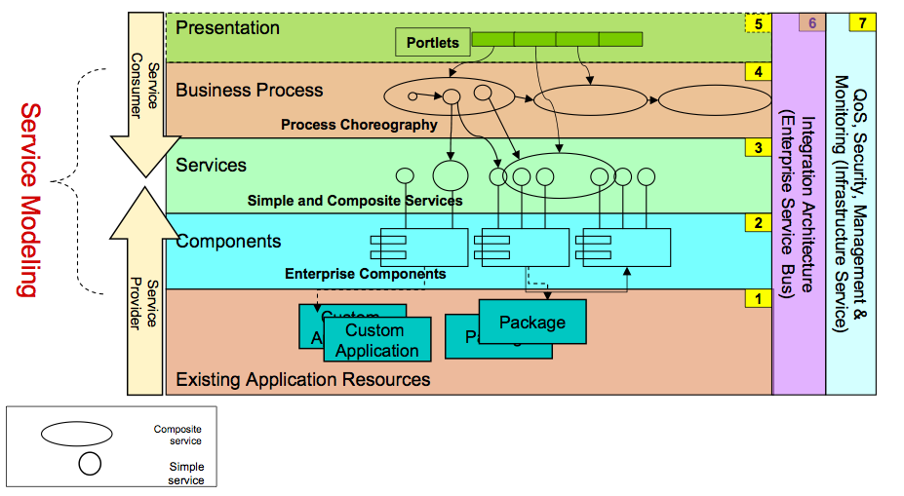
SOA emerged as layered composition model
Why asynchronous services are important
Animated slide
Asynchronously triggered processes historically not in focus. SOA was envisioned as layered, application-like architectures – and thus fragile to operate.

Slide 6
SOA based integration
Why asynchronous services are important
act Process
Business process transformed into process orchestration
Produce BOM
Create Forecast
sd SOA
Get Production Plan
Request capacities
Send Forecast
«Service»
«Service»
«Legacy Adapter»
Forecasting Process
3
Partner Service
Production Planning
1
submitDeliveryForecast
requestCapacity
receiveCapacityStatement
4
5
receiveDeliveryForecast
2b,4b
«notification»
Firewall, Wan
«Service»
2
BOM Service
explodeFeatureList
4b
2b
«notification»
«notification»
«Service»
«Service»
Alarm Tracking
Business Optimization
raiseAlarm
recordEvent

Slide 7
Asynchronous services:
Stateless, batch one-way service invocation
Why asynchronous services are important
sd SOA
«Service»
«Service»
«Legacy Adapter»
Forecasting Process
3
Partner Service
Production Planning
1
submitDeliveryForecast
requestCapacity
receiveCapacityStatement
4
5
receiveDeliveryForecast
2b,4b
«notification»
«Service»
2
BOM Service
explodeFeatureList
4b
2b
«notification»
«notification»
«Service»
«Service»
Alarm Tracking
Business Optimization
raiseAlarm
recordEvent

Slide 8
Synchronous service:
Request-repsponse
Why asynchronous services are important
sd SOA
«Service»
«Service»
«Legacy Adapter»
Forecasting Process
3
Partner Service
Production Planning
1
submitDeliveryForecast
requestCapacity
receiveCapacityStatement
4
5
receiveDeliveryForecast
2b,4b
«notification»
«Service»
2
BOM Service
explodeFeatureList
4b
2b
«notification»
«notification»
«Service»
«Service»
Alarm Tracking
Business Optimization
raiseAlarm
recordEvent

Slide 9
Asynchronous services:
Stateful conversation
Why asynchronous services are important
sd SOA
«Service»
«Service»
«Legacy Adapter»
Forecasting Process
3
Partner Service
Production Planning
1
submitDeliveryForecast
requestCapacity
receiveCapacityStatement
4
5
receiveDeliveryForecast
2b,4b
«notification»
«Service»
2
BOM Service
explodeFeatureList
4b
2b
«notification»
«notification»
«Service»
«Service»
Alarm Tracking
Business Optimization
raiseAlarm
recordEvent

Slide 10
Asynchronous services:
Event-driven services
Why asynchronous services are important
sd SOA
«Service»
«OneWay,Reliable»
«Legacy Adapter»
Forecasting Process
3
«Service»
Production Planning
1
Partner Service
«OneWay,
produceDeliveryForecast
requestCapacity
Reliable»
receiveCapacityStatement
4
«OneWay,
(from Business Process Model)
Reliable»
5
forcastMaterial
2b,4b
«OneWay,Reliable»
«notification»
(from Business Process Model)
«ReqRepl»
«Service»
2
BOM Service
explodeFeatureList
4b
2b
«notification»
«notification»
«Service»
«Service»
Alarm Tracking
Business Optimization
raiseAlarm
recordEvent
(from Business Process Model)

Slide 11
Why Asynchronous Services – Summary
Why asynchronous services are important
Business-to-Business over the internet
  Asynchronous by nature
  COTS B2B gateways too complex/expensive for smaller businesses (Rosetta net, edifact...)
Event-driven architectures
  Asynchronous by nature (publish / subscribe)
  Unsolicited events for alarming and business process monitoring
When (very) loose coupling is required
  Large, synchronous call stacks (”large service depth”) are fragile
  Different operations cycles and uptime requirements may require asynchronous de-coupling

Slide 12
Asynchronous Message Exchange
Why asynchronous services are important
Asynchronous Message Exchange
Quality-of-service
Web-Service technology
Interoperability of asynchronous web services
Deploying SOA integrations to an ESB
Summary
Q&A

Slide 13
Asynchronous Message Exchange
One-way
Request/Response with callback
Bi-directional with callback
Message Correlation
Stateful Conversations
Mediation (intermediaries)

Slide 14
One-way
Asynchronous Message Exchange
sd SOA
«Service»
«Service»
«Legacy Adapter»
Forecasting Process
3
Partner Service
Production Planning
1
submitDeliveryForecast
requestCapacity
receiveCapacityStatement
4
5
receiveDeliveryForecast
2b,4b
«notification»
«Service»
2
BOM Service
explodeFeatureList
4b
2b
«notification»
«notification»
«Service»
«Service»
Alarm Tracking
Business Optimization
raiseAlarm
recordEvent

Slide 15
One-way
Asynchronous Message Exchange
One-way service
  Operation has no response message
analysis Basic MEPs
Asynchronous
processRequest()
Aynchronous
Client
reference
Service
Server

Slide 16
Request/Response
Asynchronous Message Exchange
Request/Response Service – Operation has response-message
  Response message becomes implicit callback
  Asynchronous use not supported by BPEL
analysis Basic MEPs
Synchronous Client
reference
processRequest() : Response
«synchronous»
Asynchronous
processRequest(request) : Response
Synchronous
Client
«asynchronous»
Server
Service
return response
Callback Service
«asynchronous»

Slide 17
Bi-directional with callback
Asynchronous Message Exchange
sd SOA
«Service»
«Service»
«Legacy Adapter»
Forecasting Process
3
Partner Service
Production Planning
1
submitDeliveryForecast
requestCapacity
receiveCapacityStatement
4
5
receiveDeliveryForecast
2b,4b
«notification»
«Service»
2
BOM Service
explodeFeatureList
4b
2b
«notification»
«notification»
«Service»
«Service»
Alarm Tracking
Business Optimization
raiseAlarm
recordEvent

Slide 18
Bi-directional with callback
Asynchronous Message Exchange
Server logic explicitly sends the response through a callback interface
Tight coupling between service- and callback interfaces
  WS Design best-practice: Server Service + Client callback Service in same WSDL
analysis Business Objects
Asynchronous
processRequest()
Aynchronous
Client
reference
«asynchronous»
Service
Server
processResponse()
Callback Service
«asynchronous»
Callback reference

Slide 19
Message Correlation
Asynchronous Message Exchange
Request and response of bi-directional message exchanges needs to be correlated
  ...when client is stateless
  Responses will be processed in parallel
  Requests will be processed in parallel
analysis Correlation
Req3
Req2
Req1
Asynchronous
processRequest()
Client
Asynchronous
reference
Service
Server
Callback Service
Callback reference
Res2
Res1
Res3

Slide 20
Message Correlation
Asynchronous Message Exchange
sd SOA
«Service»
«Service»
«Legacy Adapter»
Forecasting Process
3
Partner Service
Production Planning
1
submitDeliveryForecast
requestCapacity
receiveCapacityStatement
4
5
receiveDeliveryForecast
2b,4b
«notification»
«Service»
2
BOM Service
explodeFeatureList
4b
2b
«notification»
«notification»
«Service»
«Service»
Alarm Tracking
Business Optimization
raiseAlarm
recordEvent

Slide 21
Message Correlation – Protocol Support
Asynchronous Message Exchange
Message metadata carries a technical / generated correlation identifier
Stateless client has to ”remember” association between correlation identifier and business context
Id=mid1
analysis Correlation
Req3
Req2
Req1
Asynchronous
processRequest()
Client
Asynchronous
reference
Service
Server
Callback Service
Callback reference
Res2
Res1
Res3
messageID ”1” -> Forecast ”W0812”
Rel=mid1

Slide 22
Message Correlation – Application managed
Asynchronous Message Exchange
Requires that request- and response message content share a business identifier
Stateless client has to ”remember” association between correlation identifier and business context
Can not handle parallell callbacks for the same ”business object”
analysis Correlation
Req3
Forecast ”W0812”
Req2
Req1
Asynchronous
processRequest()
Client
Asynchronous
reference
Service
Server
return response
callback Service
Res2
Res1
Res3
Forecast ”W0812”
Forecast ”W0812”

Slide 23
Stateful Conversations
Transparent Correlation
Asynchronous Message Exchange
sd SOA
«Service»
«Service»
«Legacy Adapter»
Forecasting Process
3
Partner Service
Production Planning
1
submitDeliveryForecast
requestCapacity
receiveCapacityStatement
4
5
receiveDeliveryForecast
2b,4b
«notification»
Firewall, Wan
«Service»
2
BOM Service
explodeFeatureList
4b
2b
«notification»
«notification»
«Service»
«Service»
Alarm Tracking
Business Optimization
raiseAlarm
recordEvent

Slide 24
Stateful Conversations
Transparent Correlation
Asynchronous Message Exchange
Conversations are virtually stateful
  Infrastructure aware of ”Server Instances” (incl. protocol)
  Practically stateless, due to passivation (e.g. in database)
  Can handle parallell callbacks for the same ”business object”
Asynchronous
Req2
Req1
Asynchronous
Client
reference
Service
Server
Res2
Res1
callback reference
callback Service
Request 1 Instance :
Req1
Response 1
Asynchronous Client
reference
Service
Instance :
Asynchronous Server
Res1
callback Service
callback reference
Conversation state
Request 2 Instance :
Req2
Response 2
Asynchronous Client
reference
Service
Instance :
Asynchronous Server
Res2
callback Service
callback reference

Slide 25
Mediation (intermediaries)
Asynchronous Message Exchange
De-coupling of endpoint address from service
Common in traditional messaging systems
Foundation for service-oriented message bus
Asynchronous
Asynchronous
Client
reference
Service
Server
I only know the end point of the intermediary...
callback Service
callback reference
Protocol endpoint: ”AsynchronousServer”
Intermediary
I know how to translate and route logical address (”AsynchronousServer”) to the ultimate endpoint!
Protocol endpoint: The Intermediary
Logical Endpoint: ”AsynchronousServer”

Slide 26
Asynchronous Message Exchange
Why asynchronous services are important
Asynchronous Message Exchange
Quality-of-service
Web-Service technology
Interoperability of asynchronous web services
Deploying SOA integrations to an ESB
Summary
Q&A

Slide 27
Quality-of-service
Typical QoS requirements for asynchronous messaging
  Reliable transmission of messages (requests and responses)
  Secure transmissions (out-of-scope for this presentation)
  Robust error handling
Reliability requirements for message transmission
  Once and only once
    All messages have to arrive
    Requirements on transmission time
  In order
    arrive in same sequence as produced
Transaction coordination
  Mainly for mediation activities – depends on underlying messaging system

Slide 28
Web-Service technology
Why asynchronous services are important
Asynchronous Message Exchange
Quality-of-service
Web-Service technology
Interoperability of asynchronous web services
Deploying SOA integrations to an ESB
Summary
Q&A

Slide 29
Web-Service technology
Web-Service technology
WS-Addressing
  Foundation for routing. Re-used by other specs in this list
WS-Reliable Messaging
  Reliable point-to-point transport for web-services
WS-Notification framework
  Publish / Subscribe model for web-services
WS-BPEL
  High-level language for synch orchestration of web services.
Service Component Architecture
  Provides generalized support for stateful synch conversations between service component wires (not only for web-services and not only for Java)

Slide 30
WS-Addressing: Foundation for routing
Web-Service technology
Runtime
Design time
SOAP Envelope
WSDL
<wsaw:action>there</wsaw:action>
SOAP Header
<wsa:action>there</wsa:action>
<wsa:To>...</wsa:to>
Body
EndpointReferens
SOAP Header wsa
+To
-
Address: anyURI
extensions
-
Action: anyURI
0..1
-
MessageID: anyURI
-
RelatesTo: anyURI
+From
0..1
JAX-WS generates code that uses WSDL addressing as default when sending a WS-request.
+ReplyTo
0..1
+FaultTo
0..1

Slide 31
WS-ReliableMessaging
Web-Service technology
SOAP extension for reliable transmissions of SOAP messages
Supports any protocol with SOAP binding (HTTP, SMTP etc)
Features
  Handshaking
  Re-send of lost transmissions
  Preserve message sequence
  WSDL integration through WS-Policy

Slide 32
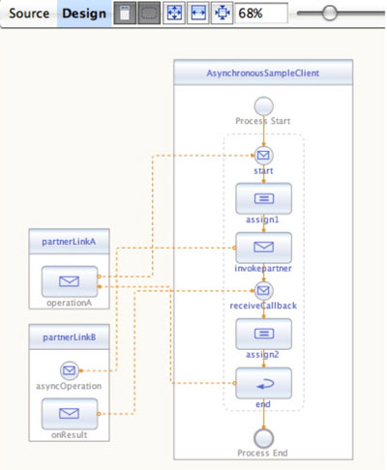
WSBPEL
Web-Service technology
XML-based language designed for service-based integration in a process-centric way
Does not support asynchronous Req/Response
Built-in support for application-level message correlation
Support for Stateful Conversations
BPEL
Service
Request 1 Instance :
Request 1 Instance :
Req1
Req1
Response 1
Asynchronous Client
Response 1
Asynchronous Client
reference
reference
Instance :
Service
Instance :
Service
Asynchronous Server
Res1
Asynchronous Server
Res1
Call
Call
-
-
back reference
Call
back reference
Call
-
-
back Service
back Service
Request 2 Instance :
Request 2 Instance :
Req2
Req2
Response 2
Asynchronous Client
Response 2
Process
Asynchronous Client
Conversation
reference
reference
Instance :
Service
Instance :
state
Service
state
Asynchronous Server
Res2
Asynchronous Server
Res2
Call
Call
-
-
back reference
Call
back reference
Call
-
-
back Service
back Service

Slide 33
Summary: WS-* support for asynchronous SOA
Web-Service technology
All message exchange patterns except re-use of synchronous services
  BPEL restriction
Separation of transport address and logical address through ”intelligent messages” (WS-Addressing)
Support for un-reliable SOAP transports (WS-ReliableMessaging)
Support for message sequence and re-send (WS-ReliableMessaging)
Dedicated language (BPEL) for orchestration of business processes

Slide 34
Interoperability of asynchronous web services
Why asynchronous services are important
Asynchronous Message Exchange
Quality-of-service
Web-Service technology
Interoperability of asynchronous web services
Deploying SOA integrations to an ESB
Summary
Q&A

Slide 35
Interoperability of asynchronous web services
WebService-Interoperability is now focusing on messaging aspects of web-service standards
Reliable Secure Profile 1.0
WS-I Basic Profile 1.2
WS-I Basic Profile 2.0
WS-I Basic Security Profile 1.0
WS-I Basic Security Profile 1.1
WS-ReliableMessaging 1.1
WS-SecureConversation 1.3
WS-Addressing 1.0 Core
WS-Addressing 1.0 SOAP Binding
WS-Addressing 1.0 WSDL Binding
SOAP 1.1 Binding for MTOM 1.0

Slide 36
Deploying SOA integrations to an ESB
Why asynchronous services are important
Asynchronous Message Exchange
Quality-of-service
Web-Service technology
Interoperability of asynchronous web services
Deploying SOA integrations to an ESB
Summary
Q&A

Slide 37
Deploying SOA integrations to an ESB
Legacy Prod Planning
UDDI directory
Partner Service
Business Event
WebSphere MQ
1
Message Mapping engine
JMS Binding Components
configured routing rules
PP Fixed-to-xml service
Other mapping
A JMS binding
3
4
5
1
1
1
Webservice-based message bus (routing of SOAP messages)
wsa:Action -> wsa:Address
1
2
2b
3
4
4b
2
4b
2b
BPEL engine
Java EE engine
Forecasting Process
Process X
BOM Service
AlarmTracking Service
BusOpt Service
ESB

Slide 38
Tracing a message exchange
Deploying SOA integrations to an ESB
Legacy Prod Planning
UDDI directory
Partner Service
WebSphere MQ
1.0
Message Mapping engine
JMS Binding Components
configured routing rules
PP Fixed-to-xml service
Other mapping
A JMS binding
1.2
1.3
1.1
Webservice-based message bus (routing of SOAP messages)
1.4
BPEL engine
Java EE engine
Forecasting Process
Process X
BOM Service
AlarmTracking Service
BusOpt Service
ESB

Slide 39
Summary
Why asynchronous services are important
Asynchronous Message Exchange
Quality-of-service
Web-Service technology
Interoperability of asynchronous web services
Deploying SOA integrations to an ESB
Summary
Q&A

Slide 40
Summary
- SOA is a powerful architecture for business process integration
- Asynchronous message exchange patterns are essential
Services needs to be designed for asynchronous process orchestration
Use the ESB as a model when implementing a service-oriented runtime
act Master Planning Process
Business model
Produce BOM
Create Delivery Forecast
New sales
Create master
Request capacities
forecast
productionplan
Submit Delivery Forecast
sd SOA
SOA model
«Service»
«Service»
«Legacy Adapter»
1
Forecasting Process
3
Partner Service
Production Planning
submitDeliveryForecast
requestCapacity
receiveCapacityStatement
4
Deployment model
2b,4b
5
receiveDeliveryForecast
«notification»
«Service»
2
BOM Service
explodeFeatureList
2b
4b
«notification»
«notification»
«Service»
«Service»
Alarm Tracking
Business Optimization
raiseAlarm
recordEvent

Slide 41

Q & A

