Slide 1
Domain Specific Languages for Acceptance Testing
Mats Ekhammar
Callista Enterprise AB

Slide 2
Agenda
Acceptance tests
Domain Specific language (DSL)
Tooling
Demo - Web GUI DSL
Demo - Custom DSL
Summary

Slide 3
Acceptance tests
Common characteristics of acceptance tests today:
Tests specified in text documents.
Results specified in text documents.
Performed on the applications user interface.
Done by non-technical people from the business side.
The whole application is tested, end-to-end.
Problems with the tests could be:
Tests are manually and error prone.
Takes a long time to complete.
Requirement documentation, test documentation and test results are in different places.

Slide 4
Acceptance tests wish list...
Acceptance tests should be automated.
Requirements (functional and non-functional), test documentation and tests results should be placed together.
All tests should be easy to create and maintain.
Easy to view result of acceptance tests.
Tests should be expressed in a language in the context of the domain.
Domain Specific Language !

Slide 5
Domain Specific Language (DSL)
Example 1:
javax.crypto.Cipher cipher;
cipher.getAlgorithm();
Example 2:
Add 3 PCS of 2878172 To Order A1
Check Order Created with Reference REF12345
The syntax describes how we can combine words, the structure of the language.
  After Add we enter a number.
The semantic describes the meaning of language expressions
  What is going to happen when running a sentence?
Notes:
Resonera kring syntax och semantik

Slide 6
Domain Specific Language (DSL)
The syntax should be easy to understand and use when writing the acceptance tests.
  A generic table format as in FIT (Framework for Integrated Tests) is easy to use and FIT knows how to interpret this format.
We also need a semantic that is intuitive in the domain where our acceptance tests are going to take place.
  The freedom to define our semantic in domain specific terms is provided by FIT fixture construction.
Notes:
Motivera verktygsval

Slide 7
FIT – Framework for Integrated Tests
FIT is a tool that helps writing automated acceptance tests.
A FIT test use a table format, which is easy to understand. The result of the test when executed is also easy to verify.
CadecTest
people | breaks()
0 | 0
10 | 1
24 | 1
25 | 2
CadecTest
people | breaks()
0 | 0
10 | 1
24 | 1 expected
 | 2 actual
25 | 2
Syntax!
Notes:
The table format gives the syntax, FIT vet ej hur den skall tolka !!!

Slide 8
FIT
Fixture1
Fixture2
Fixture3
Tables with
data for tests
Semantic!
Checks that tests
are satisfied by
system under test
: Fixture 1
: Fixture 2
: Fixture 3
: System Under Test

Slide 9
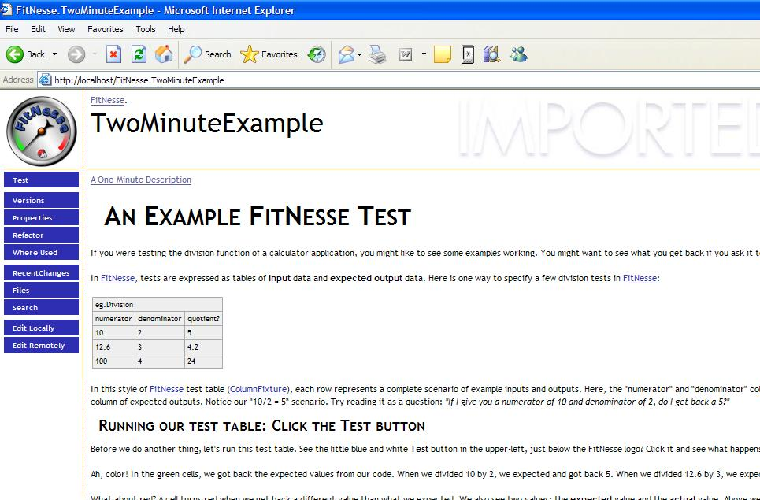
FitNesse
FitNesse is an HTML ”front-end” and wiki (web site) to FIT.
Specify requirements, set up test tables and then run the tests on one wiki page
Makes it easy to create, organize and share FIT tests.
FitNesse will run all your tests and display the results in a nice way.
Notes:
Motivation is to keep our tests in one place!

Slide 10
Web GUI DSL - demo
Example of a technical approach to DSL.
We want to record actions done on an applications GUI.
  Select links, windows
  Enter texts, select choices, check boxes, push buttons, ...
  Verify texts, values, titles, alerts, selections,...
Save them to Fitnesse for future use, automation.
The recording of actions will be done by a tool called Selenium.
Where comes DSL in?
Notes:
WIKI format klart I Selenium, bara visa! Syntax!

Slide 11
Web GUI DSL - demo
We record a test and paste it as a FIT table.
To execute our FIT test we use a fixture that
maps our recorded actions to Selenium remote calls.
This will be where we define our DSL!
Demo
: Fixture
: System Under Test
Notes:
Resonera kring vad som ej var helt bra efter demon. Syntax, semantik…

Slide 12
WEB GUI DSL - demo
+ Automated written acceptance test for a Web GUI!
- The tool (Selenium) defined our DSL’s semantic, no enhanced semantic for a business user.
- Ended up with a technical and generic solution, not with a business specific domain language set.
We need to create a more specific language that shield our business user from the inner steps of a test.

Slide 13
Custom DSL - demo
The goal is to write a more customized DSL with a higher abstraction.
Example:
se.callista.cadec2007.CreateOrderFixture
Create Order with Alias | A1
Set Order Reference | REF12345 | On Order | A1
Set Order Class | DAYORDER | On Order | A1
Add | 3 | PCS of | 2878172 | To Order | A1
Add | 5 | PCS of | 466634 | To Order | A1
Submit Order | A1
Check Order Created with Reference | REF12345
Notes:
Beskriv vad vi vill åstadkomma
Beskriv syntax och semantik!!

Slide 14
Custom DSL – Fixture code - demo
The user writes the following in a FIT table:
Add | 3 | PCS of | 466634 | To Order | A1
public class CreateOrderFixture extends DoFixture {
…
public boolean addPCSOfToOrder(int quantity, String partNumber, String orderAlias) {
selenium.open("/OrderEntry");
selenium.type("orderBasketFld",
(String)orders.get(orderAlias) );
selenium.clickAndWait("openOrderBasket");
selenium.type("inputPartNumberFld", partNumber);
...
}

Slide 15
Custom DSL – Fixture code - demo
The user writes
on the wiki page.
Add | 3 | PCS of | 466634 | To Order | A1
public class CheckOrderStatusFixture extends DoFixture {
…
public boolean addPCSOfToOrder(int quantity, String partNumber,
String orderAlias) {
return addPartsToDB(partNumber, quantity,
(String)orders.get(orderAlias));
}

Slide 16
Custom DSL – Fixture code - demo
In the code we can do things like:
Save reference to created objects in a static context.
Call a script engine (Selenium) for execution in a browser
  Enter texts, click links, ...
Make calls to databases
  Setup a test data environment, read db values, ...
Use other resources
  Mail, User repositories, Webservice calls, ...
...
Demo

Slide 17
Custom DSL
By using a Custom DSL with tooling we have reached all demands on future acceptance test stated in the beginning!
  Acceptance tests should be automated.
  Requirements (functional and non-functional) should be documented as close to the test documentation and tests as possible.
  All tests should be easy to create and maintain.
  Easy to view result of acceptance tests.
  Tests should be expressed in a language in the context of the domain.

Slide 18
Summary
By helping the customer to build a DSL for their own domain we can make it easier to create acceptance tests.
Combine the DSL with for example FIT, Fitnesse and Selenium and we get a fullfledged solution for our customers acceptance tests.
It will require some help from us developers...

Slide 19
Remember
Help your customers today to automate their acceptance tests with a language defined
in their domain.

Slide 20
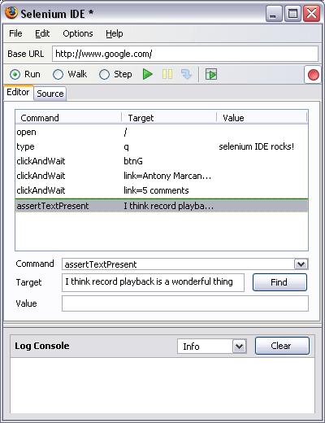
Selenium: A framework for system tests of Web applications
The Selenium test engine executes tests directly in a browser, just as real users do.
The Selenium test engine is implemented in JavaScript, and thus run in most browser (Internet Explorer, Mozilla, Firefox, Opera, Safari …) on most platforms.
This makes Selenium an excellent choise for both Browser compatibility testing as well as System functional testing of full-featured web applications.

Slide 21
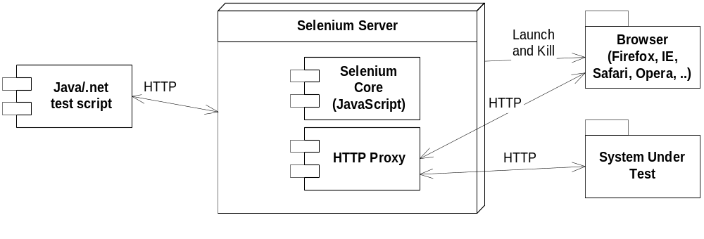
Selenium Remote Control
Selenium Remote Control allows Selenium tests to be written in a programming language, but still execute the tests inside any mainstream JavaScript-enabled browser.
Selenium Remote Control provides a Selenium Server, which can automatically start/stop/control any supported browser.
The Selenium Server communicates directly with the browser using AJAX (XmlHttpRequest).

