Slide 1
JavaEE Seams Easy
JBoss Seam: A Web Application Component Framework for EJB3, JPA, JSF and AJAX

Slide 2
Agenda
The JavaEE 5 programming model: Remaining issues
Introducing Seam
  Contextual Components
  Seam Conversations
  Bijection
  Remoting
  Testability
Short demo
Summary
Q&A

Slide 3
Java EE 5 programming model
JSF 1.2
  Template language
    extensible component model for widgets
  “Managed bean” component model
    JavaBeans with dependency injection
    XML-based declaration
  Defines interactions between the page and managed
  beans
    Expression Language (EL) for binding controls to managed beans

Slide 4
Java EE 5 programming model (contd.)
EJB 3.0
  Component model for transactional components
    dependency injection
    declarative transaction and persistence context demarcation
    sophisticated state management
  JPA ORM for persistence
  Annotation-based programming model

Slide 5

Java EE 5 Compared to J2EE
Simpler programming model
  Fewer artifacts (look Mum, no DTOs!)
  Less noise (EJB boilerplate, Struts boilerplate)
  Much simpler ORM
  Finer grained components
More powerful for complex problems
  Powerful ORM engine
  EJB interceptors support lightweight AOP
  JSF is amazingly flexible and extensible
Much better testability
  All components (except JSP pages)
  can be unit tested in isolation

Slide 6
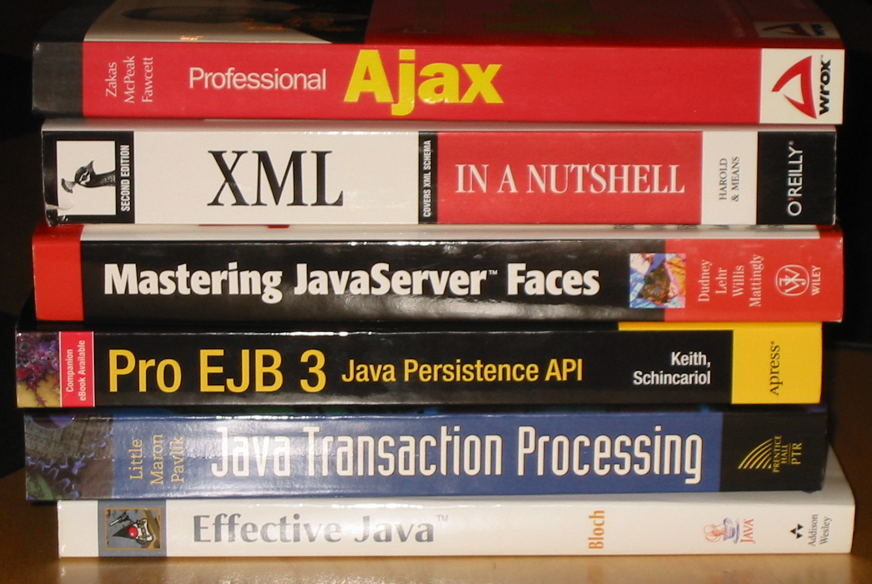
So what is the problem?
Incoherent programming models
Remaining JSF complexity
  Managed beans are just unnecessary plumbing
  XML configuration
Lack of power
  Enemy of the State:
  No Flows
  Dependency Injection
  is not enough
What about Ajax?

Slide 7

Seam Goals
Unify the two component models
  Simplify Java EE 5, filling a gap
  Improve usability of JSF
Deprecate stateless architectures
Decouple technology from execution environment
Enable richer user experience
Notes:
Kritisera JSF, snarare än att påstå att probrammeringsmodellerna är spretiga

Slide 8

Fix the mismatch between JSF and EJB 3.0 component programming models
No more excessive XML configuration
  @Annotations everywhere!
  #{EL} expressions everywhere!
No more awkward “Managed Beans”.
(Want to know what gets between my JSFs and my EJBs?
  Nothing … )

Slide 9
Seam Components in Action!
The @Name annotation binds
a component to a contextual
variable
@Stateful
@Name(“docEdit”)
public EditDocumentBean implements EditDocument {
@PersistenceContext
private EntityManager em;
private Long id;
public void setId(Long id) {
this.id = id;
}
private Document document;
public Document getDocument() {
return document;
}
public void save() {
...
}
}
Context variables are
accessible from EL
<f:form>
<table>
<tr>
<td>Title</td>
<td>
<h:inputText value=“#{docEdit.document.title}”>
<f:validateLength maximum=“100"/>
</h:inputText>
</td>
</tr>
<tr>
<td>Password</td>
<td><h:inputText value=“#{docEdit.document.content}”/></td>
</tr>
</table>
<h:messages/>
<h:commandButton type="submit" value=“Save" action="#{docEdit.save}"/>
</f:form>
Seam components can be
Session Beans, Entity Beans
or simply POJOs

Slide 10
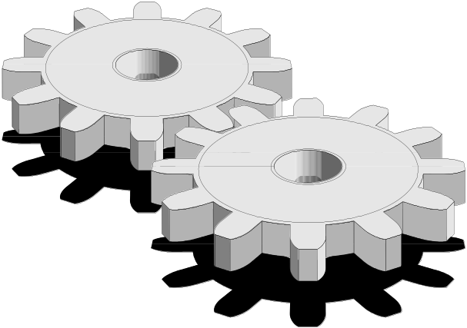
Contextual Components
Most of the problems in Web Application development relate directly or indirectly to state management
  Servlet Spec contexts (Page, Request, Session, Application) are not meaningful in terms of the application
We want a richer context model providing meaningful, “logical” contexts
What’s missing: Conversations

Slide 11
Conversations In Action!
Components are assigned
to a scope using the
@Scope annotation
@Stateful
@Name(“documentEditor”)
@Scope(ScopeType.CONVERSATION)
public EditDocumentBean implements EditDocument {
@PersistenceContext
private EntityManager em;
...
@Begin
public String get() {
document = em.find(Document.class, id);
return document==null ? “notFound” : “success”;
}
@End
public String save(Document doc) {
document = em.merge(doc);
return “success”;
}
}
Conversations are demarcated
using @Begin and @End
annotations
Notes:
Lägg till Components are assigned to a scope using the @Scope annotation i text block

Slide 12
Conversations helps solve real, inherent problems in Web Applications
Multi-Window operations
Back Button support
“Workspace Management”
Nested conversations
  multiple concurrent inner conversations within an outer conversation - a stack of continuable states
Time for a demo!

Slide 13
Conversations and Persistence
Transaction-scoped persistence contexts have problems if you (re)use objects across transactions
  not held open for entire request (while rendering view), hence can result in LazyInitializationException while navigating lazy associations
  NonUniqueObjectException reassociating detached instances
  Less opportunity for caching
Conversation-scoped persistence contexts solves these problems
  Much cleaner than well-known (and highly questionable) “open session in view” idiom!
Notes:
Korta ner, återkoppla direkt till Magnus föredrag

Slide 14

Dependency Injection Sucks! Here’s Bijection!
Dependency injection is broken for stateful components
  Rigid and static
  Does not support the notion of contexts
What we really need is Bijection, which is
  Dynamic
  Bidirectional
    Injection
    “Outjection”
  Contextual

Slide 15
Bijection in Action!
@Stateless
@Name(“changePassword”)
public class ChangePasswordBean implements Login {
@PersistenceContext
private EntityManager em;
@In @Out
private User currentUser;
public String changePassword() {
currentUser = em.merge(currentUser);
}
}
@In and @Out annotations are
used to inject and “outject“
variables into the context
Notes:
Exemplifiera med request-attribut!

Slide 16
Bijection in Action!
@Stateful
@Name("hotelSearch")
@Scope(ScopeType.SESSION)
@LoggedIn
public class HotelSearchingAction implements HotelSearching {
@PersistenceContext private EntityManager em;
private String searchString;
private int pageSize = 10;
@DataModel private List<Hotel> hotels;
@DataModelSelection private Hotel selectedHotel;
public String find() {...}
@DataModel annotation
outjects search result
into the context
Notes:
Exemplifiera med request-attribut!

Slide 17
Bijection in Action – Referring to context variable
<h:dataTable value="#{hotels}" var="hot" rendered="#{hotels.rowCount>0}">
<h:column>
<f:facet name="header">Name</f:facet> #{hot.name} </h:column>
<h:column>
<f:facet name="header">Address</f:facet> #{hot.address} </h:column>
<h:column>
<f:facet name="header">City, State</f:facet> #{hot.city},
#{hot.state}
</h:column>
</h:dataTable>
Notes:
Exemplifiera med request-attribut!

Slide 18

What about Ajax?
Ajax seems to be here to stay, whether we like it or not. And the JavaScript programming model comes straight from Hell …
JSF components in themselves can encapsulate JavaScript code, but that is a closed model
  What about those fancy JS libraries that you might have to use (Rico, Prototype, script.acolo.us, …)?
  What about access to the server-side, contextual components?
Seam Remoting gives DWR-like Javascript access to any Seam component

Slide 19
Seam Remoting in Action
@Local
public interface Manager {
... ...
@WebRemote
public boolean checkName (String name);
}
@Name("manager")
public class ManagerAction implements Manager {
... ...
public boolean checkName (String name) {
…
}
}
<script language="javascript">
// Get the "manager" Seam component
var manager =
Seam.Component.getInstance("manager");
// Make the async call with a callback handler
function checkName () {
var e = document.getElementById("form:name");
var inputName = e.value;
manager.checkName(inputName,
checkNameCallback);
}
function checkNameCallback (result) {
if (result) {
hideCheckNameError ();
} else {
showCheckNameError ();
}
}
</script>

Slide 20
Runtime Requirements
Java SE 5
JSF 1.x
Servlet 2.4+ container (i.e. Tomcat 5.x)
JPA implementation only required if persistent contextual objects are used
EJB 3 container only required if the Contextual objects are EJBs
  Also works with JBoss Embeddable EJB3 container

Slide 21

Conclusions
Seam provides a unified programming model that brings together JSF, JPA, EJB 3 and AJAX
Relies on two powerful tools:
  Annotations
  Expression Language
Greatly simplifies development of stateful Web Applications with complex flows
… but is not yet a standard, which might lead to single vendor lock-in. You might want to wait for WebBeans (JSR 299).

Slide 22

Time for Questions!

Slide 23
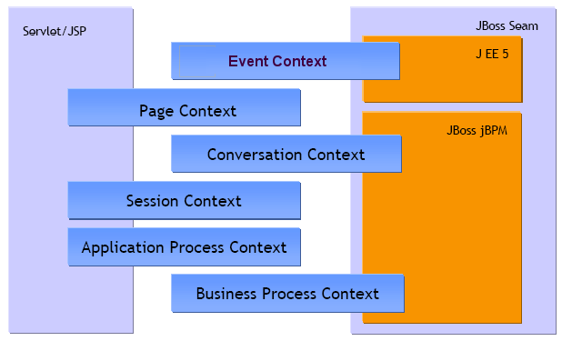
Seam Contexts
EVENT
PAGE
CONVERSATION
SESSION
PROCESS
APPLICATION
Components are assigned to a scope using the @Scope annotation

Slide 24

Support for Test Driven Development
public class BookingTest extends SeamTest {
@Test
public void testBookHotel() throws Exception {
new FacesRequest() {
@Override
protected void invokeApplication() throws Exception {
Contexts.getSessionContext().set("loggedIn", true);
Contexts.getSessionContext().set("user", new User("Gavin King", "foobar"));
}
}.run();
new FacesRequest("/main.xhtml") {
@Override
protected void updateModelValues() throws Exception {
setValue("#{hotelSearch.searchString}", "Union Square");
}
@Override
protected void renderResponse() {
DataModel hotels = (DataModel) Contexts.getSessionContext().get("hotels");
assert hotels.getRowCount()==1;
assert ( (Hotel) hotels.getRowData() ).getCity().equals("NY");
assert getValue("#{hotelSearch.searchString}").equals("Union Square");
assert !Manager.instance().isLongRunningConversation();
}
}.run();

