Slide 1
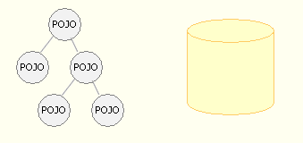
Java Persistence API v1.0 a standard for ORM frameworks and POJO based Persistence
Magnus Larsson ml@callistaenterprise.se
Notes:
Att skriva databas access kod inom ramen för J2EE och dess standarder och mönster har aldrig varigt särskilt roligt historia.
Mönster som Data Access Objects och Data Transfer Objects har lämnat en hel del övrigt att önska om inte annat så ur ett produktivitetsperspektiv…
Under senare år har det vuxit fram alternativa produktspecifika lösningar för att göra databas access betydligt enklare.
Vi har sett så kallade Objekt Relations Mappningsramverk som jobbar enligt principen ”POJOB baserad persistens” få ett allt större momentum inom Java communitien.
Jag tänkte då på produkter som Hibernate och Toplink.
I den nya Java Enterprise Edition 5.0 standarden så har man med fasta på detta och standardiserat användning av denna typ av produkter i Java Persistence API specifikationen eller JPA som vi brukar förkorta det till !
I det här föredraget så kommer jag att dels ge en introduktion till JPA men också försöka dela med mig av erfarenheter från de första projekten där vi hjälpt våra kunder att införa JPA

Slide 2
Agenda
Bored of writing Data Access Objects?
Terminology
  ORM - Object Relational Mapping frameworks
  POJO based persistence
Introducing JPA…
  What is it?
  Examples!
Details & Guidelines
  Until time runs out…
Summary
Notes:
+ ORM FW → ORM Framework eller ORM
Bild 6 är rörig!
+ Bild 12 nämn de tre arv mappningstyperna (SINGLE_TABLE, TABLE_PER_CLASS, JOINED) eller inte tre alls.
+ Bild 37. Var exmplict med att håll bulk operationer separat
+ Bild 38. Liten modell mellan emp och phonenumber
+ Bild 39. Dumt exempel! Kan ev utelämnas helt!

Slide 3
Bored of writing Data Access Objects?
A sample DAO method – “find by Primary Key”
public SampleDTO sampleLookup(String id) {
Connection c = null;
PreparedStatement ps = null;
ResultSet rs = null;
SampleDTO dto = null;
try {
c = getDataSource().getConnection();
ps = c.prepareStatement(”SELECT ...”);
ps.setString(1, id);
rs = ps.executeQuery();
if (rs.first()) {
dto = new SampleDTO(id, rs.getString(1), rs.getString(2), rs.getString(2));
}
} catch (SQLException se) {
throw new SampleDAORuntimeException(se));
} finally {
if (rs != null) try {rs.close();} catch (SQLException se) {}
if (ps != null) try {ps.close();} catch (SQLException se) {}
if (c != null) try {c.close();} catch (SQLException se) {}
}
return dto;
}

Slide 4
Bored of writing DAO’s?
What about instead looking up en entity by
Or inserting an entity in the database by
Or updating an entity in the database by
…and doing it based on a standard…
Sample entity = entityManager.find(Sample.class, id);
Sample entity = new Sample();
entity.setAttr1(attr1);
entity.setAttr2(attr2);
entityManager.persist(entity);
entity.setAttr(newValue);

Slide 5
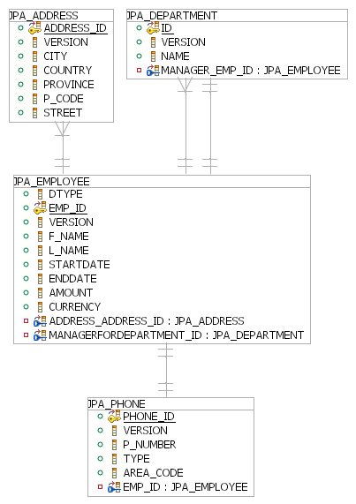
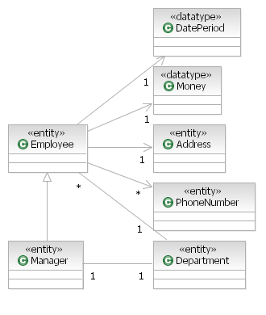
ORM - Object Relational Mapping framework
?
Declarative Mapping
Framework API
Query Language
Transaction support
Notes:
Declarative mapping
Between entity object model and database schema
An framework API
For persisting, finding and removing objects
A query language
Operates on the object model and not the database schema
Support for transactions

Slide 6
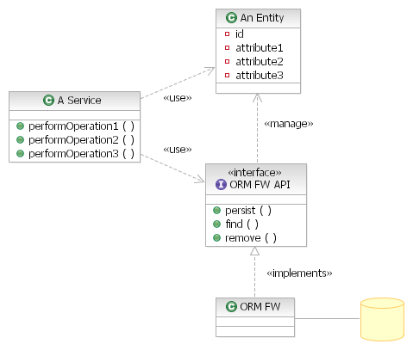
POJO based persistence
1. The entity classes
are unaware of that
they will be persisted
They are pure POJO’s!
(Plain Old Java Objects)
2. The ORM keeps
the entity objects in
synch with the database
3. Only non entity classes
Uses the ORM API!
NOTE: Also known as
“transparent persistence”

Slide 7
POJO based persistence
public class Employee {
private Long id;
private Long version;
private String firstName;
private String lastName;
private Money salary;
private Address address;
// Setters and getters
// left out ☺
}
1. The entity classes
are unaware of that
they will be persisted
They are pure POJO’s!
(Plain Old Java Objects)
2. The ORM keeps
the entity objects in
synch with the database
3. Only non entity classes
Uses the ORM API!
NOTE: Also known as
“transparent persistence”

Slide 8
POJO based persistence
1. The entity classes
are unaware of that
they will be persisted
They are pure POJO’s!
(Plain Old Java Objects)
2. The ORM keeps
the entity objects in
synch with the database
3. Only non entity classes
Uses the ORM API!
NOTE: Also known as
“transparent persistence”

Slide 9
POJO based persistence
1. The entity classes
are unaware of that
they will be persisted
They are pure POJO’s!
(Plain Old Java Objects)
public class EmployeeServicesBean
implements EmployeeServices {
public Employee createEmployee(
String firstName,
String lastName) {
Employee e = new Employee();
e.setFirstName(firstName);
e.setLastName(lastName);
entityManager.persist(e);
return e;
}
}
2. The ORM keeps
the entity objects in
synch with the database
3. Only non entity classes
Uses the ORM API!
NOTE: Also known as
“transparent persistence”

Slide 10
POJO based persistence
1. The entity classes
are unaware of that
they will be persisted
They are pure POJO’s!
(Plain Old Java Objects)
2. The ORM keeps
the entity objects in
synch with the database
3. Only non entity classes
Uses the ORM API!
NOTE: Also known as
“transparent persistence”

Slide 11
Where are we?
Bored of writing Data Access Objects?
Terminology
  ORM - Object Relational Mapping frameworks
  POJO based persistence
Introducing JPA…
  What is it?
  Examples!
Details & Guidelines
  Until time runs out…
Summary

Slide 12
JPA 1.0 – Java Persistence API
What is it?
  A standard for Object Relational Mapping frameworks
    Based on ”POJO based persistence”
  Modeled to a great deal after JBoss Hibernate
  Released in May 2006
    As a part of EJB 3.0 and Java EE 5.0
    Replaces EJB 2.x Entity Beans in EJB 3.0
  Runs on Java SE 5.0
    JPA does not require neither EJB 3.0 nor Java EE 5.0!
  Pluggable in Java EE 5.0
    The JPA implementation can be replaced in Java EE 5.0

Slide 13
JPA 1.0 – Java Persistence API
JPA 1.0 implementations
  Sun Glassfish
  Toplink Essentials
  JBoss Hibernate
  Apache Open JPA
  Oracle Toplink
  BEA Kodo
  SAP JPA
  CocoBase
  JPOX
based on
based on

Slide 14
JPA 1.0 – Key Features
Key Features
  Declarative mapping
    Between entity object model and database schema
  A Manager API, Entity Manager
    For persisting, finding and removing objects
    Handles Session and Cache management
  A query language, Java Persistence QL
    Similar to Hibernate QL
    Operates on the entity object model
  Support for transactions
    Both JPA resource local and JTA/EJB CMT global transactions

Slide 15
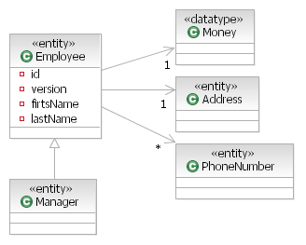
JPA 1.0 - Declarative Object Relational Mapping
5. Use either annotations or
deployment descriptors
1. Classes are mapped to tables
(including inheritance)
4. Support for
embedded objects
2. Fields are mapped to columns
(including pk, auto pk,
version and enum)
3. All types of relationships are supported
(1-1, 1-M, M-M, uni- and bi-directional)
Notes:
nämn de tre arv mappningstyperna (SINGLE_TABLE, TABLE_PER_CLASS, JOINED) eller inte tre alls.

Slide 16
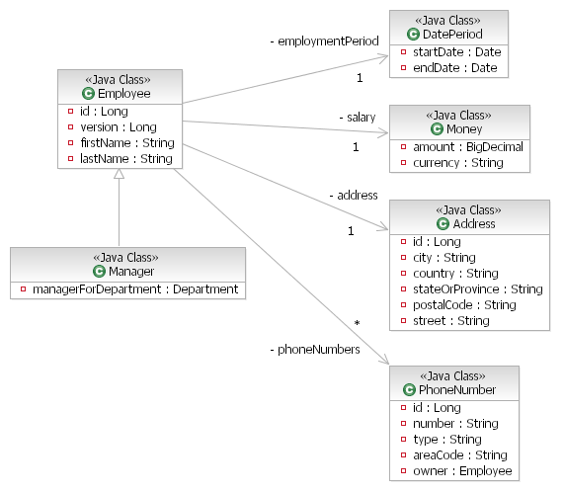
JPA 1.0 - Examples
Class Diagram

Slide 17
JPA 1.0 - Examples
Entity Employee with friends…
@Entity
@Inheritance(strategy=SINGLE_TABLE)
public class Employee {
@Id
@GeneratedValue(strategy=AUTO)
private Long id;
@Version private Long version;
@Column(length=20)
private String firstName;
private String lastName;
@Embedded private Money salary;
@Embedded private DatePeriod employmentPeriod;
@OneToOne
private Address address;
@OneToMany(mappedBy = "owner")
private List<PhoneNumber> phoneNumbers;
// Setters and getters left out ☺
@Entity
public class Manager extends Employee {
@OneToOne
private Department mgrForDept;
@Embeddable
public class Money {
public enum CurrencyEnum
{SEK, EUR, USD};
private BigDecimal amount;
private CurrencyEnum currency;

Slide 18
JPA 1.0 - Examples
Table mapping
@Entity
@Inheritance(strategy=SINGLE_TABLE)
public class Employee {
@Id
@GeneratedValue(strategy=AUTO)
private Long id;
@Version private Long version;
@Column(length=20)
private String firstName;
private String lastName;
@Embedded private Money salary;
@Embedded private DatePeriod employmentPeriod;
@OneToOne
private Address address;
@OneToMany(mappedBy = "owner")
private List<PhoneNumber> phoneNumbers;
// Setters and getters left out to save some space ☺
CREATE TABLE "EMPLOYEE" (
"ID" BIGINT NOT NULL,
"VERSION" BIGINT,
"FIRSTNAME" VARCHAR(20),
"LASTNAME" VARCHAR(255),
"AMOUNT" NUMERIC(19 , 2),
"CURRENCY" INTEGER,
"STARTDATE" DATE,
"ENDDATE" DATE,
"ADDRESS_ADDRESS_ID" BIGINT,
"DTYPE" VARCHAR(255) NOT NULL,
"MGRFORDEPT_ID" BIGINT
)

Slide 19
JPA 1.0 - Examples
Table mapping
@Entity
@Inheritance(strategy=SINGLE_TABLE)
public class Employee {
@Id
@GeneratedValue(strategy=AUTO)
private Long id;
@Version private Long version;
@Column(length=20)
private String firstName;
private String lastName;
@Embedded private Money salary;
@Embedded private DatePeriod employmentPeriod;
@OneToOne
private Address address;
@OneToMany(mappedBy = "owner")
private List<PhoneNumber> phoneNumbers;
// Setters and getters left out to save some space ☺
CREATE TABLE "EMPLOYEE" (
"ID" BIGINT NOT NULL,
"VERSION" BIGINT,
"FIRSTNAME" VARCHAR(20),
"LASTNAME" VARCHAR(255),
"AMOUNT" NUMERIC(19 , 2),
"CURRENCY" INTEGER,
"STARTDATE" DATE,
"ENDDATE" DATE,
"ADDRESS_ADDRESS_ID" BIGINT,
"DTYPE" VARCHAR(255) NOT NULL,
"MGRFORDEPT_ID" BIGINT
)
JPA-providers can create database tables “at startup” in runtime, examples:
Toplink: <property name="toplink.ddl-generation" value="create-tables"/>
Hibernate: <property name="hibernate.hbm2ddl.auto" value="update" />
Open JPA: <property name="openjpa.jdbc.SynchronizeMappings" value="buildSchema"/>

Slide 20
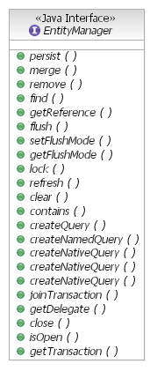
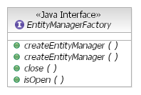
JPA 1.0 – API
An API for persisting, finding
and removing objects
  An EntityManager is used to manage persistent objects
    Handles the session (and caching) where the persistent objects lives when “managed”
  An EntityManagerFactory is used for creating EntityManagers

Slide 21
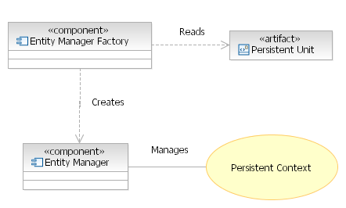
JPA 1.0 – Components
<persistence-unit name=“…">
<provider>…</provider>
<jta-data-source>…</jta-data-source>
<properties>…</properties>
</persistence-unit>
Heavyweight
Contains “Managed Entities”
Lightweight
Notes:
JPA guarantees uniqueness within a PC,
i.e. no need to implement equals() and
hashCode() for entities with non composite PK

Slide 22
JPA 1.0 – Types of Entity Managers/
Persistent Contexts
Application-Managed Persistence Context
  The application manages the Entity Manager,
  i.e. is responsible for
    Creation of Entity Managers
    Closing the Entity Managers (and its Persistent Context)
    Transaction demarcation
    Enlisting Entity Managers with global JTA Transactions, if any
    Coordinating Entity Managers and Active Transactions
  Typically used in a Java SE 5.0 environment

Slide 23
JPA 1.0 – Types of Entity Managers/
Persistent Contexts
Container-Managed Persistence Context
  All above is handled by the EJB 3.0 Container ☺
  Comes in two flavors
    Transaction-Scoped
      The Persistent Context is closed at transaction demarcation
    Extended
      The Persistent Context is open between transactions
      Requires a statefull session bean
      Updates queued until next transaction demarcation
Extended Persistent Context
Presentation
Transaction boundary
Tx-Scoped Persistent Context
Business
Data Access
Notes:
Utan EPC:
Visa:
- en find! VARFÖR???
- en get på Emp och Phone
Update
- en get på Emp och Phone av web-save
- en get på Emp och Phone av server merge
- en update på Emp

Slide 24
JPA 1.0 - Examples
Usage of JPA with Container Managed Persistence Context
Ejb 3.0 Session bean
@Stateless
public class EmployeeServicesBean implements EmployeeServices {
private EntityManager m_em = null;
@PersistenceContext(unitName="Hibernate_Derby_Jta")
public void setEntityManager(EntityManager em) {
m_em = em;
}
persistence.xml (JPA Deployment Descriptor)
<persistence-unit name="Hibernate_Derby_Jta" transaction-type="JTA">
<provider>org.hibernate.ejb.HibernatePersistence</provider>
<jta-data-source>jdbc/Jee5TestDb</jta-data-source>
<properties>
<property name="hibernate.dialect" value="org.hibernate.dialect.DerbyDialect" />
<property name="hibernate.hbm2ddl.auto" value="update" />
<property name="hibernate.show_sql" value="true" />
</properties>
</persistence-unit>
Pluggable JPA

Slide 25
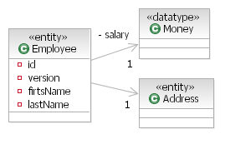
JPA 1.0 - Examples
Create a Employee and persist it
Ejb 3.0 Session bean
public Employee createEmployee(String firstName, String lastName, int salary...) {
Employee e = new Employee();
// Init the emp-object itself
e.setFirstName(firstName);
e.setLastName(lastName);
// Create an salary-object and update the emp
e.setSalary(new Money(new BigDecimal(salary), SEK));
// Create an address-object and update the emp
Address a = new Address();
a.setCity(city);
...
e.setAddress(a);
// We are done with the object graph, let's persist it...
m_em.persist(e);
return e;
}

Slide 26
JPA 1.0 - Examples
Find Employees using Queries
Ejb 3.0 Session bean
public List<Employee> findEmployees(int start, int max, String lastName) {
return m_em.createQuery(
"SELECT e FROM Employee e WHERE e.lastName LIKE :lastName
ORDER BY e.lastName, e.firstName")
.setParameter(“lastName", lastName + "%")
.setFirstResult(start)
.setMaxResults(max)
.getResultList();
}
Caller
List<Employee> empList = employeeServices.findEmployees(0, 10, “A”);
for (Employee employee : empList) {
System.out.println(
employee.getId() + ": " +
employee.getSalary().getAmount() + " " +
employee.getSalary().getCurrency());
}

Slide 27
JPA 1.0 - Examples
Find Employees using Named Queries
JPA 1.0 ORM.XML
<named-query name = "findEmp">
<query>
SELECT e FROM Employee e WHERE e.lastName LIKE :lname
ORDER BY e.lastName, e.firstName
</query>
</named-query>
Ejb 3.0 Session bean
public List<Employee> findEmployees(int start, int max, String lastName) {
return m_em.createNamedQuery("findEmp")
.setParameter(“lastName", lastName + "%")
.setFirstResult(start)
.setMaxResults(max)
.getResultList();
}

Slide 28
Where are we?
Bored of writing Data Access Objects?
Terminology
  ORM - Object Relational Mapping frameworks
  POJO based persistence
Introducing JPA…
  What is it?
  Examples!
Details & Guidelines
  Until time runs out…
Summary

Slide 29
JPA 1.0 - Details & Guidelines
Managed and Detached entities
Guidelines for Persistent Contexts
Lazy and Eager loading
Constructor expressions in queries
Cascading operations
Bulk Update and Delete
Validations

Slide 30
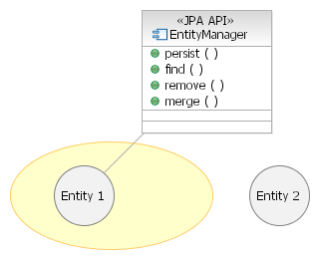
JPA 1.0 – Managed and Detached entities
Managed Entities
  Updates automatically saved
  Related objects automatically loaded
  (if required)
    E.g.:
    emp.getPhoneNumbers()
    results in
    SELECT … FROM PHONE_NUMBER…
Detached Entities
  Managed entities becomes detached when the Entity Manger is closed
  Becomes managed again after
  using the merge-operation
Persistent
Context
Managed entity
Detached entity

Slide 31
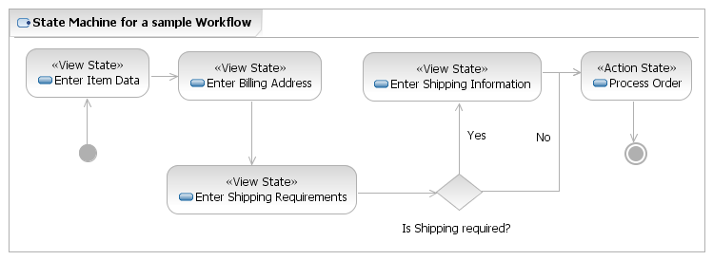
JPA 1.0 – Guidelines for Persistent Contexts (PC)
Use Container-Managed PC whenever possible
  Use Transaction-Scoped PC by default
  Consider using Extended PC for
    Well defined Workflows
  Note: See later on how JBoss Seam simplifies use of Extended PC!
Extended PC
Presentation
Tx-Scoped PC
Business
Data Access
Extended PC
is created!
Extended PC
is closed!

Slide 32
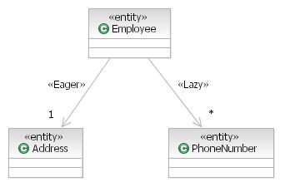
JPA 1.0 – Lazy and Eager loading
Controlling when related entities are loaded
  Eager
  Load related entities when
  the “parent” entity is loaded
  Lazy
  Load related entities if
  they are navigated to
Loaded when its
Employee is loaded
Only loaded when
navigated to

Slide 33
JPA 1.0 - Lazy and Eager loading
Lazy
@OneToMany(cascade=ALL, mappedBy = "owner", fetch=LAZY)
private List<PhoneNumber> phoneNumbers;
  Potential performance problem: Many small SQL statements
Eager
@OneToMany(cascade=ALL, mappedBy = "owner", fetch=EAGER)
private List<PhoneNumber> phoneNumbers;
  Potential performance problem: Too large SQL statements
Guideline
  Use lazy loading on relations and “fetch join” on queries
SELECT e FROM Employee e LEFT JOIN FETCH e.phoneNumbers WHERE ...
Notes:
@Entity
public class Employee {

Slide 34
JPA 1.0 - Constructor Expressions in queries
We only want
these fields
Normal queries return object graphs
Not suitable for queries
that only require some fields
in a complex object graph
  Don’t want to
    traverse the full object graph
    to get the fields
    populate object graph
    with unused fields
Constructor Expressions to the rescue!

Slide 35
JPA 1.0 - Constructor Expressions in queries
Example
POJO non - Entity bean
public class EmployeeReportData {
private String firstName;
private String lastName;
private String city;
private Date startDate;
public EmployeeReportData
(String firstName, String lastName, String city, Date startDate) {
this.firstName = firstName;
this.lastName = lastName;
this.city = city;
this.startDate = startDate;
}
// Setters and Getters...

Slide 36
JPA 1.0 - Constructor Expressions in queries
Example
Ejb 3.0 Session bean
public List<EmployeeReportData> findEmployeeReportData
(int startIndex, int maxResults, String lastName) {
return m_em.createQuery(
"SELECT new se.callista.jpa.dalitest.services.api.EmployeeReportData " +
" (e.firstName, e.lastName, a.city, e.employmentPeriod.startDate) " +
" FROM Employee e JOIN e.address a " +
" WHERE e.lastName LIKE :lastName ORDER BY e.lastName, e.firstName")
.setParameter("lastName", lastName + "%")
.setFirstResult(startIndex)
.setMaxResults(maxResults)
.getResultList();
}
Caller
for (EmployeeReportData row : employeeServices.findEmployeeReportData(0, 10, "")) {
System.out.println(row.getFirstName() + ", " + row.getLastName() + ", " +
row.getCity() + " " + row.getStartDate());
}

Slide 37
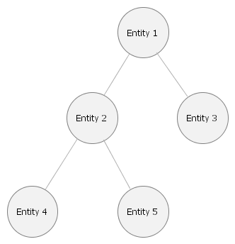
JPA 1.0 – Cascaded operations
Applicable for Entity Manager operations
  Persist
  Merge
  Remove
  Refresh
Defined per relationship
All new entities will be
persisted when the
entity manager persist
the top level entity
«Persist»
«Persist»
«Persist»
«Persist»

Slide 38
JPA 1.0 - Cascaded operations
Declaration
@OneToOne(cascade=ALL)
private Address address;
Very powerful but obviously very dangerous
  Persist, Merge and Remove operation can be propagated far beyond your expectations…
Guideline
  Do not overuse cascading operations
  Target well defined composites

Slide 39
JPA 1.0 - Bulk Update and Delete
Execute Updates and Delete directly against the database
We can still use the abstractions in the object model!
Warning: The Persistent Context is not updated!!!
  Usage
    In separate transactions
    As the first operation using Transaction-Scoped Persistence Contexts
@TransactionAttribute(REQUIRES_NEW)
public void assignManager(Department dept, Employee manager) {
em.createQuery(
"UPDATE Employee e SET e.manager = ?1 WHERE e.department = ?2 ")
.setParameter(1, manager)
.setParameter(2, dept)
.executeUpdate();
}
Notes:
@TransactionAttribute(TransactionAttributeType.REQUIRES_NEW)
public void assignManager(Department dept, Employee manager) {
em.createQuery("UPDATE Employee e " +
"SET e.manager = ?1 " +
"WHERE e.department = ?2 ")
.setParameter(1, manager)
.setParameter(2, dept)
.executeUpdate();
}

Slide 40
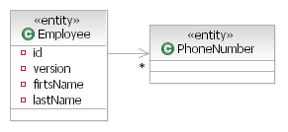
JPA 1.0 - Validations
Validation can be performed by using
Lifecycle Callback Methods
  Lifecycle Callback Methods
    PrePersist, PostPersist
    PreUpdate, PostUpdate
    PreRemove, PostRemove
    Throwing an exception will mark
    the current transaction for rollback
@Entity public class Employee {
@PreUpdate
@PrePersist
@PostPersist
public void validate() {
if (getPhoneNumbers() == null || getPhoneNumbers().size() == 0)
throw new ValidationException(INVALID_EMP_PHONE_MISSING);
}
Notes:
@PreUpdate
@PrePersist
public void validate() {
System.out.println("*** Creating an Employee with id = " + getId());
if (getPhoneNumbers() == null || getPhoneNumbers().size() == 0) {
throw new RuntimeException("*** You are not allowed to create an employee without setting its phonenumbers ***");
}
}

Slide 41
Summary
Start using JPA today!
  The JPA standard is based on well proven technology
  Huge vendor support
    Both from Open Source and from Product Vendors
  Do not start new projects using ORM framework proprietary API’s
    JPA support for vendor specific features can be used if really needed
  Secure skills if you are new to ORM frameworks
    The road from DAO/DTO J2EE Patterns to JPA have some pitfalls…
Notes:
To minimize risk for ”portability issues”
Select at least two candidate JPA implementations
Define automated test suites for your JPA code
Run the test suite as a part of you build process to ensure that your code works on the selected JPA implementations
Keep track of SQL statements created by the JPA implementation
You might get surprised from time to time…

Slide 42

Questions?

