Slide 1
Agile prototyping using Naked Objects
Ola Deibitsch
Callista Enterprise AB

Slide 2
Agenda
The Problem
Introduction
Adapting to unforseable requirements...
The Naked Objects Pattern
Layers?
Enriching object domain
Summary
Q&A

Slide 3
The Problem
Requirements that not relates to each other.
Requirements that don’t reflects the reality.
Not being able to explore the domain.
Not being able to verify the domain model.

Slide 4
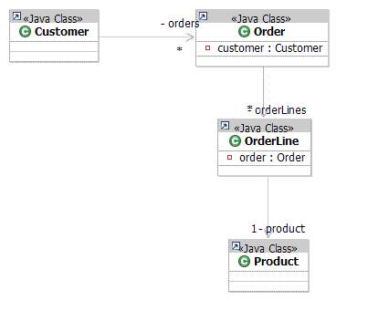
Introduction
A different and rapid approach in context of prototyping domain objects.
All about prototyping POJOs.
”On the fly” exploration capabillities.
User interface is automatically driven by business object definitions, i.e POJOs.
Helps to capture and modeling of business requirements.

Slide 5
Demo

Slide 6
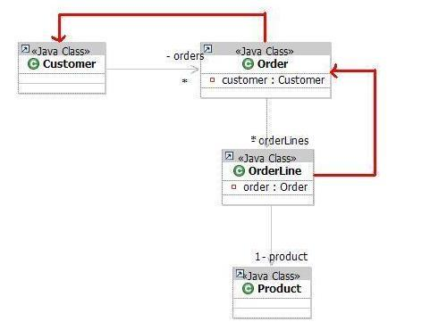
Adapting to unforseable requirements...
Adding relations
  Order --> Customer
  OrderLine --> Order

Slide 7
Demo

Slide 8
Naked Objects Pattern
”Behaviourally complete” domain objects
Encapsulate all the behaviour/functionality within the domain objects.
Single point definition
All the representations of a domain object such as user-interface, database-mapping, should be derived automatically from the domain object class itself.
Object-oriented user-interface (OOUI)
By exposing behaviorally-complete objects, users can view and interact with underlying domain objects, only by invoking its methods.

Slide 9
Layers?
3-Layer
Customer
Order
OrderLine
Product
CustomerForm
CustomerAction
OrderForm
OrderAction
ProductForm ProductAction
Non-layered
CustomerService
OrderService
ProductService
CustomerDto
OrderDto
OrderLineDto
ProductDto
CustomerDao
OrderDao
ProductDao

Slide 10
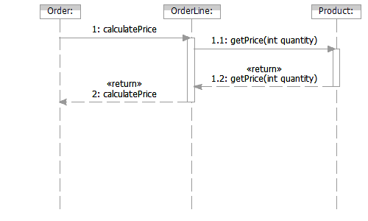
Enriching object behaviour
Order
  Add calculatePrice()
OrderLine
  Add calculatePrice()
Product
  Add getPrice(int quantity)

Slide 11
Demo

Slide 12
Summary
A different and rapid approach in context of prototyping domain models.
Helps in order to build an understanding of the domain and capture requirements.
Simulates business tasks from the beginning of the modeling activity.

Slide 13
Q&A
?

