Slide 1
Web dialogs as drop-in components
Killing the monolithic webapp
Håkan Dahl, Callista Enterprise AB
Notes:
This is a conceptual talk backed up with proof-of-concept (POC) code.

Slide 2
Agenda
Background
Problem
Vision
Demo
Solution
Conclusion
Notes:
show the purpose and how it works and then how it is done! (instead of some academic derivation of a solution-space)

Slide 3
Background
Concept born last year on Callista’s blogg
  response to typical web-related problems
  web-navigation is tricky!
  recurring pattern in customer projects
Valid context is medium-to-large web-applications
Notes:
concept born earlier this year on the Callista Enterprise blog (by JE)
valid contexts for concept are large webapplications where re-use AND/OR composition are wanted properties
References will sometimes be made to Struts 1 since that’s probably the most familiar web-framework

Slide 4
The problem
Web application development generally has these problems:
no re-use in presentation layer (at dialog level)
no modularization
navigation and state management
resulting in products with characteristics:
monolithic
  a single big piece of software containing all complexity
  implicit dependencies (brittle to change)
  no parts can be re-used (violating the “Don’t Repeat Yourself” principle)
expensive maintenance
Notes:
Further problems:
low development productivity

Slide 5
The vision
Composite web applications built from modules where:
dialogs are included in a webapp as jar-files (components)
no special config (in web.xml etc) needed to include a jar
dialogs can be put together to form ”modal” dialogs
the webapp (war-file) is only an assembly
robust navigation and state management
Advantages:
encapsulation of well defined functionality (high coherence)
enables re-use
components can be developed and tested ”standalone”

Slide 6
The vision - raising the bar for re-use
The level of re-use is traditionally at the service layer
  but we are aiming higher!
Typical re-use of presentation would be in:
  modal dialogs (the webapp equivalent to modal dialogs)
  search dialogs
  other webapp’s in the same system (for example admin-app)
Presentation layer
Service layer
Integration layer
Notes:
compare to typical Windows behaviour with modal dialogs

Slide 7
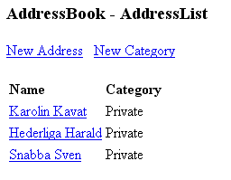
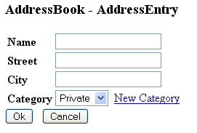
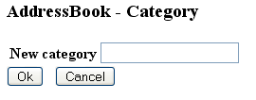
Navigation flow example
and the components!
re-used!
Notes:
show navigation
modal dialog + re-use of dialog
Comments
navigate back to the parent dialog where we came from (non-trivial in a structured way)
explicit component contracts with entry/exit points and input/output necessary – and enables re-use!

Slide 8
Demo
Proof-of-Concept!
Notes:
Runtime: Tomcat 5.5, Myfaces 1.1.4, Facelets 1.1.11
DEMO FLOW
create new address -> create new category OK!
create category -> open address and change!
compare to (for example): create an order – and then a previosly non-existing order-receiver (sometimes done in a not-so-user-friendly way: go back create the user and then the order)

Slide 9
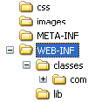

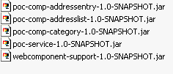
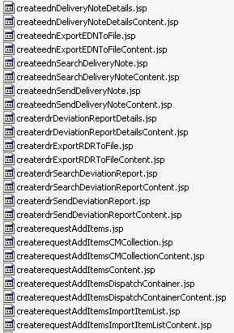
war-file content - compared to Struts 1
Struts1_webapp.war
poc-webapp-addressbook.war
loads of classes
and view files
view-components
service component
modularization support lib
The webapp has become
an assembly!
Notes:
Struts 1 comment:
effectively a monolithe (hard to re-use anything from a traditional webapplication)
POC
index-page only for forwarding to the entry-view
Assembly: compare to the Service Component Architecture (SCA) – but for the presentation layer
GAINS/LOSSES: +modularisering, -possible naming collisions (due to classloading of view files – a file can be in the same package-name in different JAR’s)
we need a naming convention!

Slide 10
The solution - how is it done?
Utilizing features of enabling technologies
  JSF (Java Server Faces)
  Facelets
Custom code to utilize feature for
  view resolution
Custom code for resource resolution
  stylesheets (CSS), JavaScript-files, images
Conventions for namespaces
Notes:
Solution overview!
It’s not another web-framework!
builds upon existing frameworks

Slide 11
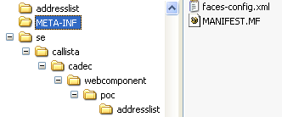
Enabling technology (1) - JSF
JSF (Java Server Faces)
  faces-config.xml (compare to struts-config.xml) can be modularized
  faces-config.xml has a well defined resolution order:
  first search META-INF –dir of JAR’s in classpath
faces-config.xml
poc-comp-addresslist-1.0-SNAPSHOT.jar
Backing bean class
Notes:
faces-config.xml handles navigation and backing bean declaration (compare to Struts Action’s)
Struts 1 and other JSP centric frameworks not usable for modularization
JSF faces-config.xml resolution order: 1) META-INF 2) web.xml 3) WEB-INF
Note: JSF 1.2 is standard in Java EE 5

Slide 12

Enabling technology (2) - Facelets
Rendering
  view-files must be able to exist in jar-file
  rules out JSP (which must exist in a web-root based path)
Facelets to the rescue! https://facelets.dev.java.net/
  xhtml-files as views
  view-files can be resolved from classpath with a custom View-resolver
poc-comp-addresslist-1.0-SNAPSHOT.jar
View-file
Notes:
Facelets taglibs are resolved against the META-INF-dirs in the classpath (like JSF resolves faces-config.xml)
web.xml:
<context-param>
<param-name>facelets.RESOURCE_RESOLVER</param-name>
<param-value>se.callista.cadec.webcomponent.support.FaceletsClasspathResourceResolver</param-value>
</context-param>

Slide 13


Resource resolution & Namespace
Custom servlet to resolve resources (images, stylesheets) requested by a web-browser for a view (classpath resolution)
Namespace to ensure resource uniqueness
poc-comp-addresslist-1.0-SNAPSHOT.jar
Same filename, would
collide without namespace
Component namespace
poc-comp-addressentry-1.0-SNAPSHOT.jar
Notes:
common resources not resolved from within components – see next page!
namespace would really be the base packagename of the component + ”view” but shortened here for illustration!
TODO: BUG in picture! MUST use path-mapping for servlet!

Slide 14

Common resources
Organisation wide resources like
  logotypes, images
  fonts and colors (stylesheet)
Not duplicated into every component
  common-resources jar
poc-resources-common-1.0-SNAPSHOT.jar
Reference in view-file
...
<img src="#{wct:ctxPath()}res/common/images/callistaenterprise.gif” />
...
path-mapping for servlet
Notes:
Comment on build system: Maven2 (or another dependency resolution) greatly helps when building with components!

Slide 15
Component contract
Contract is made up of
  entry/exit view
  in/out parameter
  scope (request, session, ...)
Navigation and state management
  use your own strategy with session state (quickly becomes messy!)
  or
  use a flow engine (like Spring WebFlow)

Slide 16
How to partition into components?
During analysis
Together with interaction design
Up-front design?

Slide 17
Conclusion
Concept works technically
  but is yet to be proven in a real-world application
Technology maturity
  Facelets is a growing community
Ways to adopt concept
  full adoption – use a flow engine for navigation and state management!
  only for modularity (no re-use)
Notes:
see concept as a tool in the architectural toolbox
bonus: Works with Portlets also (with a minor addition of a replacement for the JSP-taglib for <PORTLET/> to give unique identifiers to forms etc)

Slide 18

Questions

