Slide 1
How to Play Diplomacy
…And Lose Friends

Slide 2
“Luck plays no part in Diplomacy. Cunning, cleverness, and perfectly-timed betrayal are the tools needed to outwit your fellow players. The most skillful negotiator will climb to victory over the backs of both enemies and friends. Who do you trust?”
– Avalon Hill

Slide 3
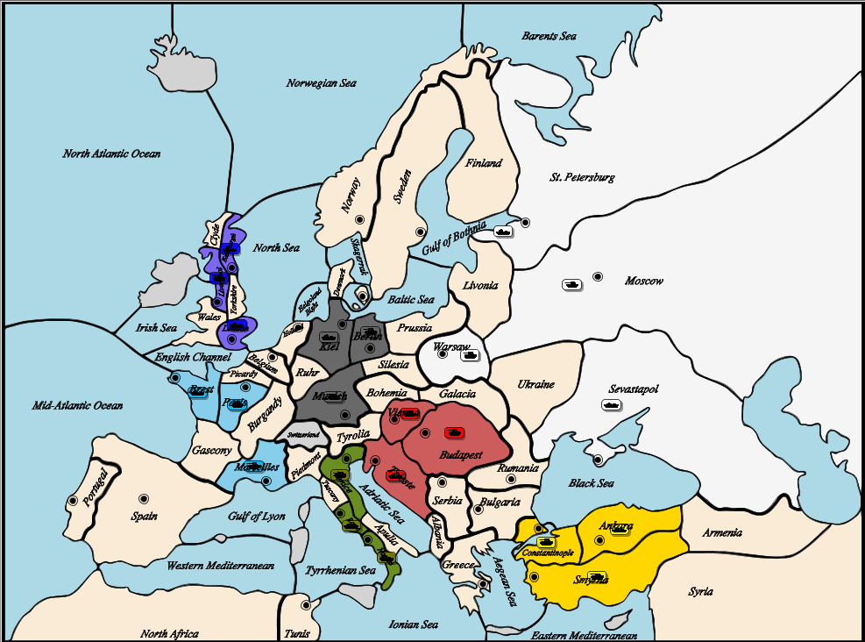

Slide 5
Three Game Phases
Spring: Negotiate, make orders, retreat as necessary.
Fall: Negotiate, make orders, retreat as necessary.
Winter: Build or destroy units until you have the same number of units as supply centers. (Units are built on unoccupied home supply centers.)

Slide 6
Two Timers
Round Timer
First Spring season will last 25 minutes.
All future seasons will last 13 minutes each.
Except winter seasons, which last 5 minutes.
Game Timer
The entire game will end after four hours (and the person with the most supply centers wins).

Slide 7
Army Unit
Fleet Unit

Slide 16
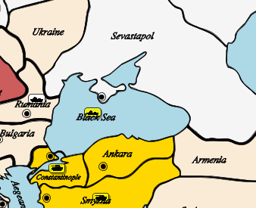

Slide 17
How to Play Diplomacy
…And Lose Friends

