Slide 1
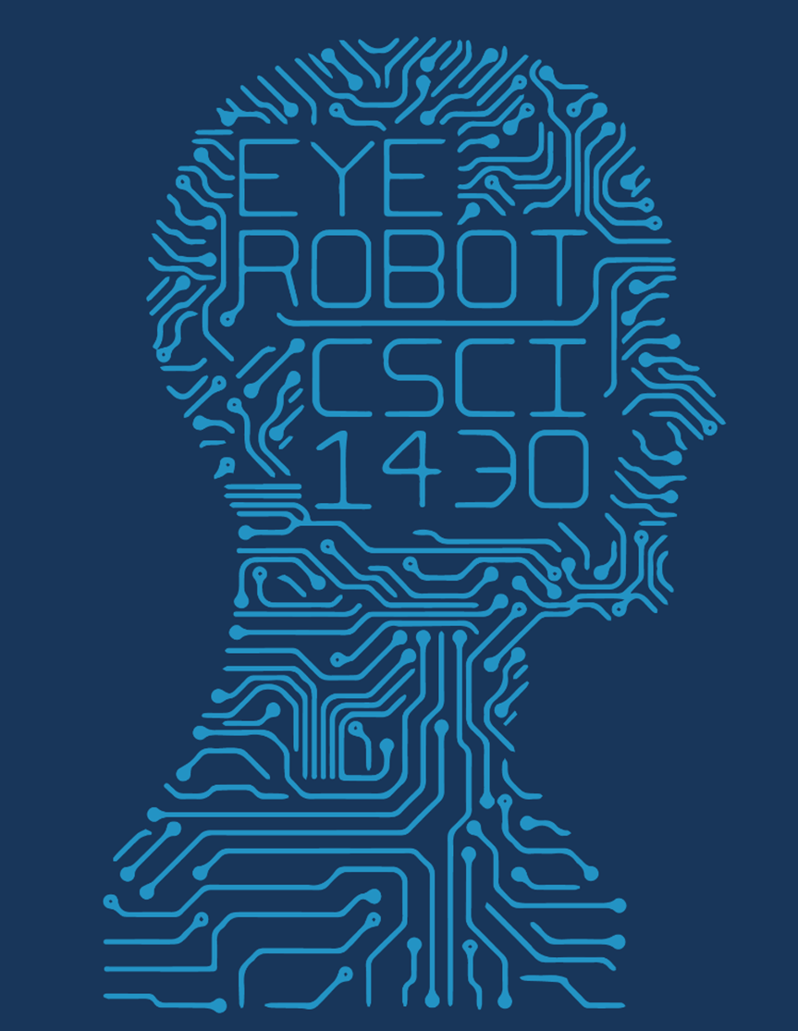
SuperZoom
Mary Dong, Peter Huson, Michael Litt, Gabe Weedon
Deep learning approach to finding missing resolution in images

Slide 2
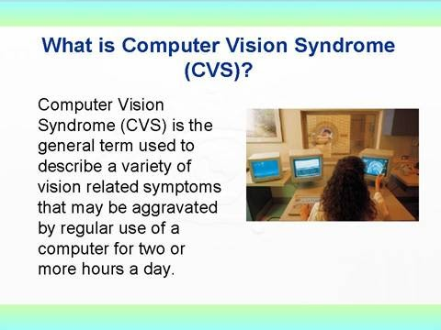
Do anything you like here. Maybe even change the background and text.
CSCI 1430
Notes:
Src: http://pkkindia.blogspot.com/2011/02/computer-vision-syndrome.html

