Slide 1







Computing secret key rates
Cite Qcrypt works – check list
Alice
Eve
Bob
QKD
QCrypt2024 Tutorial Peter Brown 4th September 2024

Slide 2











The key-rate problem
Alice and Bob want to share a secret key...
…so they do some QKD.
Alice
Bob
1001101...
1001101...
1001111...
Eve
They generate raw keys using their devices.
2. They correct errors (information reconciliation)
Asymptotic cost:
A and B observed
3. They extract randomness (privacy amplification)
Asymptotic gain:
E unknown
Asymptotic secret key rate: bits per round [DW04]

Slide 3

The entropy optimization problem
Want to study the following problem
Set of "attacks" depends on security model and protocol:
Device dependent
Alice
Bob
Characterized system
E.g. Known POVMs / state
Semi-device independent
Alice
Bob
Partially characterized system
See Armin's tutorial!
E.g. Known dimension
Device independent
Alice
Bob
Fully uncharacterized system

Slide 4


Entropy – a measure of uncertainty
We consider entropies of cq-states:
1. von Neumann: where
(average uncertainty)
2. min-entropy: where
(worst-case uncertainty)
Operational meanings
Lower bound on extractable epsilon-secure randomness [R05]
Asymptotically achievable rate of randomness extraction [R11]

Slide 5




Entropy – some properties
We have a few "intuitive" properties of entropy
1. Strong subadditivity
More information = Less uncertainty
2. Unitary / Isometry invariance If is a unitary / isometry and then
Unitaries / isometries preserve information
3. Inequalities

Slide 6
Device-dependent rates

Slide 7










Device-dependent QKD – data generation
Alice
Bob
Protocol round sketch
Distribute an entangled state
BB84 example
2. Alice and Bob measure with POVMs
and and announce (x,y).
2.
3. Alice and Bob generate raw key f(a,x,y) and
g(b,x,y).
3.
A - Alice's raw key B – Bob's raw key P – Public announcements
Procedure can be described by channel

Slide 8



Device-dependent QKD – Eve's attacks
Alice
Eve
Bob
Eve can manipulate the transmitted state
State at end of round
But she is still constrained...
Statistical
Prepare and measure

Slide 9







DD-QKD key rate problem
Alice
Eve
Bob
How much certifiable randomness does Alice generate in one-round?
x
x
x
Eve's attacks
Post-measurement states
Certifiable randomness
Post-measurement state
Valid quantum state
We have more constraints on Eve's attacks!

Slide 10

DD-QKD key rate problem
Alice
Eve
Bob
How much certifiable randomness does Alice generate in one-round?
x
x
x
Eve's attacks
Post-measurement states
Certifiable randomness
Post-measurement state
Valid quantum state
Linear constraints on
P(a,b,x,y)

Slide 11

DD-QKD key rate problem
Alice
Eve
Bob
How much certifiable randomness does Alice generate in one-round?
x
x
x
Eve's attacks
Post-measurement states
Certifiable randomness
Post-measurement state
Valid quantum state
Attacks
Linear constraints on
P(a,b,x,y)
Prepare and measure constraint

Slide 12


Simplifying the problem
E dimension a priori unbounded
Minimizing a concave function
Simplification 1: Eve can always purify!
(strong subadditivity)

Slide 13







Simplifying the problem
E dimension a priori unbounded
Minimizing a concave function
Isometric invariance of entropy
Tool: Isometric equivalence of purifications
If and are both purifications of . Then there exists an isometry
or
such that
or

Slide 14


Simplifying the problem
E dimension a priori unbounded
E dimension bounded
Minimizing a concave function
Simplification 2: All purifications are equivalent!
E system completely fixed now
Optimization reduced to Q_A and Q_B only

Slide 15


The simpler problem
Purify
x
x
x
x
Lemma:
Guaranteed to find optima!
The device-dependent rate problem is a convex optimization problem.
Efficient algorithms exist!

Slide 16





The simpler problem – convexity proof
Lemma:
The DD rate problem is a convex optimization problem.
Proof
Feasible set of is convex.
Need to check objective function is convex
Consider two feasible points and and let
Purification of

Slide 17
Current approaches
Computing DD key-rates is easy...
…because some nice people have done the hard work for us.
Ref. | Method | Language | Code
[VH24] | Franke-Wolfe / Interior point | Matlab | github.com/tvanhimbeeck/NonlinSDP
[AHNPT23] | Semidefinite optimization | Matlab | github.com/araujoms/qkd
[OpenQKD] | Franke-Wolfe / Interior point | Matlab | github.com/Optical-Quantum-Communication-Theory/openQKDsecurity
[LPCA24] | Conic optimization | Julia | github.com/araujoms/ConicQKD.jl
[Poster 114]
[Poster 87]
Specify protocol
Construct key channel
Pass to a package

Slide 18
Device-independent rates

Slide 19





Device-independence
Roger's Tutorial QCrypt2022 -- DIQKD Rotem's Tutorial QCrypt2019 -- DI Security proofs
Alice
Bob
Protocols executed on untrusted quantum hardware.
Protects against faulty / malicious hardware.
Circumvents the problem of device characterization.
A bit Difficult to implement...
Devices now characterized by
Some assumptions: 1. Inputs chosen randomly and independently 2. Devices can be shielded to prevent communication

Slide 20






Device-independence – key observation
Certain distributions only obtainable by the devices measuring shared entangled states.
Alice
Bob
Example (CHSH game)
Classical strategy
Quantum strategy
Expected winning
probability

Slide 21







The DI randomness problem
How much randomness is generated from Alice's device when x=0?
Alice
Bob
Eve
Eve is more powerful
Post-measurement state
Eve is still constrained though...

Slide 22
The DI randomness problem
Alice
Bob
Eve
How much randomness is generated from Alice's device when x=0?
(Post-measurement state)
Can be replaced with any linear constraints on p(a,b|x,y).
(Statistical constraints)
Dimension unbounded...
(Valid quantum system)
...need a new perspective

Slide 23



Toolbox: Polynomial optimization
[NPA07, PNA10]
Let's look at a simpler problem:
Dimension still unbounded
X are Hermitian
Parameter
Need a dimension-free compressed representation of a system...
… re-express everything in terms of moments!
Different from tracial hierarchies of Armin.

Slide 24

Toolbox: Polynomial optimization
Building a moment matrix:
Gather the operators of your problem

Slide 25

Toolbox: Polynomial optimization
Building a moment matrix:
Gather the operators of your problem
Index a matrix with the operators, the (X,Y) entry represents

Slide 26







Toolbox: Polynomial optimization
Building a moment matrix:
Gather the operators of your problem
Index a matrix with the operators, the (X,Y) entry represents
Compressed representation
of the system
We can simplify!
Hermitian X
Tr[rho] = 1
Tr[rho X1] = a
Tr[rho X2] = 0
Xi^2 = Id
Tr[rho] = 1

Slide 27








Toolbox: Polynomial optimization
Any feasible quantum system has a moment matrix of the form
(See Armin's tutorial)
Important: Moment matrices are always positive semidefinite.
Not tight in general
Achievable!
Semidefinite program (SDP) - Efficient algorithms - Guaranteed optima

Slide 28

Toolbox: Polynomial optimization
Moment matrix method gives SDP relaxations.
Better relaxations possible with larger indexing sets
"Level 2" relaxation
Relaxations converge to actual optima under mild conditions
Bounded operators sufficient
Applies to very general polynomial problems
Expectation of polynomial
Equalities and inequalities
Lots of applications beyond DI cryptography Review [TPBA24]
Operator constraints

Slide 29






Simple DI key-rate bounds
Alice
Bob
Eve
Maximum probability that Eve can guess A if Alice and Bob's boxes win with a CHSH score of w
Instead of von Neumann entropy let's bound the guessing probability.
Not quite a polynomial problem yet
Now we have a polynomial problem!
Relaxes the tensor product constraint.
Need to "forget" the tensor product

Slide 30



Simple DI key-rate bounds
Alice
Bob
Eve
Can no longer solve by hand but numerical tools are readily available:
Running the numerics we find:
Level 1 is not sufficient
Level 2 gives optimal bound [MPA11]

Slide 31
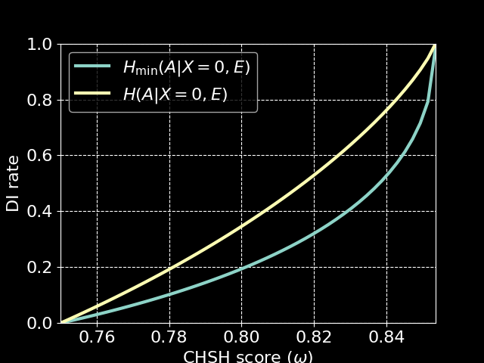
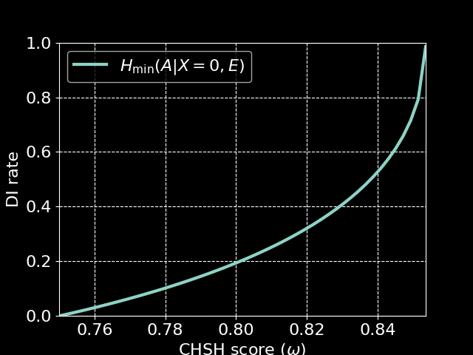
Min vs. von Neumann entropy
Alice
Bob
Eve
Guessing probability gives us a min-entropy bound
This lower bounds the von Neumann entropy
Valid lower bound on our randomness rates
Far from optimal...
[PABGMS09]

Slide 32
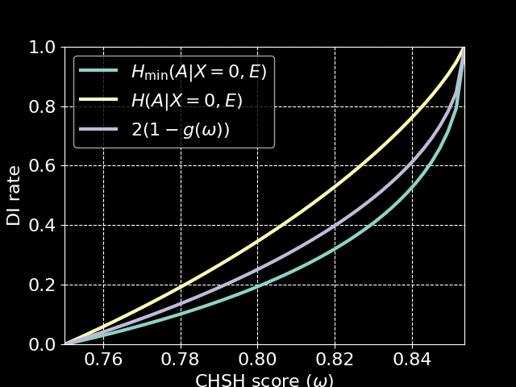

Better bounds on H(A|E)?
Goal: Find better numerical bounds on H(A|E)...
Better entropy inequalities: If A is uniform and binary then
[BH09]
Cheap fix
Limited scope
Better polynomial bounds: Bounds of the form
General and tight*
[TSGPL21, BFF21, BFF24]
Quickly too expensive
Hybrid bounds: Analytical reductions + numerics
Fast and tight
[MPW22]
Limited scope

Slide 33
Some other things I didn't talk about
Armin's tutorial
Semi-DI protocols
CV-QKD
(Exercise)
Poster 36
Analytical
rates
Automated protocol design
Numerical rates in practice
Poster 36, 87, 114

Slide 34
What's next?
More efficient numerical methods
Higher dimension protocols
Protocol optimization techniques

Slide 35
What's next?
More efficient numerical methods
Rényi entropy bounds (better finite size)
Higher dimension protocols
Protocol optimization techniques
Poster 100, 177
[VH24]

Slide 36
What's next?
More efficient numerical methods
Rényi entropy bounds (better finite size)
Exploration of the technique landscape
Higher dimension protocols
Protocol optimization techniques
Poster 100, 177
[VH24]
Correlation hierarchies
MDI / TF / SI
Device-dependent Techniques
Semi-DI protocols
Device-independent Techniques​

Slide 37
References
[BH09] Briët, Jop, and Peter Harremoës. "Properties of classical and quantum Jensen-Shannon divergence." Physical Review A—Atomic, Molecular, and Optical Physics 79.5 (2009): 052311.
[DW04] Devetak, Igor, and Andreas Winter. "Distillation of secret key and entanglement from quantum states." Proceedings of the Royal Society A: Mathematical, Physical and engineering sciences 461.2053 (2005): 207-235.
[R05] Renner, Renato. "Security of quantum key distribution." International Journal of Quantum Information 6.01 (2008): 1-127.
[R11] Renes, Joseph M. "Duality of privacy amplification against quantum adversaries and data compression with quantum side information." Proceedings of the Royal Society A: Mathematical, Physical and Engineering Sciences 467.2130 (2011): 1604-1623.
[VH24] Van Himbeeck, Thomas, "NonlinSDP: Interior-point solver for convex nonlinear optimisation over the semidefinite cone." Code available at https://github.com/tvanhimbeeck/NonlinSDP
[AHNPT23] Araújo, Mateus, et al. "Quantum key distribution rates from semidefinite programming." Quantum 7 (2023): 1019. Code available at https://github.com/araujoms/qkd
[OpenQKD] Open QKD Security Platform for numerical evaluation of secret key rates for general Quantum Key Distribution (QKD) protocols. Code available at https://github.com/Optical-Quantum-Communication-Theory/openQKDsecurity
[LPCA24] Lorente, Andrés González, et al. "Quantum key distribution rates from non-symmetric conic optimization." arXiv:2407.00152 (2024). Code available at https://github.com/araujoms/ConicQKD.jl
[LL+21] Liu, Wen-Zhao, et al. "Device-independent randomness expansion against quantum side information." Nature Physics 17.4 (2021): 448-451.
[PABGMS09] Pironio, Stefano, et al. "Device-independent quantum key distribution secure against collective attacks." New Journal of Physics 11.4 (2009): 045021.
[NPA07] Navascués, Miguel, Stefano Pironio, and Antonio Acín. "A convergent hierarchy of semidefinite programs characterizing the set of quantum correlations." New Journal of Physics 10.7 (2008): 073013.
[PNA10] Pironio, Stefano, Miguel Navascués, and Antonio Acin. "Convergent relaxations of polynomial optimization problems with noncommuting variables." SIAM Journal on Optimization 20.5 (2010): 2157-2180.
[MPA11] Masanes, Lluis, Stefano Pironio, and Antonio Acín. "Secure device-independent quantum key distribution with causally independent measurement devices." Nature communications 2.1 (2011): 238.
[TPBA24] Tavakoli, Armin, et al. "Semidefinite programming relaxations for quantum correlations." Accepted in Rev. Mod. Phys. arXiv:2307.02551 (2023).
[BFF21] Brown, Peter, Hamza Fawzi, and Omar Fawzi. "Computing conditional entropies for quantum correlations." Nature communications 12.1 (2021): 575.
[BFF24] Brown, Peter, Hamza Fawzi, and Omar Fawzi. "Device-independent lower bounds on the conditional von Neumann entropy" Quantum 8 (2024): 1445.
[TSGPL21] Tan, Ernest Y-Z., et al. "Computing secure key rates for quantum cryptography with untrusted devices." npj Quantum Information 7.1 (2021): 158.
[MPW22] Masini, Michele, Stefano Pironio, and Erik Woodhead. "Simple and practical DIQKD security analysis via BB84-type uncertainty relations and Pauli correlation constraints." Quantum 6 (2022): 843.

