Slide 1
Literary Analysis Using Control Charts
Peter Martinson

Slide 2

Introduction
Punctuation sets the rhythm of a story
Changing punctuation can create intensity
Control Charts can indicate phase changes in a story

Slide 3
Design of Experiment
Unit of Observation
Normalizing the Observations
Punctuation Rate
Paragraph
Sentences per Paragraph
Punctuation per Sentence in each paragraph

Slide 4
Analyzing a Paragraph
Paragraph 9, Legend of Sleepy Hollow
His schoolhouse was a low building of one large room, rudely constructed of logs; the windows partly glazed, and partly patched with leaves of old copybooks. It was most ingeniously secured at vacant hours, by a withe twisted in the handle of the door, and stakes set against the window shutters; so that though a thief might get in with perfect ease, he would find some embarrassment in getting out,--an idea most probably borrowed by the architect, Yost Van Houten, from the mystery of an eelpot. The schoolhouse stood in a rather lonely but pleasant situation, just at the foot of a woody hill, with a brook running close by, and a formidable birch-tree growing at one end of it. From hence the low murmur of his pupils’ voices, conning over their lessons, might be heard in a drowsy summer’s day, like the hum of a beehive; interrupted now and then by the authoritative voice of the master, in the tone of menace or command, or, peradventure, by the appalling sound of the birch, as he urged some tardy loiterer along the flowery path of knowledge. Truth to say, he was a conscientious man, and ever bore in mind the golden maxim, “Spare the rod and spoil the child.” Ichabod Crane’s scholars certainly were not spoiled.
Determine number of punctuation marks per sentence, for each paragraph.
6 sentences
2 semicolons
2/6 = 0.333 semicolons per sentence
His schoolhouse was a low building of one large room, rudely constructed of logs; the windows partly glazed, and partly patched with leaves of old copybooks.
It was most ingeniously secured at vacant hours, by a withe twisted in the handle of the door, and stakes set against the window shutters; so that though a thief might get in with perfect ease, he would find some embarrassment in getting out,--an idea most probably borrowed by the architect, Yost Van Houten, from the mystery of an eelpot.
The schoolhouse stood in a rather lonely but pleasant situation, just at the foot of a woody hill, with a brook running close by, and a formidable birch-tree growing at one end of it.
From hence the low murmur of his pupils’ voices, conning over their lessons, might be heard in a drowsy summer’s day, like the hum of a beehive; interrupted now and then by the authoritative voice of the master, in the tone of menace or command, or, peradventure, by the appalling sound of the birch, as he urged some tardy loiterer along the flowery path of knowledge.
Truth to say, he was a conscientious man, and ever bore in mind the golden maxim, “Spare the rod and spoil the child.”
Ichabod Crane’s scholars certainly were not spoiled.
Semicolons (;)

Slide 5

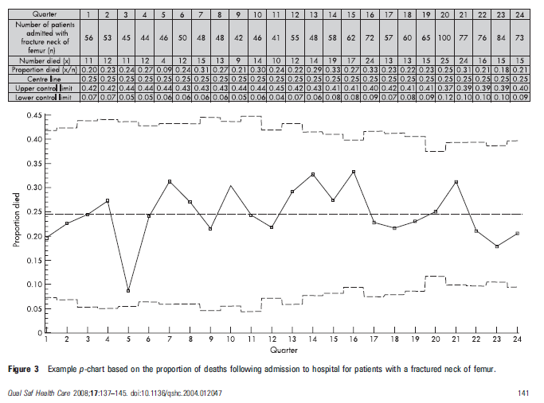



Percentage Control Chart (p-chart)
Upper Control Limit =
Proportion (%) =
Central Line
Lower Control Limit =

Slide 6
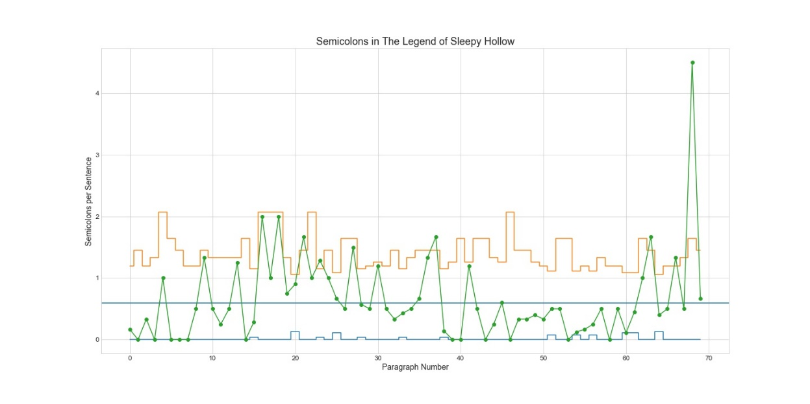
Data: The Legend of Sleepy Hollow
Notes:
Lower limit stops at 0 – no negative occurrences
Constant underlying probability of occurring
Events are independent of each other
Events are binary (not quite here!!)

Slide 7
Possible special cause variations
Outside the Limits
Trend of six
Run of eight

Slide 8
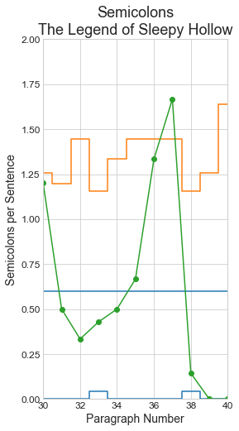
Results: Trend of Six
System going out of control
Author builds anticipation
Ichabod goes to the dance

Slide 9
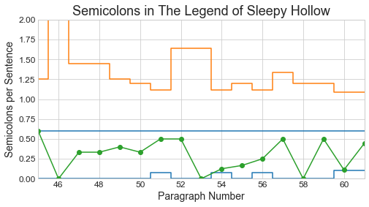
Results: Run of Eight
Indicates “System Change”
Author sets up the final chase
Ichabod listens to stories about the Headless Horseman

Slide 10
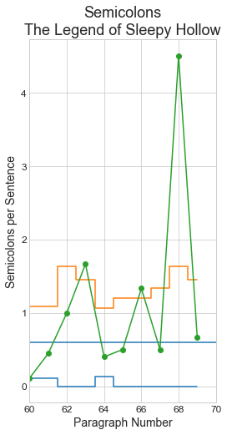
Results: Outside the Limits
3
System clearly out of control!
Final chase by Headless Horseman
The search for Ichabod
Rumors of Ichabod still alive
Author completes the story, varies attention quickly.
1
2

Slide 11
Summary
Control charts (esp. p-charts) can be used to analyze phases of a short story
Control charts can indicate increasing intensity
Next steps: Analyze more stories!

Slide 12
Citations
https://blog.minitab.com/blog/statistics-and-quality-improvement/laney-p-prime-charts-show-how-poe-creates-intensity-in-the-fall-of-the-house-of-usher

