Slide 1

Restaurant Site selection for Miami
Applied Data Science Capstone project

Slide 2
One of the principal reasons why new restaurants fail is location.
It would make sense to research suitable locations before investing money to open a new restaurant.
The geographic area that this project will focus on is the city of Miami, Florida.
This will be of interest to anyone planning to open a new restaurant in Miami.

Slide 3
Data acquisition and cleaning
We will rely on the Foursquare location data for the neighborhoods of Miami for information on existing restaurants. For information on planned restaurants there is data available at https://gis-mdc.opendata.arcgis.com/ from Miami-Dade county which includes the city of Miami. For neighborhood location data we will use data from https://en.wikipedia.org/wiki/List_of_neighborhoods_in_Miami . This site also includes population size and density and average income data. Currently the site shows 25 neighborhoods but this may be reduced after Data Cleaning due to e.g. missing data (see below). For the Midtown neighborhood data source is http://www.city-data.com/neighborhood/Midtown-Miami-FL.html . Income data for Grapeland Heights neighborhood was obtained from https://www.point2homes.com/US/Neighborhood/FL/Grapeland-Heights-Demographics.html .
The BeautifulSoup tool https://www.crummy.com/software/BeautifulSoup/bs4/doc/ will be used to scrape data from the required websites. An obvious problem with using neighborhoods as the basis of analysis is the variation in size and shape of the neighborhoods. This affects, for example, the radius size of the search and explore features of Foursquare. Instead of using a standard radius we will use the population density and size to estimate the radius

Slide 4
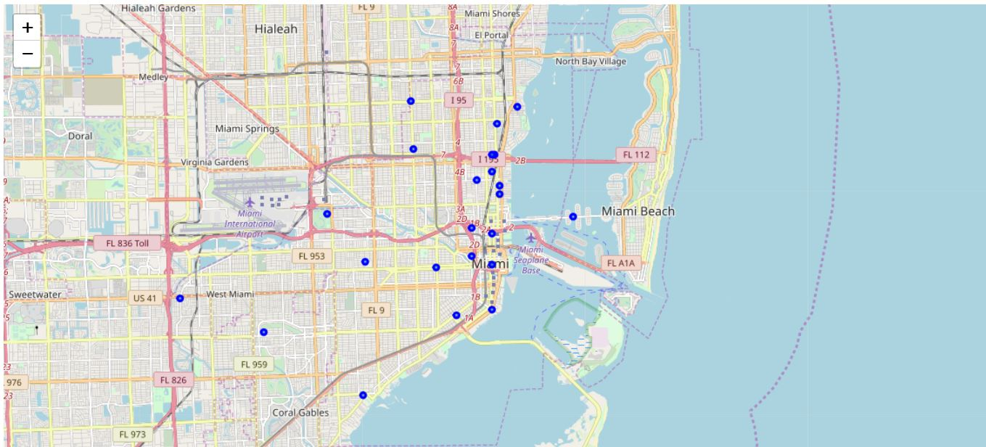
Target Area

Slide 5
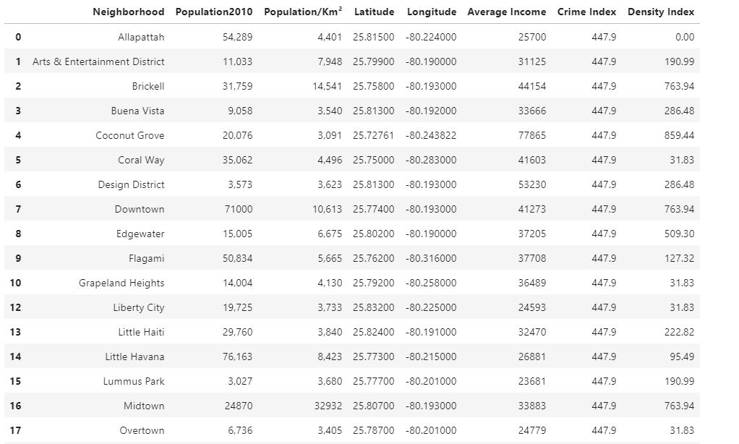
Miami Neighborhood Data

Slide 6
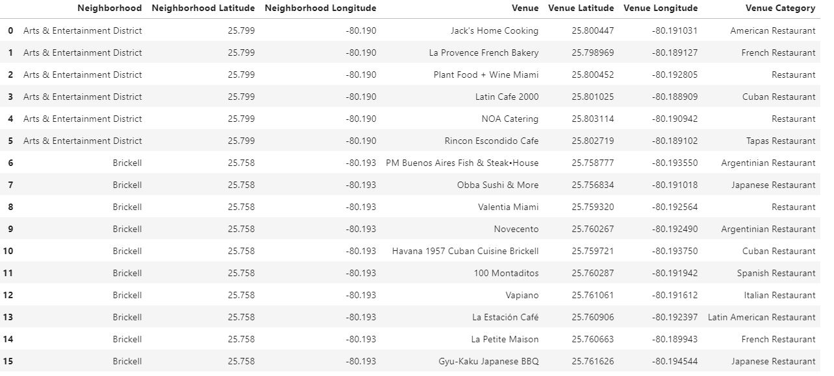
Restaurant Data from Foursquare

Slide 7
Restaurant Density Calculation
Density Index = (R * T) / π, where T = number of restaurants reported by Foursquare for the neighborhood, R = circle radius passed to Foursquare in the explore query.
A radius of 100 was used.

Slide 8
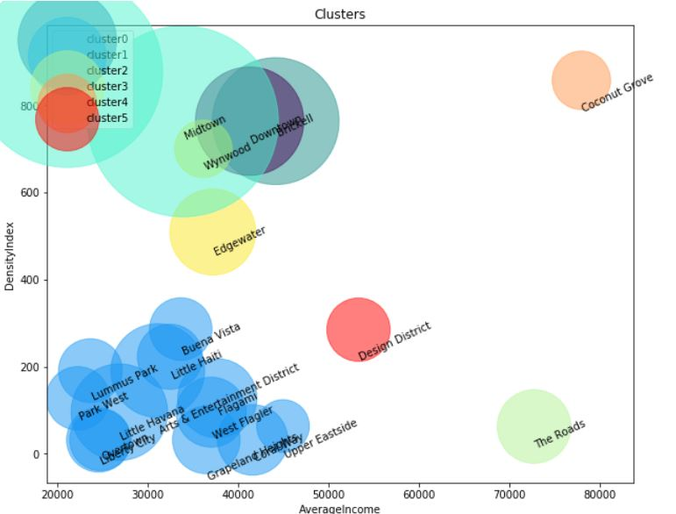
Agglomerative Clusters

Slide 9
Recommendation
The Miami neighborhoods of The Roads and Design District would be the best choices for location of a new restaurant.

Slide 10

Thank You!
Peter McGranaghan

