Slide 1
Project: Steambuddy – Games Recommender
623.503 Advanced Software Engineering
Jochum Peter
Lila Keti
Marktl Daniel
Starzacher Philipp
Zenzmaier Florian

Slide 2
Backend – Layered Architecture
Provides a clean path from REST Entrypoint to the database
Makes it easy to extend the backend without modifying existing elements (OCP)
REST Controller
Entrypoint to accept incoming REST Calls
Service
Modifies the data as needed
Repository
Retrieves the data from the database
REST Controller
Service
Repository

Slide 3
Frontend
Bootstrap v4.5
Components
Game-list
Displays a list of recommended games
Game-service
Communicate with backend services using HTTP
Game
Angular interface which holds information for the games
Footer
Basic footer information
Navbar
Search box , home, menu

Slide 4
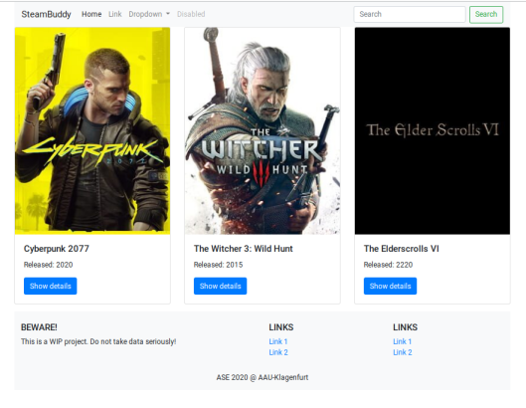
Screenshot of the current work

