Slide 1
Calculation matrix elements in XMS-CASPT2
Peter John Cherry
Shiozaki group meeting
September 6th 2017

Slide 2

Derivatives of XMS-CASPT2 wavefunctions
The XMS-CASPT2 energy is not minimized with respect to the CI and orbital coefficients obtained in the CASSCF calculation.
This makes differentiating it with respect to perturbations of the Hamiltonian difficult.
Accordingly, a Lagrangian is defined, which is minimized with respect to these variables:
Typically, differentiating this Lagrangian with respect to some perturbative parameter is much easier than differentiating the XMS-CASPT2 energy.

Slide 3
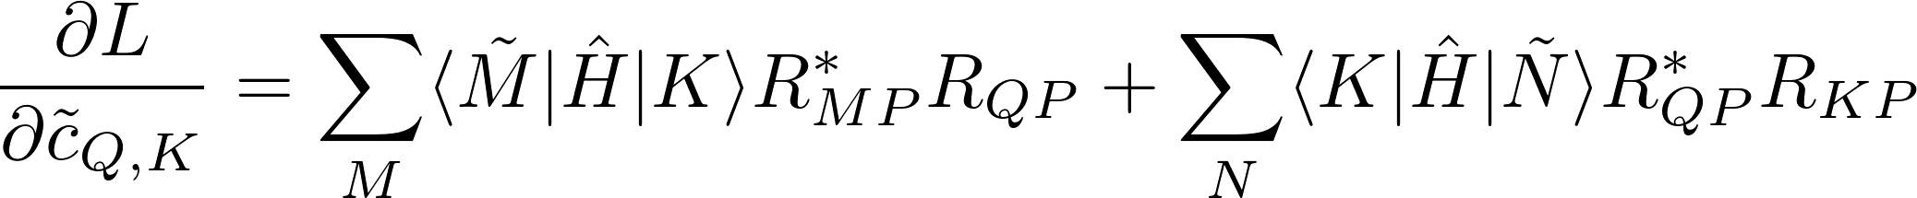
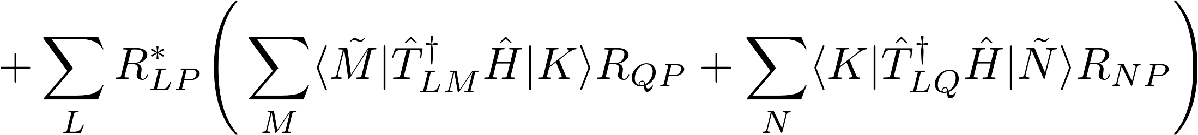
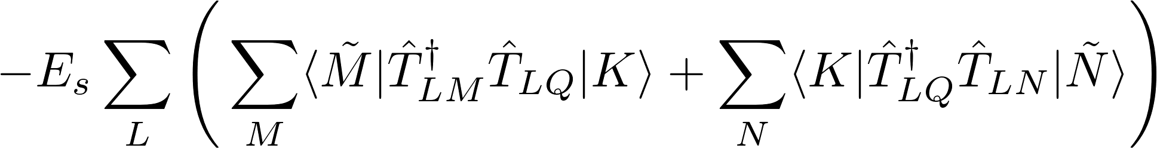
CI derivatives

Slide 4
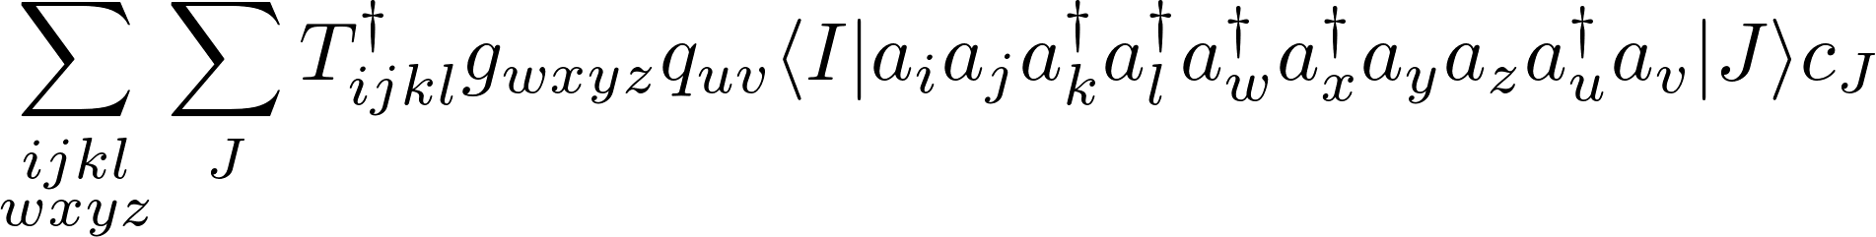
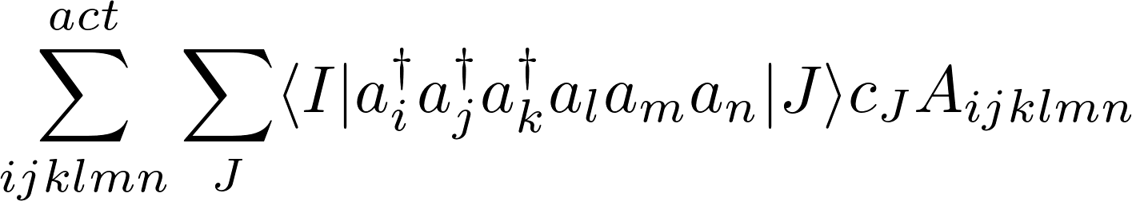
Calculation of matrix elements for many electron operators
Need a generic approach for evaluating terms of the form
SMITH3 generates code of evaluating these integrals.
Jae developed and implemented and algorithm such that the most costly term is
This is highly efficient, but unfortunately, it is not as well suited to the cases with spin-flipping interactions.

Slide 5

Derivatives of XMS-CASPT2 wavefunctions
In a relativistic framework, magnetic properties are often obtained via the principal of minimal coupling:
Here is describes the perturbation.

Slide 6
CI derivatives

Slide 7
CI derivatives

Slide 8
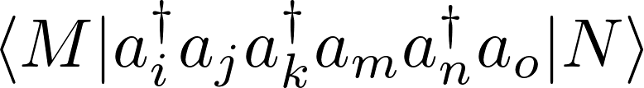
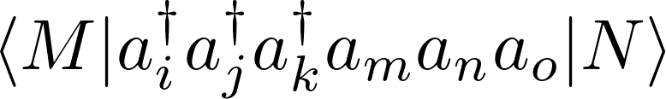
Calculation of matrix elements for many electron operators
Main differences in new code:
      Takes advantage of time reversal symmetry in the relativistic case.
      Does not express the matrix element as a sum of normal ordered terms, instead uses alternating order, e.g.,
      Operators may be repeatedly reordered so as to take advantage of symmetry conditions.
      Currently does not generate code; instead uses a generic algorithm.
not

Slide 9


Method outline
Step 1 : Read in tensors corresponding to operators represented in the molecular orbital basis.
Step 2 : Use constraints and symmetry conditions to determine unique blocks.
Step 3 : Determine all possible contractions, , of these tensors.
Step 4 : Calculate matrices for the relevant spin sector.
Step 5 : Contract matrices with the relevant .
Guiding principal : Relativistic and non-relativistic cases should be treated using the same basic algorithm.

Slide 10
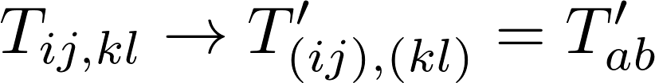
Methodological outline
Step 1a : Read molecular orbital representations of operators, their symmetry conditions and constraints.
Step 1b : Flatten pairs of indices, e.g,
Step 1c : Decompose the matrix into blocks, and using the constraints and symmetry relations to determine which ones vanish or are equivalent, e.g.,
Step 1d : Construct a map which can be used to identify only those matrix elements which are necessary.

Slide 11





Application of block symmetry
Example : CASPT2 perturbation coefficients .
Possible transitions

Slide 12




Application of block symmetry
Example : CASPT2 perturbation coefficients .
Possible transitions

Slide 13
Application of block symmetry
Example : CASPT2 perturbation coefficients .
Possible transitions

Slide 14
Application of block symmetry
Example : CASPT2 perturbation coefficients .
Possible transitions

Slide 15
Block specific permutation symmetry
Within each block the ranges of the indices are constrained to specific ranges.
For a given block, it may be that two indexes cannot be interchanged, as their ranges are different.
Hence the permutation symmetry varies between blocks.

Slide 16
Application of symmetry
Example : CASPT2 perturbation coefficients .
Possible transitions

Slide 17
Method outline
Step 1 : Read in tensors corresponding to operators represented in the molecular orbital basis.
Step 2 : Use constraints and symmetry conditions to determine unique blocks.
Step 3 : Determine all possible contractions, , of these tensors.
Guiding principal : Relativistic and non-relativistic cases should be treated using the same basic algorithm.
→ Relativistic wavefunctions just have twice as many blocks (from spin), and extra symmetry relations.

Slide 18
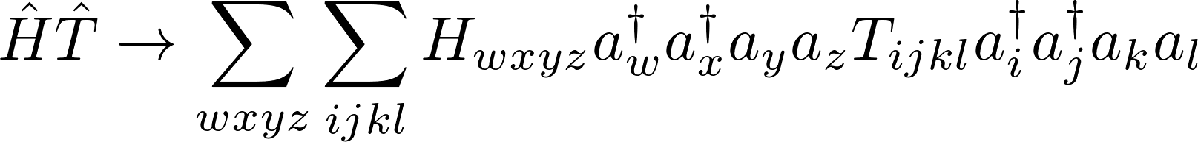
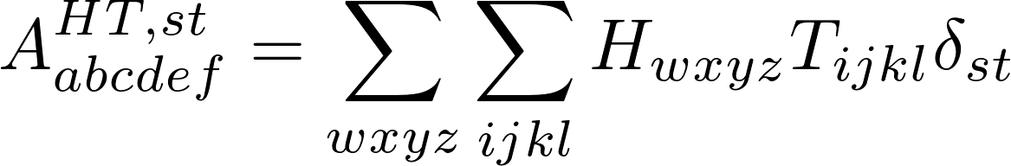


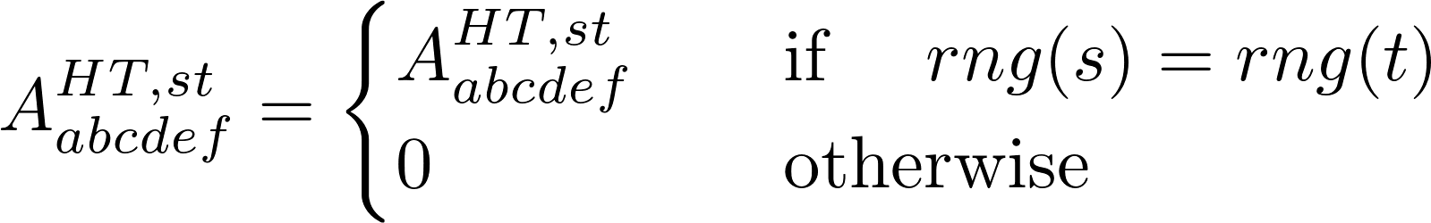
Contraction of tensor blocks
Step 3a : Contract over all possible pairs of indexes, e.g.,
Step 3b : Use the block range constraints to rule out possible contractions, e.g.

Slide 19
Method outline
Step 1 : Read in tensors corresponding to operators represented in the molecular orbital basis.
Step 2 : Use constraints and symmetry conditions to determine unique blocks.
Step 3 : Determine all possible contractions, , of these tensors.
Step 4 : Calculate matrices for the relevant spin sector.
Guiding principal : Relativistic and non-relativistic cases should be treated using the same basic algorithm.
→ Relativistic wavefunctions just have twice as many blocks (from spin), and extra symmetry relations.

Slide 20
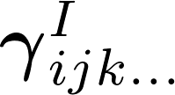
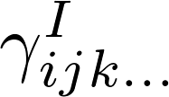

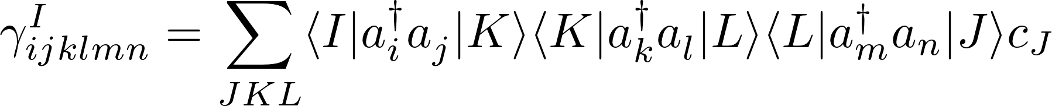
Calculation of
Step 4e : Calculate from a product of , e.g.,
Alternating order facilitates merging of terms and has some useful qualities.

Slide 21






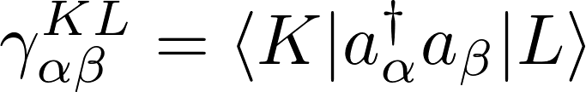


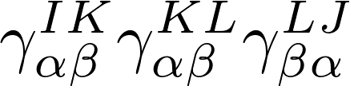





Spin transition pathways
Representation in terms of individual transitions can help with application of
symmetry :
Spin sector

Slide 22
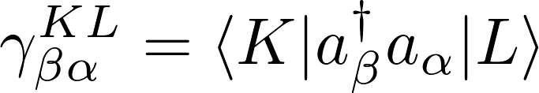
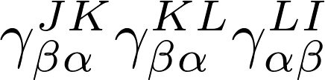
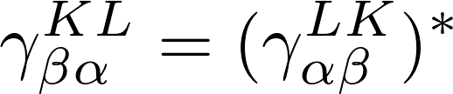
Spin transition pathways
“Forwards” and “backwards” transitions are connected by time reversal
Spin sector

Slide 23
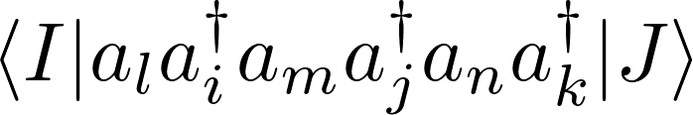
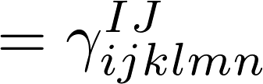
Calculation of
Step 4a : First take creation and annihilation operators in order specified by input operator, e.g.,
Step 4b : Rewrite in normal order:
Step 4c : Remove terms which known to be zero from index ranges.
Step 4d : Repeat process, but reorder to alternating order

Slide 24

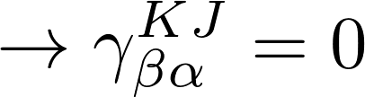
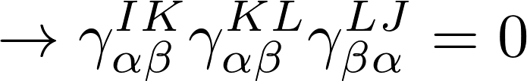
Spin transition pathways
Application of spin constraints is more straightforward
Spin sector

Slide 25
Spin transition pathways
Application of spin constraints is more straightforward
Spin sector

Slide 26


Calculation of
Step 4 : Calculate from a product of , e.g.,
Alternating order enables merging of terms and some useful properties.
All indexes must be active, but can be or .
The program is designed so that arbitrary range constraints, not necessarily involving spin, can be placed upon the indexes.

Slide 27
Method outline
Step 1 : Read in tensors corresponding to operators represented in the molecular orbital basis.
Step 2 : Use constraints and symmetry conditions to determine unique blocks.
Step 3 : Determine all possible contractions, , of these tensors.
Step 4 : Calculate matrices for the relevant spin sector.
Step 5 : Contract matrices with the relevant .
Guiding principal : Relativistic and non-relativistic cases should be treated using the same basic algorithm.
→ Relativistic wavefunctions just have twice as many blocks (from spin), and extra symmetry relations.

Slide 28
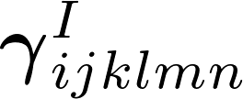

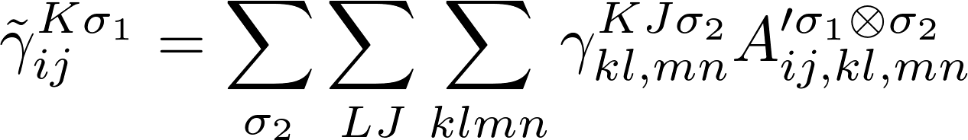
Contraction of and
Step 5 : Perform contraction in two steps:
Where
and
This step should be comparable in speed to the most expensive step of the current algorithm.

Slide 29
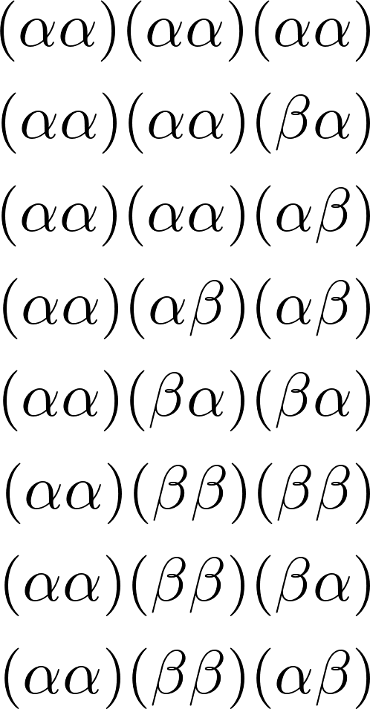
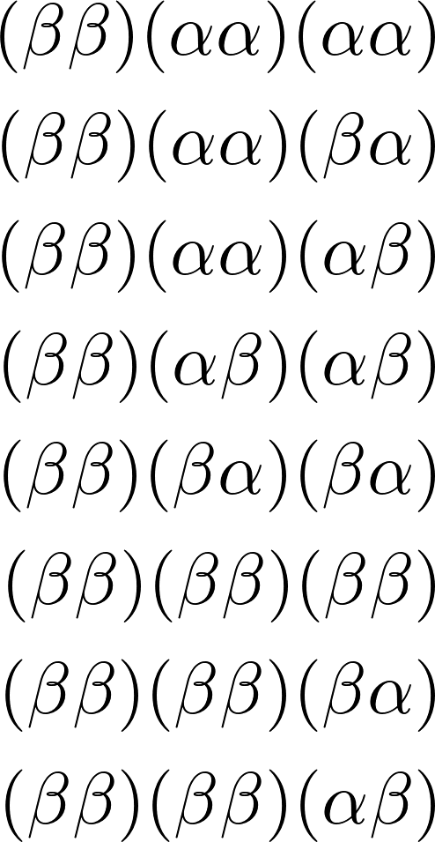


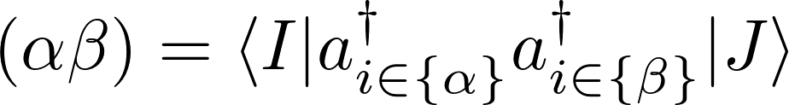
Calculation of
Use CAR relations to minimize the number of spin flipping terms, and ensure they are always grouped on the right, i.e.,
Guarantees that the number of contractions to be performed in step 5 is at worst 18
(typically far fewer due to symmetry).

Slide 30
Method outline
Step 1 : Read in tensors corresponding to operators represented in the molecular orbital basis.
Step 2 : Use constraints and symmetry conditions to determine unique blocks.
Step 3 : Determine all possible contractions, , of these tensors.
Step 4 : Calculate matrices for the relevant spin sector.
Step 5 : Contract matrices with the relevant .
Guiding principal : Relativistic and non-relativistic cases should be treated using the same basic algorithm.
→ Relativistic wavefunctions just have twice as many blocks (from spin), and extra symmetry relations.

