Slide 1
Calculation of derivative properties in XMS-CASPT2
Peter John Cherry
Shiozaki group meeting
October 3rd 2017

Slide 2

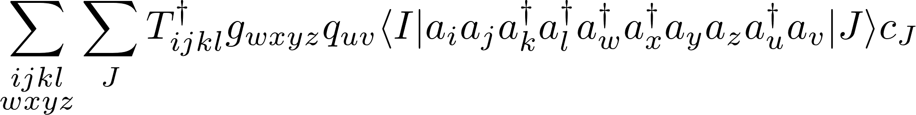
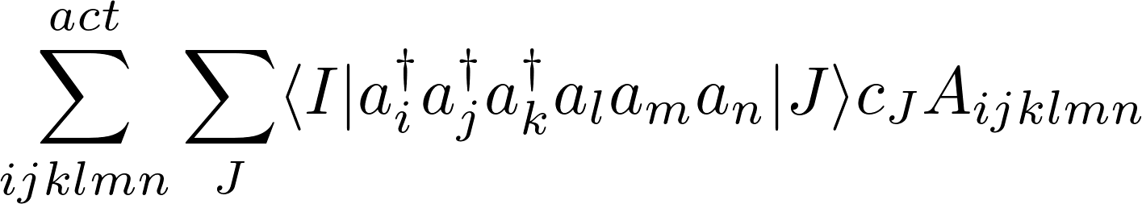
Calculation of matrix elements for many electron operators
Need a generic approach for evaluating terms of the form
SMITH3 generates code of evaluating these integrals.
Jae developed and implemented and algorithm such that the most costly term is
This is highly efficient, but unfortunately, it is not as well suited to the cases with spin-flipping interactions.

Slide 3
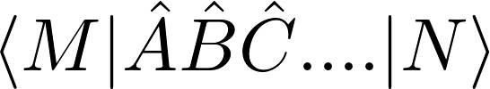
Outline of new approach
Aim to produce routine which can calculate arbitrary BraKet:
Should take advantage of symmetries, and range constraints.
The program uses the following information to construct an object associated with each operator:
        Number of indices.
        Position of creation and annihilation operators.
        Range of indices.
        List of symmetry functions and constraints.
        If the operator couples spin and spatial components.
A braket object is then built from a vector of such objects.
The program then uses this information to build a list of operations (tensor contractions and additions) which need to be performed.

Slide 4
Distinction from current approach
Cannot calculate CI-derivatives for four component wavefunctions using the current approach.
New approach should incorporate symmetry more effectively, particularly symmetries associated with spin.
New approach repeatedly reshuffles the indexes in order to take advantage of constraints on the indices.
Final expressions are not normal ordered, and a different algorithm is used for evaluating the CI derivatives.
Using a generic algorithm, not generated code.

Slide 5
Outline of method
    Step 1 : Get operator information.
        Split input tensors up into blocks.
        Generate all possible contractions of these blocks.
        Identify which blocks/contracted blocks are equivalent.
    Step 2 : Manipulate indexes.
        Rearrange indexes to normal order, applying range constraints.
        Put indexes into alternating order and group common indexes.
    Step 3 : Generate computational proceedure.
        Merge all contributions from different brakets.
        Generate a task list to obtain contracted A-tensors.
    Step 4 : Execute computational proceedure.
        Contract A-tensors with gamma matrices.
    Step 5 : Loop over spin sectors and states.
        Repeat for all necessary spin sectors.

Slide 6
Outline of method
    Step 1 : Get operator information.
        Split input tensors up into blocks.
        Generate all possible contractions of these blocks.
        Identify which blocks/contracted blocks are equivalent.
    Step 2 : Manipulate indexes.
        Rearrange indexes to normal order, applying range constraints.
        Put indexes into alternating order and group common indexes.
    Step 3 : Generate computational proceedure.
        Merge all contributions from different brakets.
        Generate a task list to obtain contracted A-tensors.
    Step 4 : Execute computational proceedure.
        Contract A-tensors with gamma matrices.
    Step 5 : Loop over spin sectors and states.
        Repeat for all necessary spin sectors.
Working here now

Slide 7
Outline of method
    Step 1 : Get operator information.
        Split input tensors up into blocks.
        Generate all possible contractions of these blocks.
        Identify which blocks/contracted blocks are equivalent.
    Step 2 : Manipulate indexes.
        Rearrange indexes to normal order, applying range constraints.
        Put indexes into alternating order and group common indexes.
    Step 3 : Generate computational proceedure.
        Merge all contributions from different brakets.
        Generate a task list to obtain contracted A-tensors.
    Step 4 : Execute computational proceedure.
        Contract A-tensors with gamma matrices.
    Step 5 : Loop over spin sectors and states.
        Repeat for all necessary spin sectors.
Problem area.
Problem area.
Working here now

Slide 8
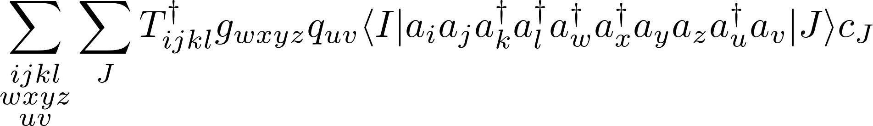
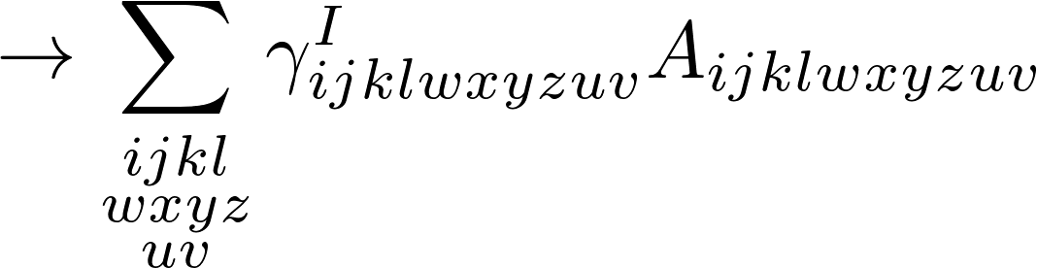
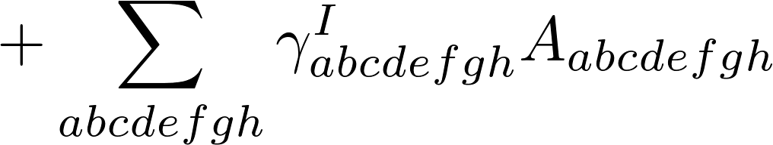
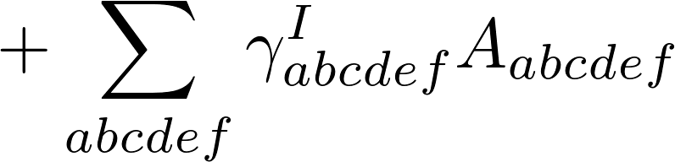
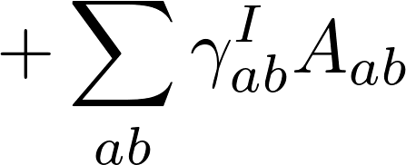
Generation of contraction task list
Most terms are too complicated to evaluate directly, e.g.,
Reordering indexes to represent as sum of contractions:

Slide 9
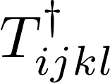



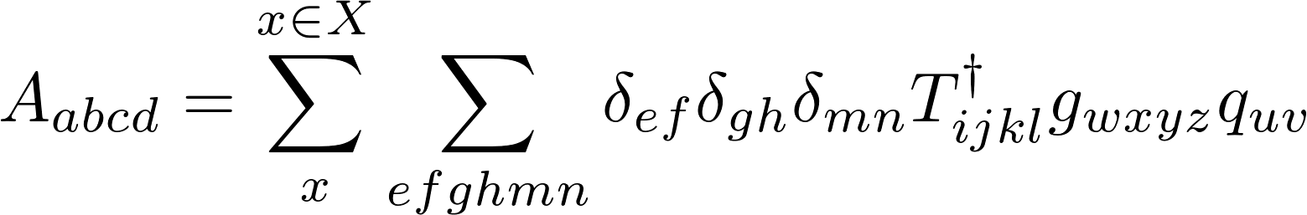

Generation of contraction task list
Each A-tensor is defined by the original operators, , , , and a set, , of contraction indices and factors:
Each contribution, , to the A-tensor is obtained by performing a recursive sequence of operations:

Slide 10
Generation of contraction task list
The sequence of the operations is the task list.
How the task list is built can significantly influence the computational cost.
Currently using the following tactics to reduce cost:
    Standardize order in which contractions are performed (facilitates term reuse).
    Reorder indexes so that simlar indexes are together (facilitates term reuse).
    Perform all intra-tensor contractions before any inter tensor contractions (reduces maximum dimension of tensor to be contracted).
    Never store product tensors.

Slide 11
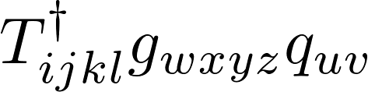
Contraction tree

Slide 12




Contraction tree

Slide 13







Contraction tree

Slide 14










Contraction tree

Slide 15
Contraction tree

Slide 16
Generation of contraction task list
Each A-tensor is defined by the original operators, , , , and a set, , of contraction indices and factors:
Each path from top to bottom corresponds to a member of .
Order of contractions is not important.
Reorder the individual members of to get the most efficient tree.

Slide 17





Application of block symmetry
Example : CASPT2 perturbation coefficients .
Possible transitions

Slide 18




Application of block symmetry
Example : CASPT2 perturbation coefficients .
Possible transitions

Slide 19
Application of symmetry
Example : CASPT2 perturbation coefficients .
Possible transitions

Slide 20




Application of block symmetry
Gaunt (or Breit) term:
Possible transitions

Slide 21
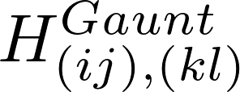
Application of block symmetry
Example : Gaunt (or Breit) term:
Possible transitions

Slide 22
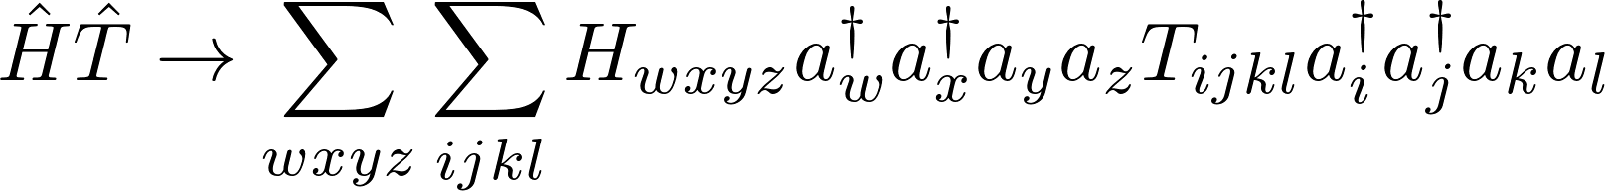
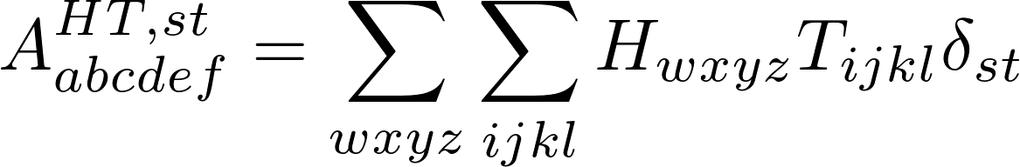


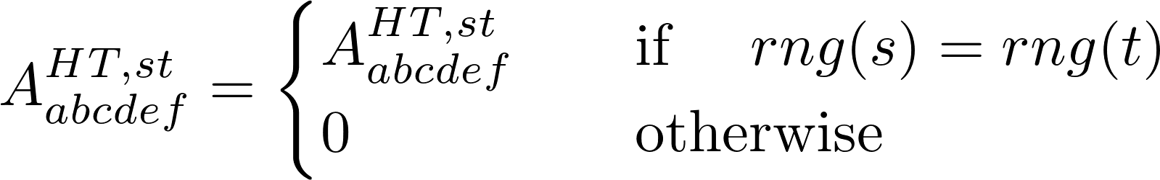
Contraction of tensor blocks
Contract over all possible pairs of indexes, e.g.,
Use the block range constraints to rule out possible contractions, e.g.
Contraction list is different for every range block.

Slide 23
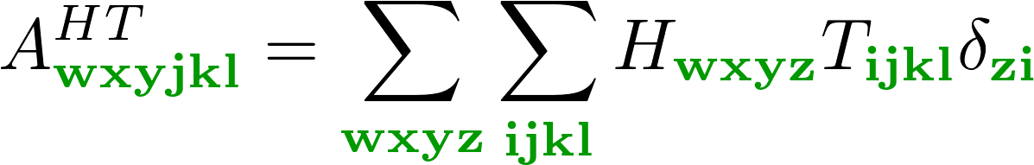

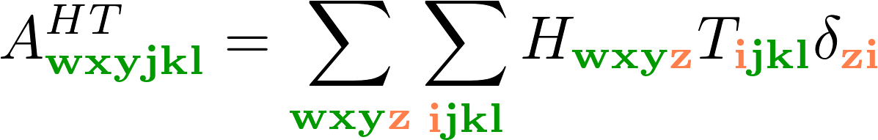

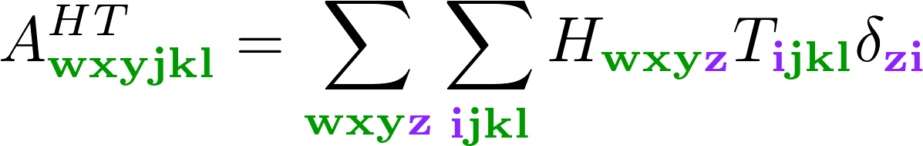

Contraction of tensor blocks
Distinct range blocks may become equivalent following contraction, e.g.
Following the contraction the range block is the same.
Important to combine contraction lists following this; otherwise can potentially increase the complexity.

Slide 24
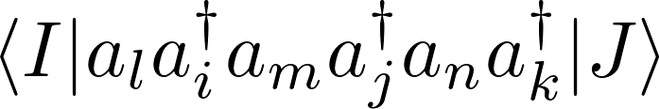
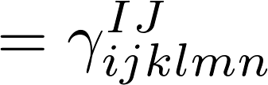
Generation of contraction list
Step 1 : First take creation and annihilation operators in order specified by input operator, e.g.,
Step 2 : Rewrite in normal order:
Step 3 : Remove terms which known to be zero from index ranges.
Step 4 : Repeat process, but reorder to alternating order

Slide 25
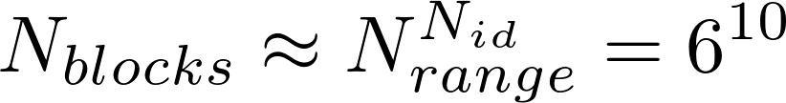
Grouping of indexes
Takes too long in relativistic framework;
Furthermore, applying spin symmetry was difficult.
Rewrote contraction list generation routines to avoid this problem.
Gamma generation routine now takes range constraints.
Possible to immediately rule out majority of ranges.

Slide 26
Grouping of indexes
Introduced grouping of indexes to reduce number of distinct terms, e.g.,
Colours denote different ranges.
Immediately useful for spin, but can be used in other contexts, e.g., point symmetry.

Slide 27
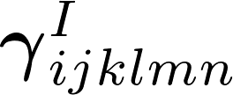

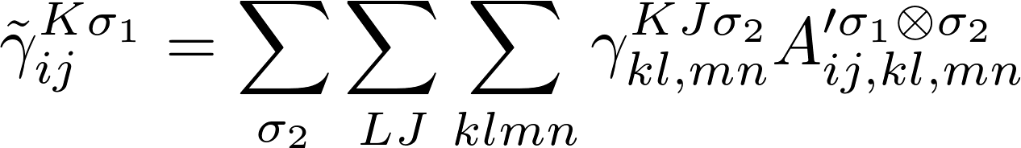
Contraction of and
Perform contraction in two steps:
Where
and
This step should be comparable in speed to the most expensive step of the current algorithm.

Slide 28
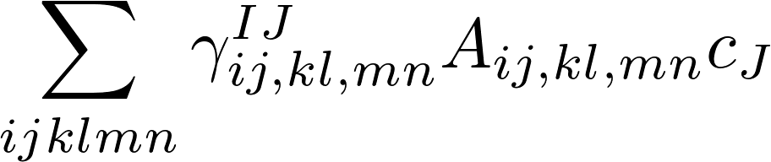
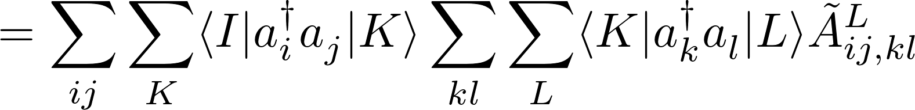
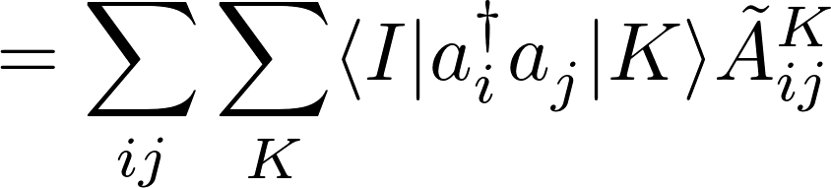
Contraction of and
Contract with A-tensor whilst generating the gamma matrices:
Minimizes the number of gamma matrices which need to be generated and stored.

