Slide 1
Calculation of derivative properties in XMS-CASPT2
Peter John Cherry
Shiozaki group meeting
November 28th 2017

Slide 2

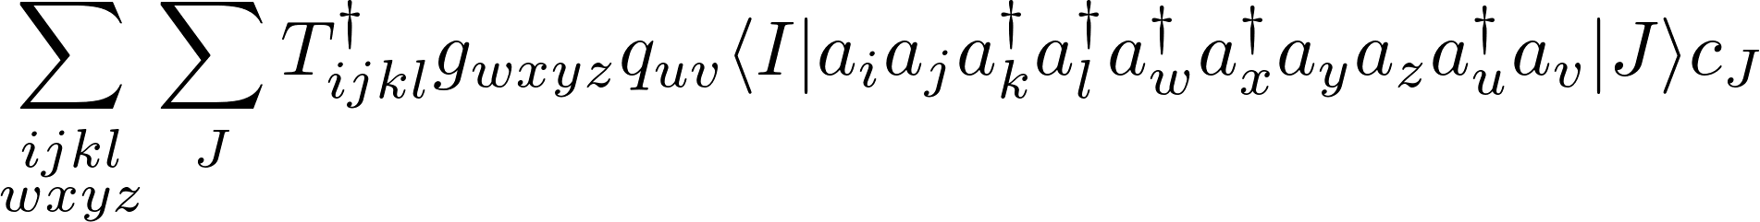
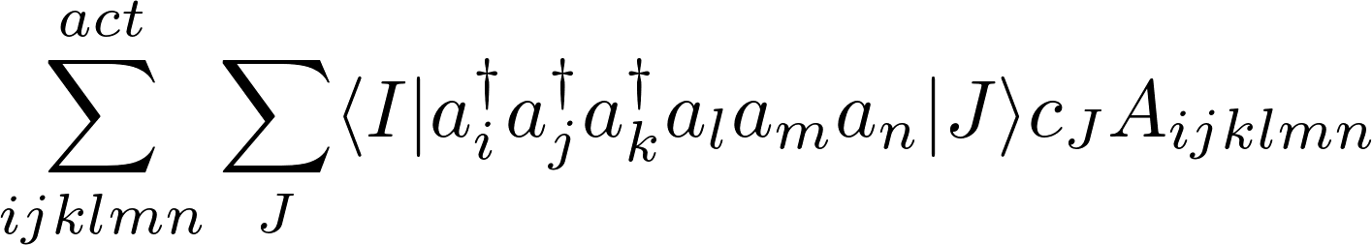
Calculation of matrix elements for many electron operators
We need a generic approach for evaluating terms of the form
These terms can be decomposed into a sum of expressions of the following form:
Jae used code from SMITH3 to develop an efficient method of doing this in a non-relativistic framework.
However, for cases involving spin-flipping interactions, we need to develop a method which takes advantage of spin symmetry.

Slide 3
Outline of method
    Step 1 : Get operator information.
        Split input tensors up into blocks and identify symmetries
        between blocks.
    Step 2 : Simplify expression
        Use expression manipulator to reduce the number of terms
        to be calculated.
    Step 3 : Generate computational proceedure.
        Generate a task list to obtain contracted A-tensors
        and corresponding RDM/RDM derivatives.
    Step 4 : Execute computational proceedure.
        Obtain A-tensors/RDM matrices and contract.
    Step 5 : Loop over spin sectors and states.
        Repeat for all necessary spin sectors.
Changes here
Changes here
Changes here

Slide 4
Outline of method
    Step 1 : Get operator information.
        Split input tensors up into blocks and identify symmetries
        between blocks.
    Step 2 : Simplify expression
        Use expression manipulator to reduce the number of terms
        to be calculated.
    Step 3 : Generate computational proceedure.
        Generate a task list to obtain contracted A-tensors
        and corresponding RDM/RDM derivatives.
    Step 4 : Execute computational proceedure.
        Obtain A-tensors/RDM matrices and contract.
    Step 5 : Loop over spin sectors and states.
        Repeat for all necessary spin sectors.
    Step 6 : Implement CI derivative expression
Working*
Working*
Working*
Needs retesting
Doing now

Slide 5
Possible use of SMITH3
Project has been progressing slowly; should reconsider direction.
With some modification, existing algorithms in SMITH3 could probably be used, however...
          Modification could be significant, or at least would require substantial effort to verify I had done it correctly.
          Not so easily extensible to other properties.
          Likely to be more computationally expensive due to lack of incorporation of symmetry
                Would like to implement MRCI
          Current approach is starting to work better, and will hopefully be more productive in the longer term.

Slide 6
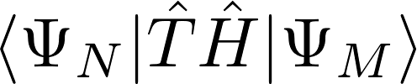
Program Structure
System Information
Input : Civectors, operators
Results
Expression Constructor
Input : mathematical expression, e.g.,
Expression Task Lists
Expression Calculator
Input : Task List, Results
Density Matrix
Manipulator
Operator
Manipulator
Density Matrix
Calculator
Tensor
Contractor

Slide 7
Advantage for other property calculations
Having overall system info class simplifies efficient reuse of previously calculated quantities.
Not specific to XMS-CASPT2; generic format, e.g., can be used for MRCI.
For most properties, the additional work should only be in the programming of the integrals.
Should be possible to extend frame work to include solution of basic equations (e.g., the linear solver currently used to obtain the T-amplitudes).
Ultimate aim is to have the option to enter mathematical expressions for properties in the input file
      Not totally unreasonable as the expressions for many different properties use the same underlying operators.

Slide 8
Why MRCI and not XMS-CASPT2?
Concern about the use of state-averaging in XMS-CASPT2.

Slide 9
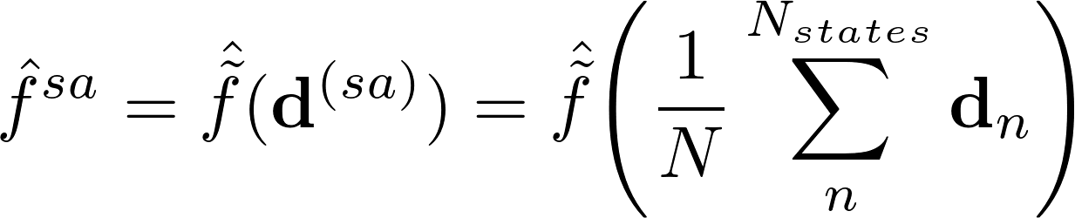
Significance of state averaging in relativistic XMS-CASPT2
XMS-CASPT2 uses a state averaged density

Slide 10
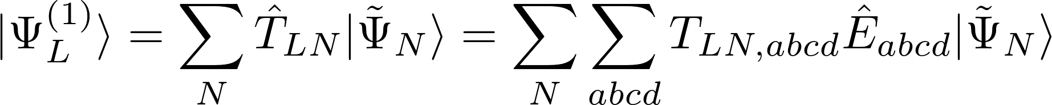

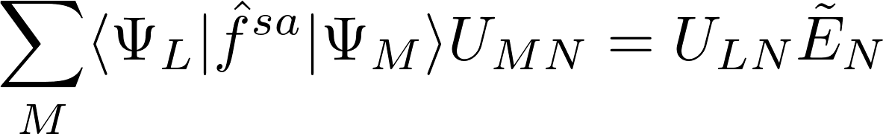
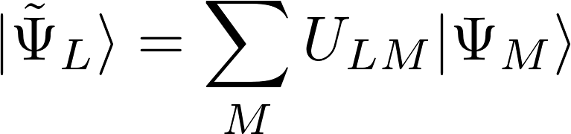
Possible influence of state averaging on T-amplitudes
XMS-CASPT2 wavefunction is given by:
The (T-amplitudes) satisfy the equation :
Where
and
State averaging plays an important role in XMS-CASPT2.

Slide 11
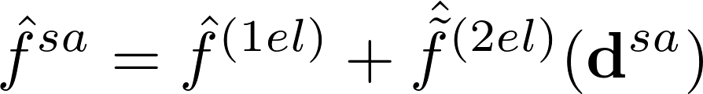
Significance of state averaging in relativistic XMS-CASPT2
XMS-CASPT2 uses a state averaged density
The state averaging impacts two electron terms:
The charge densities for different states are typically quite similar; they cannot differ by more than the number of electrons in the active space.
States within the same spin multiplet have the same charge density.

Slide 12



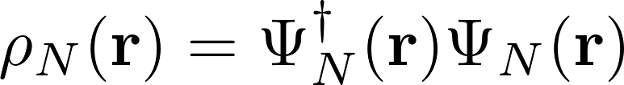

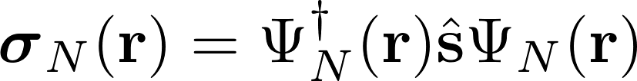

Significance of state averaging in relativistic XMS-CASPT2
The spin densities are typically very different for all states in a multiplet :
Charge density :
                Spin density :
Can split Fock-operator into spin-dependent and spin-independent terms :
It is not clear (to me) what the influence of the state averaging will be on the spin dependent terms.

Slide 13
Why MRCI and not XMS-CASPT2?
Concern about the use of state-averaging in XMS-CASPT2.
Methods such as Douglas-Kroll-Hess are often very good for 1-electron relativistic effects, but can struggle with spin-spin and spin-other-orbit interactions.
Accurate spin-spin interactions are important for justifying the large computational cost of four-component methods.
However, memory demands of four component MRCI are large.
Storing T-amplitudes is expensive enough to cause problems; storing rdm-derivatives could be a major issue.

Slide 14
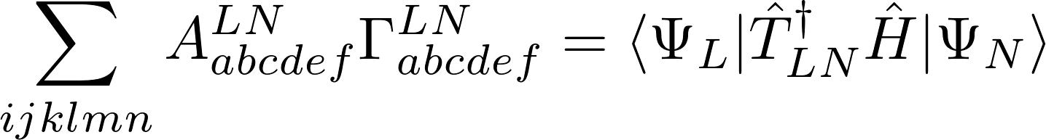



Reducing memory cost
Currently calculate the complete A-tensor, then the complete reduced density matrix and then perform the contraction :
Must store both the density matrix and the A-tensor.

Slide 15
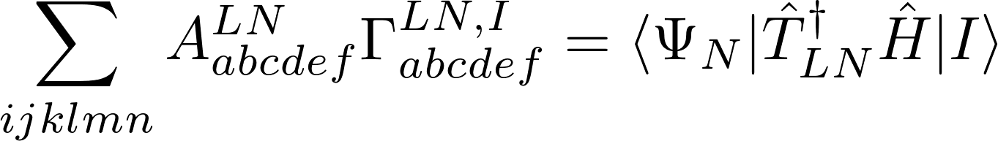



Reducing memory cost
Currently calculate the complete A-tensor, then the complete reduced density matrix derivative and then perform the contraction :

Slide 16
Blockwise contractions
Can instead calculate one block at a time, and contract immediately, avoiding the need to store the entire tensor :
Note : For this to be practical, must have already decomposed A-tensor into different spin sectors.

Slide 17
Blockwise contractions
Can instead calculate one block at a time, and contract immediately, avoiding the need to store the entire tensor :
Note : For this to be practical, must have already decomposed A-tensor into different spin sectors.

Slide 18
Blockwise contractions
Can instead calculate one block at a time, and contract immediately, avoiding the need to store the entire tensor :
Note : For this to be practical, must have already decomposed A-tensor into different spin sectors.

Slide 19
Summary
Little change in what I am trying to do, however, parts of it are now working.
No longer programming underlying machinery, but using the machinery to implement the equations for XMS-CASPT2.

