Slide 1
Properties with
Relativistic XMS-CASPT2
Peter John Cherry
Shiozaki group meeting
July 5th 2017

Slide 2

Properties in XMS-CASPT2
The XMS-CASPT2 energy is not minimized with respect to the CI and orbital coefficients obtained in the CASSCF calculation.

Slide 3
Properties in XMS-CASPT2
The XMS-CASPT2 energy is not minimized with respect to the CI and orbital coefficients obtained in the CASSCF calculation.
This makes differentiating it with respect to perturbations of the Hamiltonian difficult.

Slide 4
Properties in XMS-CASPT2
The XMS-CASPT2 energy is not minimized with respect to the CI and orbital coefficients obtained in the CASSCF calculation.
This makes differentiating it with respect to perturbations of the Hamiltonian difficult.
Accordingly, a Lagrangian is defined, which is minimized with respect to these variables:

Slide 5
Properties in XMS-CASPT2
The XMS-CASPT2 energy is not minimized with respect to the CI and orbital coefficients obtained in the CASSCF calculation.
This makes differentiating it with respect to perturbations of the Hamiltonian difficult.
Accordingly, a Lagrangian is defined, which is minimized with respect to these variables:
Amplitudes from CASPT2

Slide 6
Properties in XMS-CASPT2
The XMS-CASPT2 energy is not minimized with respect to the CI and orbital coefficients obtained in the CASSCF calculation.
This makes differentiating it with respect to perturbations of the Hamiltonian difficult.
Accordingly, a Lagrangian is defined, which is minimized with respect to these variables:
Coefficients from CASSCF calculation

Slide 7
Properties in XMS-CASPT2
The XMS-CASPT2 energy is not minimized with respect to the CI and orbital coefficients obtained in the CASSCF calculation.
This makes differentiating it with respect to perturbations of the Hamiltonian difficult.
Accordingly, a Lagrangian is defined, which is minimized with respect to these variables:
Conditions from CASSCF
Lagrange multipliers associated with conditions from CASSCF

Slide 8
Properties in XMS-CASPT2
The XMS-CASPT2 energy is not minimized with respect to the CI and orbital coefficients obtained in the CASSCF calculation.
This makes differentiating it with respect to perturbations of the Hamiltonian difficult.
Accordingly, a Lagrangian is defined, which is minimized with respect to these variables:
Conditions from
XMS-CASPT2
Lagrange multipliers associated with conditions from XMS-CASPT2

Slide 9
Properties in XMS-CASPT2
The XMS-CASPT2 energy is not minimized with respect to the CI and orbital coefficients obtained in the CASSCF calculation.
This makes differentiating it with respect to perturbations of the Hamiltonian difficult.
Accordingly, a Lagrangian is defined, which is minimized with respect to these variables:
Typically, differentiating this Lagrangian with respect to some perturbative parameter is much easier than differentiating the XMS-CASPT2 energy.

Slide 10
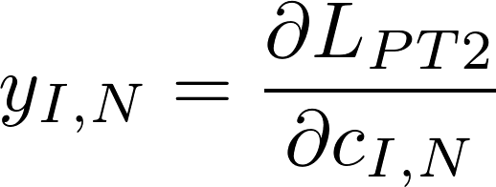
Z-vector and Lambda equations
The Z constraint can be obtained by solution of the “Z-vector equation”.
This requires, amongst other things, calculation of the CI-deratives:
Derivative of the CASPT2 Lagrangian with respect to CASSCF reference coefficients.

Slide 11
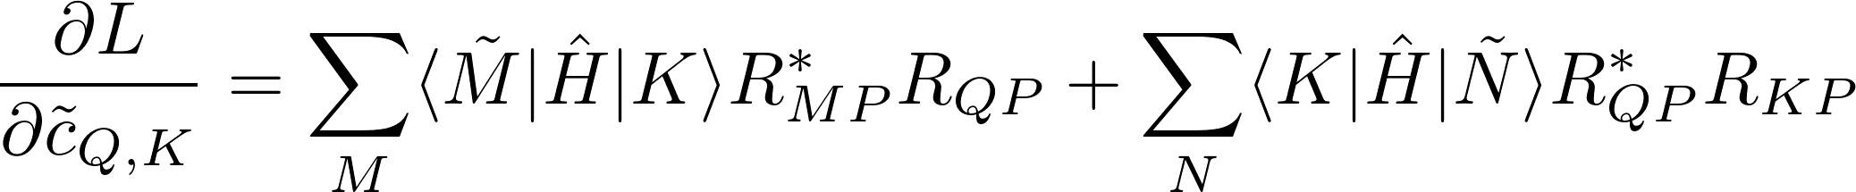

CI derivatives

Slide 12
CI derivatives
CASSCF
reference
state
Determinant in CAS

Slide 13
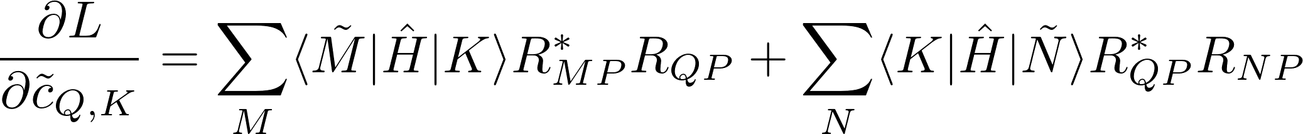
CI derivatives
CASSCF
reference
state
Determinant in CAS
pth eigenvector of effective
XMS-CASPT2 Hamiltonian

Slide 14
CI derivatives

Slide 15
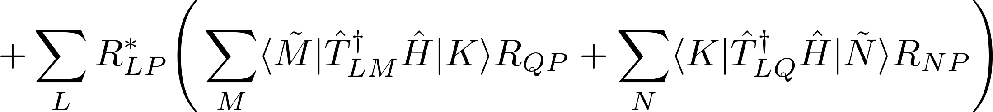
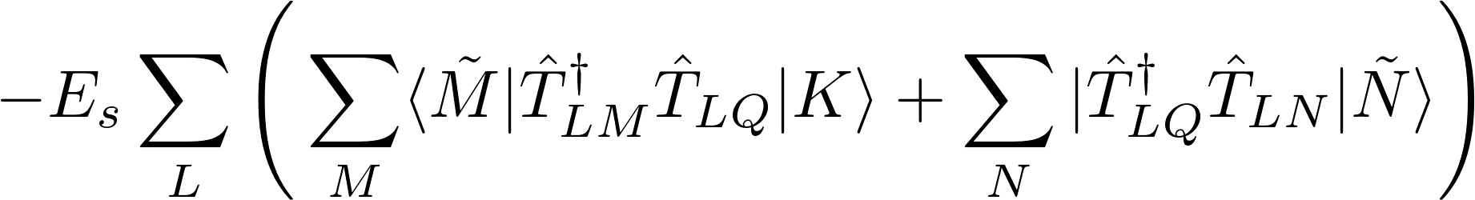
CI derivatives

Slide 16
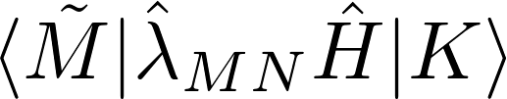
Calculation of CI derivatives
Requires evaluation of terms of this form

Slide 17
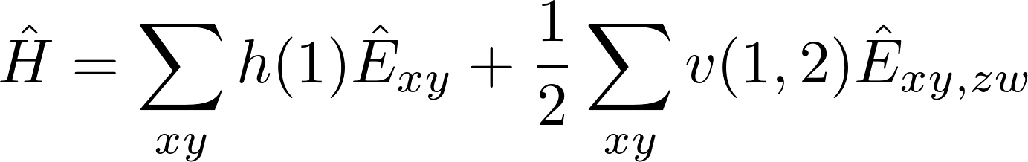
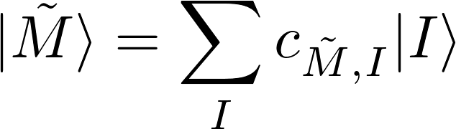
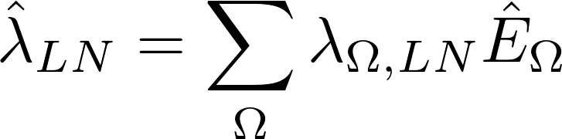
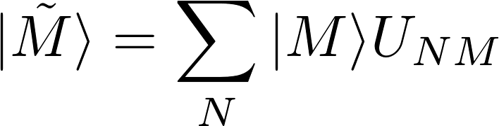
Calculation of CI derivatives
Requires evaluation of terms of this form

Slide 18
Calculation of CI derivatives
Requires evaluation of terms of this form

Slide 19
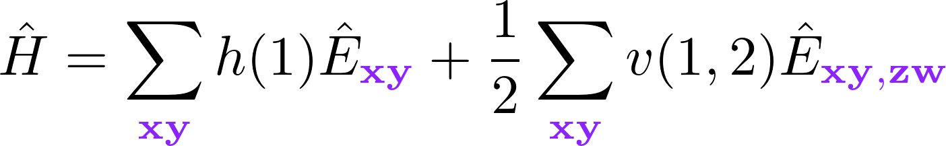
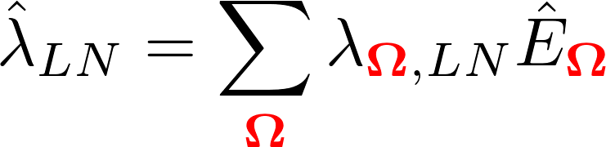
Calculation of CI derivatives
Requires evaluation of terms of this form
Excitations from Hamiltonian.
Excitations associated with XMS-CASPT2.

Slide 20
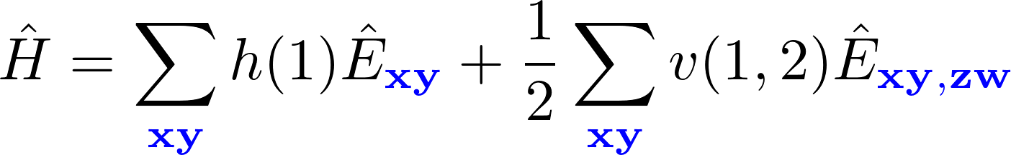
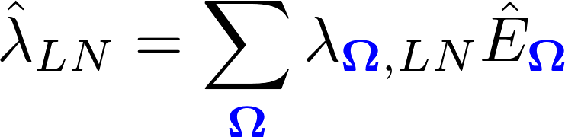
Calculation of CI derivatives
Requires evaluation of terms of this form
Excitations from Hamiltonian.
Excitations associated with XMS-CASPT2.
General Indices
(virtual, active, closed)

Slide 21
Calculation of CI derivatives
Requires evaluation of terms of this form
This sum over general indices can be rewritten as a sum over active indices:

Slide 22
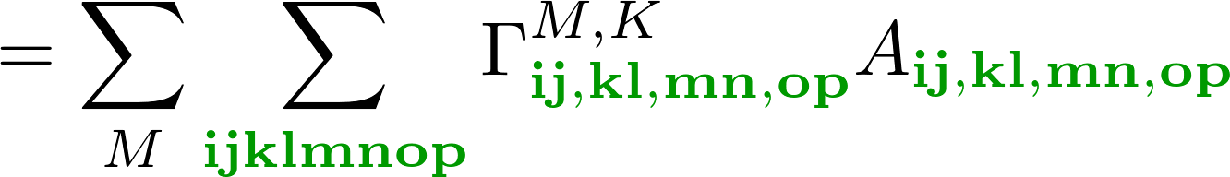
Calculation of CI derivatives
Requires evaluation of terms of this form
This sum over general indices can be rewritten as a sum over active indices:
Weighted MO integrals
Reduced density matrix derivative

Slide 23
Calculation of CI derivatives
Requires evaluation of terms of this form
This sum over general indices can be rewritten as a sum over active indices:
Computationally efficient; can be evaluated without the need to store any eight index tensors.
This is Jae’s recent work:

Slide 24
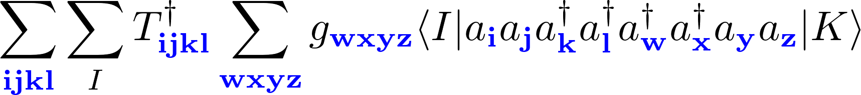
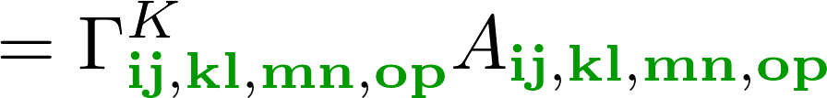


Calculation of CI derivatives
Requires evaluation of terms of this form
The terms have been manually coded.
The terms can be obtained from code generated using SMITH3.
Dependent upon
CI-coefficients and active space
Dependent upon operator ordering and molecular orbital integrals.

Slide 25
Advantages of normal ordering
Situation is simplified once creation and annihilation operators are normal ordered:

Slide 26
Advantages of normal ordering
Situation is simplified once creation and annihilation operators are normal ordered:

Slide 27
Advantages of normal ordering
Situation is simplified once creation and annihilation operators are normal ordered:

Slide 28
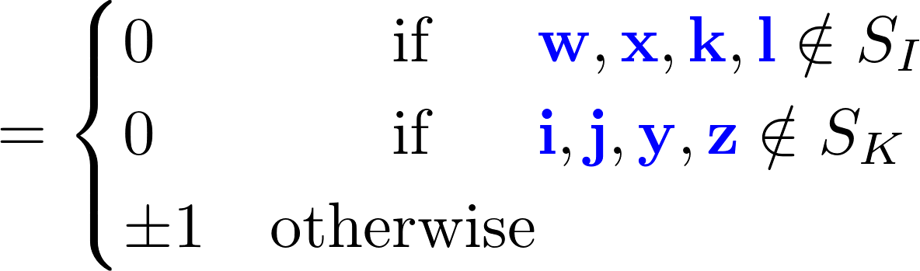
Advantages of normal ordering
Situation is simplified once creation and annihilation operators are normal ordered:

Slide 29
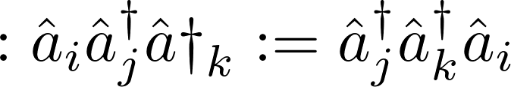
Wick’s Theorem
Any operator can be written as a sum of normal ordered terms.
Normal ordering
All creation operators on the left, all annihilation operators on the right.

Slide 30
Wick’s Theorem
Any operator can be written as a sum of normal ordered terms.
Normal ordering
All creation operators on the left, all annihilation operators on the right.
Contraction (!!)
Difference between normal ordered form and original ordering.

Slide 31
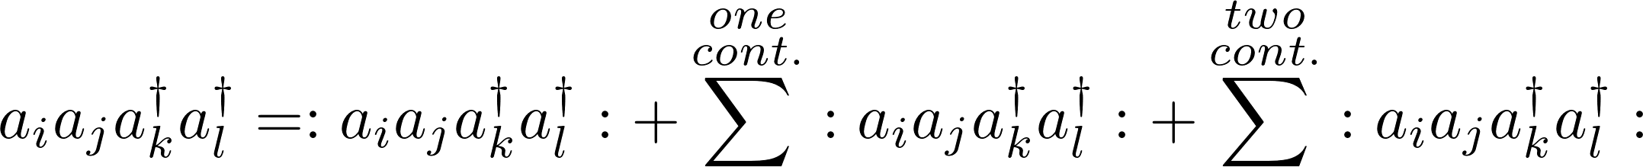
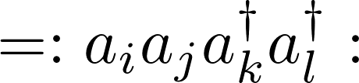
Wick’s Theorem
For operators with more than two excitations, sum over all possible contractions:

Slide 32
Wick’s Theorem
For operators with more than two excitations, sum over all possible contractions:

Slide 33
Wick’s Theorem
For operators with more than two excitations, sum over all possible contractions:

Slide 34

Wick’s Theorem
For operators with more than two excitations, sum over all possible contractions:

Slide 35
Wick’s Theorem
For operators with more than two excitations, sum over all possible contractions:
A series of normal ordered operators, with factors determined from the properties of the creation and annihilation operators.

Slide 36
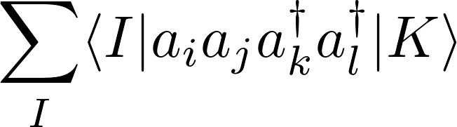

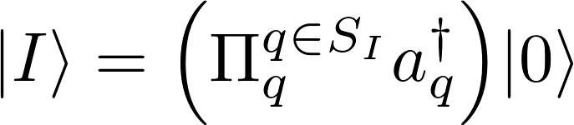
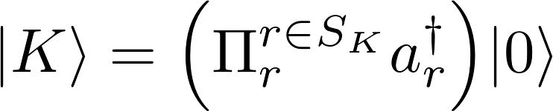
Wick’s Theorem
Rewrite sum over matrix elements for a two electron operator using Wick’s theorem.

Slide 37
Wick’s Theorem
Rewrite sum over matrix elements for a two electron operator using Wick’s theorem.

Slide 38
Wick’s Theorem
Rewrite sum over matrix elements for a two electron operator using Wick’s theorem.
Normal ordered terms will vanish if any of the
indices are not in the SI or SK.

Slide 39
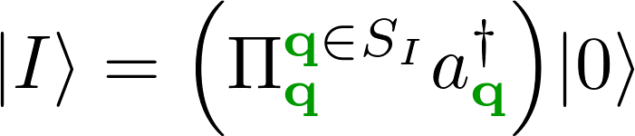
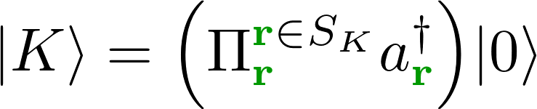
Wick’s Theorem
Rewrite sum over matrix elements for a two electron operator using Wick’s theorem.
Normal ordered terms will vanish if any of the
indices are not in the active space.
I and K are determinants in the active space

Slide 40
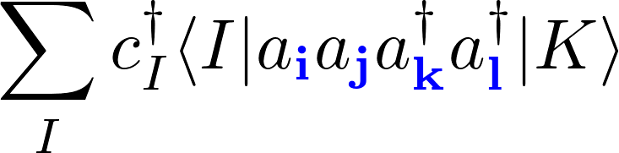
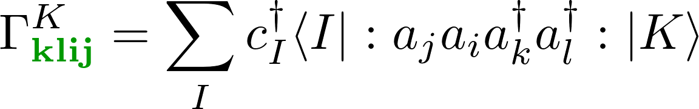
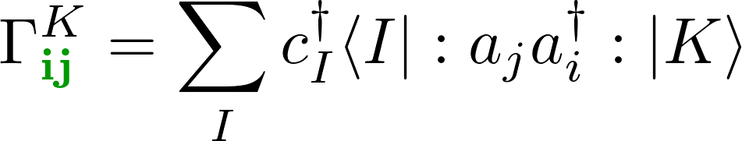
Wick’s Theorem
Introduce rdm derivatives for terms with active indices:
RDM derivatives

Slide 41
Wick’s Theorem
Introduce rdm derivatices for terms with active indices:
RDM derivatives

Slide 42
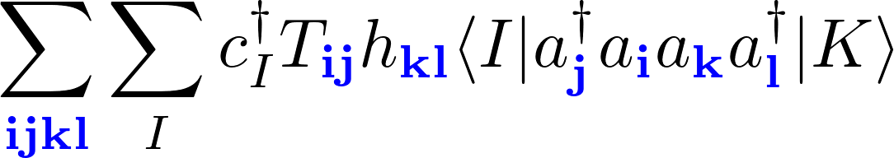
Wick’s Theorem
Rewrite sum over matrix elements for a two electron operator using Wick’s theorem.

Slide 43
Wick’s Theorem
Rewrite sum over matrix elements for a two electron operator using Wick’s theorem.
Rearrange to seperate active and general indices

Slide 44
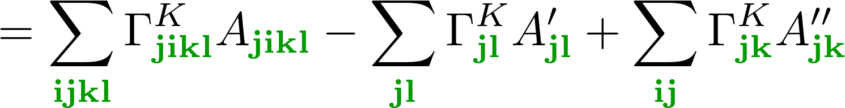
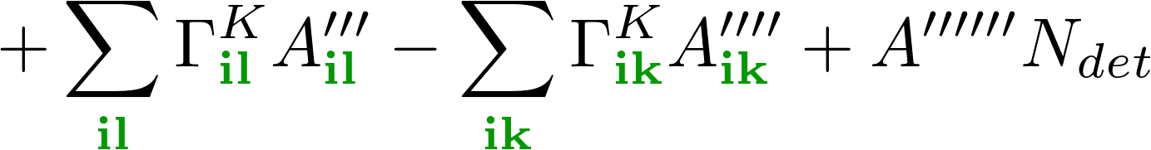
Wick’s Theorem
Rewrite sum over matrix elements for a two electron operator using Wick’s theorem.
Rearrange to seperate active and general indices

Slide 45
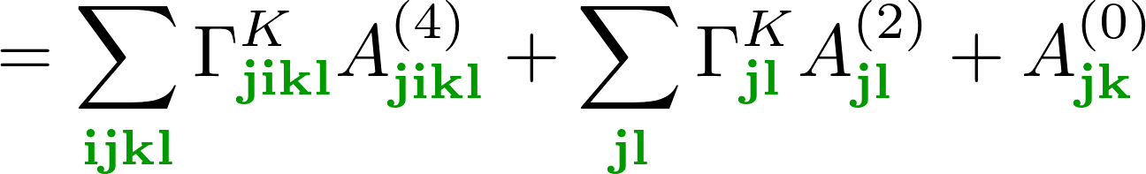
Wick’s Theorem
Rewrite sum over matrix elements for a two electron operator using Wick’s theorem.
Rearrange to seperate active and general indices

Slide 46
Wick’s Theorem
Rewrite sum over matrix elements for a two electron operator using Wick’s theorem.
Rearrange to seperate active and general indices

Slide 47
Calculation of CI derivatives
Requires evaluation of terms of this form
This sum over general indices can be rewritten as a sum over active indices:
Computationally efficient; can be evaluated without the need to store any eight index tensors.
This is Jae’s recent work:

Slide 48
Difference between relativistic and non-relativistic framework
Alpha and beta orbitals are treated independently ➡ twice as many active orbitals.
Alpha and beta orbitals can interact ➡ twice as many possible excitation operators.

Slide 49
Difference between relativistic and non-relativistic framework
Alpha and beta orbitals are treated independently ➡ twice as many active orbitals.
Alpha and beta orbitals can interact ➡ twice as many possible excitation operators.
One electron density matrix is (potentially) 4 times larger.
Four electron density matrix is (potentially) 4⁴ = 256 times larger.

Slide 50
Difference between relativistic and non-relativistic framework
Alpha and beta orbitals are treated independently ➡ twice as many active orbitals.
Alpha and beta orbitals can interact ➡ twice as many possible excitation operators.
One electron density matrix is (potentially) 4 times larger.
Four electron density matrix is (potentially) 4⁴ = 256 times larger.
Determinants with difference numbers of alpha and beta electrons may interact.
RDM derivatives could be > 256 times larger.

Slide 51
Difference between relativistic and non-relativistic framework
Alpha and beta orbitals are treated independently ➡ twice as many active orbitals.
Alpha and beta orbitals can interact ➡ twice as many possible excitation operators.
One electron density matrix is (potentially) 4 times larger.
Four electron density matrix is (potentially) 4⁴ = 256 times larger.
Determinants with difference numbers of alpha and beta electrons may interact.
RDM derivatives could be > 256 times larger.
This issue can be managed by use of time reversal symmetry.

Slide 52

CI strings
A determinant, I, can be defined by a set of indices of the occupied active orbitals, e.g.,
The set of all active determinants can then be written

Slide 53
CI strings
Split up the CI-string space into alpha and beta subspaces:

Slide 54
CI strings
Split up the CI-string space into alpha and beta subspaces:
A spin-sector is the Cartesian product of an alpha and a beta subspace:

Slide 55





CI strings
Split up the CI-string space into alpha and beta subspaces:
A spin-sector is the Cartesian product of an alpha and a beta subspace:
Combine the alpha and beta string spaces to get the full CI-string space, e.g.,

Slide 56
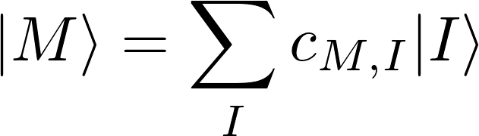







Non-relativistic CI-vector
Non-relativistic CI-vector only has determinants from a single spin sector:
Conf.
...
...
...
...
...
...
...
...

Slide 57








Interaction between spin-sectors
Non-relativistic case:

Slide 58

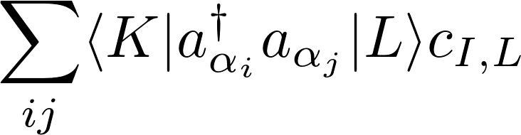

Interaction between spin-sectors
Non-relativistic case:

Slide 59








Relativistic CI-vector
Spin-orbit coupling terms results in contributions from determinants in different spin sectors:
 | Spin sectors
Conf. #
...
...
...
...
...
...
...
...
...
...
...
...
...
...
...
...
...
...
...
...
...
...
...
...
...
...
...
...
...
...
...
...
...
...
...
...
...
...
...
...
...
...
...
...
...
...

Slide 60
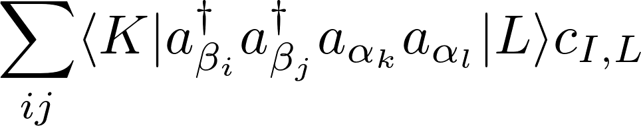
Interaction between spin-sectors
Relativistic case :

Slide 61
Applying Time Reversal Symmetry
Different kinds of excitations are connected via time reversal:

Slide 62

Applying Time Reversal Symmetry
Different kinds of excitations are connected via time reversal:
Can be applied to molecular orbital integrals:

Slide 63
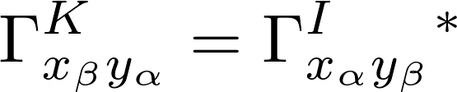


Applying Time Reversal Symmetry
Different kinds of excitations are connected via time reversal:
Can be applied to molecular orbital integrals:
Can relate terms in different spin sectors:
where
and

Slide 64




Applying Time Reversal Symmetry
Different kinds of excitations are connected via time reversal:
Can be applied to molecular orbital integrals:
Can relate terms in different spin sectors:
Do not need both of and or both and .
Number of distinct quantities to be calculated is reduced by a factor of ~2⁴.
where
and

Slide 65
Spin sector looping for RDM derivatives
Define a seperate RDM for each spin sector.
Classify excitations into four types:

Slide 66
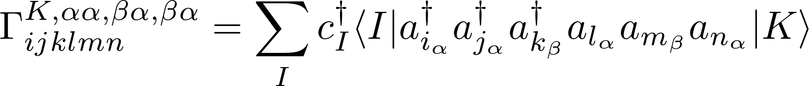
Spin sector looping for RDM derivatives
Define a seperate RDM for each spin sector.
Classify excitations into four types:
Classify different rdm derivatives by different combinations of theses types, e.g.,

Slide 67
Spin sector looping for RDM derivatives
Define a seperate RDM for each spin sector.
Classify excitations into four types:
Classify different rdm derivatives by different combinations of theses types, e.g.,
Each is the approximately the same size as a non-relativistic rdm derivative.

Slide 68
Applying Wick’s Theorem
Normal ordered terms will vanish if any of the
indices are not in the active space.

Slide 69
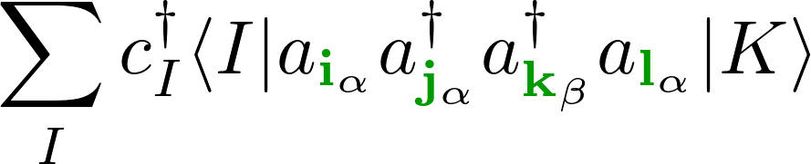




Application of spin constraints
Restrict excitation operators to or orbitals.

Slide 70
Application of spin constraints
Restrict excitation operators to or orbitals.
Several terms will not contribute.

Slide 71
Application of spin constraints
Restrict excitation operators to or orbitals.
Several terms will not contribute.

Slide 72
Application of spin constraints
Restrict excitation operators to or orbitals.
Several terms will not contribute.
Which terms are removed is dependent on the combination of excitation operators.

Slide 73
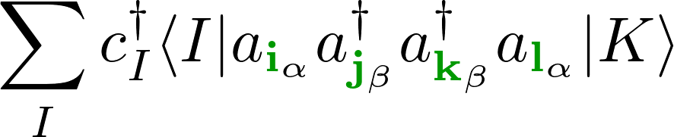

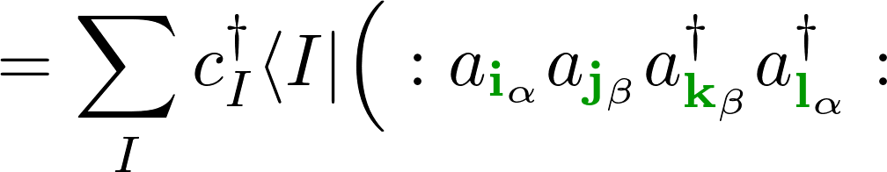
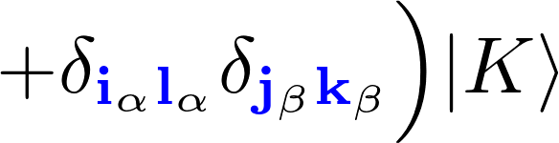
Application of spin constraints
Restrict excitation operators to or orbitals.
Several terms will not contribute.
Which terms are removed is dependent on the combination of excitation operators.

Slide 74
Application of spin constraints
Restrict excitation operators to or orbitals.
Several terms will not contribute.
Which terms are removed is dependent on the combination of excitation operators.

Slide 75


Application of spin constraints

Slide 76
Application of spin constraints
I and K belong to different spin sectors

Slide 77

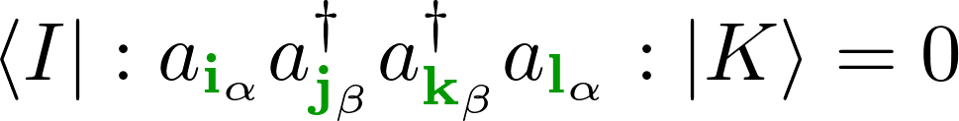
Application of spin constraints
I and K belong to different spin sectors
If then :

Slide 78

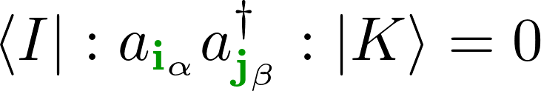
Application of spin constraints
I and K belong to different spin sectors
If then :
If then :

Slide 79
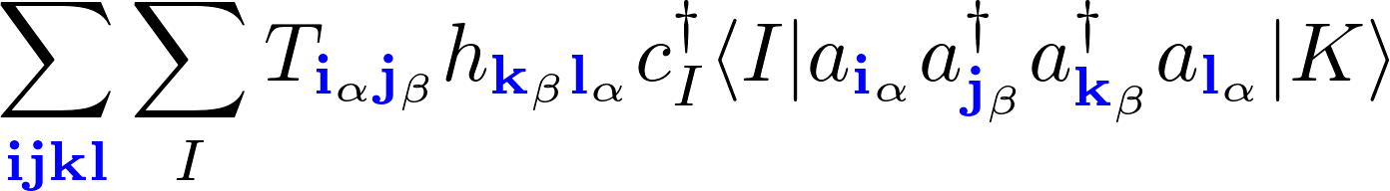
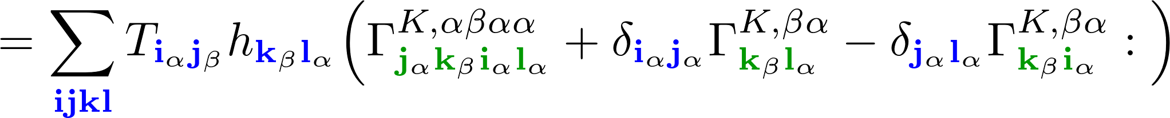
Application of spin constraints
Rewrite as a contraction of tensors with only active indices:
Which terms are included in tensors is spin sector dependent:

Slide 80
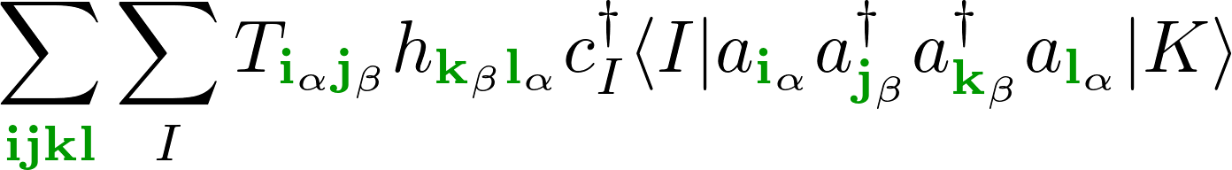
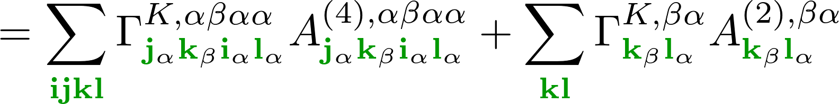
Application of spin constraints
Rewrite as a contraction of tensors with only active indices:
Which terms are included in tensors is spin sector dependent:

Slide 81

Spin-unconstrained version ( )
Rewrite as a contraction of tensors with only active indices:
Which terms are included in tensors is spin sector dependent:

Slide 82
Spin-unconstrained version ( )
Rewrite as a contraction of tensors with only active indices:
Which terms are included in tensors is spin sector dependent:

Slide 83
Spin-unconstrained version ( )
Rewrite as a contraction of tensors with only active indices:
Which terms are included in tensors is spin sector dependent:

Slide 84
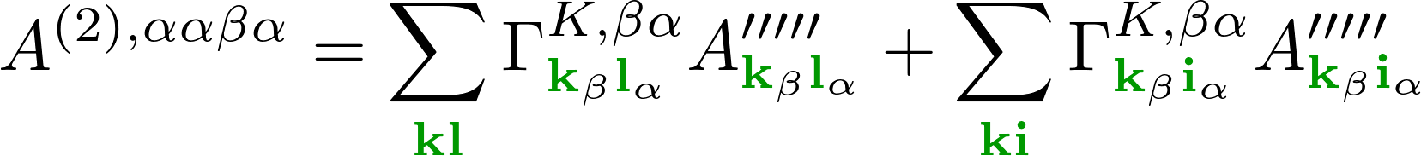
Spin dependence of integral tensors
Expressions to calculate molecular orbital tensors are spin-sector and spin excitation dependent
The expressions for the tensors change by more than just the indexes.

Slide 85
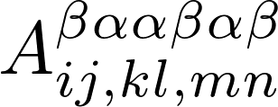
Modifications to SMITH3
This behaviour of is specific to the spin-sector looping case.
To accomodate it, SMITH needs to be adapted in the following ways:
        Enable use of multiple combinations of different indices for alpha and beta spin sectors.
        Remove spin-dependence.
        Incorporate spin-sector dependence of summation of molecular orbital tensors.
        Incorporate spin-excitation dependence of summation of molecular orbital tensors.

Slide 86



4-component vs 2-component
Douglas-Kroll-Hess second order approach is an effective way to include relativistic effects.
Works by (approximately) block diagonalizing the 4-component Hamiltonian.
Transformations and are dependent upon the Hamiltonian.
Derivatives with respect to a change in the Hamiltonian require derivatives of these transformations.
This is often computationally expensive, and in the case of a perturbation by a vector potential, notoriously difficult to program.

Slide 87




Hylleras functional
First order terms in the perturbation expansion:

Slide 88

XMS-CASPT2
XMS-CASPT2 : Extended multistate complete active space second order perturbation theory.
Initial wavefunction from a CASSCF calculation:
Generate new set of states by diagonalizing the Fock operator in the space formed by these states:

Slide 89
XMS-CASPT2
First-order perturbation to the wavefunction is expanded in basis of excited determinants:
Sum over states in CASSCF reference space

Slide 90
XMS-CASPT2
First-order perturbation to the wavefunction is expanded in basis of excited determinants:
T amplitudes
Single and double excitations between inactive, active and virtual orbitals.
Excitation operator

Slide 91

XMS-CASPT2
First-order perturbation to the wavefunction is expanded in basis of excited determinants:
The T amplitudes for a given state are those which satisfy

Slide 92
XMS-CASPT2
First-order perturbation to the wavefunction is expanded in basis of excited determinants:
The T amplitudes for a given state are those which satisfy
State averaged Fock Matrix
Zeroth order energy of state L

Slide 93
XMS-CASPT2
XMS-CASPT2 energy
          T amplitudes.
          Orbital rotations.
          CI coefficients.

Slide 94
XMS-CASPT2
Spin-orbit coupling terms results in coupling between determinants from different spin sectors:
Conf.
...
...
...
...
...
...
...
...
...
...
...
...
...
...
...
...
...
...
...
...
...
...
...
...
...
...
...
...
...
...
...
...
...
...
...
...
...
...
...
...
...
...
...
...

Slide 95


XMS-CASPT2
Solve for initial XMS-CASPT2 energy
Solve for Lamda coefficients
Solve Z-vector equation

Slide 96

Difference between relativistic and non-relativistic framework
Alpha and beta orbitals are treated seperately.
Different spin-sectors can interact via spin-orbit coupling and spin-other-orbit interactions.
Potentially much more expensive.

Slide 97

Time reversal symmetry
Can substantially reduce the number of rdm derivatives which need to be calculated:

Slide 98



CI seperation
Rewrite so no explicit orbital indices
Define a pair of determinants

Slide 99


CI seperation
Rewrite using Wick’s theorem:

Slide 100

CI seperation
Rewrite so no explicit orbital indices
Define a pair of determinants

Slide 101
CI seperation
Rewrite so no explicit orbital indices
Define a pair of determinants

Slide 102


CI seperation
The determinants I and K can be defined by a set of indices of the occupied active orbitals, e.g.,
The set of all active determinants can then be written
Replace the sum over determinants with a sum over these sets

Slide 103

CI seperation
The determinants I and K can be defined by a set of indices of the occupied active orbitals, e.g.,
The set of all active determinants can then be written
Replace the sum over determinants with a sum over these sets

Slide 104
Smith procedure
Define base operators from which all terms will be built:
These consist of a set of coefficients and a some labels specifying excitation ranges.
These excitation indices either specify an element of the T or lambda vectors, or specfiy a block of there specified operator.
The excitation ranges are of type “index” but they are not actual indexes themselves, just strings corresponding to labels (at least initially).
Then make lists of combinations of these operators, e.g.
list<shared_ptr<Operator>> da9 = {proje, t2dagger1, ex_1b, l20};
shared_ptr<Operator> t2dagger1 = make_shared<Op>("t2dagger", _X, _C, _X, _X);

Slide 105
Smith procedure
This list of operators is then used to construct a diagram:
auto dda0 = make_shared<Diagram>(da0, 1, "");
By calling different members of the diagram class we can construct the terms necessary for evaluation of all the terms in the perturbation diagram associated with this set of operators.
We can then combine several diagrams to construct an Equation :
auto eda0 = make_shared<Equation>(dda0, theory);
This has functions to identify like terms in the different diagrams, which prevents similar terms from being evaluated.
Note that in most cases each diagram only ranges over a subset of all the orbitals in which we are interested, whereas the equation ranges over all orbitals of interest.

Slide 106
Smith procedure
Finally we construct the rdm_ for each of the diagrams included in our equations.
edb0->active();
This uses the indices from the diagrams, as well as whether we are dealing normal rdms or rdm derivatives.
The objects defined thus far completely outline the problem to be solved, but at present they are little more than a collection of names of opearators and index ranges.
To generate the code structure we use our Equation to construct a Residual object.
The Residual class is derived from Tree .
Tree loops over each of the diagrams in the equation and for each diagram constructs a ListTensor; a list containing all the information about (indices, operator type and ordering etc., ) the tensor in that diagram.

Slide 107


CI strings
Split up the CI-string space into alpha and beta subspaces:
Define spin-sector as the Cartesian product of an alpha and a beta subspace:
Combine the alpha and beta string spaces to get the full CI-string space, e.g.,

Slide 108
Wick’s Theorem
For operators with more than two excitations, sum over all possible contractions:

Slide 109
Wick’s Theorem
For operators with more than two excitations, sum over all possible contractions:

Slide 110

CI strings
A determinant, I, can be defined by a set of indices of the occupied active orbitals, e.g.,

Slide 111
CI strings
A determinant, I, can be defined by a set of indices of the occupied active orbitals, e.g.,
The set of all active determinants can then be written

