Slide 1
Relativistic XMS-CASPT2
Peter John Cherry
Shiozaki group meeting
May 10th 2017

Slide 2

Properties in XMS-CASPT2
A Lagrangian is defined such that:

Slide 3
Properties in XMS-CASPT2
A Lagrangian is defined such that:
Coefficients from CASSCF calculation

Slide 4
Properties in XMS-CASPT2
A Lagrangian is defined such that:
Amplitudes from CASPT2

Slide 5
Properties in XMS-CASPT2
A Lagrangian is defined such that:
Conditions from CASSCF
Lagrange multipliers associated with conditions from CASSCF

Slide 6
Properties in XMS-CASPT2
A Lagrangian is defined such that:
Conditions from
XMS-CASPT2
Lagrange multipliers associated with conditions from XMS-CASPT2

Slide 7
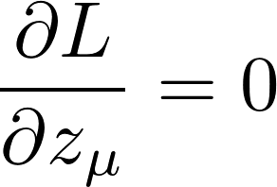
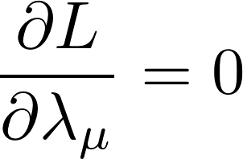
Properties in XMS-CASPT2
A Lagrangian is defined such that:
Define the stationary conditions:

Slide 8
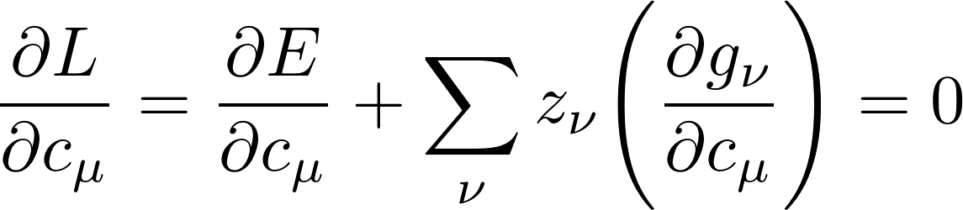
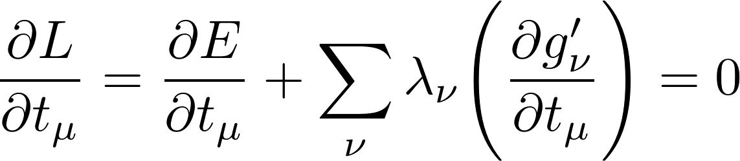
Properties in XMS-CASPT2
A Lagrangian is defined such that:
Define the stationary conditions:

Slide 9






XMS-CASPT2
Solve two further equations to obtain Lagrange multipliers:
    The Lambda equation to obtain .
    The Z-vector equation to obtain , , , , and .

Slide 10
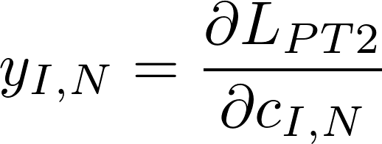
Z-vector and Lambda equations
Solve two further equations to obtain Lagrange multipliers:
    The Lambda equation to obtain .
    The Z-vector equation to obtain , , , , and .
To solve the Z-vector equation we must calculate:
Derivative of the Lagrangian with respect to CASSCF reference coefficients

Slide 11
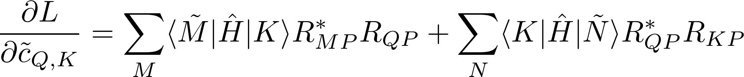

CI derivatives

Slide 12
CI derivatives
CASSCF
reference
state
Determinant in CAS

Slide 13
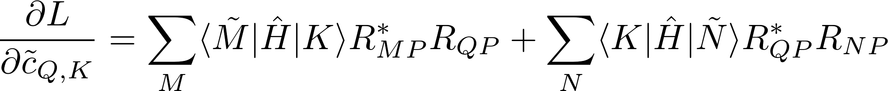
CI derivatives
CASSCF
reference
state
Determinant in CAS
pth eigenvector of effective
XMS-CASPT2 Hamiltonian

Slide 14
CI derivatives

Slide 15
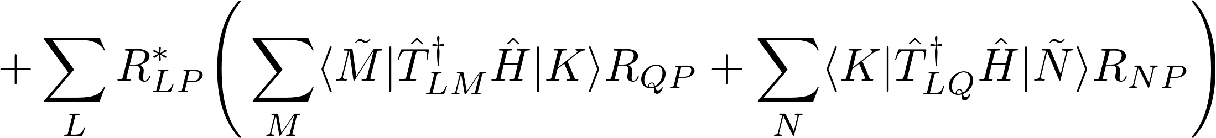
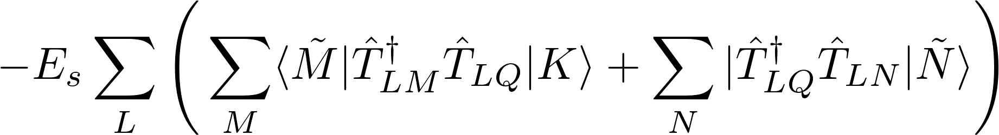
CI derivatives

Slide 16
CI derivatives

Slide 17
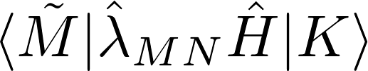
Calculation of CI derivatives
Requires evaluation of terms of this form

Slide 18
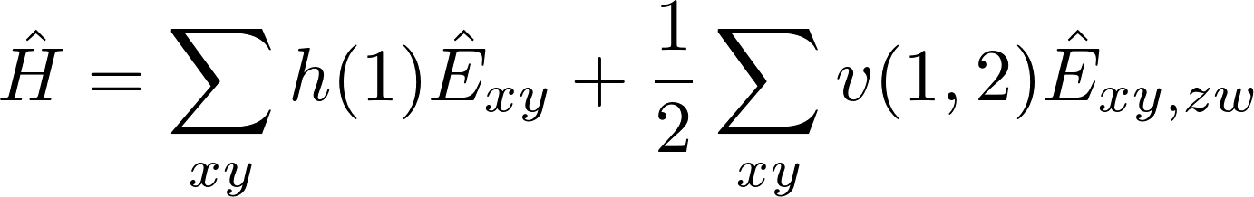
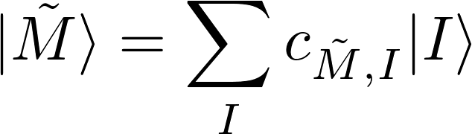
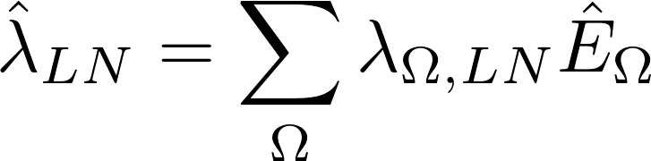
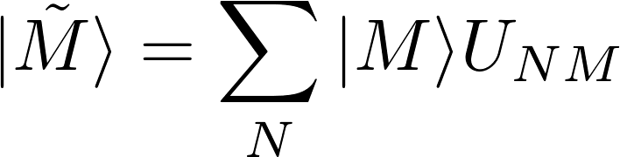
Calculation of CI derivatives
Requires evaluation of terms of this form

Slide 19
Calculation of CI derivatives
Requires evaluation of terms of this form

Slide 20
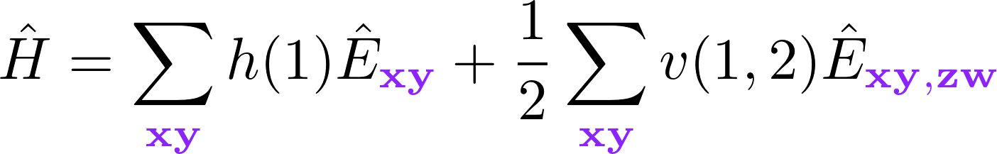
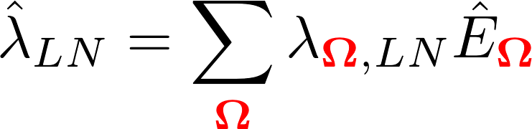
Calculation of CI derivatives
Requires evaluation of terms of this form
Excitations from Hamiltonian.
Excitations associated with XMS-CASPT2.

Slide 21
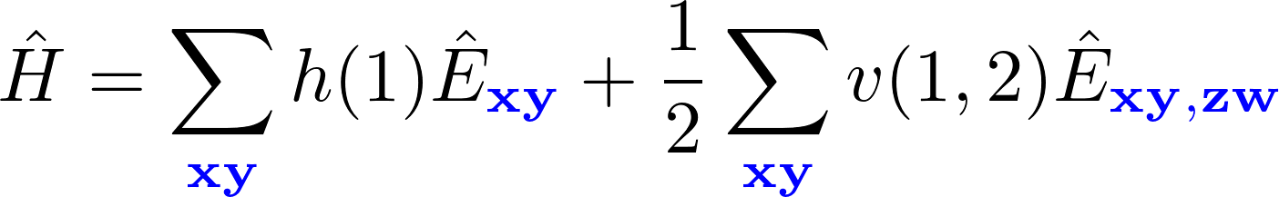
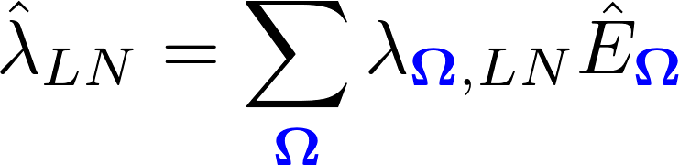
Calculation of CI derivatives
Requires evaluation of terms of this form
Excitations from Hamiltonian.
Excitations associated with XMS-CASPT2.
General Indices
(virtual, active, closed)

Slide 22
Calculation of CI derivatives
Requires evaluation of terms of this form
This sum over general indices can be rewritten as a sum over active indices:

Slide 23
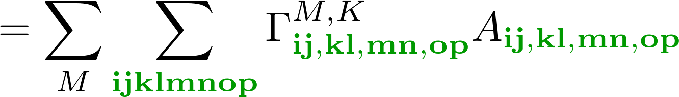
Calculation of CI derivatives
Requires evaluation of terms of this form
This sum over general indices can be rewritten as a sum over active indices:
Weighted MO integrals
Reduced density matrix derivative

Slide 24
Calculation of CI derivatives
Requires evaluation of terms of this form
This sum over general indices can be rewritten as a sum over active indices:
Computationally efficient; can be evaluated without the need to store any eight index tensors.
This is Jae’s recent work:

Slide 25
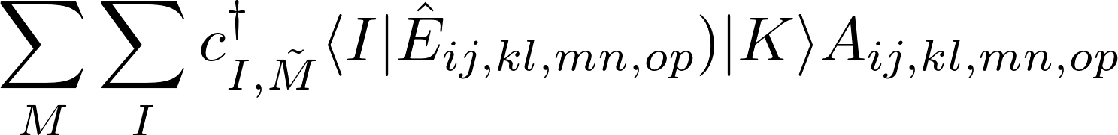
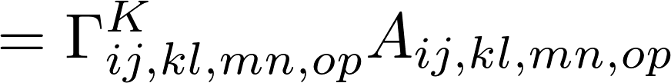


Calculation of CI derivatives
Requires evaluation of terms of this form
The terms have been manually coded.
The terms can be obtained from code generated using SMITH3.
Reduced density matrix derivative
Weighted MO integrals

Slide 26
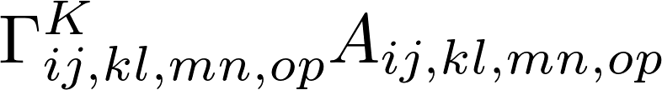
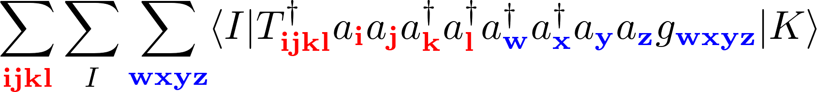
Calculation of CI derivatives
Seperation of CI-derivative terms (CI seperation) relies on Wick’s theorem:
As many as eight excitation operators e.g.,

Slide 27
Calculation of CI derivatives
Need to obtain A tensor containing molecular orbital integrals

Slide 28
Calculation of CI derivatives
Need to obtain A tensor containing molecular orbital integrals
As many as eight excitation operators e.g.,

Slide 29
Calculation of CI derivatives
Need to obtain A tensor containing molecular orbital integrals
As many as eight excitation operators e.g.,

Slide 30
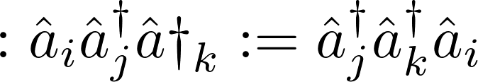
Wick’s Theorem
Any operator can be written as a sum of normal ordered terms.
Normal ordering
All creation operators on the left, all annihilation operators on the right.

Slide 31
Wick’s Theorem
Any operator can be written as a sum of normal ordered terms.
Normal ordering
All creation operators on the left, all annihilation operators on the right.
Contraction (!!)
Difference between normal ordered form and original ordering.

Slide 32
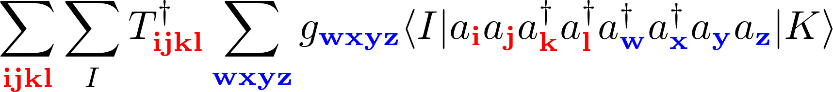
Advantages of normal ordering
Situation is simplified once creation and annihilation operators are normal ordered:

Slide 33

CI strings
A determinant, I, can be defined by a set of indices of the occupied active orbitals, e.g.,

Slide 34
CI strings
A determinant, I, can be defined by a set of indices of the occupied active orbitals, e.g.,
The set of all active determinants can then be written

Slide 35
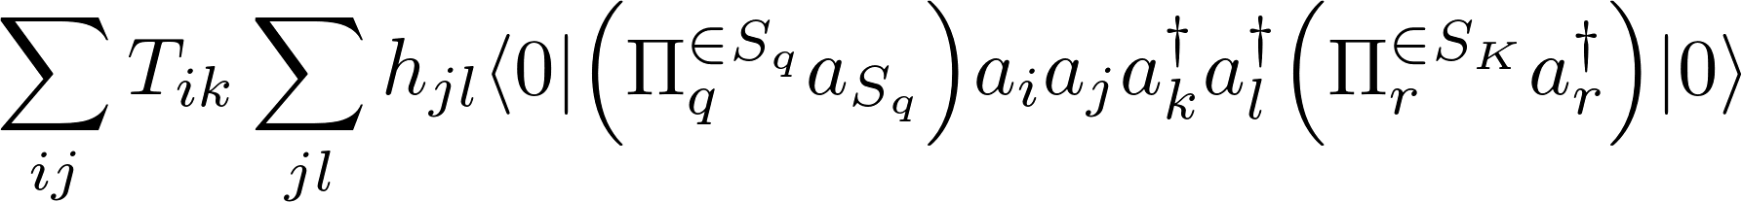
CI strings
A determinant, I, can be defined by a set of indices of the occupied active orbitals, e.g.,
The set of all active determinants can then be written
Replace the sum over determinants with a sum over the combinations of orbitals

Slide 36
Advantages of normal ordering
Situation is simplified once creation and annihilation operators are normal ordered:

Slide 37
Advantages of normal ordering
Situation is simplified once creation and annihilation operators are normal ordered:

Slide 38
Advantages of normal ordering
Situation is simplified once creation and annihilation operators are normal ordered:

Slide 39
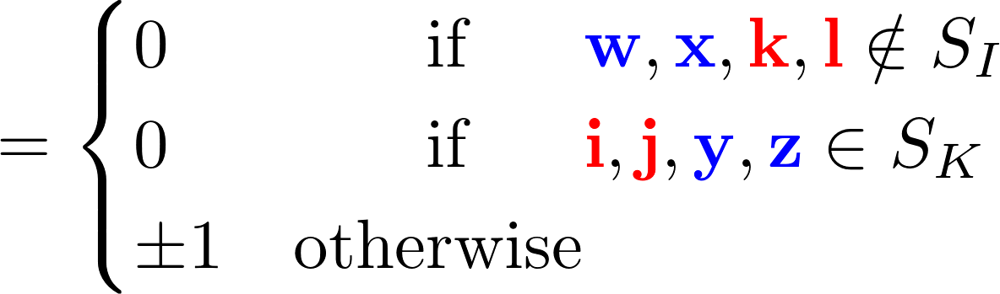
Advantages of normal ordering
Situation is simplified once creation and annihilation operators are normal ordered:

Slide 40
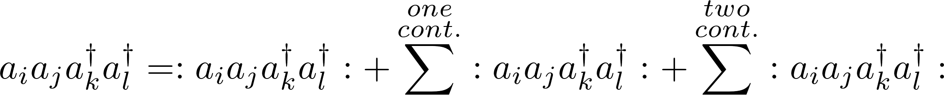
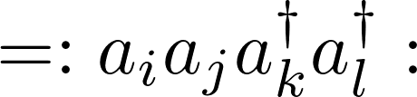
Wick’s Theorem
For operators with more than two excitations, sum over all possible contractions:

Slide 41
Wick’s Theorem
For operators with more than two excitations, sum over all possible contractions:

Slide 42
Wick’s Theorem
For operators with more than two excitations, sum over all possible contractions:

Slide 43
Wick’s Theorem
For operators with more than two excitations, sum over all possible contractions:

Slide 44
Wick’s Theorem
For operators with more than two excitations, sum over all possible contractions:

Slide 45

Wick’s Theorem
For operators with more than two excitations, sum over all possible contractions:

Slide 46
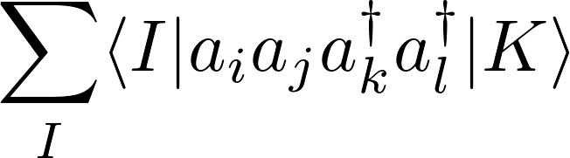
Wick’s Theorem
Rewrite sum over matrix elements for a two electron operator using Wick’s theorem.

Slide 47
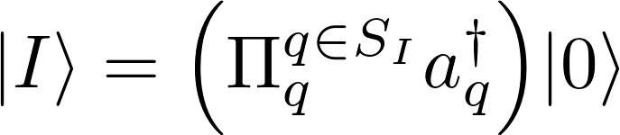
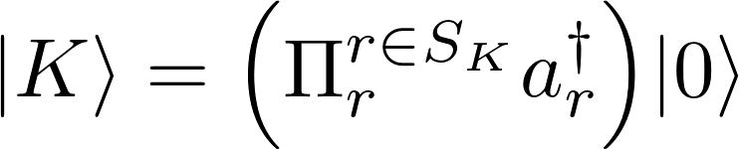
Wick’s Theorem
Rewrite sum over matrix elements for a two electron operator using Wick’s theorem.

Slide 48
Wick’s Theorem
Rewrite sum over matrix elements for a two electron operator using Wick’s theorem.

Slide 49
Wick’s Theorem
Rewrite sum over matrix elements for a two electron operator using Wick’s theorem.
Normal ordered terms will vanish if any of the
indices are not in the SI or SK.

Slide 50

Wick’s Theorem
Rewrite sum over matrix elements for a two electron operator using Wick’s theorem.
Normal ordered terms will vanish if any of the
indices are not in the SI or SK.
I and K are determinants in the active space

Slide 51
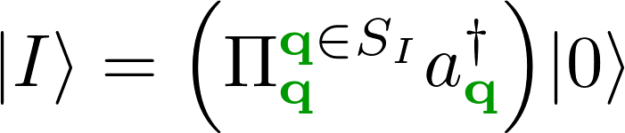
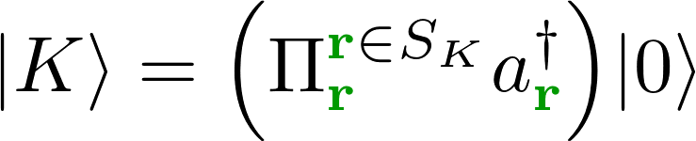
Wick’s Theorem
Rewrite sum over matrix elements for a two electron operator using Wick’s theorem.
Normal ordered terms will vanish if any of the
indices are not in the active space.
I and K are determinants in the active space

Slide 52
Wick’s Theorem
Rewrite sum over matrix elements for a two electron operator using Wick’s theorem.

Slide 53
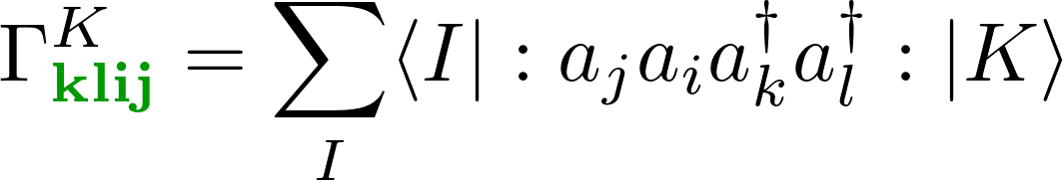
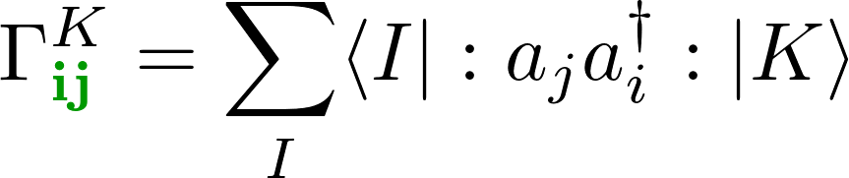
Wick’s Theorem
Rewrite sum over matrix elements for a two electron operator using Wick’s theorem.
RDM derivatives

Slide 54
Wick’s Theorem
Rewrite sum over matrix elements for a two electron operator using Wick’s theorem.
RDM derivatives

Slide 55
Calculation of CI derivatives
Requires evaluation of terms of this form
This sum over general indices can be rewritten as a sum over active indices:
Computationally efficient; can be evaluated without the need to store any eight index tensors.
This is Jae’s recent work:

Slide 56
Difference between relativistic and non-relativistic framework
Alpha and beta orbitals are treated seperately.
Different spin-sectors can interact via spin-orbit coupling and spin-other-orbit interactions.
Potentially much more expensive.

Slide 57
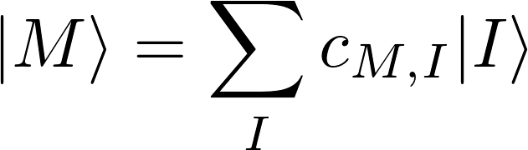
Non-relativistic CI-vector
Non-relativistic CI-vector only has determinants from a single spin sector:

Slide 58







Non-relativistic CI-vector
Non-relativistic CI-vector only has determinants from a single spin sector:
Conf.
...
...
...
...
...
...
...
...

Slide 59
















Relativistic CI-vector
Spin-orbit coupling terms results in contributions from determinants in different spin sectors:
 | Spin sectors
Conf. #
...
...
...
...
...
...
...
...
...
...
...
...
...
...
...
...
...
...
...
...
...
...
...
...
...
...
...
...
...
...
...
...
...
...
...
...
...
...
...
...
...
...
...
...
...
...

Slide 60
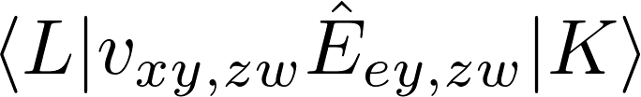
Interaction between spin-sectors
Interaction between determinants from different spin sectors:

Slide 61
Interaction between spin-sectors
Non-relativistic case:

Slide 62

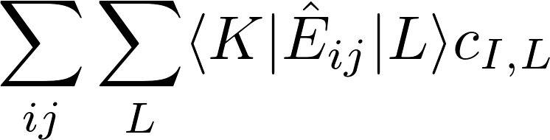

Interaction between spin-sectors
Non-relativistic case:

Slide 63
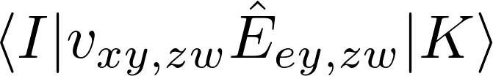
Interaction between spin-sectors
Maximum number of spin flips is two:

Slide 64
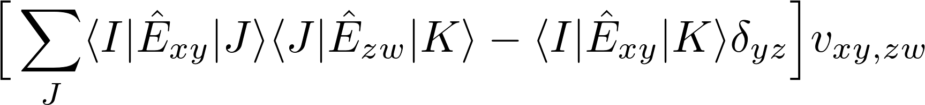
Interaction between spin-sectors
Can be rewritten :

Slide 65
Interaction between spin-sectors
Different number of configurations in each spin sector!
 | Spin sectors
Conf. #
...
...
...
...
...
...
...
...
...
...
...
...
...
...
...
...
...
...
...
...
...
...
...
...
...
...
...
...
...
...
...
...
...
...
...
...
...
...
...
...
...
...
...
...
...
...

Slide 66
Spin sector looping for RDM derivatives
Define a seperate RDM for each spin sector.
Classify excitations into four types:

Slide 67
Spin sector looping for RDM derivatives
Define a seperate RDM for each spin sector.
Classify excitations into four types:
Generate all possible sequences of excitation types for a given spin-sector.

Slide 68
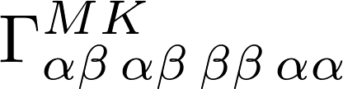
Spin sector looping for RDM derivatives
Define a seperate RDM for each spin sector.
Classify excitations into four types:
Generate all possible sequences of excitation types for a given spin-sector.
Classify different rdm derivatives by these types, e.g.,
Each is the approximately the same size as a non-relativistic rdm derivative.
At worst, each spin sector will have 4⁴=256 such terms, though many contributions can be ruled out.

Slide 69
Time reversal symmetry
Different kinds of excitations are connected via time reversal:

Slide 70




Time reversal symmetry
Different kinds of excitations are connected via time reversal:
Can substantially reduce the number of rdm derivatives which need to be calculated, e.g.,
Do not need both of and or both and .

Slide 71
Time reversal symmetry
Different kinds of excitations are connected via time reversal:
Can substantially reduce the number of rdm derivatives which need to be calculated, e.g.,
Do not need both of and or both and .
Maximum number of distinct terms per spinsector is 2⁴=16.
Similar transitions will occur repeatedly, enabling reuse of terms.

Slide 72
Wick’s Theorem
Define CI string:

Slide 73
END

Slide 74
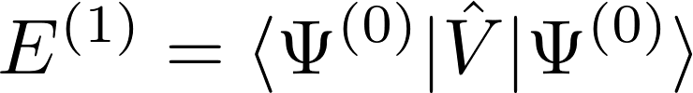
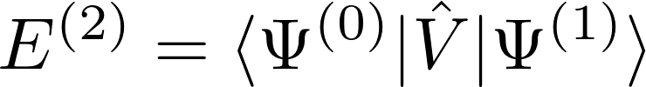

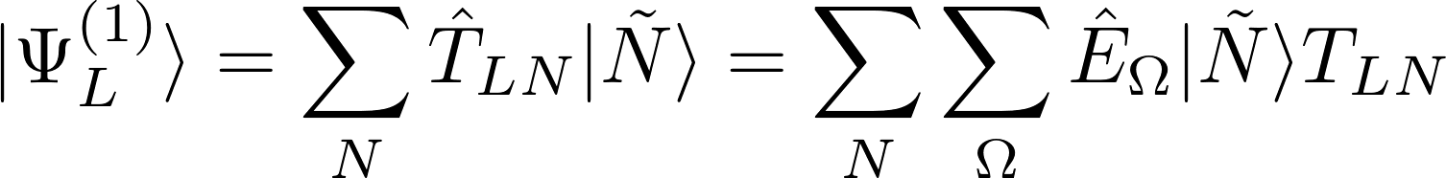
Hylleras functional
First order terms in the perturbation expansion:

Slide 75
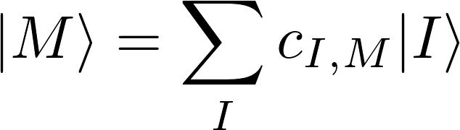
XMS-CASPT2
XMS-CASPT2 : Extended multistate complete active space second order perturbation theory.
Initial wavefunction from a CASSCF calculation:
Generate new set of states by diagonalizing the Fock operator in the space formed by these states:

Slide 76
XMS-CASPT2
First-order perturbation to the wavefunction is expanded in basis of excited determinants:
Sum over states in CASSCF reference space

Slide 77
XMS-CASPT2
First-order perturbation to the wavefunction is expanded in basis of excited determinants:
T amplitudes
Single and double excitations between inactive, active and virtual orbitals.
Excitation operator

Slide 78
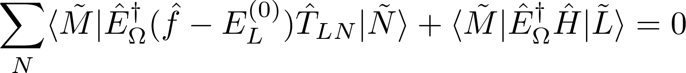
XMS-CASPT2
First-order perturbation to the wavefunction is expanded in basis of excited determinants:
The T amplitudes for a given state are those which satisfy

Slide 79
XMS-CASPT2
First-order perturbation to the wavefunction is expanded in basis of excited determinants:
The T amplitudes for a given state are those which satisfy
State averaged Fock Matrix
Zeroth order energy of state L

Slide 80
XMS-CASPT2
XMS-CASPT2 energy
          T amplitudes.
          Orbital rotations.
          CI coefficients.

Slide 81
XMS-CASPT2
Spin-orbit coupling terms results in coupling between determinants from different spin sectors:
Conf.
...
...
...
...
...
...
...
...
...
...
...
...
...
...
...
...
...
...
...
...
...
...
...
...
...
...
...
...
...
...
...
...
...
...
...
...
...
...
...
...
...
...
...
...

Slide 82
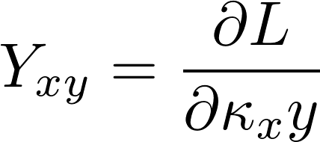
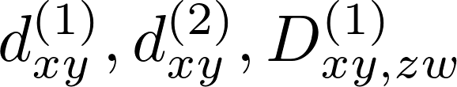
XMS-CASPT2
Solve for initial XMS-CASPT2 energy
Solve for Lamda coefficients
Solve Z-vector equation

Slide 83
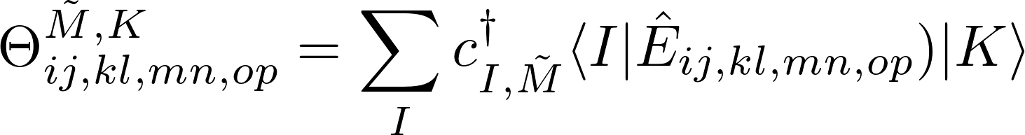
Difference between relativistic and non-relativistic framework
Alpha and beta orbitals are treated seperately.
Different spin-sectors can interact via spin-orbit coupling and spin-other-orbit interactions.
Potentially much more expensive.

Slide 84

Time reversal symmetry
Can substantially reduce the number of rdm derivatives which need to be calculated:

Slide 85



CI seperation
Rewrite so no explicit orbital indices
Define a pair of determinants

Slide 86


CI seperation
Rewrite using Wick’s theorem:

Slide 87

CI seperation
Rewrite so no explicit orbital indices
Define a pair of determinants

Slide 88
CI seperation
Rewrite so no explicit orbital indices
Define a pair of determinants

Slide 89


CI seperation
The determinants I and K can be defined by a set of indices of the occupied active orbitals, e.g.,
The set of all active determinants can then be written
Replace the sum over determinants with a sum over these sets

Slide 90

CI seperation
The determinants I and K can be defined by a set of indices of the occupied active orbitals, e.g.,
The set of all active determinants can then be written
Replace the sum over determinants with a sum over these sets

Slide 91
Smith procedure
Define base operators from which all terms will be built:
These consist of a set of coefficients and a some labels specifying excitation ranges.
These excitation indices either specify an element of the T or lambda vectors, or specfiy a block of there specified operator.
The excitation ranges are of type “index” but they are not actual indexes themselves, just strings corresponding to labels (at least initially).
Then make lists of combinations of these operators, e.g.
list<shared_ptr<Operator>> da9 = {proje, t2dagger1, ex_1b, l20};
shared_ptr<Operator> t2dagger1 = make_shared<Op>("t2dagger", _X, _C, _X, _X);

Slide 92
Smith procedure
This list of operators is then used to construct a diagram:
auto dda0 = make_shared<Diagram>(da0, 1, "");
By calling different members of the diagram class we can construct the terms necessary for evaluation of all the terms in the perturbation diagram associated with this set of operators.
We can then combine several diagrams to construct an Equation :
auto eda0 = make_shared<Equation>(dda0, theory);
This has functions to identify like terms in the different diagrams, which prevents similar terms from being evaluated.
Note that in most cases each diagram only ranges over a subset of all the orbitals in which we are interested, whereas the equation ranges over all orbitals of interest.

Slide 93
Smith procedure
Finally we construct the rdm_ for each of the diagrams included in our equations.
edb0->active();
This uses the indices from the diagrams, as well as whether we are dealing normal rdms or rdm derivatives.
The objects defined thus far completely outline the problem to be solved, but at present they are little more than a collection of names of opearators and index ranges.
To generate the code structure we use our Equation to construct a Residual object.
The Residual class is derived from Tree .
Tree loops over each of the diagrams in the equation and for each diagram constructs a ListTensor; a list containing all the information about (indices, operator type and ordering etc., ) the tensor in that diagram.

