Slide 1

Typical
Expectation value (“full”) type terms :
CI-derivative type terms :
Excitation derivative type terms:

Slide 2
Primary term types
Expectation value (“full”) type terms :
CI-derivative type terms :
Excitation derivative type terms:

Slide 3
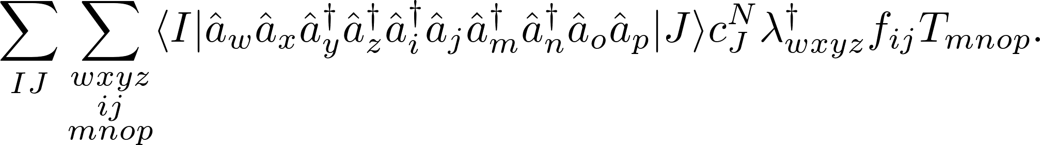
Evaluation of terms
Evaluate terms by contraction of a density matrix type term with molecular orbital tensors, e.g.,
The orbital indexes range over virtual, active, and core orbitals.
If there are 100 orbitals and 10,000 active determinants this is 10¹⁴ elements!
Must find a more efficient method.

Slide 4
“External determinants”
virtual
active
closed

Slide 5
Evaluation of terms
Evaluate terms by contraction of a density matrix type term with molecular orbital tensors, e.g.,
The orbital indexes range over virtual, active, and core orbitals.
If there are 100 orbitals and 10,000 active determinants this is 10¹⁴ elements!
Must find a more efficient method.

Slide 6
“External determinants”
virtual
active
closed

Slide 7
“Active determinants”
virtual
active
closed

Slide 8
Evaluation of terms
Evaluate terms by contraction of a density matrix type term with molecular orbital tensors, e.g.,
The orbital indexes range over virtual, active, and core orbitals.
If there are 100 orbitals and 10,000 active determinants this is 10¹⁴ elements!
Must find a more efficient method.

Slide 9
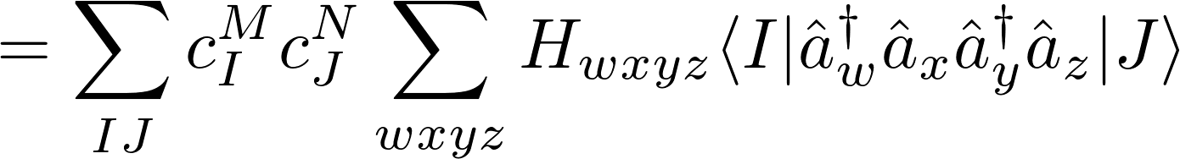
Normal Ordering
It is possible to use the commutation relations to rewrite any term as a linear combination of “normal ordered” terms, e.g.,
All annihilation operations are performed on the Ket before any creation operations.
The Bra and Ket are both active determinants, we know any normal ordered terms with an uncontracted core or virtual index will vanish.

Slide 10
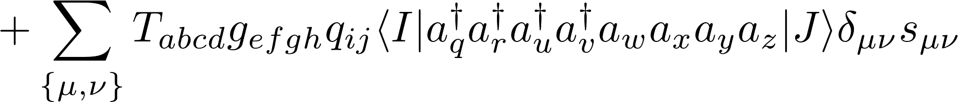
Initial reordering

Slide 11
Rearrangement of terms
Computationally expensive to calculate
This sum over general indices can be rewritten as a sum over active indices:
Computationally efficient; can be evaluated without the need to store any eight index tensors.
This is Jae’s recent work:

Slide 12
Rearrangement of terms
These terms are very computationally expensive to calculate
This sum over general indices can be rewritten as a sum over active indices:
Computationally efficient; can be evaluated without the need to store any eight index tensors.
This is Jae’s recent work:

Slide 13
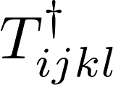



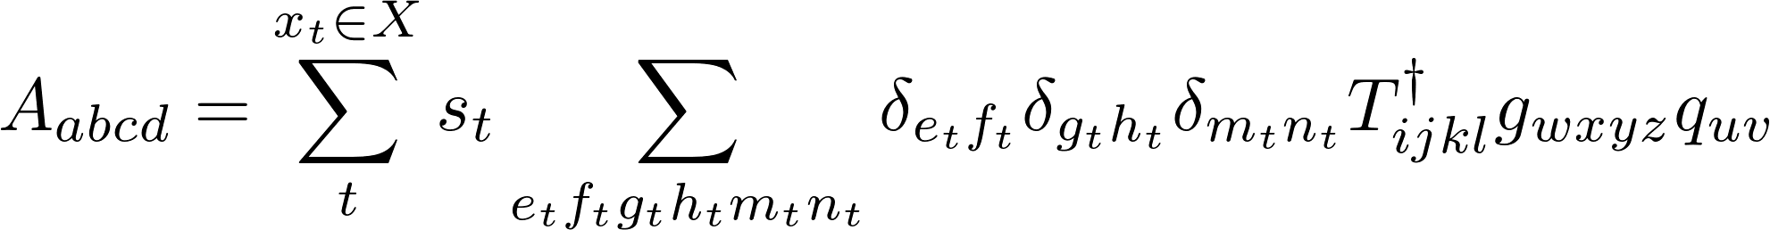
Generation of A-tensors
Each A-tensor is defined by the original operators, , , , and a set, , of contraction indices and factors:

Slide 14
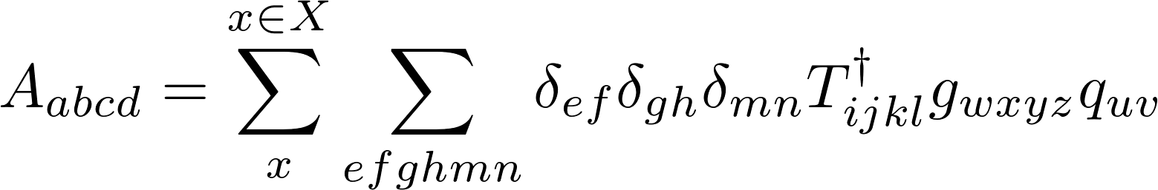

Generation of A-tensors
Each A-tensor is defined by the original operators, , , , and a set, , of contraction indices and factors:
Each contribution, , to the A-tensor is obtained by performing a recursive sequence of operations:

Slide 15
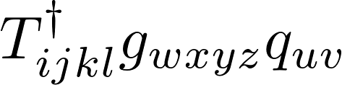





















Contraction tree
5el
4el
3el
2el

Slide 16


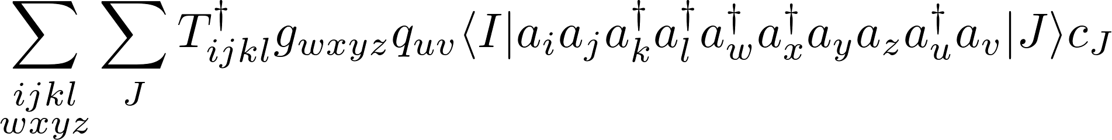
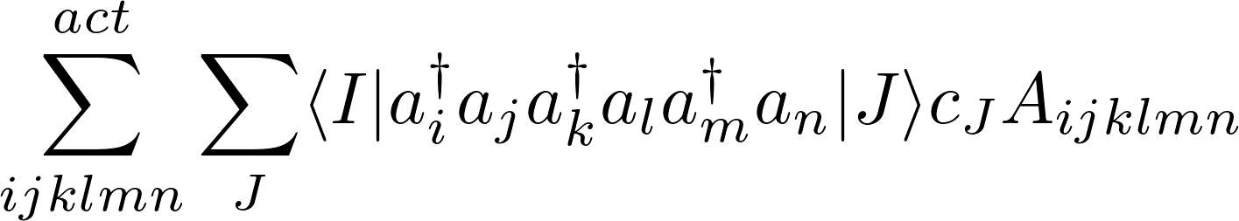
Building contraction tree
The contraction tree is quite large; at each vertex connects to paths.
This leads to distinct paths (14400 for a five electron operator).
Which paths we need are determined by how we reorder the expression in question:
Obtaining all A-tensors efficiently is not the only consideration; we must also consider the evaluation of final contraction:

Slide 17
Generation of contraction task list
Each A-tensor is defined by the original operators, , , , and a set, , of contraction indices and factors:
Each path from top to bottom corresponds to a member of .
Order of contractions is not important.
Reorder the individual members of to get the most efficient tree.

Slide 18
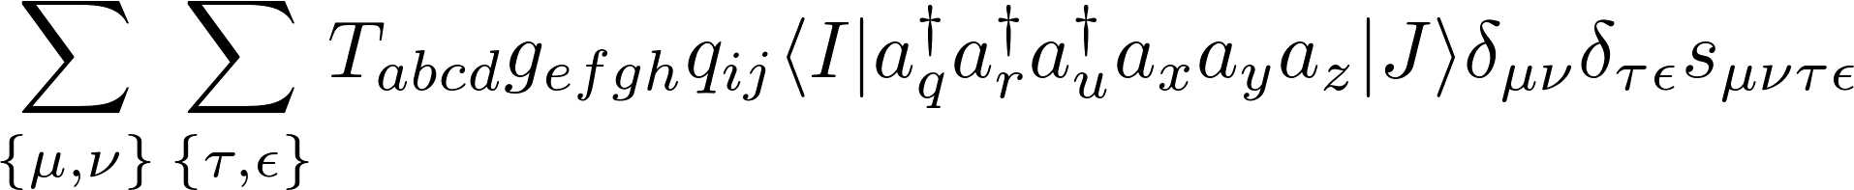
Six electron contribution
The order of the indexes on the bra-ket and contractions still have the same indexes as the operators, T, g and q, but the ordering is changed:
The ordering, sign and any constraints on the indexes are determined by the entire sequence of permutation operations necessary to get to that point.
In terms of computational cost, which sequence of permutations is used is (almost) as important as the final index order.
New terms due to reordering are always of equal or lower rank; apply reordering recursively from largest term to smallest.

Slide 19
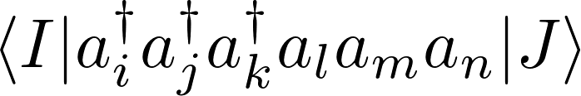
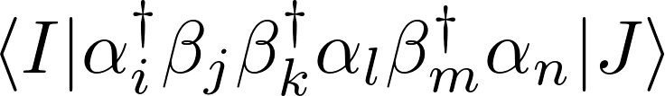
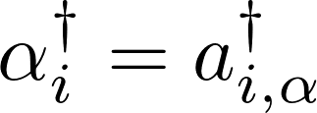
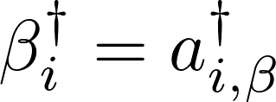
Optimal ordering sequence
By passing through certain orders, it is possible to eliminate terms and simplify the final expression.
Normal order
Indexes in bra-ket must be active.
Spin maximizing/minimizing order
Reorder so as to maximally decrease or increase spin.
May result in contractions (depending on the spin-sector).

Slide 20




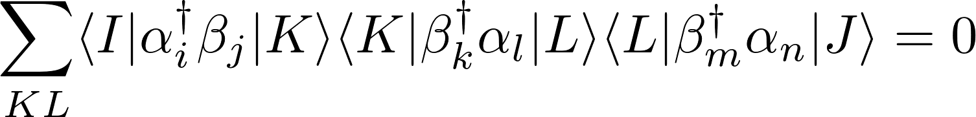








Spin constraints
Chose order so as to push the wavefunction out of the active space.
Spin sector

Slide 21
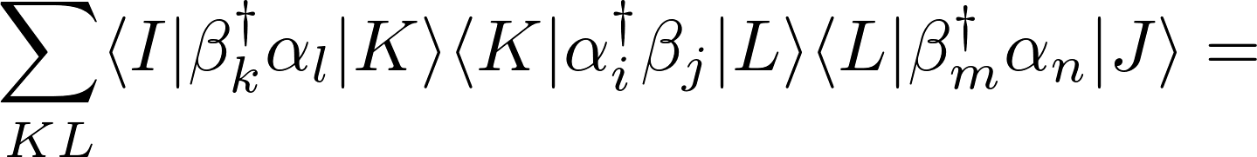
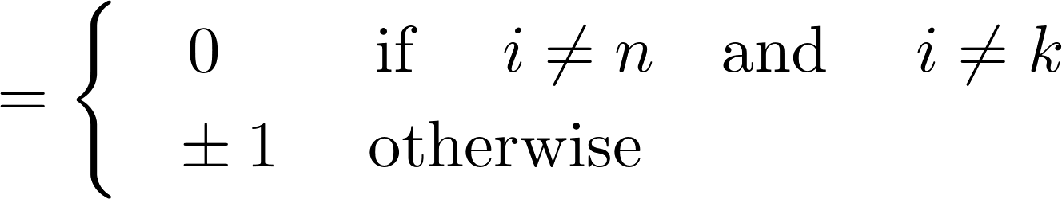
Spin constraints
Chose order so as to push the wavefunction out of the active space.
Spin sector

Slide 22
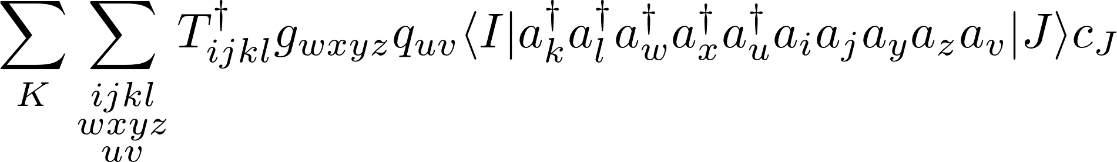
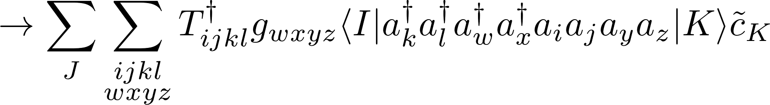
Optimal ordering
By passing through certain orders, it is possible to eliminate terms and simplify the final expression.
Grouped operator index order
May decompose expression into product of two sub expressions

Slide 23
Optimal ordering
By passing through certain orders, it is possible to eliminate terms and simplify the final expression.
Final order should be determined from symmetry constraints, and the need to minimize the number of vertices high in the contraction tree.

Slide 24







Application of block symmetry
Example : CASPT2 perturbation coefficients .
Possible transitions

Slide 25
Application of symmetry
Example : CASPT2 perturbation coefficients .
Possible transitions

Slide 26
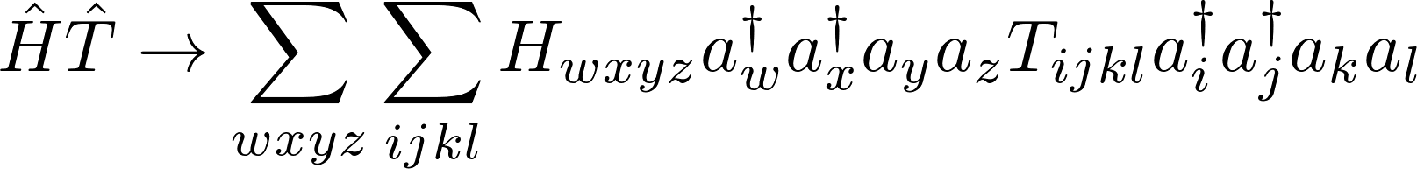
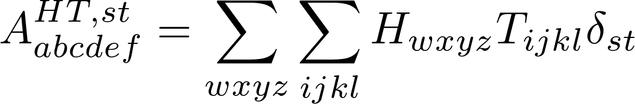


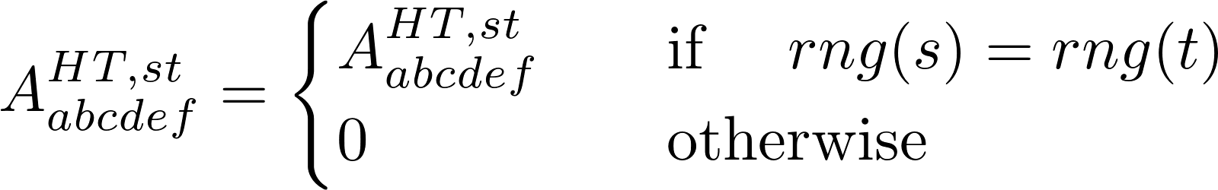
Contraction of tensor blocks
Contract over all possible pairs of indexes, e.g.,
Use the block range constraints to rule out possible contractions, e.g.
Contraction list is different for every range block.

Slide 27
Contraction tree
5el
4el
3el
2el

Slide 28
Block specific contraction trees
Which paths contribute is depends on the block(s) under consideration.
5el
4el
3el
2el

Slide 29
Block specific contraction trees
Which paths contribute is depends on the block(s) under consideration.
5el
4el
3el
2el

Slide 30
Block specific contraction trees
Which paths contribute is depends on the block(s) under consideration.
5el
4el
3el
2el

Slide 31
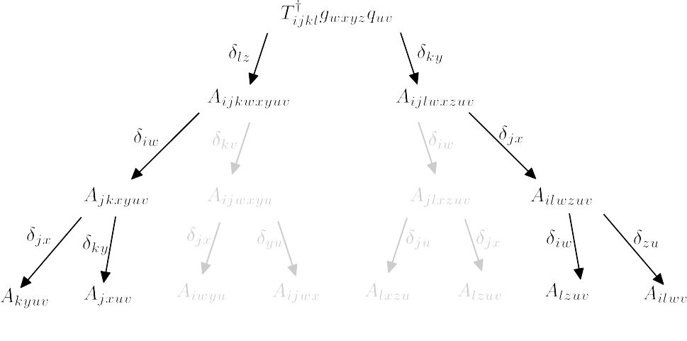
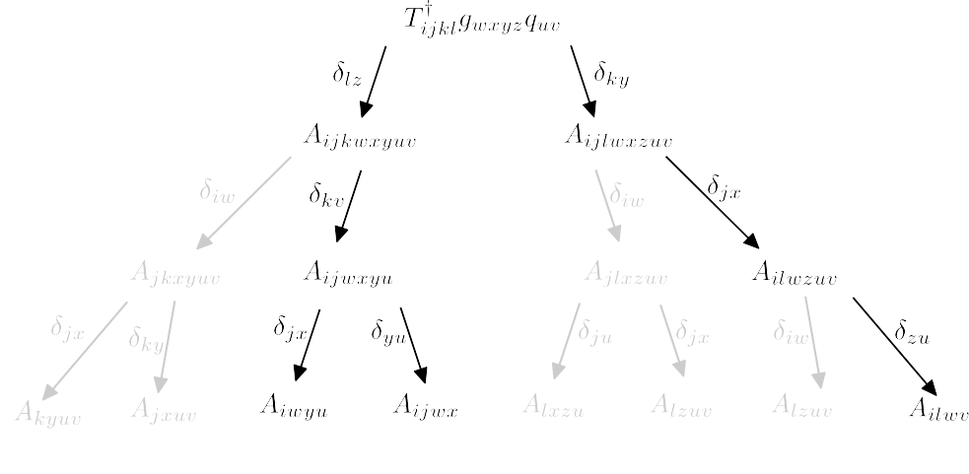
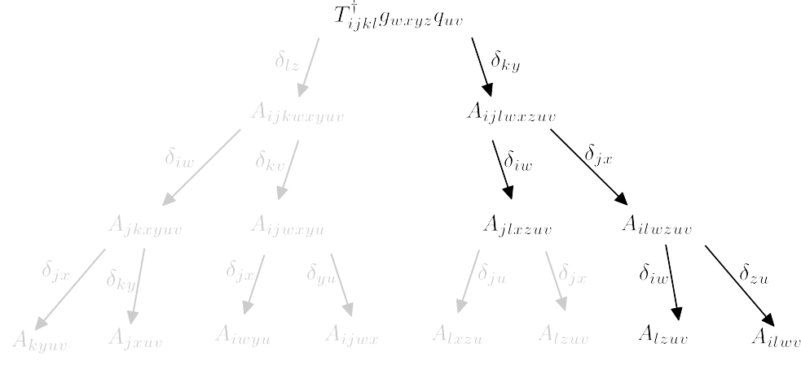


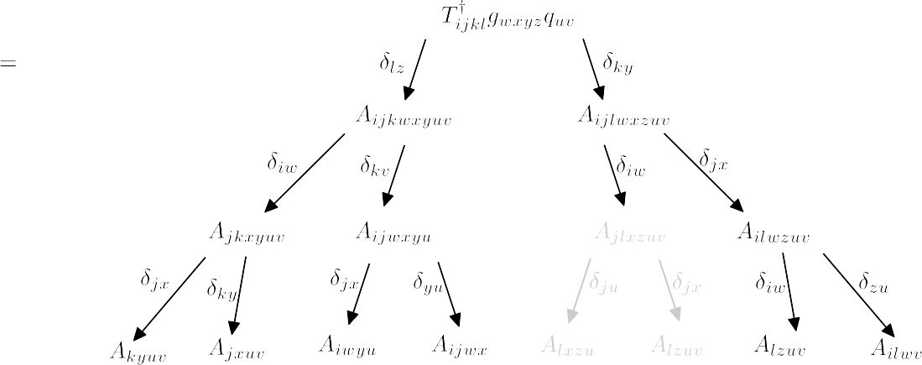
Merge block specific contraction trees

Slide 32
Application of block symmetry
The tree for each block is generated seperately.
Each vertex on the tree is an object which contains information about itself and it’s position in the tree.
      All requirements (vertexes higher up in the tree).
      All dependents (vertexes lower in the tree).
Due to the block symmetry several vertexes are equivalent, which can lead to redundancies.
To avoid redundancies, block symmetry is accounted for not just in the final contraction, but also in the construction of the tree.

Slide 33



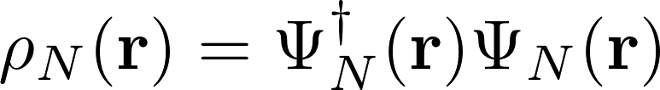

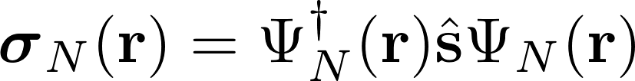

Significance of state averaging in relativistic XMS-CASPT2
The spin densities are typically very different for all states in a multiplet :
Charge density :
                Spin density :
Can split Fock-operator into spin-dependent and spin-independent terms :
It is not clear (to me) what the influence of the state averaging will be on the spin dependent terms.

