Slide 1
Relativistic XMS-CASPT2
(and hyperfine splitting)
Peter John Cherry
Shiozaki group meeting
May 10th 2017

Slide 2

Significance of dynamic electron correlation to spin-dynamics
Single molecular magnet
      Can orientate the magnetic moment of a molecule in a certain direction it will stay there.

Slide 3










Significance of dynamic electron correlation to spin-dynamics
Single molecular magnet
      Can orientate the magnetic moment of a molecule in a certain direction it will stay there.
      A consequence of the presence of a spin reversal barrier:

Slide 4
Significance of dynamic electron correlation to spin-dynamics
Single molecular magnet
      Can orientate the magnetic moment of a molecule in a certain direction it will stay there.
      A consequence of the presence of a spin reversal barrier:

Slide 5
Significance of dynamic electron correlation to spin-dynamics
Single molecular magnet
      Aim for very slow relaxation times at high temperatures.

Slide 6
Significance of dynamic electron correlation to spin-dynamics
Single molecular magnet
      Aim for very slow relaxation times at high temperatures.
      Suitability can be characterized by:
              Height of spin reversal barriers.
              Available relaxation pathways.

Slide 7
Hyperfine tensors
Interaction between the electronic magnetic moment and the nucleus.

Slide 8
Hyperfine tensors
Interaction between the electronic magnetic moment and the nucleus.
Important in determining EPR spectra; one of the main tools for investigating single molecular magnets of most systems of interest due to presence of hydrogen.
Typically small when compared to other effects.
Requires very accurate spin density; small fluctuations can completely alter the results.

Slide 9
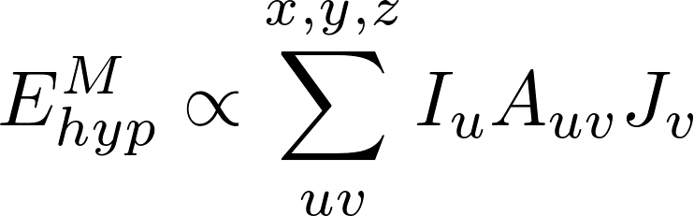
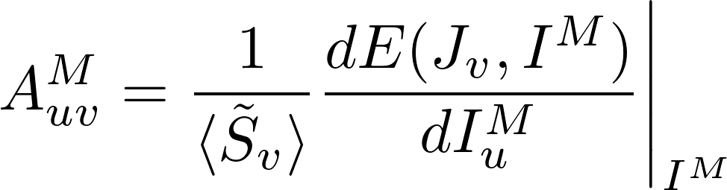
Hyperfine tensors
Definition is (normally) based on energy derivatives

Slide 10
Hyperfine tensors
Definition is (normally) based on energy derivatives
Hyperfine splitting energy for nucleus M

Slide 11
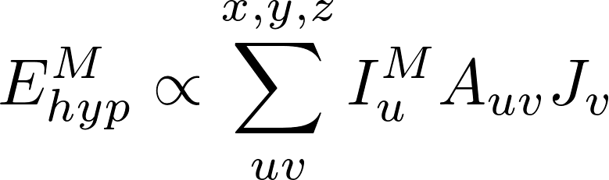
Hyperfine tensors
Definition is (normally) based on energy derivatives
Nuclear magnetic moment vector
Total magnetization vector

Slide 12
Hyperfine tensors
Definition is (normally) based on energy derivatives
Component of hyperfine tensor
for nucleus M

Slide 13
Hyperfine tensors
Definition is (normally) based on energy derivatives
Component of pseudospin

Slide 14
Hyperfine tensors
Definition is (normally) based on energy derivatives
Typically decomposed into two main contributions:
    Fermi contact contribution (when the spin density at nucleus is non-zero).
    Dipolar interaction between the electronic magnetic moment and the nuclear magnetic moment.

Slide 15
Importance of dynamic correlation for hyperfine splitting
T. Shiozaki and T. Yanai, JCTC 12, 4347-4351 (2016)
 | ⁴[V(H2O)6]²⁺ | ⁴[Cr(H2O)6]³⁺ | ⁶[Mn(H2O)6]²⁺
CASSCF(10 orb) | -0.6 | -23.1 | 66.8
CASSCF(23 orb) | -132.7 | 8.9 | -113.0
CASPT2(10 orb) | -232.0 | 45.3 | -224.2
Experiment | -247 | 55 | -245
Isotropic hyperfine coupling constants for ⁴[V(H2O)6]²⁺, ⁴[Cr(H2O)6]³⁺, and ⁶[Mn(H2O)6]²⁺ in MHz.

Slide 16
XMS-CASPT2
XMS-CASPT2 : Extended multistate complete active space second order perturbation theory.

Slide 17
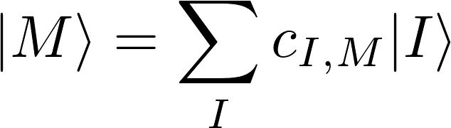
XMS-CASPT2
XMS-CASPT2 : Extended multistate complete active space second order perturbation theory.
Initial wavefunction from a CASSCF calculation:

Slide 18
XMS-CASPT2
XMS-CASPT2 : Extended multistate complete active space second order perturbation theory.
Initial wavefunction from a CASSCF calculation:
CASSCF wavefunction
Expansion
coefficients
Determinants in active space

Slide 19
XMS-CASPT2
XMS-CASPT2 : Extended multistate complete active space second order perturbation theory.
Initial wavefunction from a CASSCF calculation:
Generate new set of states by diagonalizing the state averaged Fock operator in the space formed by these states:

Slide 20
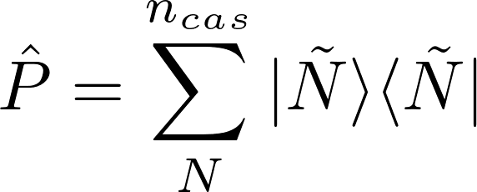

XMS-CASPT2
Define two projectors, one onto the reference space, the other onto its complement:

Slide 21

XMS-CASPT2
Define two projectors, one onto the reference space, the other onto its complement:
Zeroth order XMS-CASPT2 Hamiltonian is given by:

Slide 22
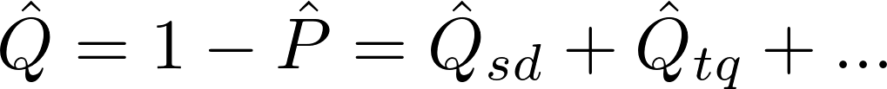
XMS-CASPT2
Define two projectors; one onto the reference space, the other onto its complement:
Zeroth order XMS-CASPT2 Hamiltonian is given by:

Slide 23
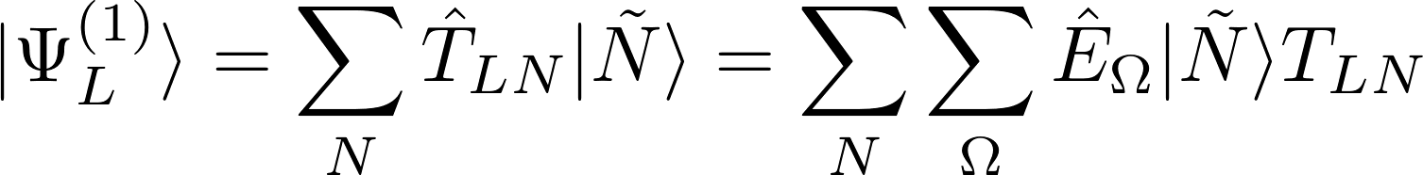
XMS-CASPT2
The first-order wavefunction is expanded in the internally contracted basis:

Slide 24
XMS-CASPT2
The first-order wavefunction is expanded in the internally contracted basis:
Sum over reference space

Slide 25
XMS-CASPT2
The first-order wavefunction is expanded in the internally contracted basis:
Perturbation amplitudes
Sum over double excitations from inactive and active to
virtual space
Excitation operator

Slide 26
XMS-CASPT2
The first-order wavefunction is expanded in an internally contracted basis:
The perturbation amplitudes minimize the Hylleraas functional for the second order energy:

Slide 27
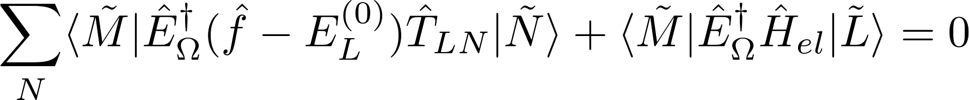
XMS-CASPT2
The first-order wavefunction is expanded in an internally contracted basis:
The perturbation amplitudes minimize the Hylleraas functional for the second order energy:
Differentiation of which yields the amplitude equation:

Slide 28
XMS-CASPT2
The effective Hamiltonian may then be written as:

Slide 29

XMS-CASPT2
The effective Hamiltonian may then be written as:
This is then diagonalized to find the XMS-CASPT2 energies:

Slide 30
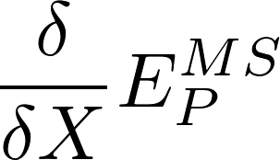
Properties in XMS-CASPT2
Several properties are, or can be, defined as the derivative of the energy with respect to some parameter, e.g.,

Slide 31
Properties in XMS-CASPT2
Several properties are, or can be, defined as the derivative of the energy with respect to some parameter, e.g.,
This includes all EPR tensors.

Slide 32
Properties in XMS-CASPT2
Several properties are, or can be, defined as the derivative of the energy with respect to some parameter, e.g.,
This includes all EPR tensors.
Derivative of XMS-CASPT2 energy with respect to X will require evaluation of derivatives of :
                Amplitudes from CASPT2.
                Coefficients from CASSCF.
                Atomic orbital basis functions.

Slide 33
Properties in XMS-CASPT2
A Lagrangian is defined such that:

Slide 34
Properties in XMS-CASPT2
A Lagrangian is defined such that:
Coefficients from CASSCF calculation

Slide 35
Properties in XMS-CASPT2
A Lagrangian is defined such that:
Amplitudes from CASPT2

Slide 36
Properties in XMS-CASPT2
A Lagrangian is defined such that:
Conditions from CASSCF
Lagrange multipliers associated with conditions from CASSCF

Slide 37
Properties in XMS-CASPT2
A Lagrangian is defined such that:
Conditions from
XMS-CASPT2
Lagrange multipliers associated with conditions from XMS-CASPT2

Slide 38
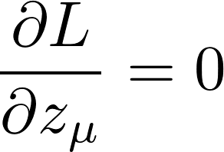
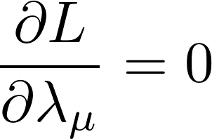
Properties in XMS-CASPT2
A Lagrangian is defined such that:
Define the stationary conditions:

Slide 39
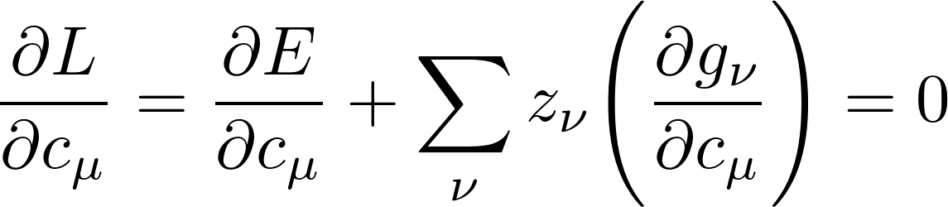
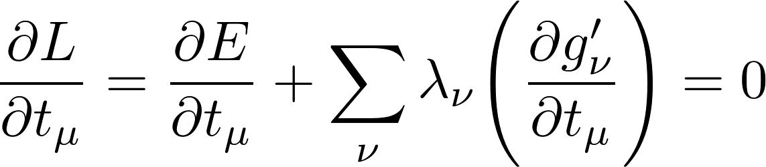
Properties in XMS-CASPT2
A Lagrangian is defined such that:
Define the stationary conditions:

Slide 40
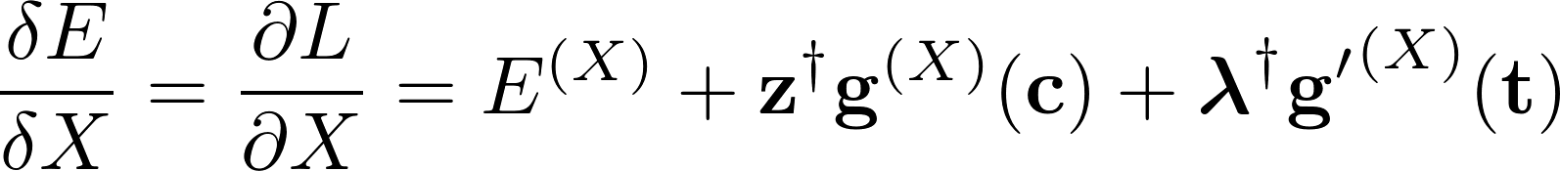
Properties in XMS-CASPT2
A Lagrangian is defined such that:
Define the stationary conditions:

Slide 41

Advantages of the Lagrangian approach
Avoids the need for differentation of and with respect to the perturbation.
The equations for the Lagrange multipliers are independent of the perturbation.
Particularly useful in geometry optimization when there is a large number of perturbations (three for each atom).
Generic formalism which can be applied to multiple properties.

Slide 42

XMS-CASPT2 Lagrangian
Minimize this Lagrangian with respect to
XMS-CASPT2
energy

Slide 43
XMS-CASPT2 Lagrangian
Define the Lagrangian to minimize XMSCASPT2 energy with respect to
Constraint from XMS-CASPT2 amplitude equation

Slide 44
XMS-CASPT2 Lagrangian
Define the Lagrangian to minimize XMSCASPT2 energy with respect to
Constraint from XMS-CASPT2 amplitude equation

Slide 45
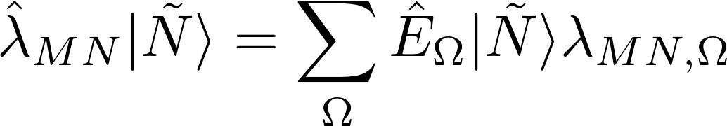
XMS-CASPT2 Lagrangian
Define the Lagrangian to minimize XMSCASPT2 energy with respect to
Constraint from XMS-CASPT2 amplitude equation

Slide 46
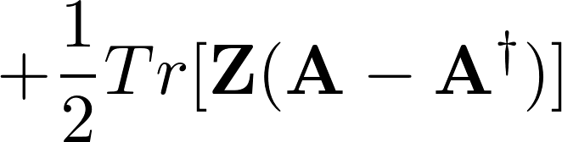
XMS-CASPT2 Lagrangian
Minimize this Lagrangian with respect to
CASSCF orbital gradient

Slide 47
XMS-CASPT2 Lagrangian
Minimize this Lagrangian with respect to
CASSCF orbital gradient

Slide 48
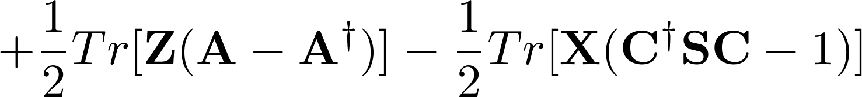
XMS-CASPT2 Lagrangian
Minimize this Lagrangian with respect to
Orthogonality of orbitals

Slide 49
XMS-CASPT2 Lagrangian
Minimize this Lagrangian with respect to
Orthogonality of orbitals

Slide 50
XMS-CASPT2 Lagrangian
Minimize this Lagrangian with respect to
Weight of state N used in state averaging

Slide 51

XMS-CASPT2 Lagrangian
Minimize this Lagrangian with respect to
Constraints on CASSCF reference coefficients .

Slide 52
XMS-CASPT2 Lagrangian
Minimize this Lagrangian with respect to
Constraints on CASSCF reference coefficients .

Slide 53
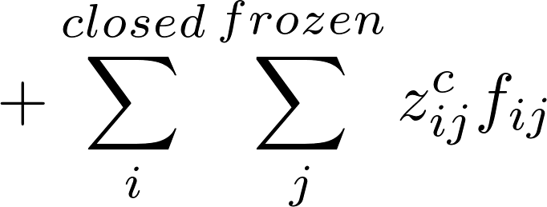
XMS-CASPT2 Lagrangian
Minimize this Lagrangian with respect to
Diagonalization of effective Fock matrix by inactive orbitals

Slide 54
XMS-CASPT2 Lagrangian
Minimize this Lagrangian with respect to
Diagonalization of effective Fock matrix by inactive orbitals

Slide 55
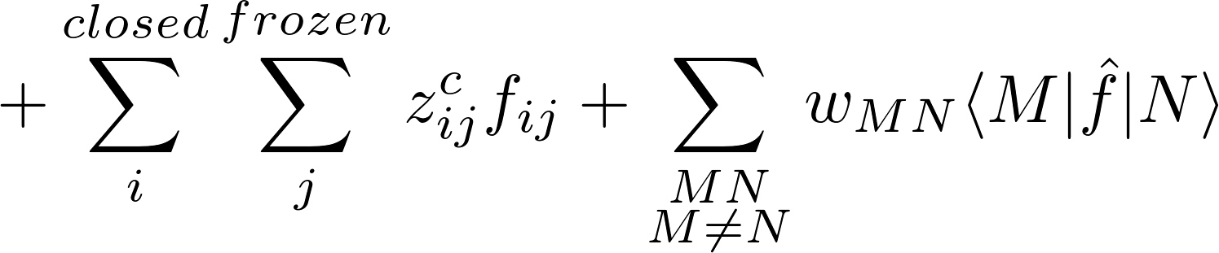
XMS-CASPT2 Lagrangian
Minimize this Lagrangian with respect to
Diagonalization of state averaged Fock operator in the reference space

Slide 56
XMS-CASPT2
Solve two further equations

Slide 57






XMS-CASPT2
Solve two further equations
    The Lambda equation to obtain .
    The Z-vector equation to obtain , , , , and .

Slide 58
XMS-CASPT2 Lagrangian
Minimize this Lagrangian with respect to

Slide 59
Z-vector and Lambda equations
Solve two further equations
    The Lambda equation to obtain .
    The Z-vector equation to obtain , , , , and .

Slide 60
Z-vector and Lambda equations
Solve two further equations
    The Lambda equation to obtain .
    The Z-vector equation to obtain , , , , and .

Slide 61
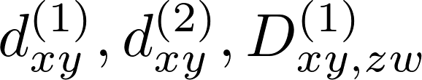
Z-vector and Lambda equations
Solve two further equations
    The Lambda equation to obtain .
    The Z-vector equation to obtain , , , , and .
Solution of the Z-vector equation first requires calculation of
Solve two further equations
    The Lambda equation to obtain
    The Z-vector equation to obtain , , , , and .

Slide 62
Z-vector and Lambda equations
Solve two further equations
    The Lambda equation to obtain .
    The Z-vector equation to obtain , , , , and .
Solution of the Z-vector equation first requires calculation of
Solve two further equations
    The Lambda equation to obtain .
    The Z-vector equation to obtain , , , , and .
First and second order contributions to correlated density matrices

Slide 63
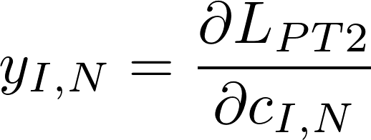
Z-vector and Lambda equations
Solve two further equations
    The Lambda equation to obtain .
    The Z-vector equation to obtain , , , , and .
Solution of the Z-vector equation first requires calculation of
First and second order contributions to correlated density matrices

Slide 64
Z-vector and Lambda equations
Solve two further equations
    The Lambda equation to obtain .
    The Z-vector equation to obtain , , , , and .
Solution of the Z-vector equation first requires calculation of
First and second order contributions to correlated density matrices
Derivative of the Lagrangian with respect to CASSCF reference coefficients

Slide 65
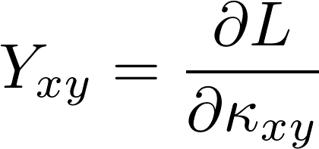
Z-vector and Lambda equations
Solve two further equations
    The Lambda equation to obtain .
    The Z-vector equation to obtain , , , , and .
Solution of the Z-vector equation first requires calculation of
First and second order contributions to correlated density matrices
Derivative of the Lagrangian with respect to CASSCF reference coefficients

Slide 66
Z-vector and Lambda equations
Solve two further equations
    The Lambda equation to obtain .
    The Z-vector equation to obtain , , , , and .
Solution of the Z-vector equation first requires calculation of
First and second order contributions to correlated density matrices
Derivative of the Lagrangian with respect to CASSCF reference coefficients
Derivative of the Lagrangian with respect to CASSCF orbital rotations.

Slide 67
Z-vector and Lambda equations
Solve two further equations
    The Lambda equation to obtain .
    The Z-vector equation to obtain , , , , and .
Solution of the Z-vector equation first requires calculation of
First and second order contributions to correlated density matrices.
Where I
am now
Derivative of the Lagrangian with respect to CASSCF reference coefficients.
Derivative of the Lagrangian with respect to CASSCF orbital rotations.

Slide 68
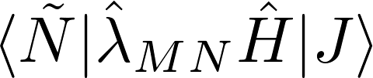
Calculation of CI derivatives
Requires evaluation of terms of this form

Slide 69
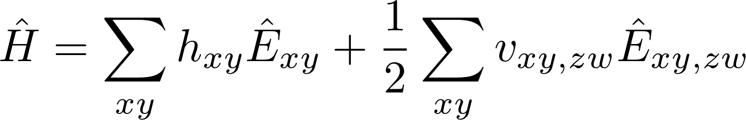
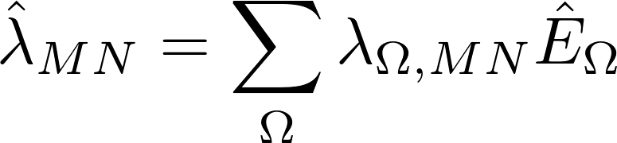
Calculation of CI derivatives
Requires evaluation of terms of this form

Slide 70
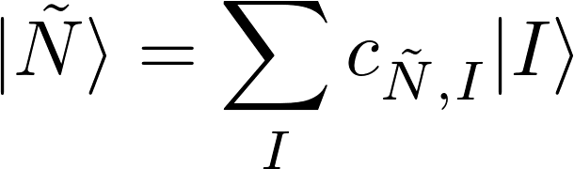
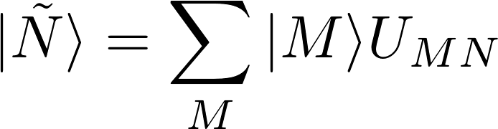
Calculation of CI derivatives
Requires evaluation of terms of this form

Slide 71

Calculation of CI derivatives
Requires evaluation of terms of this form

Slide 72
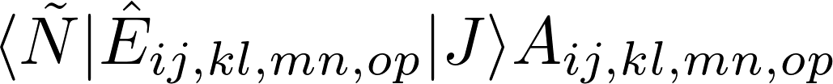
Calculation of CI derivatives
Requires evaluation of terms of this form

Slide 73
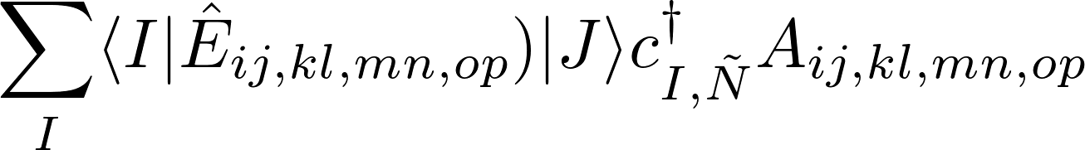
Calculation of CI derivatives
Requires evaluation of terms of this form

Slide 74
Calculation of CI derivatives
Requires evaluation of terms of this form

Slide 75
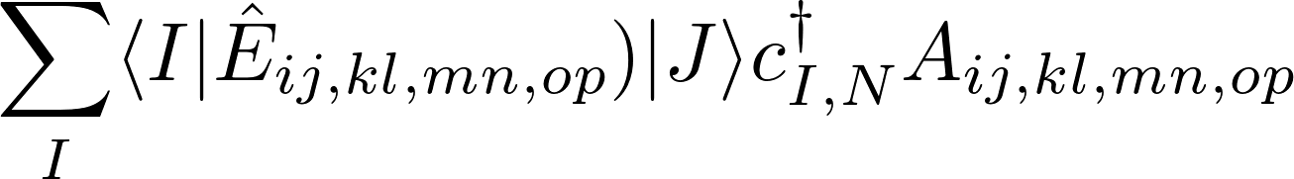
Calculation of CI derivatives
Requires evaluation of terms of this form
Reduced density matrix derivative

Slide 76

Calculation of CI derivatives
Requires evaluation of terms of this form
The terms can be obtained from code generated using SMITH3.
Reduced density matrix derivative

Slide 77

Calculation of CI derivatives
Requires evaluation of terms of this form
The terms can be obtained from code generated using SMITH3.
The terms requires manually written code.
Reduced density matrix derivative

Slide 78
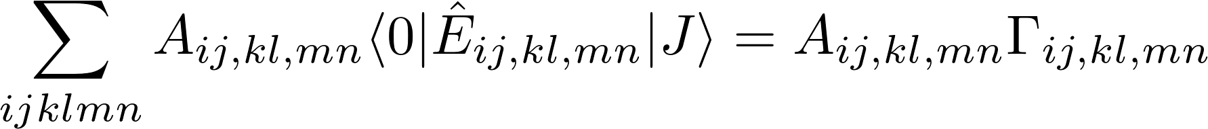
Calculation of CI derivatives
Have up to four particle excitations:

Slide 79
Calculation of CI derivatives
Have up to four particle excitations:
Expressions involving many particle excitations can be rewritten as products of expressions involving single particle excitations.

Slide 80
Calculation of CI derivatives
Have up to four particle excitations:
Expressions involving many particle excitations can be rewritten as products of expressions involving single particle excitations.
The largest contribution is of the form

Slide 81
Relativistic electron-electron interactions
Interaction of electrons is different in a relativistic framework.
`

Slide 82
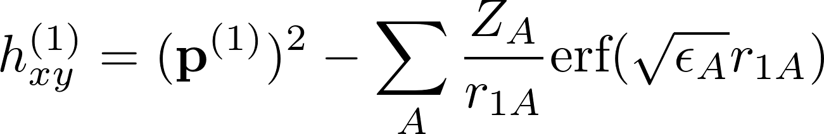
Relativistic electron-electron interactions
Interaction of electrons is different in a relativistic framework.
Non-relativistic one-electron terms
`

Slide 83
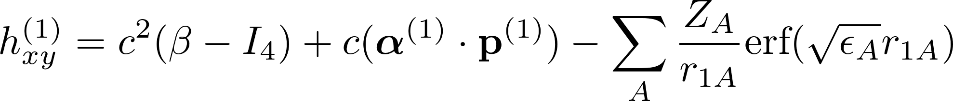
Relativistic electron-electron interactions
Interaction of electrons is different in a relativistic framework.
Non-relativistic one-electron terms
Relativistic one-electron terms
`

Slide 84
Relativistic electron-electron interactions
Interaction of electrons is different in a relativistic framework.
Non-relativistic one-electron terms
Relativistic one-electron terms
`

Slide 85
Relativistic electron-electron interactions
Interaction of electrons is different in a relativistic framework.
`

Slide 86
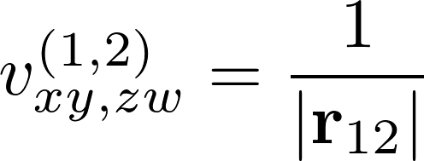
Relativistic electron-electron interactions
Interaction of electrons is different in a relativistic framework.
Non-relativistic two-electron terms
`

Slide 87
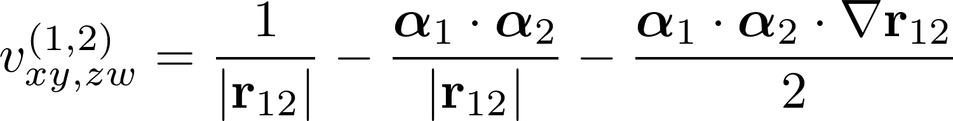
Relativistic electron-electron interactions
Interaction of electrons is different in a relativistic framework.
Non-relativistic two-electron terms
Relativistic two-electron terms
`

Slide 88
Relativistic electron-electron interactions
Interaction of electrons is different in a relativistic framework.
Non-relativistic two-electron terms
Relativistic two-electron terms
`

Slide 89
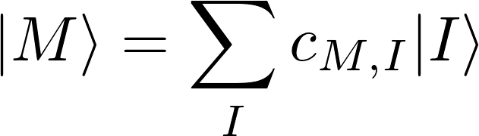
Non-relativistic CI-vector
Non-relativistic CI-vector only has determinants from a single spin sector:

Slide 90







Non-relativistic CI-vector
Non-relativistic CI-vector only has determinants from a single spin sector:
Conf.
...
...
...
...
...
...
...
...

Slide 91
Relativistic electron-electron interactions
Interaction of electrons is different in a relativistic framework.
Non-relativistic two-electron terms
Relativistic two-electron terms
`

Slide 92
















Relativistic CI-vector
Spin-orbit coupling terms results in contributions from determinants in different spin sectors:
 | Spin sectors
Conf. #
...
...
...
...
...
...
...
...
...
...
...
...
...
...
...
...
...
...
...
...
...
...
...
...
...
...
...
...
...
...
...
...
...
...
...
...
...
...
...
...
...
...
...
...
...
...

Slide 93



Calculation of CI derivatives
Have up to four particle excitations:
The most computationally expensive contribution is of the form
In the relativistic framework , and can belong to different spin sectors.

Slide 94
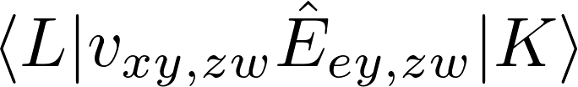
Interaction between spin-sectors
Interaction between determinants from different spin sectors:

Slide 95
Interaction between spin-sectors
Non-relativistic case:

Slide 96
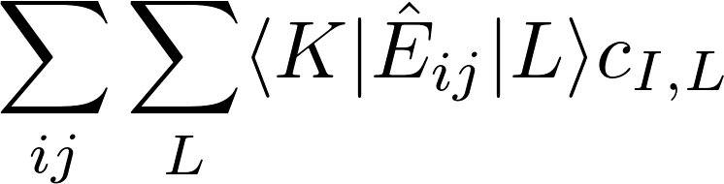
Interaction between spin-sectors
Non-relativistic case:

Slide 97
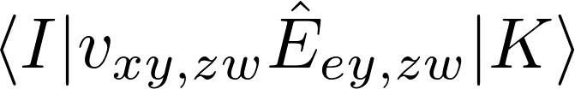
Interaction between spin-sectors
Maximum number of spin flips is two:

Slide 98
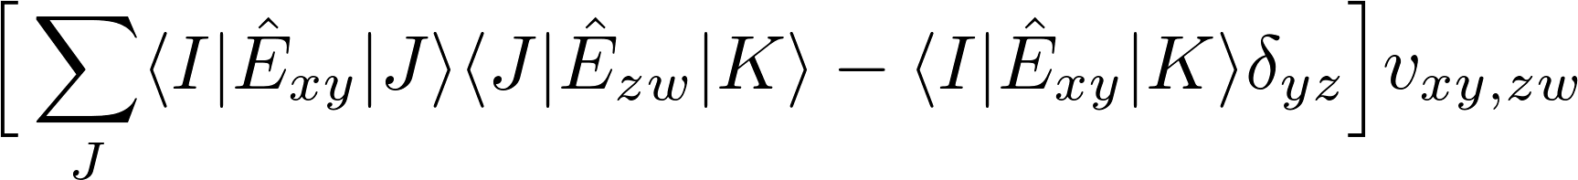
Interaction between spin-sectors
Can be rewritten :

Slide 99
Interaction between spin-sectors
Different number of configurations in each spin sector!
 | Spin sectors
Conf. #
...
...
...
...
...
...
...
...
...
...
...
...
...
...
...
...
...
...
...
...
...
...
...
...
...
...
...
...
...
...
...
...
...
...
...
...
...
...
...
...
...
...
...
...
...
...

Slide 100
Relativistic XMS-CASPT2
The quantities to be evaluated are essentially the same as before:

Slide 101
Relativistic XMS-CASPT2
The quantities to be evaluated are essentially the same as before:
The main difference is the range of the summations.
Must be careful about varying lengths of the CI-vectors when parallelizing.
Only some terms in the Hamiltonian result in spin flips.

Slide 102
END
Check basic definition is correct.
Include definition of Hylleras functional.
Differentiate Hylleras functional wrt T amplitudes.
Include effective Hamiltonian slide. Say this gives us the energies.
Improve definition of first order wavefuntion.
Check basic terms for A and gamma are correct.
Explain why we use the Lagrangian method: do not want to differentiate energy directly, instead define Lagrangian which must be satisfied, and which has Lagrange multipliers from which the T apmplitudes, CI coefficients and orbital coefficients can be determined.
Check relativistic Hamiltonian is OK.
Check constraints are correctly identified.
Add citations.

Slide 103
END
Check terms in Hmailtonian are OK.
Cehck spin sector definitions and interaction is OK.
Check if stuff on spin reversal barrier has been done by Ryan.

Slide 104
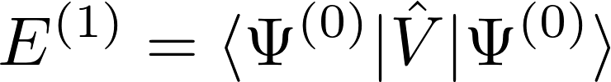
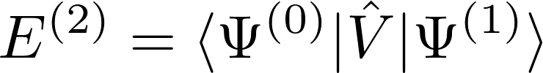

Hylleras functional
First order terms in the perturbation expansion:

Slide 105
XMS-CASPT2
XMS-CASPT2 : Extended multistate complete active space second order perturbation theory.
Initial wavefunction from a CASSCF calculation:
Generate new set of states by diagonalizing the Fock operator in the space formed by these states:

Slide 106
XMS-CASPT2
First-order perturbation to the wavefunction is expanded in basis of excited determinants:
Sum over states in CASSCF reference space

Slide 107
XMS-CASPT2
First-order perturbation to the wavefunction is expanded in basis of excited determinants:
T amplitudes
Single and double excitations between inactive, active and virtual orbitals.
Excitation operator

Slide 108
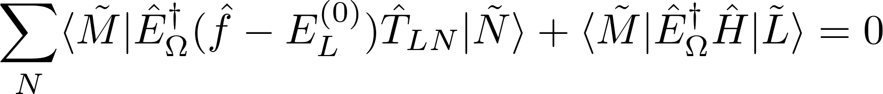
XMS-CASPT2
First-order perturbation to the wavefunction is expanded in basis of excited determinants:
The T amplitudes for a given state are those which satisfy

Slide 109
XMS-CASPT2
First-order perturbation to the wavefunction is expanded in basis of excited determinants:
The T amplitudes for a given state are those which satisfy
State averaged Fock Matrix
Zeroth order energy of state L

Slide 110
XMS-CASPT2
XMS-CASPT2 energy
          T amplitudes.
          Orbital rotations.
          CI coefficients.

Slide 111
XMS-CASPT2
Spin-orbit coupling terms results in coupling between determinants from different spin sectors:
Conf.
...
...
...
...
...
...
...
...
...
...
...
...
...
...
...
...
...
...
...
...
...
...
...
...
...
...
...
...
...
...
...
...
...
...
...
...
...
...
...
...
...
...
...
...

Slide 112
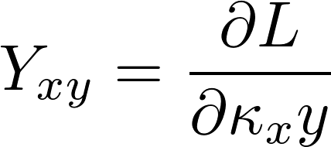
XMS-CASPT2
Solve for initial XMS-CASPT2 energy
Solve for Lamda coefficients
Solve Z-vector equation

