Slide 1

Primary terms types
Expectation value (“full”) type terms :
CI-derivative type terms :
Excitation derivative type terms:

Slide 2
Primary term types
Expectation value (“full”) type terms :
CI-derivative type terms :
Excitation derivative type terms:

Slide 3
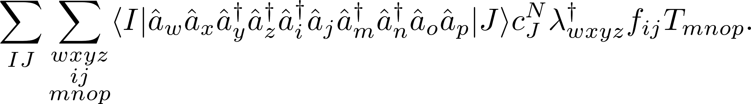
Evaluation of terms
Evaluate terms by contraction of a density matrix type term with molecular orbital tensors, e.g.,
The orbital indexes range over virtual, active, and core orbitals.
If there are 100 orbitals and 10,000 active determinants this is 10¹⁴ elements!
Must find a more efficient method.

Slide 4
“Active determinants”
virtual
active
closed

Slide 5
Rearrangement of terms
Use the anti-commutation relations for the creation and annihilation operators to reorder

Slide 6
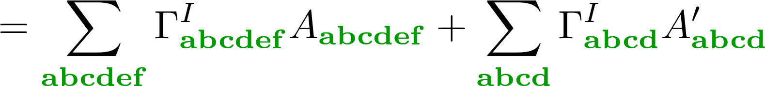
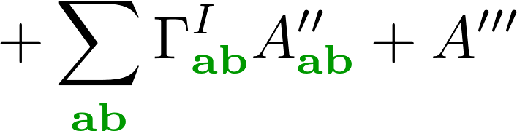
Rearrangement of terms
Use the anti-commutation relations for the creation and annihilation operators to reorder
This sum over general indices can be rewritten as a sum over active indices:

Slide 7
“Active determinants”
virtual
active
closed

Slide 8


Normal ordering constraints
virtual
active
closed

Slide 9
Rearrangement of terms
Use the anti-commutation relations for the creation and annihilation operators to reorder
This sum over general indices can be rewritten as a sum over active indices:

Slide 10
SMITH3
Current CASPT2 module makes use of code generated using SMITH3.
Has been extensively used to generate a number of results:
PAPERS!
Designed primarily for the non-relativistic framework.
Is less flexible, and not suited to the kinds of terms which I am interested in calculating.

Slide 11
Rearrangement of terms
Use the anti-commutation relations for the creation and annihilation operators to reorder
This sum over general indices can be rewritten as a sum over active indices:

Slide 12
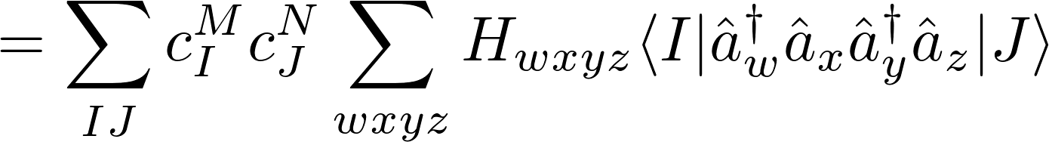
Normal Ordering
It is possible to use the commutation relations to rewrite any term as a linear combination of “normal ordered” terms, e.g.,
All annihilation operations are performed on the Ket before any creation operations.
The Bra and Ket are both active determinants, we know any normal ordered terms with an uncontracted core or virtual index will vanish.

Slide 13
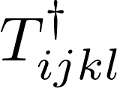



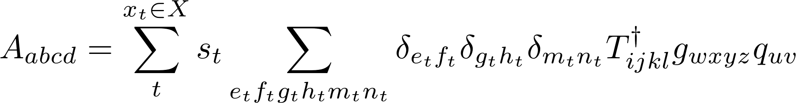
Generation of A-tensors
Each A-tensor is defined by the original operators, , , , and a set, , of contraction indices and factors:

Slide 14
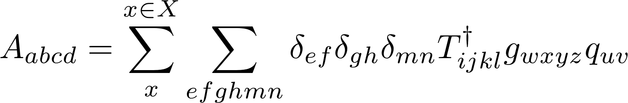

Generation of A-tensors
Each A-tensor is defined by the original operators, , , , and a set, , of contraction indices and factors:
Each contribution, , to the A-tensor is obtained by performing a recursive sequence of operations:

Slide 15
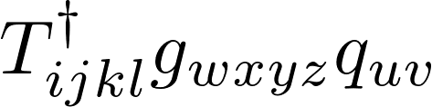





















Contraction tree
5el
4el
3el
2el

Slide 16
Generation of contraction task list
Each A-tensor is defined by the original operators, , , , and a set, , of contraction indices and factors:
Each path from top to bottom corresponds to a member of .
Order of contractions is not important.
Reorder the individual members of to get the most efficient tree.

Slide 17
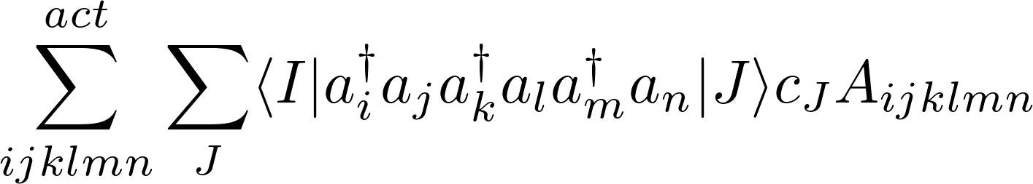
Spin sectors and density matrices
In the relativistic case, the Bra and Ket may be from different spin sectors.

Slide 18
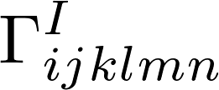









Interacting spin-sectors
1-electron rdm derivatives which need to be calculated for with

Slide 19
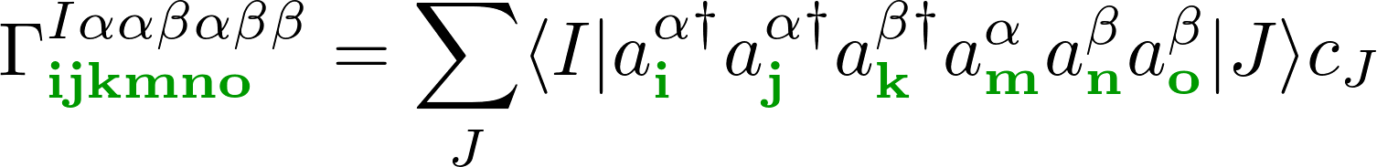
Spin sectors and density matrices
In the relativistic case, the Bra and Ket may be from different spin sectors.
Due to memory constraints, we cannot evaluate the full density matrix at once.
Introduce spin-constrained density matrices:
Each index acts on either alpha or beta indexes.
This corresponds to an interaction between two spin sectors.

Slide 20
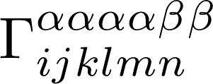

Non-interacting spin-sectors
Contribution for and .

Slide 21
Spin sectors and density matrices
In the relativistic case, the Bra and Ket may be from different spin sectors.
Due to memory constraints, we cannot evaluate the full density matrix at once.
Introduce spin-constrained density matrices:
Each index acts on either alpha or beta indexes.
This corresponds to an interaction between two spin sectors.
Switch to alternating order, enables us to think in terms of “spin transition pathways”.

Slide 22




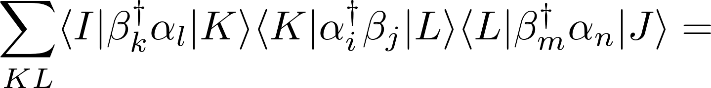
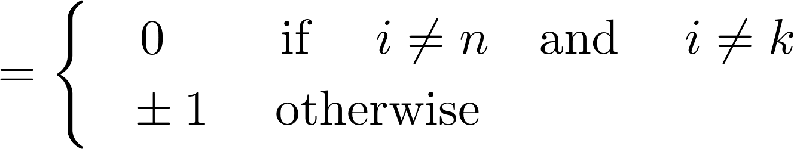
Spin constraints
Chose order so as to push the wavefunction out of the active space.
Spin sector

Slide 23
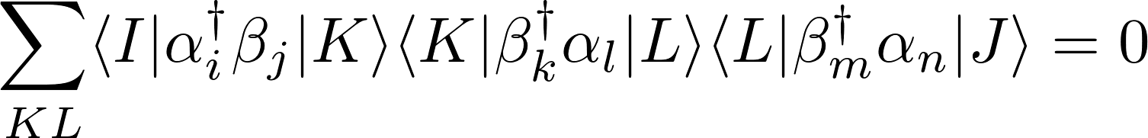
Spin constraints
Chose order so as to push the wavefunction out of the active space.
Spin sector

Slide 24
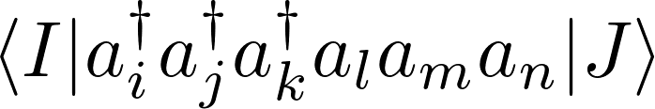
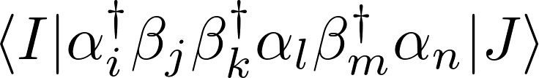
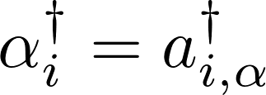
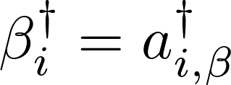
Optimal ordering sequence
By passing through certain orders, it is possible to eliminate terms and simplify the final expression.
Normal order
Indexes in bra-ket must be active.
Spin maximizing/minimizing order
Reorder so as to maximally decrease or increase spin.
May result in contractions (depending on the spin-sector).

Slide 25
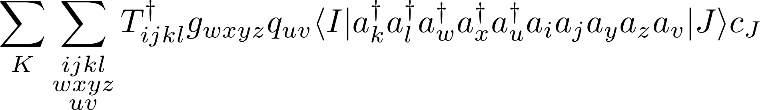
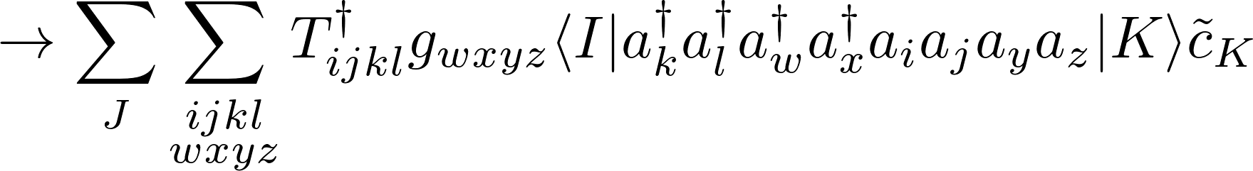
Optimal ordering
By passing through certain orders, it is possible to eliminate terms and simplify the final expression.
Grouped operator index order
May decompose expression into product of two sub expressions

Slide 26
Optimal ordering
By passing through certain orders, it is possible to eliminate terms and simplify the final expression.
Final order should be determined from symmetry constraints, and the need to minimize the number of vertices high in the contraction tree.

Slide 27







Application of block symmetry
Example : CASPT2 perturbation coefficients .
Possible transitions

Slide 28




Application of block symmetry
In the relativistic framework we must also block by spin transition.
Possible transitions

Slide 29
Application of block symmetry
Example : CASPT2 perturbation coefficients .
Possible transitions

Slide 30
Application of block symmetry
Example : CASPT2 perturbation coefficients .
Possible transitions

Slide 31
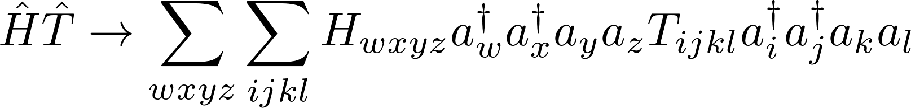
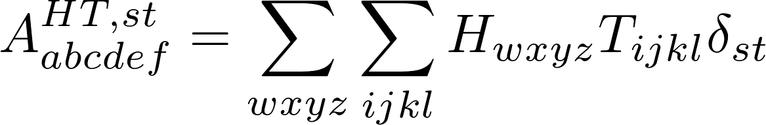


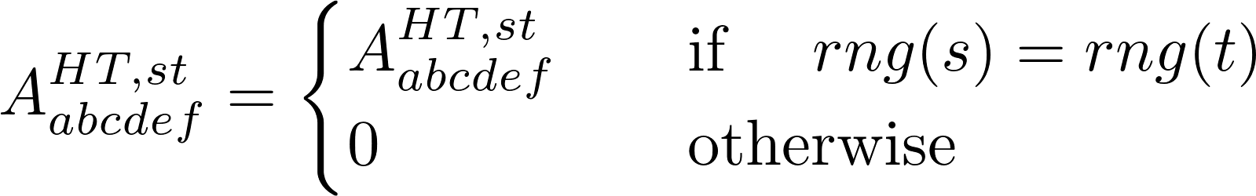
Contraction of tensor blocks
Contract over all possible pairs of indexes, e.g.,
Use the block range constraints to rule out possible contractions, e.g.
Contraction list is different for every range block.

Slide 32
Contraction tree
5el
4el
3el
2el

Slide 33
Block specific contraction trees
Which paths contribute is depends on the block(s) under consideration.
5el
4el
3el
2el

Slide 34
Block specific contraction trees
Which paths contribute is depends on the block(s) under consideration.
5el
4el
3el
2el

Slide 35
Block specific contraction trees
Which paths contribute is depends on the block(s) under consideration.
5el
4el
3el
2el

Slide 36
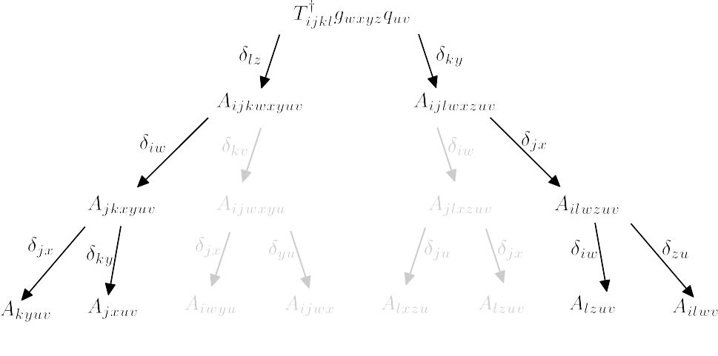
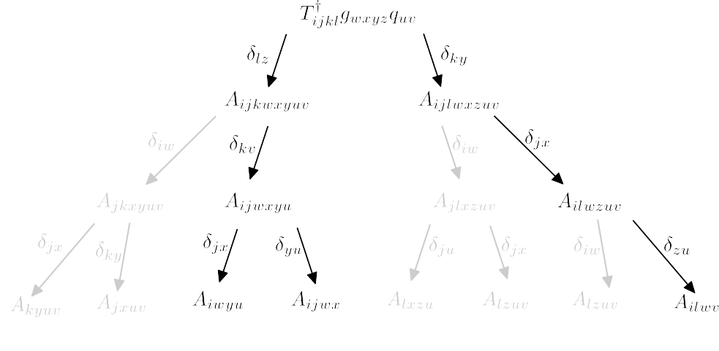
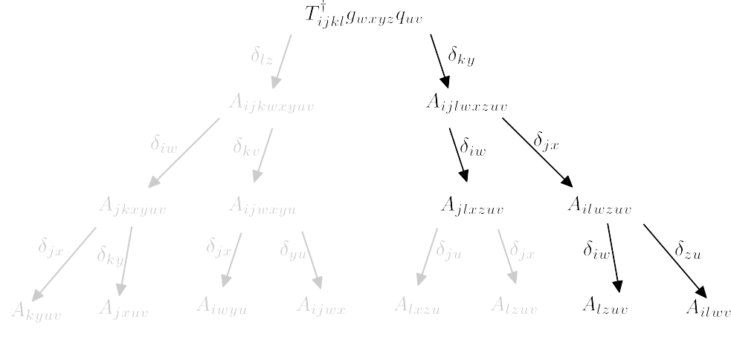


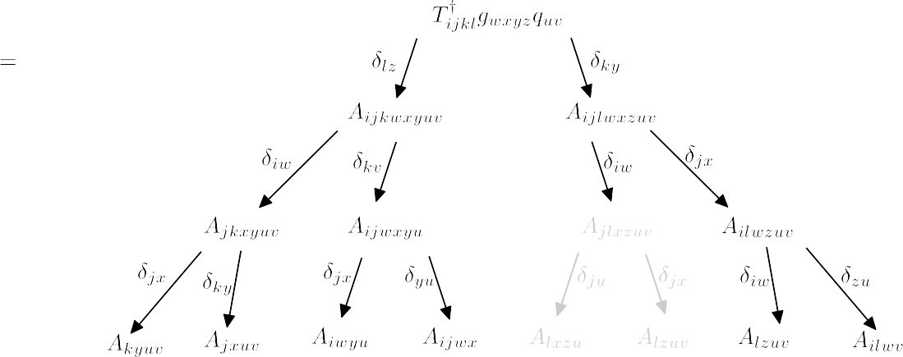
Merge block specific contraction trees

Slide 37
Application of block symmetry
Due to the block symmetry several vertexes are equivalent, which can lead to redundancies.
To avoid redundancies, block symmetry is accounted for not just in the final contraction, but also in the construction of the tree.
The tree for each block is generated seperately; the reordering sequence is block dependent.

Slide 38
Program Structure
Input
Driver
Mathematical task translator
Algebraic Manipulator
Linear algebra and CI routines

Slide 39
Summary
A new program for calculating arbitrarily complex expressions in a multireference relativistic framework.
Intended as a theory development platform; test new ideas without programming.
Motivated by development of EPR theory, but widely applicable (core excitation spectra, forbidden spin transitions).
Distinguishing features are the heavy use of symmetry, and adaptation to the four component framework.
Design ensures it is readily portable and extendable.

Slide 40



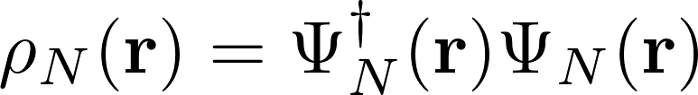

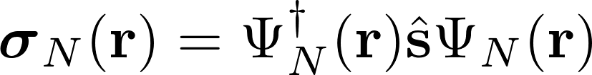

Significance of state averaging in relativistic XMS-CASPT2
The spin densities are typically very different for all states in a multiplet :
Charge density :
                Spin density :
Can split Fock-operator into spin-dependent and spin-independent terms :
It is not clear (to me) what the influence of the state averaging will be on the spin dependent terms.

