Slide 1
Calculation of derivative properties in XMS-CASPT2
Peter John Cherry
Shiozaki group meeting
October 30th 2017

Slide 2

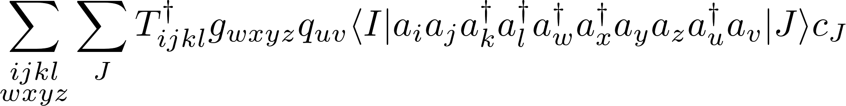
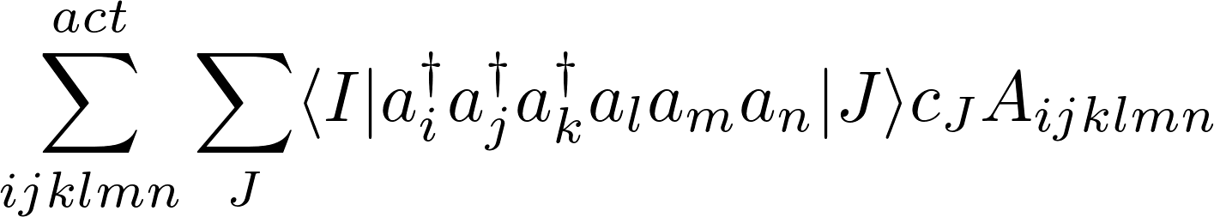
Calculation of matrix elements for many electron operators
We need a generic approach for evaluating terms of the form
These terms can be decomposed into a sum of expressions of the following form:
Jae used code from SMITH3 to develop an efficient method of doing this in a non-relativistic framework.
However, for cases involving spin-flipping interactions, we need to develop a method which takes advantage of spin symmetry.

Slide 3
Outline of method
    Step 1 : Get operator information.
        Split input tensors up into blocks.
        Generate all possible contractions of these blocks.
        Identify which blocks/contracted blocks are equivalent.
    Step 2 : Manipulate indexes.
        Rearrange indexes to normal order, applying range constraints.
        Put indexes into alternating order and group common indexes.
    Step 3 : Generate computational proceedure.
        Merge all contributions from different brakets.
        Generate a task list to obtain contracted A-tensors.
    Step 4 : Execute computational proceedure.
        Contract A-tensors with gamma matrices.
    Step 5 : Loop over spin sectors and states.
        Repeat for all necessary spin sectors.

Slide 4
Outline of method
    Step 1 : Get operator information.
        Split input tensors up into blocks.
        Generate all possible contractions of these blocks.
        Identify which blocks/contracted blocks are equivalent.
    Step 2 : Manipulate indexes.
        Rearrange indexes to normal order, applying range constraints.
        Put indexes into alternating order and group common indexes.
    Step 3 : Generate computational proceedure.
        Merge all contributions from different brakets.
        Generate a task list to obtain contracted A-tensors.
    Step 4 : Execute computational proceedure.
        Contract A-tensors with gamma matrices.
    Step 5 : Loop over spin sectors and states.
        Repeat for all necessary spin sectors.
Changes here
Changes here
Changes here
Working here

Slide 5
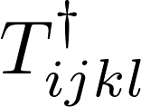



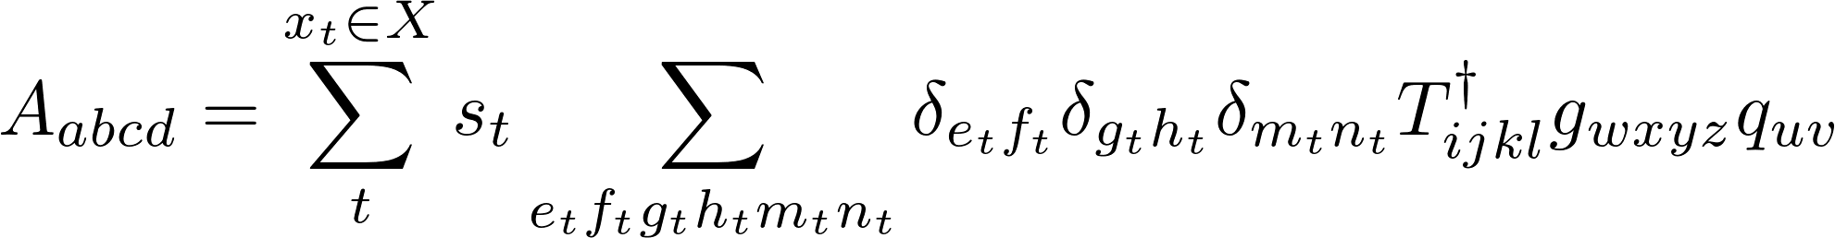
Generation of A-tensors
Each A-tensor is defined by the original operators, , , , and a set, , of contraction indices and factors:

Slide 6
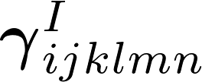

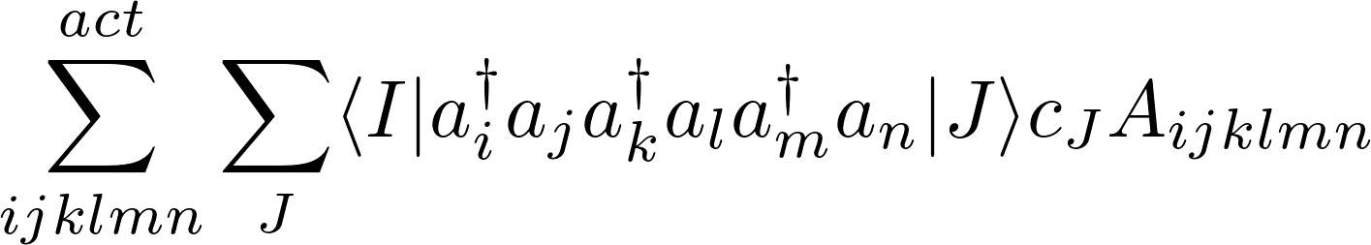
Contraction of and
Contraction of A-tensor with reduced density matrix (or similar) term:
The middle term is often too large to be stored in memory.
Two possible methods may be used to calculate this term “on-the-fly” will be discussed at the end.

Slide 7
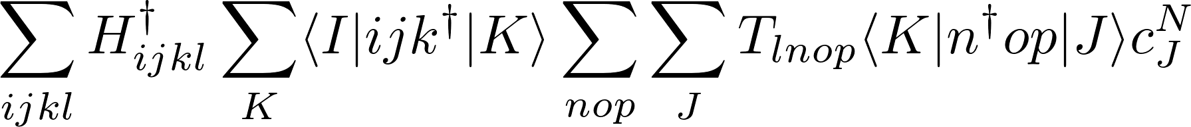
Contraction of and
Final step is to contract the A-tensor with the reduced density matrix or similar terms :
Aim to avoid storing the six index reduced density matrix derivative term in memory.

Slide 8
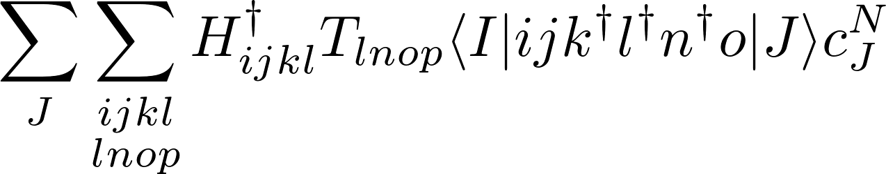
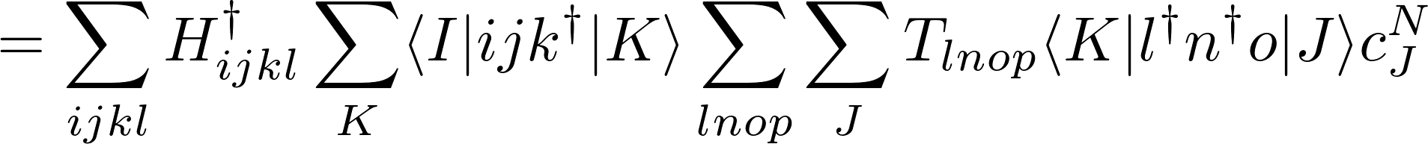
Contraction of and
Another alternative is to use two three index terms
Often there are only a few contributions to the A-tensor, which
One possible method is to decompose it into a four index and two index term:

Slide 9
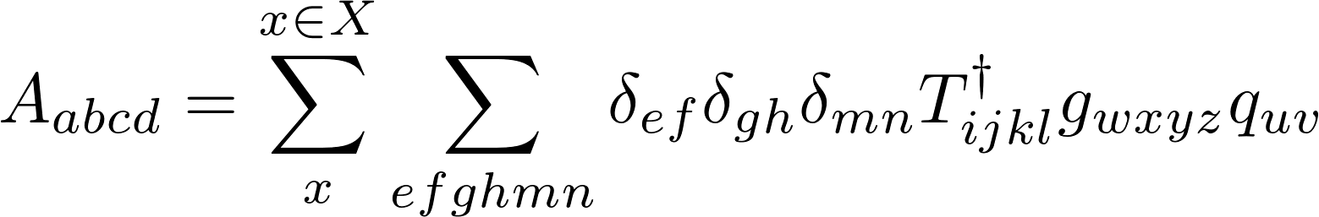

Generation of A-tensors
Each A-tensor is defined by the original operators, , , , and a set, , of contraction indices and factors:
Each contribution, , to the A-tensor is obtained by performing a recursive sequence of operations:

Slide 10
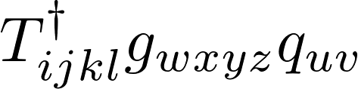





















Contraction tree
5el
4el
3el
2el

Slide 11


Building contraction tree
The contraction tree is quite large; at each vertex connects to paths.
This leads to distinct paths (14400 for a five electron operator).
Which paths we need are determined by how we reorder the expression in question:
Obtaining all A-tensors efficiently is not the only consideration; we must also consider the evaluation of final contraction:

Slide 12
Generation of contraction task list
Each A-tensor is defined by the original operators, , , , and a set, , of contraction indices and factors:
Each path from top to bottom corresponds to a member of .
Order of contractions is not important.
Reorder the individual members of to get the most efficient tree.

Slide 13
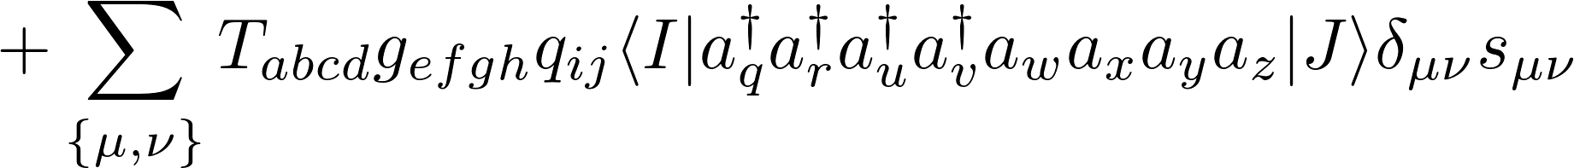


Initial reordering
Initial ordering is ill-suited to efficient computation. Reorder to normal order :
Now all indexes in the BraKet must be active; this constraint greatly reduces the computational cost as typically and .

Slide 14
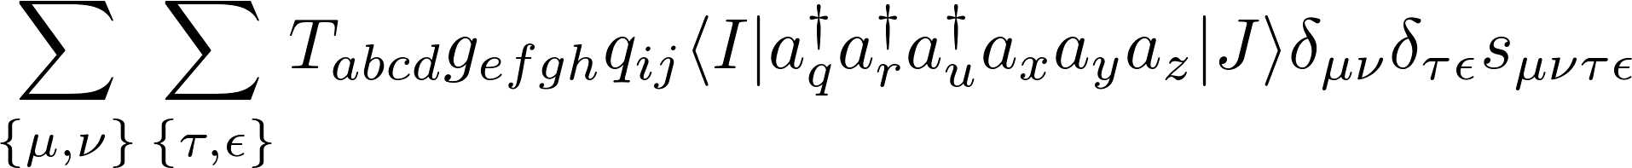
Six electron contribution
The order of the indexes on the bra-ket and contractions still have the same indexes as the operators, T, g and q, but the ordering is changed:
The ordering, sign and any constraints on the indexes are determined by the entire sequence of permutation operations necessary to get to that point.
In terms of computational cost, which sequence of permutations is used is (almost) as important as the final index order.
New terms due to reordering are always of equal or lower rank; apply reordering recursively from largest term to smallest.

Slide 15
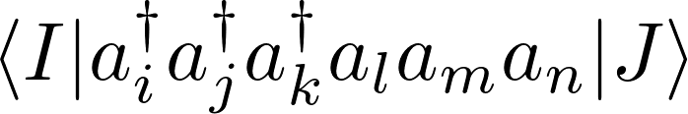
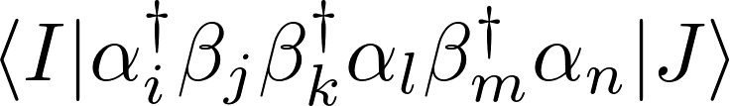
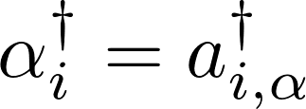
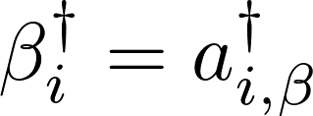
Optimal ordering sequence
By passing through certain orders, it is possible to eliminate terms and simplify the final expression.
Normal order
Indexes in bra-ket must be active.
Spin maximizing/minimizing order
Reorder so as to maximally decrease or increase spin.
May result in contractions (depending on the spin-sector).

Slide 16




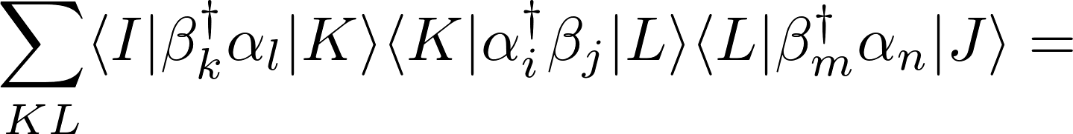


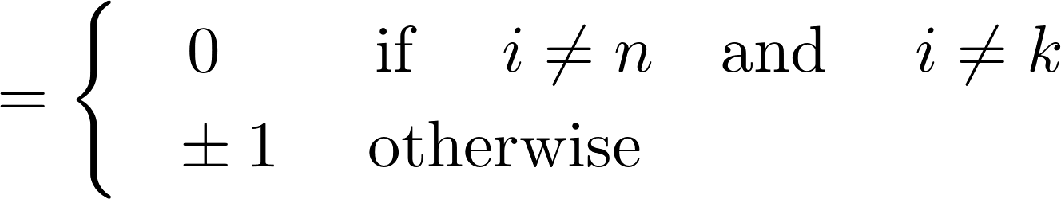






Spin constraints
Chose order so as to push the wavefunction out of the active space.
Spin sector

Slide 17
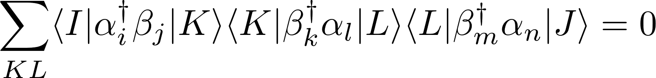
Spin constraints
Chose order so as to push the wavefunction out of the active space.
Spin sector

Slide 18
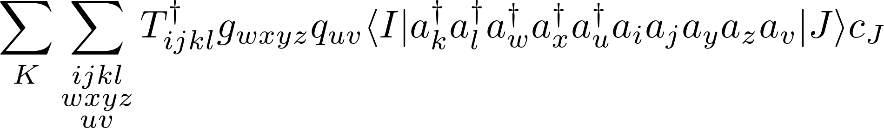
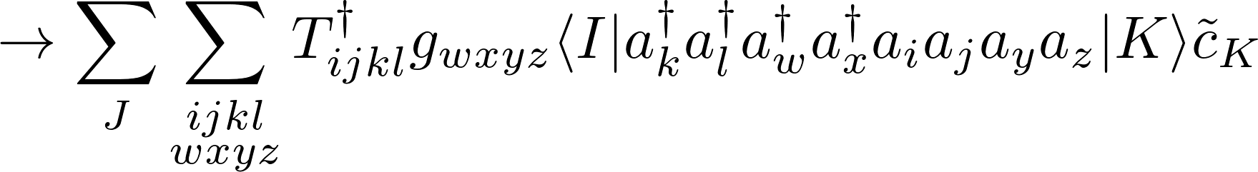
Optimal ordering
By passing through certain orders, it is possible to eliminate terms and simplify the final expression.
Grouped operator index order
May decompose expression into product of two sub expressions

Slide 19
Optimal ordering
By passing through certain orders, it is possible to eliminate terms and simplify the final expression.
Final order should be determined from symmetry constraints, and the need to minimize the number of vertices high in the contraction tree.

Slide 20







Application of block symmetry
Example : CASPT2 perturbation coefficients .
Possible transitions

Slide 21
Application of symmetry
Example : CASPT2 perturbation coefficients .
Possible transitions

Slide 22
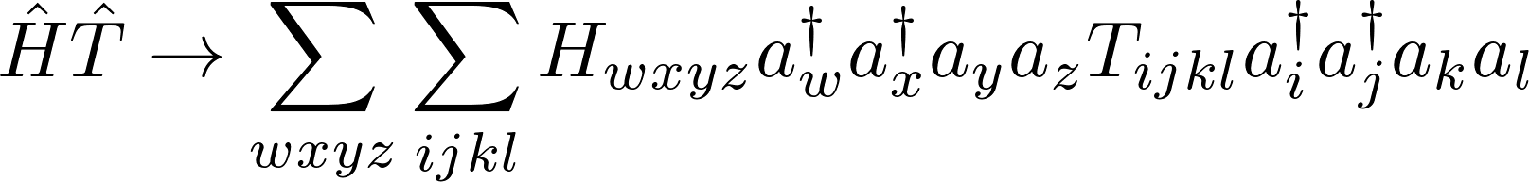
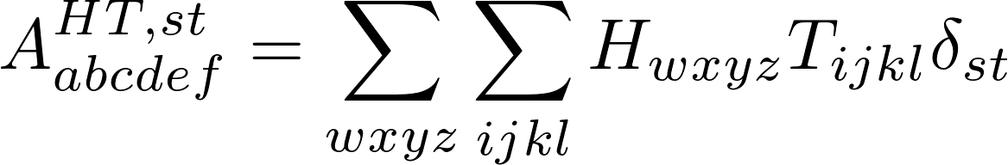


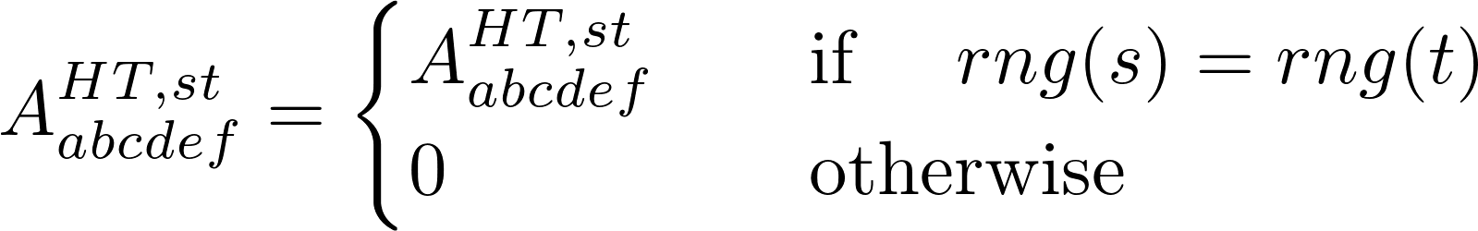
Contraction of tensor blocks
Contract over all possible pairs of indexes, e.g.,
Use the block range constraints to rule out possible contractions, e.g.
Contraction list is different for every range block.

Slide 23
Contraction tree
5el
4el
3el
2el

Slide 24
Block specific contraction trees
Which paths contribute is depends on the block(s) under consideration.
5el
4el
3el
2el

Slide 25
Block specific contraction trees
Which paths contribute is depends on the block(s) under consideration.
5el
4el
3el
2el

Slide 26
Block specific contraction trees
Which paths contribute is depends on the block(s) under consideration.
5el
4el
3el
2el

Slide 27
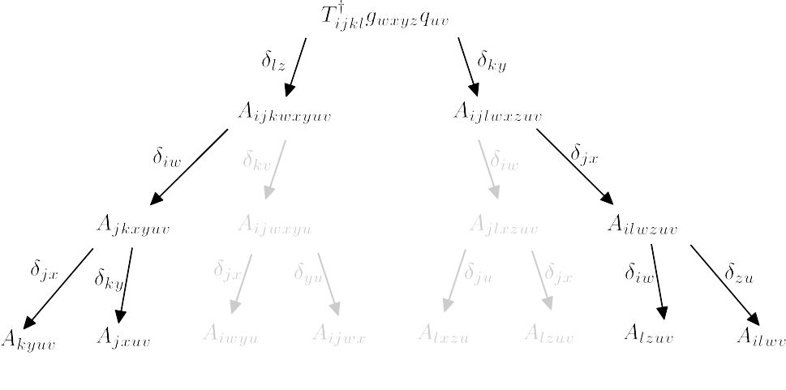
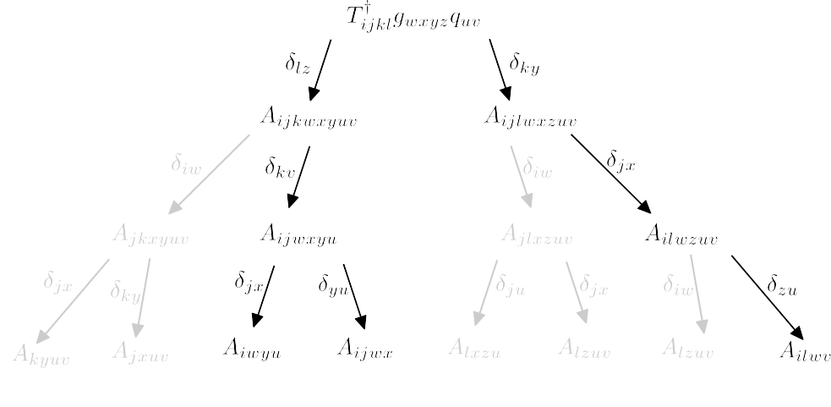
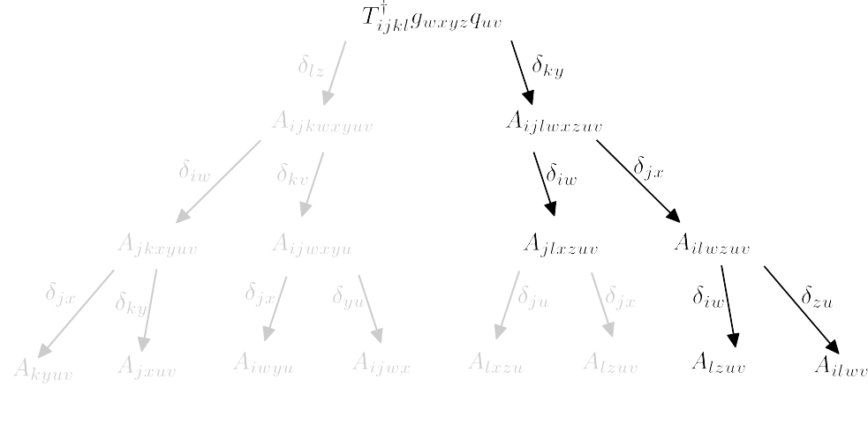


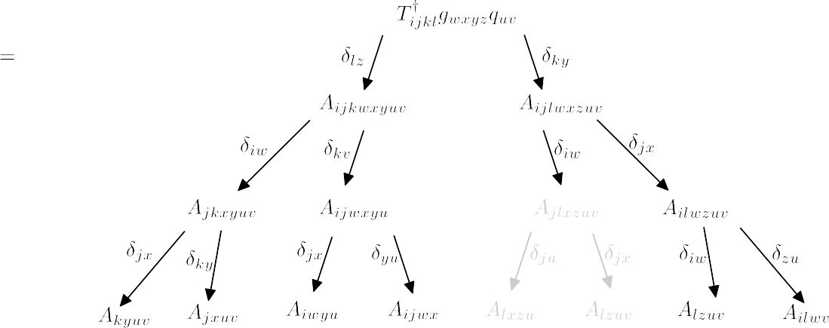
Merge block specific contraction trees

Slide 28
Application of block symmetry
The tree for each block is generated seperately.
Each vertex on the tree is an object which contains information about itself and it’s position in the tree.
      All requirements (vertexes higher up in the tree).
      All dependents (vertexes lower in the tree).
Due to the block symmetry several vertexes are equivalent, which can lead to redundancies.
To avoid redundancies, block symmetry should be accouted for not just in the final contraction, but also in the construction of the tree.
Currently, a very basic approach based on index substitution and standardized ordering is used.

Slide 29
Application of block symmetry
The tree for each block is generated seperately.
Each vertex on the tree is an object which contains information about itself and it’s position in the tree.
      All requirements (vertexes higher up in the tree).
      All dependents (vertexes lower in the tree).
Due to the block symmetry several vertexes are equivalent, which can lead to redundancies.
To avoid redundancies, block symmetry should be accouted for not just in the final contraction, but also in the construction of the tree.
Currently, a very basic approach based on index substitution and standardized ordering is used.

Slide 30




Application of block symmetry
Currently, a very basic approach based on index substitution is used.
All indexes are named, and the program reorders them so they always occur in a certain order.
closed
active
virtual
Closed-virtual block
Virtual-closed block
closed
Id names :
Ranges :
CA ops :
active
virtual
Id names :
Ranges :
CA ops :

Slide 31
Contraction of and
Final step is to contract the A-tensor with the reduced density matrix or similar terms :
Aim to avoid storing the six index reduced density matrix derivative term in memory.
One possible approach is to consider contributions to the A-tensor individually, enabling us to avoid evaluation of any density matrices with more than three indices :

Slide 32
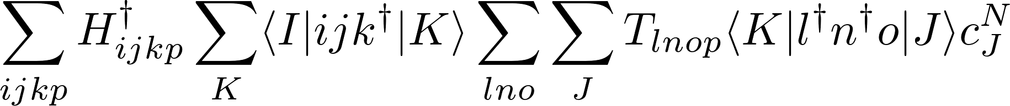
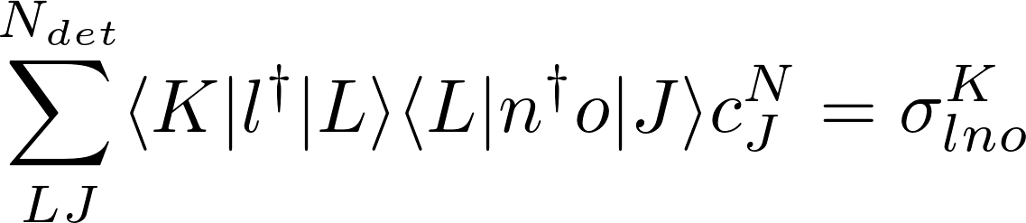
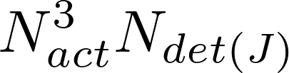
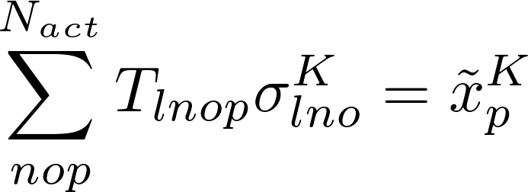
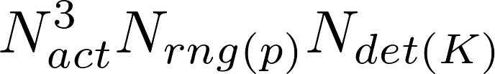
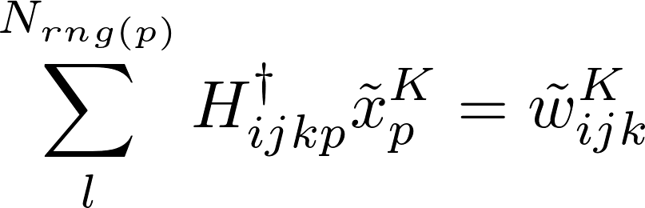
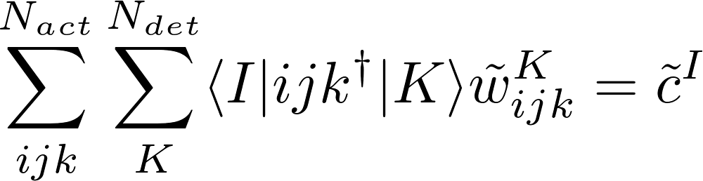
Contraction of and
May be evaluated by the following sequence:
(1)
(2)
(3)
(4)

Slide 33

Contraction of and
Avoid storing the rdm derivatives and A-tensor at the cost of recalculating the third order rdm multiple times.
Key advantage is that rdm derivatives (or similar) and large A-tensor terms are not stored.
Only the ci-vector and relevant tensor blocks are required; reduces communication.
No reordering of indexes of large tensors.
Becomes very costly if there are multiple contractions between different tensors, due to the occurence of terms.

