Slide 1
A Tool for Multireference Perturbation Theory Calculations

Slide 2
Why not DFT or TDDFT?
Interested in spin dynamics in actinide systems, particularly single molecular magnets (SMMs):
  Do not want to use broken symmetry DFT to probe the behavior of electron spins [1][2].
  Non-collinear 4c-TDDFT is still under development [3].
[1] P. J. Cherry, S. Komorovsky, V. G. Malkin, and O. L. Malkina, Mol. Phys., 115, 75–89 (2017)
[2] P. J. Cherry, V. G. Malkin, O. L. Malkina, and J. R. Asher, J. Chem. Phys. 145, 174108 (2016)
[3] S. Komorovksy, P. J. Cherry, and M. Repisky, “Four-component relativistic time-dependent density-functional theory using stable noncollinear DFT ansatz applicable to both closed- and open-shell systems” (In preparation).

Slide 3
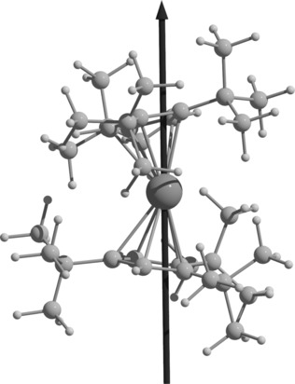
Single Molecular Magnets
Single molecular magnets (SMMs) are a being investigated for use in quantum computers.
A key feature is the how long the magnetization is maintained.
Heavily dependent on spin-orbit coupling.
Performance at high temperatures is important for practical viability.
Figure 1. Dysprosium metallocene single Molecular magnet [4]
[4] F. S. Guo, B. M. Day, Y. C. Chen, M. L. Tong, A. Mansikkamäki, and R.A. Layfield, Ang. Chem. Int. Ed., 56(38), 11445-11449 (2017).

Slide 4
Method Requirements
Some key challenges:
  Near-degenerate (conical intersections following perturbation).
  Spin-spin interactions raise questions regarding state-averaging key to some existing methods.
  Need for derivative properties.
  Computationally demanding.
Tools exist, but not optimized for the four-component framework.

Slide 5
Longer term goals
Several SMMs have multiple paramagnetic centres.
  Want a tool which is applicable to tensor decomposed wavefunctions and operators.
Want to be able to interface directly to spin-dynamics packages.
  Enable on the fly task list construction.
To accomplish this, began working on own program, MRPTool.

Slide 6
Existing tools
Code generation widely used.
  Tensor Contraction Engine (NWChem).
  SMITH3 (Bagel).
Has become a standard technique.
  Increasingly relevant as supercomputer architectures become more complicated.
  Not widely adopted by the majority of 4-component post-HF codes.

Slide 7
MRPTool Capabilities
Should be able to :
  Evaluate three basic terms types.
  Combine these appropriately, and use them to solve a user-specified equation.
  Calculate independent contributions sequentially (if computing resources require this).
  Take advantage of symmetry and sparsity (particularly spin related symmetries).
Extensibility is important:
  Not tied to specific approach to storing data.
  Can swap out tensor manipulation and FCI routines, without impacting basic functioning.

Slide 8
MRPTool Capabilities
Should be able to :
  Evaluate three basic terms types.
  Combine these appropriately, and use them to solve a user-specified equation.
  Calculate independent contributions sequentially (if computing resources require this).
  Take advantage of symmetry and sparsity (particularly spin related symmetries).
Extensibility is important:
  Not tied to specific approach to storing data.
  Can swap out tensor manipulation and FCI routines, without impacting basic functioning.

Slide 9
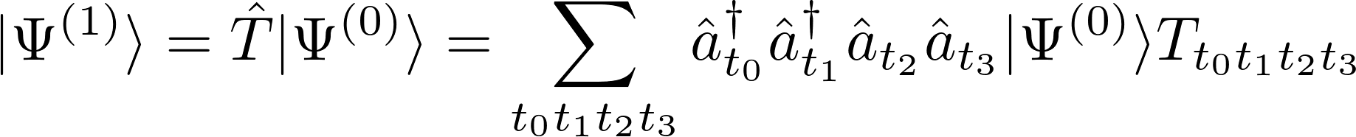
First order CASPT2 wavefunction
The first-order wavefunction is expanded in an internally contracted basis:
The perturbation amplitudes minimize the Hylleraas functional for the second order energy:

Slide 10
Derivative properties
The CASPT2 energy is not minimized with respect to the CASCI coefficients.
Calculation of the derivatives of the CASCI-coefficients is very complicated, and computationally expensive.
To avoid this, we define a Lagrangian which satisfies:

Slide 11
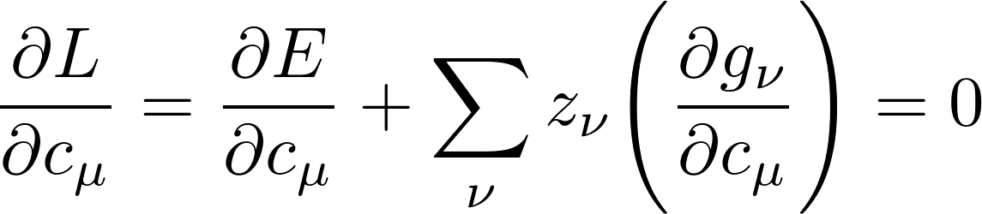
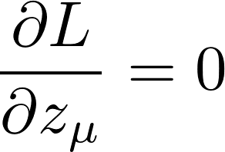
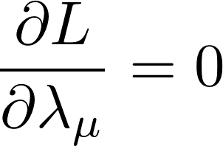
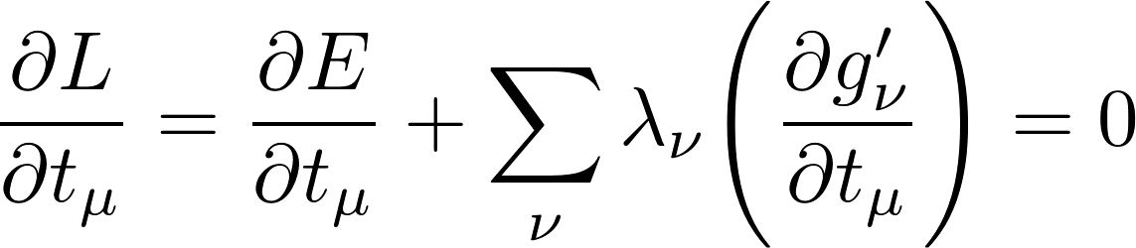
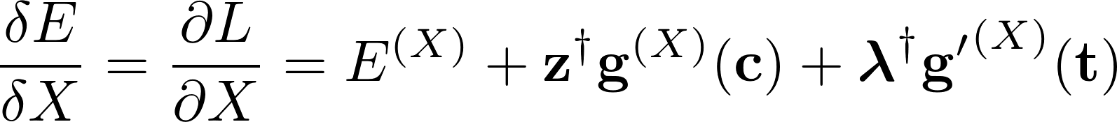
Lagrangian definition
Lagrangian has the form:
Satisfies the conditions:

Slide 12
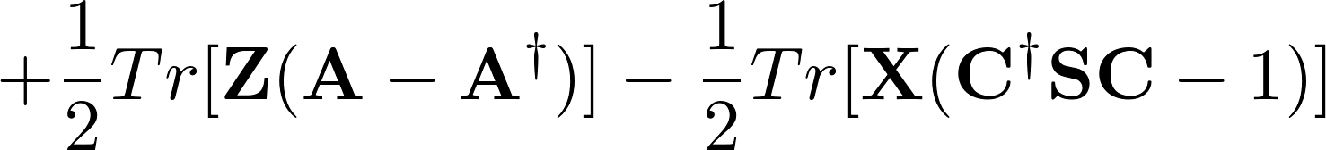
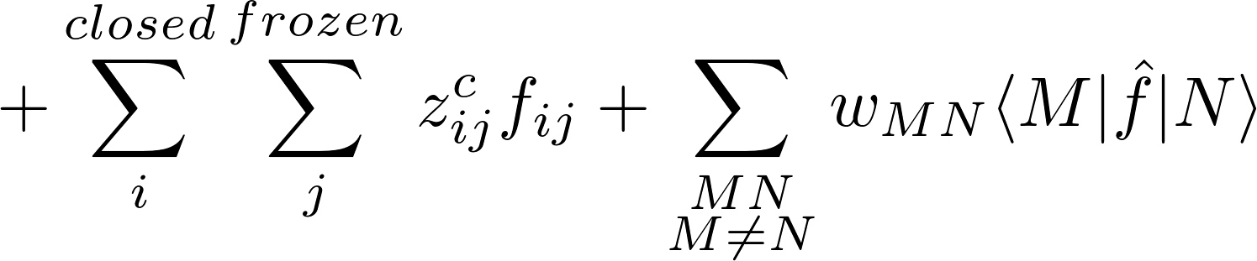
Lagrangian definition
XMS-CASPT2 Lagrangian definition:
Using MRPT2 necessitates that we have an efficient method of implementing this and similarly complicated things.

Slide 13
MRPTool Capabilities
Should be able to :
  Evaluate three basic terms types.
  Combine these appropriately, and use them to solve a user-specified equation.
  Calculate independent contributions sequentially (if computing resources require this).
  Take advantage of symmetry and sparsity (particularly spin related symmetries).
Extensibility is important:
  Not tied to specific approach to storing data.
  Can swap out tensor manipulation and FCI routines, without impacting basic functioning.

Slide 14
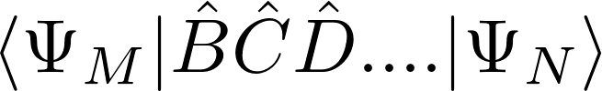
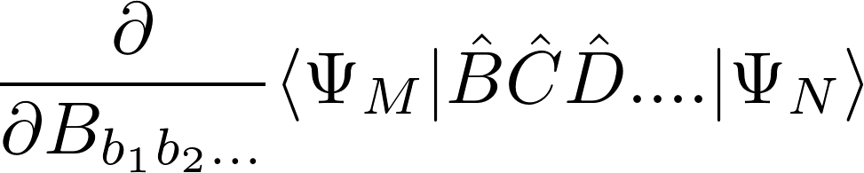
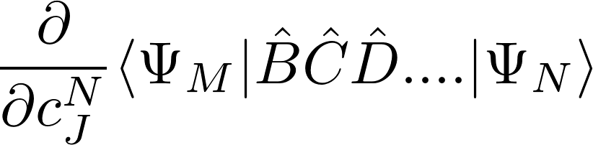
Three basic term types
All the terms of immediate interest can be broken down into three basic types of term :
  Full :
  Orbital Derivative :
  CI Derivative :

Slide 15
MRPTool Structure
Input
Driver
Mathematical task translator
Algebraic Manipulator
Linear algebra and CI routines

Slide 16
Three basic term types
All the terms of immediate interest can be broken down into three basic types of term :
  Full :
  Orbital Derivative :
  CI Derivative :

Slide 17
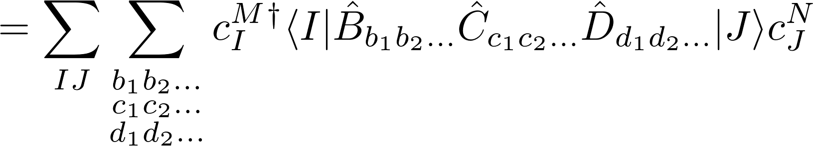
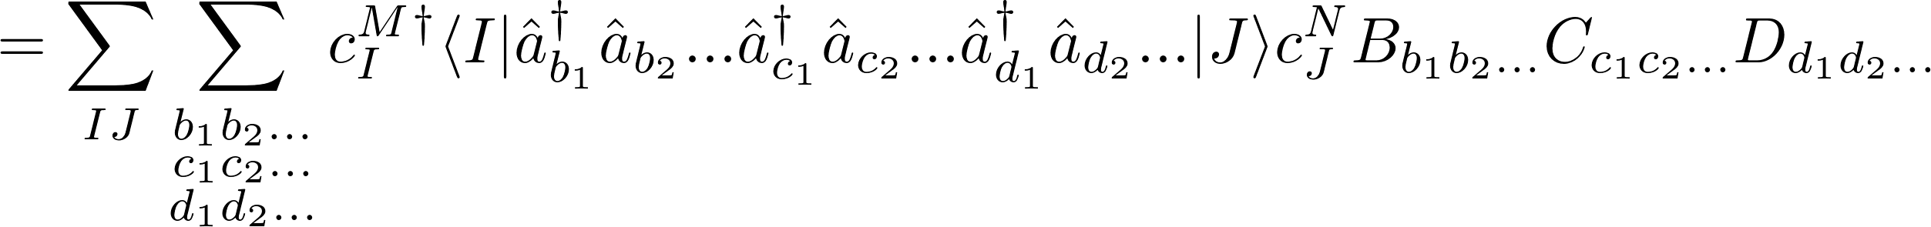
“Full” term
Simplest kind of term; “full”:

Slide 18
Three basic term types
All the terms of immediate interest can be broken down into three basic types of term :
  Full :
  Orbital Derivative :
  CI Derivative :

Slide 19
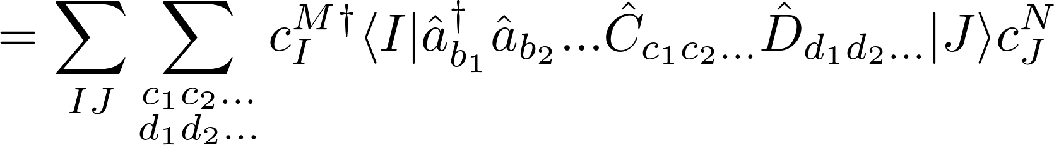
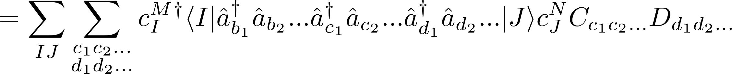
“Orbital derivative” term
Defined by taking the partial derivative with respect to one element of the representation of the operator in the orbital basis:

Slide 20
Three basic term types
All the terms of immediate interest can be broken down into three basic types of term :
  Full :
  Orbital Derivative :
  CI Derivative :

Slide 21
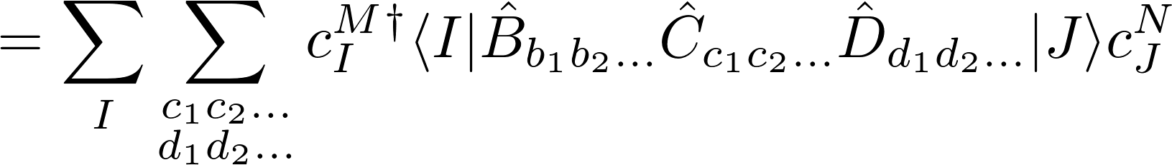
“CI derivative” term
Partial derivative with respect to a CI-coefficient

Slide 22
Term Evaluation
Four stages:
  Algebraic task list generation.
  Task list translation.
  Computational task list generation.
  Computational task list execution.

Slide 23
MRPTool Structure
Input
Driver
Mathematical task translator
Algebraic Manipulator
Linear algebra and CI routines

Slide 24
Term Evaluation
Four stages:
  Algebraic task list generation.
  Task list translation.
  Computational task list generation.
  Computational task list execution.

Slide 25
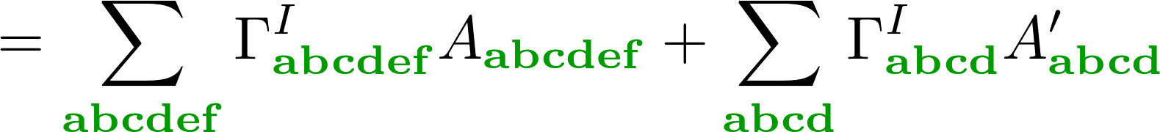
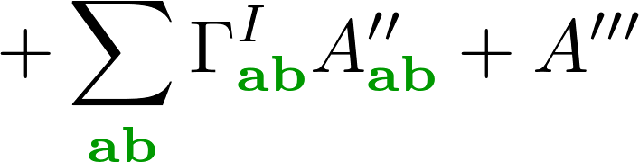
Term Evaluation
A typical term may require summation over core, active and virtual indices (general indices):
Sum over general indices is rewritten as a sum over active indices :
Significantly reduces the dimension of the problem.

Slide 26
Evaluation stages
Number of techniques employed to obtain an efficient task list, including:
  Merging of tensor terms.
  Operator reordering (e.g., Wicks theorem).
  Block decomposition.
  Block annihilation.
  Operator reordering sequences.
  Limited tensor decomposition.

Slide 27
Evaluation stages
Number of techniques employed to obtain an efficient task list, including:
  Merging of tensor terms.
  Operator reordering and range consatraints (e.g., Wicks theorem).
  Block decomposition.
  Block annihilation.
  Operator reordering sequences.
  Limited tensor decomposition.

Slide 28




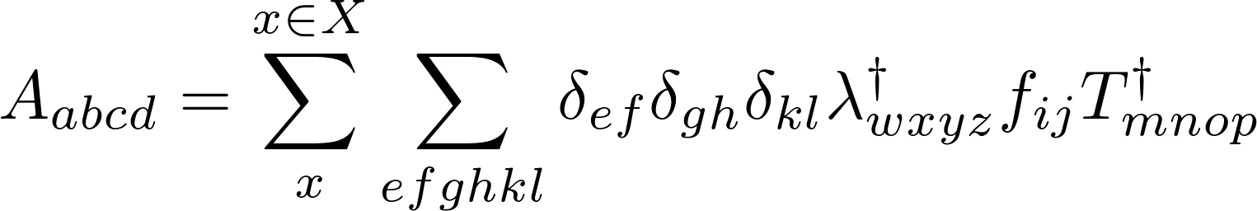

A-tensor definition
Each A-tensor is defined by the original operators, , , and , and a set, , of contraction indices and factors:
Each contribution, , to the A-tensor is obtained by performing a recursive sequence of operations:

Slide 29
Evaluation stages
Number of techniques employed to obtain an efficient task list, including:
  Merging of tensor terms.
  Operator reordering and range constraints (e.g., Wicks theorem).
  Block decomposition.
  Block annihilation.
  Operator reordering sequences.
  Limited tensor decomposition.

Slide 30



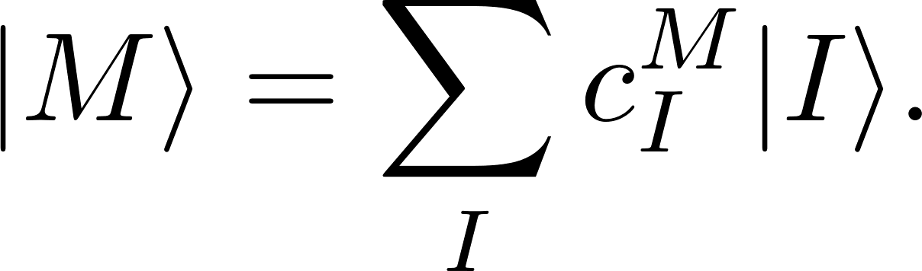




Non-relativistic CI-vector
The wavefunction is described by a linear combination of determinants :
There are a very large number of possible configurations; this is a significant computational bottleneck.
Non-relativistic CI-vector only has determinants from a single spin sector:
Conf.
...
...
...
...
...
...
...
...

Slide 31
Active determinants
virtual
active
closed

Slide 32

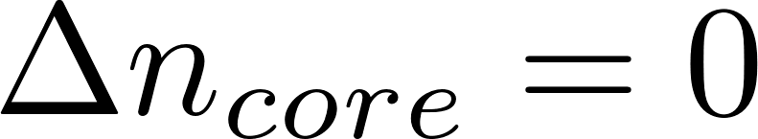

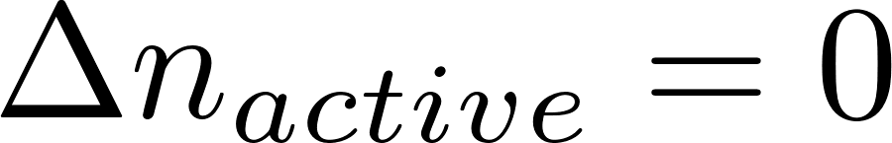

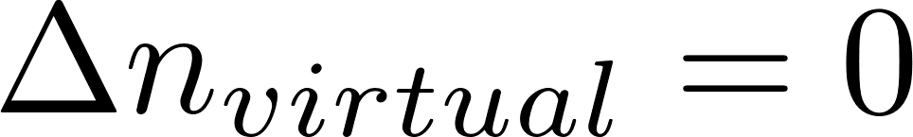
Electron number constraints
A typical term may require summation over core, active and virtual indices (general indices):
Both I and J are are active determinants belonging to the same spin sector:
This fact is exploited (via Wick’s theorem) to pair up all “non-active” indexes.

Slide 33
Evaluation stages
Number of techniques employed to obtain an efficient task list, including:
  Merging of tensor terms.
  Operator reordering and range constraints (e.g., Wicks theorem).
  Block decomposition.
  Term/Block annihilation.
  Operator reordering sequences.
  Limited tensor decomposition.

Slide 34








Block Decomposition
CASPT2 amplitudes, , and Lagrange multipliers, .
Possible transitions

Slide 35
















Block Decomposition
CASPT2 amplitudes, , and Lagrange multipliers, .
Possible transitions

Slide 36




Block Decomposition
State averaged Fock operator
Possible transitions

Slide 37
Evaluation stages
Number of techniques employed to obtain an efficient task list, including:
  Merging of tensor terms.
  Operator reordering (e.g., Wicks theorem).
  Block decomposition.
  Term/Block annihilation.
  Operator reordering sequences.
  Limited tensor decomposition.

Slide 38
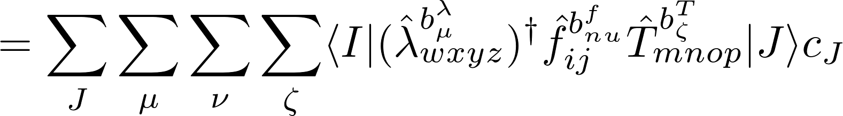
Term/Block annihilation
Split up the operators into sub-blocks, and loop over all combinations of blocks:
Several block combinations will vanish.

Slide 39
Term/Block Annihilation
Determine range shift numbers for each block, e.g.,

Slide 40
Block Decomposition
CASPT2 amplitudes, , and Lagrange multipliers, .
Possible transitions

Slide 41
Term/Block Annihilation
Determine range shift numbers for each block, e.g.,

Slide 42
Block Decomposition
State averaged Fock operator
Possible transitions

Slide 43
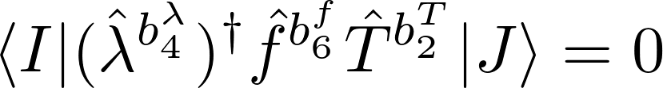
Term/Block Annihilation
Determine range shift numbers for each block, e.g.,
Combine blocks, and determine the combined range shift number :

Slide 44
Term Evaluation
A typical term may require summation over core, active and virtual indices (general indices):
Both I and J are are active determinants belonging to the same spin sector:
This fact is exploited (via Wick’s theorem) to pair up all “non-active” indexes.

Slide 45
Block Constraints
Determine range shift numbers for each block, e.g.,
Combine blocks, and determine the combined range shift number :

Slide 46
Non-relativistic CI-vector
The wavefunction is described by a linear combination of determinants :
There are a very large number of possible configurations; this is a significant computational bottleneck.
Non-relativistic CI-vector only has determinants from a single spin sector:
Conf.
...
...
...
...
...
...
...
...

Slide 47
















Relativistic CI-vector
Spin-orbit coupling terms results in contributions from determinants in different spin sectors:
 | Spin sectors
Conf. #
...
...
...
...
...
...
...
...
...
...
...
...
...
...
...
...
...
...
...
...
...
...
...
...
...
...
...
...
...
...
...
...
...
...
...
...
...
...
...
...
...
...
...
...
...
...

Slide 48

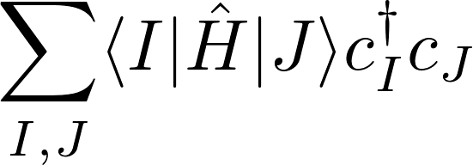

Non-interacting spin-sectors
Non-relativistic case:

Slide 49
Interacting spin-sectors
Relativistic case:

Slide 50
Relativistic CI-vector
Spin-orbit coupling terms results in contributions from determinants in different spin sectors:
 | Spin sectors
Conf. #
...
...
...
...
...
...
...
...
...
...
...
...
...
...
...
...
...
...
...
...
...
...
...
...
...
...
...
...
...
...
...
...
...
...
...
...
...
...
...
...
...
...
...
...
...
...

Slide 51
Block decomposition
Split up core, active and virtual indices into up and down spins; core and core, active and active , virtual and virtual :

Slide 52
Active determinants
virtual
active
closed

Slide 53


Active determinants
virtual
active
closed

Slide 54
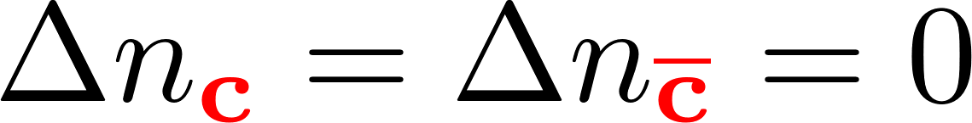
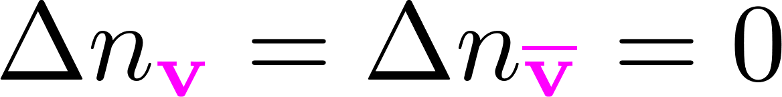


Block constraints
Split up core, active and virtual indices into up and down spins; core and core, active and active , virtual and virtual :
Spin sector transitions are possible.

Slide 55
Evaluation stages
Number of techniques employed to obtain an efficient task list, including:
  Merging of tensor terms.
  Operator reordering (e.g., Wicks theorem).
  Block decomposition.
  Term/Block annihilation.
  Operator reordering sequences.
  Limited tensor decomposition.

Slide 56




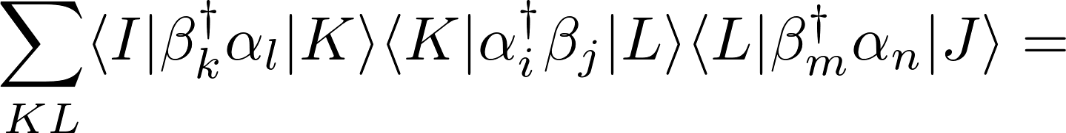
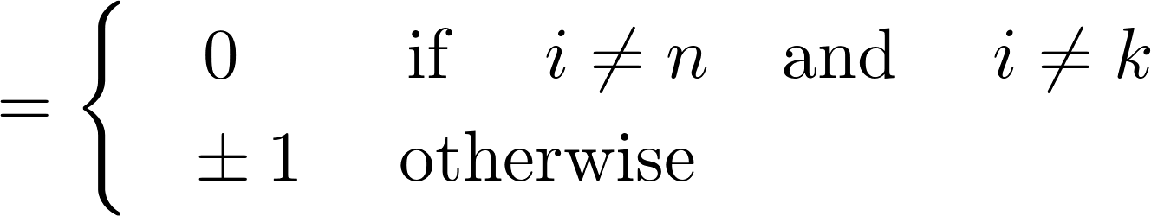
Reordering techniques
Reorder creation and annihilation operators so as to push terms out of the active space:
Spin sector

Slide 57
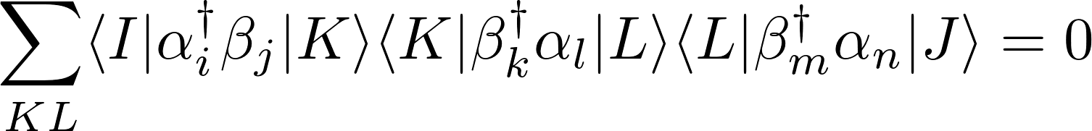
Reordering techniques
Reorder so as to “push” the wavefunction out of the active space.
Spin sector

Slide 58
Reordering sequence
Pass through multiple different reorderings so as to eliminate as many blocks as possible.
Eliminates several higher order terms at the expense of creating more lower order ones.
  First Order : Normal order (+++---).
  Second Order : Anti-normal order (---+++).
  Third Order : Alternating order (+-+-+-).
Normal order and anti-normal order purge different block combinations.
Note that “pairing” of non-active indexes never occurs; all non-active indexes are eradicated through range shift constraints.
Alternating order aids with symmetry, and efficient calculation of higher order terms.

Slide 59
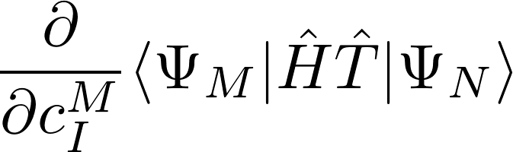
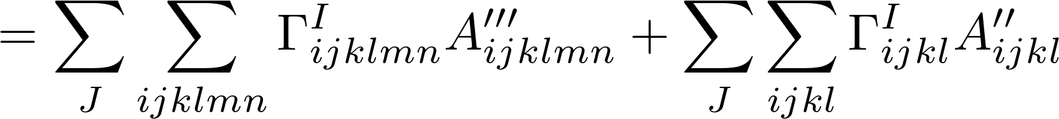
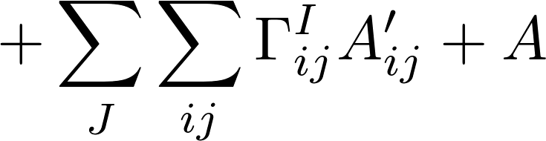
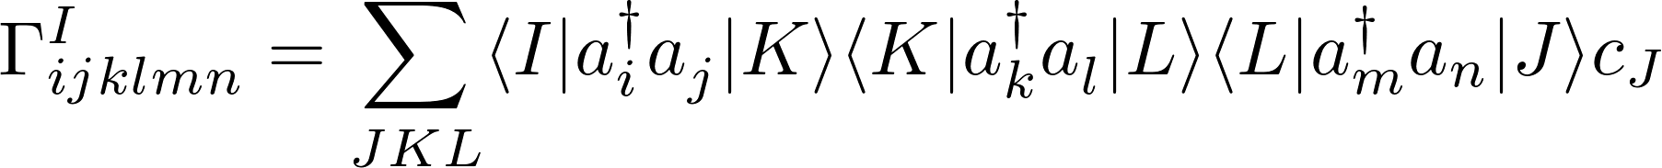
Alternating ordering
Final sequence of expressions to evaluate may be :
Where

Slide 60


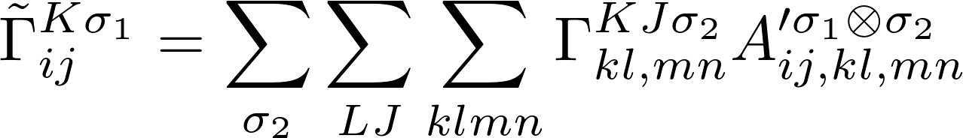



Contraction of and
Perform contraction in two steps:
Where is shorthand for a spin-transition block, e.g.,

Slide 61
Summary
Developing a tool for multireference perturbation theory calculations.
Targeted at 4-component methods, and tensor decomposed wavefunctions.
Heavy emphasis on block symmetry and sparsity.
Separation of computational and algebraic manipulation routines to facilitated rapid implementation of new task list generation.
System specific task list generation to enable task list regeneration during dynamics calculations.

Slide 62
Summary
Developing a tool for multireference perturbation theory calculations.
Targeted at 4-component methods, and tensor decomposed wavefunctions.
Heavy emphasis on block symmetry and sparsity.
Seperation of computational and algebraic manipulation routines to facilitated rapid implementation of new task list generation.
System specific task list generation with a view to interfacing with dynamics programs.
Code is available on my github account!
https://github.com/peterjohncherry/bagel_mrptool_devel

Slide 63

Acknowledgements
Supervisor
  Toru Shiozaki (General advice)
Discussions and advice
  Jae Wo Park (CASPT2).
  Ryan Reynolds (4-component integrals).
Funding
  National Science Foundation :
  Award No. 1351598
  CAREER: Theories for Magnetic Properties of Lanthanide and Actinide Complexes

Slide 64
END

Slide 65
External determinants
virtual
active
closed

