Slide 1
Calculation of ci-derivatives in relativistic XMS-CASPT2
Peter John Cherry
Shiozaki group meeting
August 2nd 2017

Slide 2
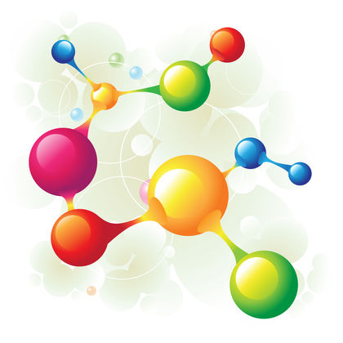
Properties in XMS-CASPT2
The XMS-CASPT2 energy is not minimized with respect to the CI and orbital coefficients obtained in the CASSCF calculation.
This makes differentiating it with respect to perturbations of the Hamiltonian difficult.
Accordingly, a Lagrangian is defined, which is minimized with respect to these variables:
Typically, differentiating this Lagrangian with respect to some perturbative parameter is much easier than differentiating the XMS-CASPT2 energy.

Slide 3
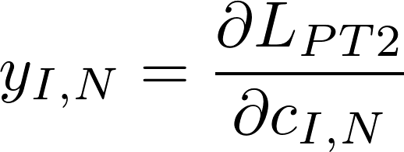
Z-vector and Lambda equations
The Z constraint can be obtained by solution of the “Z-vector equation”.
This requires, amongst other things, calculation of the CI-deratives:
Derivative of the CASPT2 Lagrangian with respect to CASSCF reference coefficients.

Slide 4
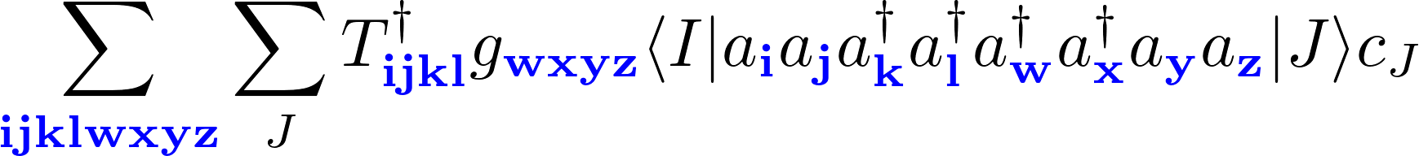
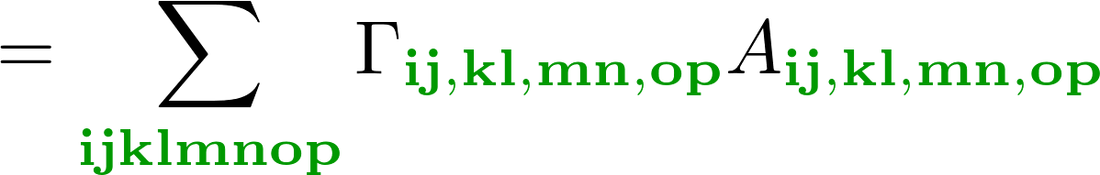
Calculation of CI derivatives
Requires evaluation of terms of this form
Wick’s theorem is used to rewrite this sum over general indices as a sum over active indices:

Slide 5
RDM derivatives
RDM derivatives are defined as:
As I and J are restricted to the active space, and thanks to the normal ordering, we have:

Slide 6
“A” tensor
Formed by summing over all possible contractions of the representations of the operators in the molecular orbital basis:
The ability to combine all these contractions into one is crucial if the method is to be efficient.

Slide 7
Relativistic case
The relativistic case is significantly more expensive:
    Alpha and beta orbitals are treated seperately.
    Can have spin flipping excitations.
                Eight index tensors can be 256 times as large.
May use time reversal symmetry to reduce cost.
Placing spin constraints on indexes is the first step.

Slide 8
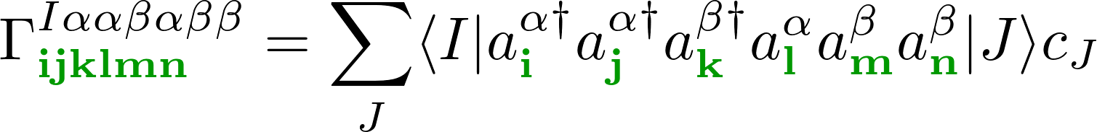
Spin restricted indexes
Constrain indexes to either alpha or beta

Slide 9
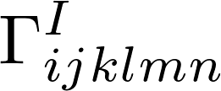









Non-interacting spin-sectors
Contributions to non-relativistic for

Slide 10
Interacting spin-sectors
Contributions to relativistic for

Slide 11
Interacting spin-sectors
1-electron rdm derivatives which need to be calculated for with

Slide 12
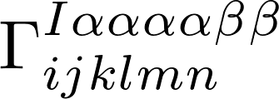
Non-interacting spin-sectors
Contribution for

Slide 13
Non-interacting spin-sectors
Contribution for

Slide 14
Interacting spin-sectors
Time reversal symmetry can at least halve the number of terms to be calculated.

Slide 15
Interacting spin-sectors
Time reversal symmetry can at least halve the number of terms to be calculated.

Slide 16
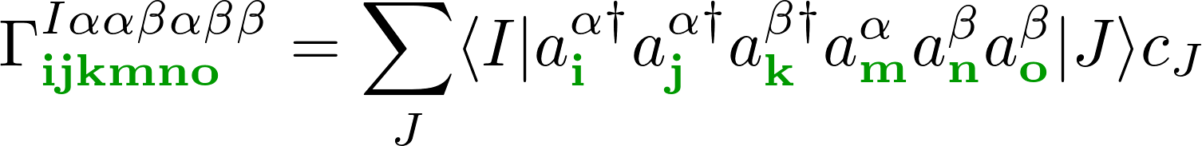

Spin restricted RDM derivatives
Constrain indexes to either alpha or beta
For the rdm derivative this is straightforward, but for the “A” tensor :
The factors, , are dependent upon the spin sector.
Consequently a the contributions to A depend upon the spin sector.

Slide 17
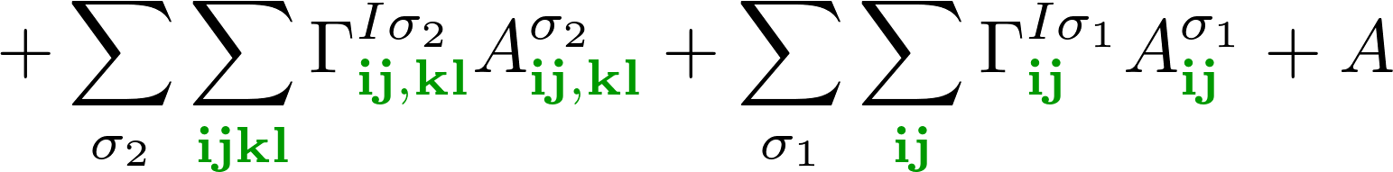



Spin restricted RDM derivatives
Indicates that we need to perform this contraction for every distinct combination
of spin excitations:
Where, , e.g., .
Different terms in the summation over correspond to different indexes,
hence we cannot swap the order of the summation.

Slide 18
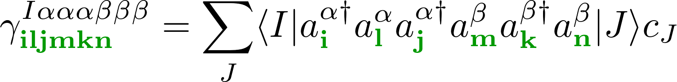
Switch to alternating order
Switching from normal order (+++---) to alternating order (+-+-+-), i.e.,
Commutation relations are used to rewrite rdm derivatives

Slide 19
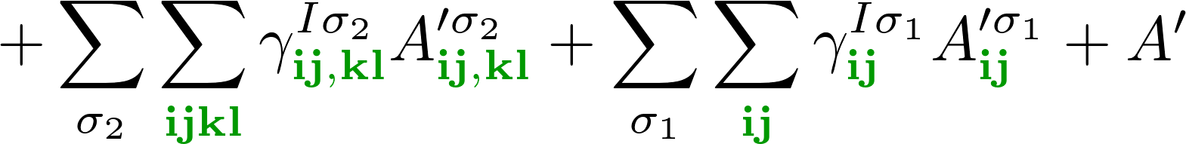
Spin restricted RDM derivatives
Still need to perform this contraction for every distinct combination
of spin excitations:
Here, , e.g.,
Different terms in the summation over correspond to different indexes,
hence we cannot swap the order of the summation.

Slide 20

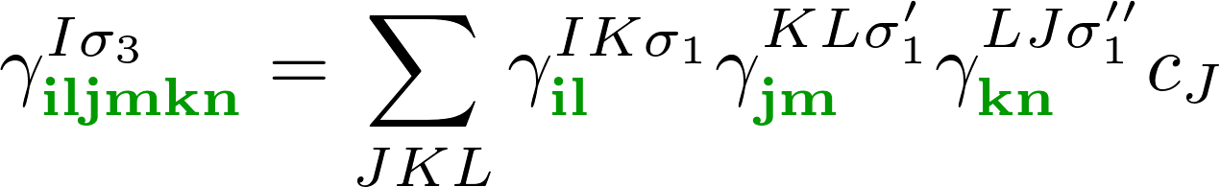
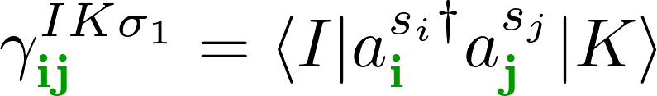
Advantages of alternating order
No new terms are being calculated; calculation of all rdm derivatives currently requires calculation of all .
Many (>2) index terms can re-expressed as products of two index terms
Similarly, all spin excitation sequences are expressed in terms of two spin sequences:

Slide 21
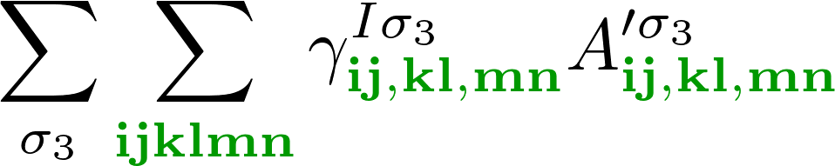
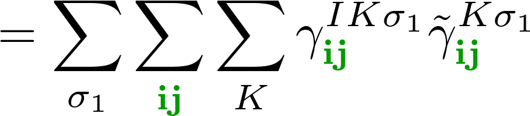
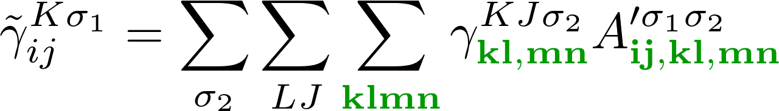
Faster calculation of contractions
Can now rewrite the summation as
Where
Avoids the need for storage of a six index RDM derivative.
Enables summation over all terms where the first two spin indexes are the same.

Slide 22





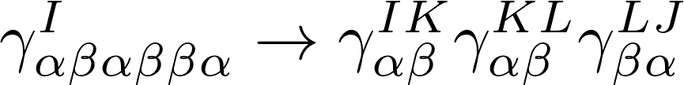
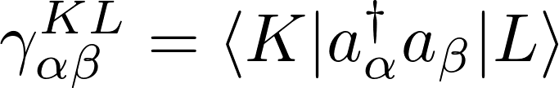
Spin transition pathways
Representation in terms of individual transitions can help with application of
symmetry :
Spin sector

Slide 23
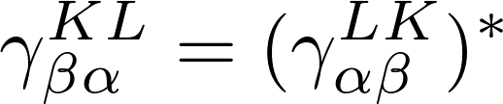
Spin transition pathways
“Forwards” and “backwards” transitions are connected by time reversal
Spin sector

Slide 24

Time reversal symmetry
Need only calculate the rdm derivatives for half the spin sectors.
Can apply time reversal applied to only a subset of the indexes:
Contributions to the “A” tensor also possess such symmetries, e.g.,
All are combined to reduce the range of the sum over :

Slide 25

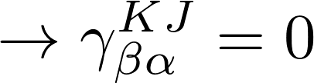
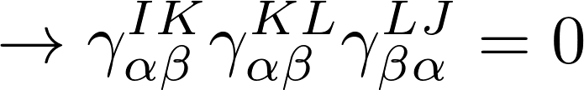
Spin transition pathways
Application of spin constraints is more straightforward
Spin sector
This is much less clear with RDM
derivatives, as they do not correspond
a single transition pathway.

Slide 26
Spin transition pathways
Application of spin constraints is more straightforward
Spin sector
This is much less clear with RDM
derivatives, as they do not correspond
a single transition pathway.

Slide 27

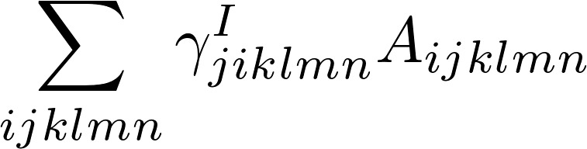
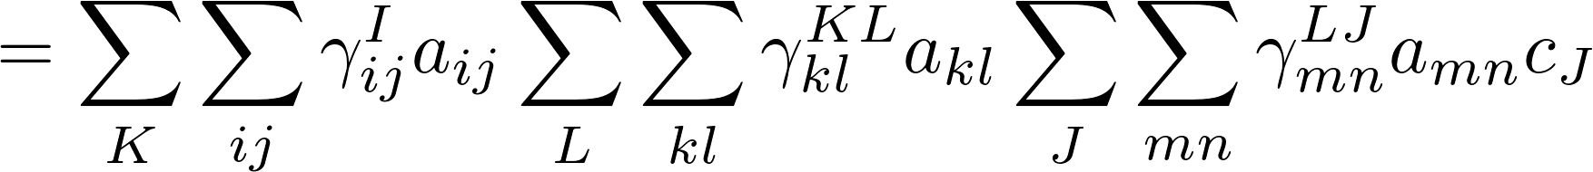
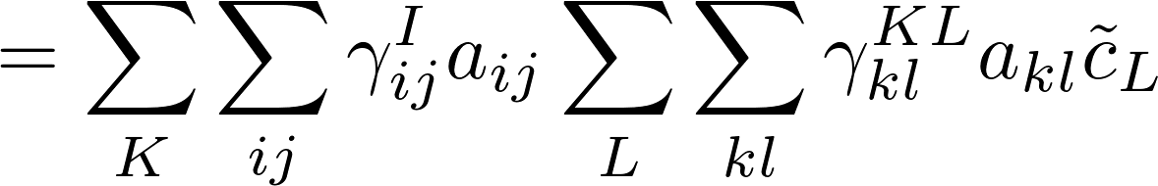
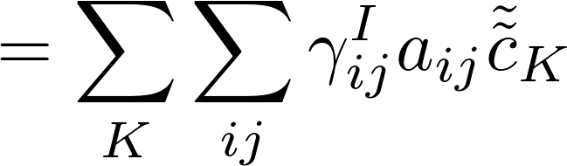
Decomposition of A
Ideally would decompose “A” tensor into two index components:
Computational cost would then be :

Slide 28
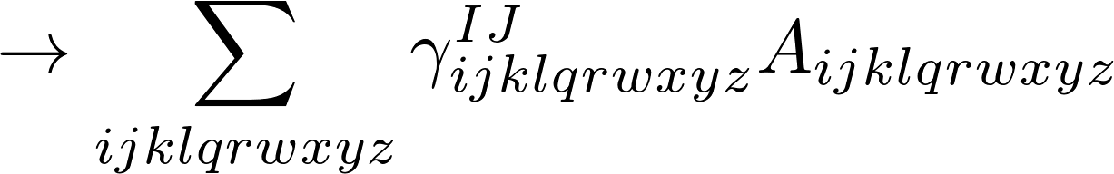
Decomposition of “A” tensor
Majority of the time we must deal with combinations of two electron operators:
Indexes may be reordered so as to isolate terms belonging to different operators:

Slide 29
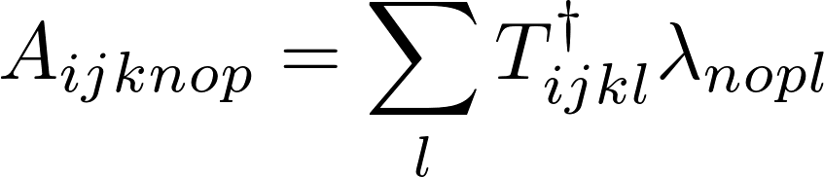
Decomposition of “A” tensor
Replaces a ten index operation, with two four index operation, and one two index operation (performed in sequence).
If A has a decomposition
The contribution will vanish, as neither T nor lambda can have all active indexes.
The largest tensor we should have to deal with is six indexes, formed from a single contraction between two 2-electron operators, e.g.,
Reorder to keep indexes belonging to the same operator together, enabling seperation of the contraction operations with the gamma matrices.
May be evaluated in sequence; instead of a single ten index term, there are two four index terms, and one two index term.

Slide 30

Method Summary
Step 1 : Determine all possible “A”-tensors.
      Determine all unique contractions (symmetry applied here).
      Represent “A”-tensors tensor products of smallest possible tensors.
Step 2 : Use normal ordering to get expression in terms of RDM derivatives with only active indexes.
      Get expressions for all possible transitions.
      Use contraction constraints to purge terms here.
Step 3 : Reorder indexes in each to get expression in terms of ‘s.
      Merge all gamma terms
      For four and six index tensors, group indexes for like operators.
      Apply further spin constraints.
Step 4 : Loop through spin sectors, performing contractions.
      Calculate contributions to ci-derivative for paired spin sectors simultaneously.
Current status : Debugging application of index range constraints in switch to alternating ordering. Recompiling Smith routines for check against density matrices.

Slide 31
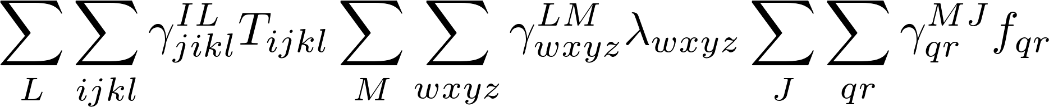
Decomposition of “A” tensor
In many cases it is possible to decompose the A-tensor into components
Reorder to keep indexes belonging to the same operator together, this the integral terms and the gamma matrices to be contracted prior to the end
May be evaluated in sequence; instead of a single ten index term, there are two four index terms, and one two index term.

Slide 32




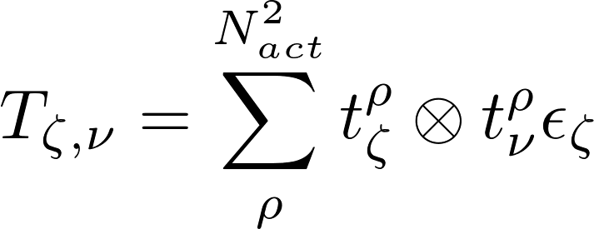
Decomposition of T
Most expensive terms are contractions involving , and
The blocks relevant to six index tensors are and
Flatten tensor from four to two indexes:

Slide 33
Decomposition of “A” tensor
In many cases it is possible to decompose the A-tensor into components
Reorder to keep indexes belonging to the same operator together:

Slide 34
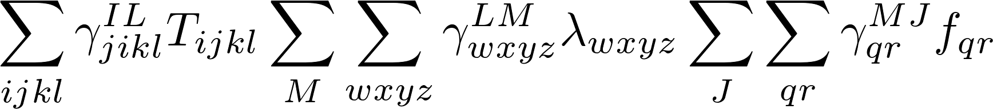
Decomposition of “A” tensor
In many cases it is possible to decompose the A-tensor into components

Slide 35
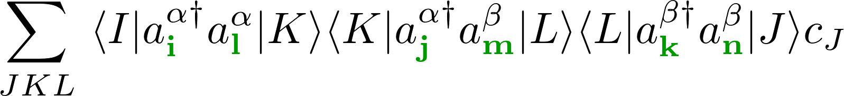
Switch from RDM derivatives
Commutation relations and resolution of identity can be used to rewrite rdm derivatives
The factor s_{lp} are dependent upon the spin sector.
Consequently a the contributions to A depend upon the spin sector.

Slide 36
Switch from RDM derivatives
Commutation relations and resolution of identity can be used to rewrite rdm derivatives
The factor s_{lp} are dependent upon the spin sector.
Consequently a the contributions to A depend upon the spin sector.

