Slide 1

Topics
1) Nuclear spin-spin coupling in paramagnetic systems.
2) Obtaining g-tensors from unrestricted determinants.
3) G-tensor theory for strong spin-orbit coupling.

Slide 2
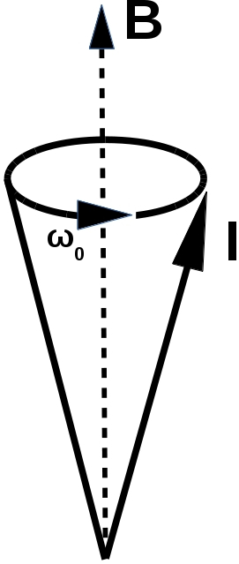
Nuclear Magnetic Resonance (NMR)
Characterize system based on its response to an external magnetic field.
Nuclear spins will precess about the magnetic field.
This is the Larmor precession, it is what experiments measure.
The frequency of the Larmor precession influenced by
1) Nuclear isotope.
2) Electron-nuclear interactions.
3) Nuclear-nuclear interactions.
4) And many others....
Fig. 1: Larmor precession cone.
Fig 2: Nucleon.

Slide 3
Nuclear Magnetic Resonance (NMR)
Characterize system based on its response to an external magnetic field.
Nuclear spins will precess about the magnetic field.
This is the Larmor precession, it is what experiments measure.
The frequency of the Larmor precession influenced by
1) Nuclear isotope.
2) Electron-nuclear interactions.
3) Nuclear-nuclear interactions.
4) And many others....
Fig. 1: Larmor precession cone.
Fig 2: Nucleon.

Slide 4
Electron Paramagnetic Resonance (EPR)
Characterize system based on its response to an external magnetic field.
The frequency of the Larmor precession is influenced by the
1) Nuclear potential:
Spin-orbit coupling.
Hyperfine structure.
3) Other electrons:
Spin-other-orbit coupling.
Spin-spin interactions.
Fig. 1: Larmor precession cone.
Fig 2: Electron.

Slide 5
Electron Paramagnetic Resonance (EPR)
Characterize system based on its response to an external magnetic field.
The frequency of the Larmor precession is influenced by the
1) Nuclear potential:
Spin-orbit coupling.
Hyperfine structure.
3) Other electrons:
Spin-other-orbit coupling.
Spin-spin interactions.
Fig. 1: Larmor precession cone.
Fig 2: Electron.

Slide 6
Applying EPR to biological systems
EPR spectrum are characterized by EPR tensors.
G-tensor is dependent upon the environment surrounding the paramagnetic centre.
Several systems of interest exhibit regions of of negative spin density and/or exist in low spin states.
We want to use unrestricted non-collinear DFT to better describe spin-orbit coupling.
Q) How well is g-tensor theory adapted to unrestricted and/or broken symmetry DFT?

Slide 7
Anisotropic Zeeman effect
Interaction determined by Zeeman operator:

Slide 8
Anisotropic Zeeman effect
Interaction determined by Zeeman operator:

Slide 9
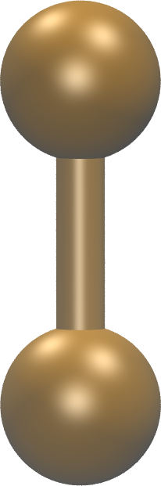
Anisotropic Zeeman effect
Interaction determined by Zeeman operator:

Slide 10
Anisotropic Zeeman effect
Interaction determined by Zeeman operator:

Slide 11
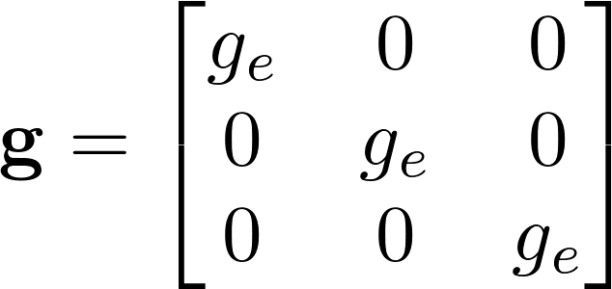
The g-tensor
Each direction of magnetic field defines a point on the surface.
The distance from center to the surface determines the g-factor.

Slide 12
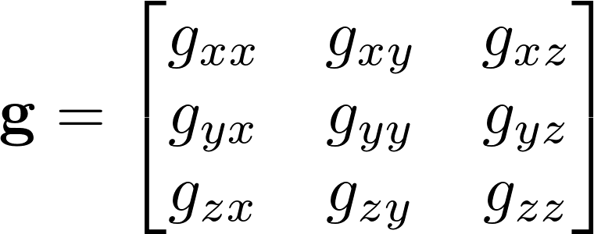
An interpretation of the g-tensor
Each direction of magnetic field defines a point on the surface.
The distance from center to the surface determines the g-factor.

Slide 13
An interpretation of the g-tensor
Each direction of magnetic field defines a point on the surface.
The distance from center to the surface determines the g-factor.

Slide 14
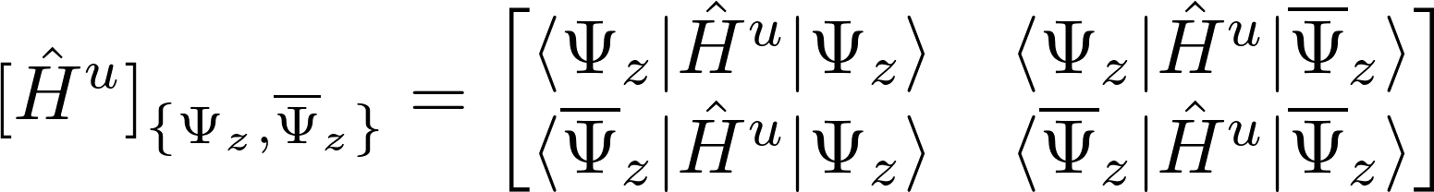
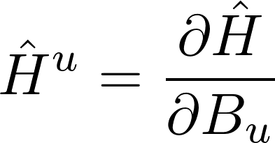
Restricted basis Zeeman Hamiltonian
A. Abragam and B. Bleaney, EPR of transition ions, OUP, 1970.

Slide 15
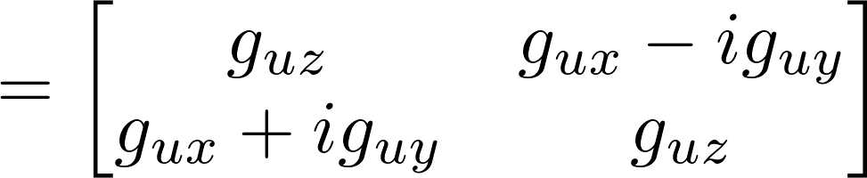
Restricted basis Zeeman Hamiltonian
A. Abragam and B. Bleaney, EPR of transition ions, OUP, 1970.

Slide 16
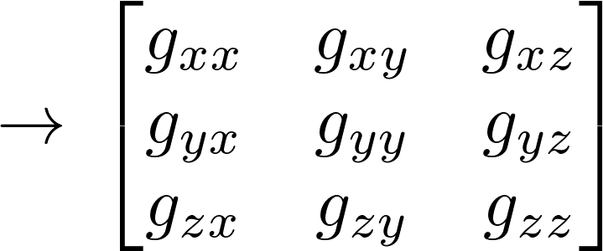
Restricted basis Zeeman Hamiltonian
A. Abragam and B. Bleaney, EPR of transition ions, OUP, 1970.

Slide 17
Restricted basis Zeeman Hamiltonian
A. Abragam and B. Bleaney, EPR of transition ions, OUP, 1970.
How and why does this connection work?

Slide 18
Evaluation of matrix elements

Slide 19
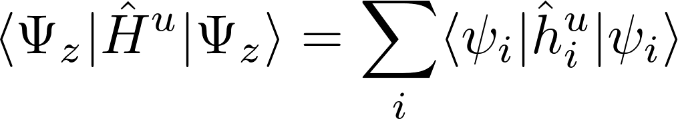
Evaluation of matrix elements
Simple to evaluate:
Sum of N one-electron operators.

Slide 20
Evaluation of matrix elements

Slide 21
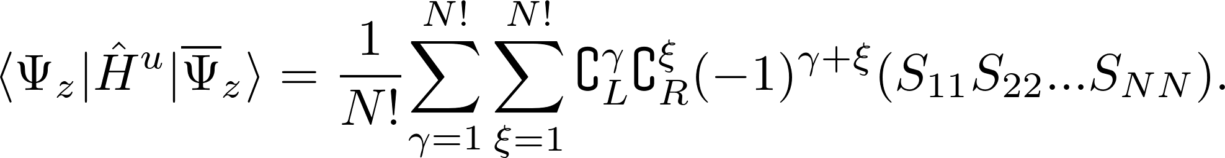
Evaluation of matrix elements
Hard to evaluate in unrestricted case:
Scales as O(N!²) …...

Slide 22
Time reversal operator

Slide 23
Time reversal operator

Slide 24
Restricted collinear determinants

Slide 25
Restricted determinants

Slide 26
Restricted determinants

Slide 27
Restricted determinants

Slide 28
Restricted determinants

Slide 29
Evaluation of matrix elements
Evaluation of matrix elements is straightforward in the restricted case:

Slide 30
Unrestricted collinear determinants

Slide 31
Unrestricted collinear determinants

Slide 32
Unrestricted collinear determinants

Slide 33
Unrestricted collinear determinants
Unrestricted DFT is needed to accurately reproduce the spin density of many systems!

Slide 34
Unrestricted collinear determinants

Slide 35
Unrestricted non-collinear determinants

Slide 36
Unrestricted non-collinear determinants
Non-collinear DFT is needed to better describe spin-orbit coupling.

Slide 37
Unrestricted noncollinear determinants

Slide 38
Evaluation of matrix elements
Evaluation of matrix elements is very expensive in the unrestricted case:
Scales as O(N!²) …...

Slide 39
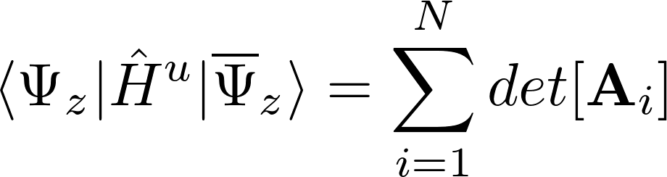
Evaluation of matrix elements
Developed new algorithm:
Scales as O(N⁴).

Slide 40
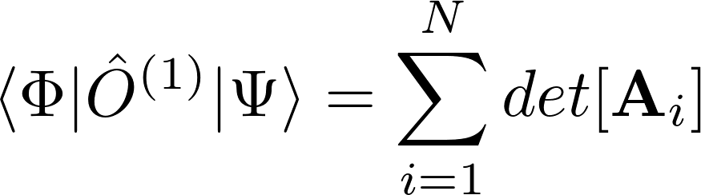
Evaluation of matrix elements
Works for any pair of determinantal wavefunctions:

Slide 41
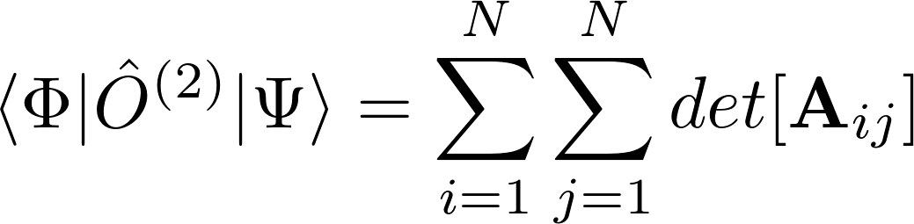
Evaluation of matrix elements
Works for any pair of determinantal wavefunctions:

Slide 42
Evaluation of matrix elements
Works for any pair of determinantal wavefunctions:
Scales as O(N⁴) for 1-electron operators.
Scales as O(N⁵) for 2-electron operators.

Slide 43
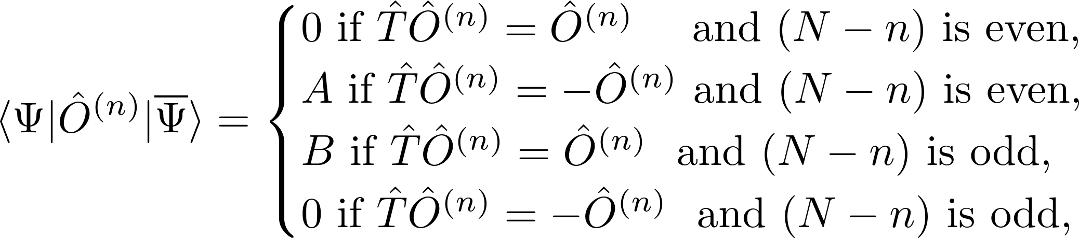
New rules for matrix element evaluation
Many matrix elements will be zero!

Slide 44
Evaluation of matrix elements
Hard to evaluate:
Scales as O(N!²) …...

Slide 45
Evaluation of matrix elements
Now easy to evaluate:
Scales as O(N⁴).

Slide 46
Application to simple systems
Molecule |  | ReSpect | Experiment ^{a,b} | Discrepancy
H₂CO+ | g_{x} | 0.9 | 4.6 | 3.7
 | g_{y} | 11.0 | 0.2 | 10.8
 | g_{z} | -0.9 | -0.8 | 0.1
H₂O+ | g_{x} | 4.7 | 0.2 | 4.5
 | g_{y} | 6.4 | 18.8 | 12.4
 | g_{z} | 3.7 | 4.8 | 1.1
Table 1. g-shift values in ppt. The molecules are in yz-plane, where z is along the main rotation axis.
Experimental results:
ª H₂CO+ : L. B. Knight and J. Steadman, J. Chem. Phys. 80, 1018 (1984)
^{b} H₂O+: L. B. Knight and J. Steadman, J. Chem. Phys. 78, 5940 (1983)

Slide 47
Application to simple systems
Molecule |  | ReSpect | Experiment ^{a,b} | Discrepancy
H₂CO+ | g_{x} | 0.9 | 4.6 | 3.7
 | g_{y} | 11.0 | 0.2 | 10.8
 | g_{z} | -0.9 | -0.8 | 0.1
H₂O+ | g_{x} | 4.7 | 0.2 | 4.5
 | g_{y} | 6.4 | 18.8 | 12.4
 | g_{z} | 3.7 | 4.8 | 1.1
Table 1. g-shift values in ppt. The molecules are in yz-plane, where z is along the main rotation axis.
Experimental results:
ª H₂CO+ : L. B. Knight and J. Steadman, J. Chem. Phys. 80, 1018 (1984)
^{b} H₂O+: L. B. Knight and J. Steadman, J. Chem. Phys. 78, 5940 (1983)

Slide 48
Application to simple systems
Molecule |  | ReSpect | Experiment ^{a,b} | Discrepancy
H₂CO+ | g_{x} | 0.9 | 4.6 | 3.7
 | g_{y} | 11.0 | 0.2 | 10.8
 | g_{z} | -0.9 | -0.8 | 0.1
H₂O+ | g_{x} | 4.7 | 0.2 | 4.5
 | g_{y} | 6.4 | 18.8 | 12.4
 | g_{z} | 3.7 | 4.8 | 1.1
Table 1. g-shift values in ppt. The molecules are in yz-plane, where z is along the main rotation axis.
Experimental results:
ª H₂CO+ : L. B. Knight and J. Steadman, J. Chem. Phys. 80, 1018 (1984)
^{b} H₂O+: L. B. Knight and J. Steadman, J. Chem. Phys. 78, 5940 (1983)

Slide 49
Error in the spin-Zeeman term
Spin Zeeman
Orbital Zeeman

Slide 50
Error in the spin-Zeeman term
Spin Zeeman
Orbital Zeeman

Slide 51
Error in the spin-Zeeman term
Spin Zeeman
Orbital Zeeman

Slide 52
Error in the spin-Zeeman term
Spin Zeeman
Orbital Zeeman

Slide 53
Zeeman Hamiltonian to g-tensor
Why does this work?

Slide 54
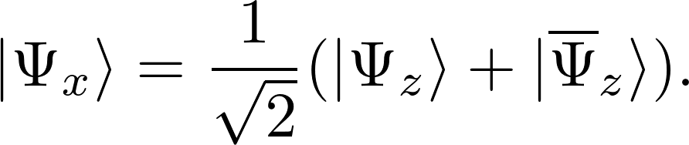
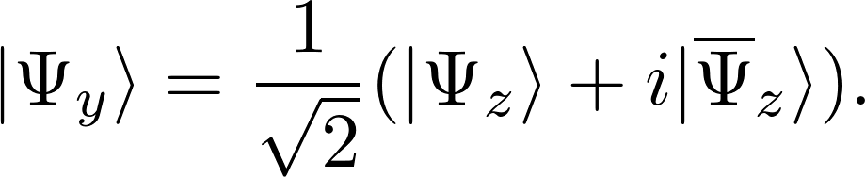
Rotations of spin using K.P.
Linear combination of Kramers pairs yields a new wavefunction, with a new orientation of spin.

Slide 55
Zeeman Hamiltonian to g-tensor

Slide 56
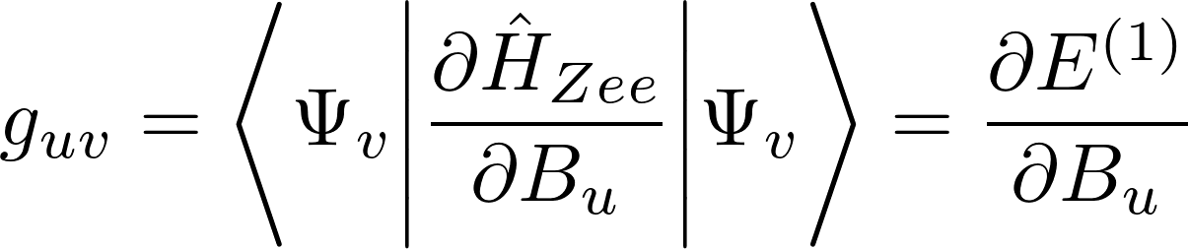
Zeeman Hamiltonian to g-tensor

Slide 57
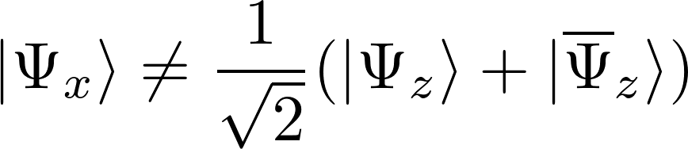
Rotations of spin using unrestricted KP
Spin rotation does not work with unrestricted Kramers pairs:

Slide 58
Rotations of spin using unrestricted KP
Spin rotation does not work with unrestricted Kramers pairs:
Error is caused by the fact that alpha and beta orbitals do not share the same spatial components:

Slide 59
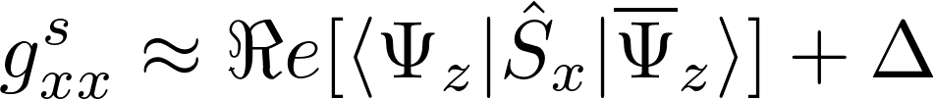
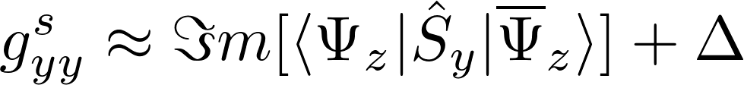
Correcting the spin-Zeeman term
Derived approximate correction for eigenvalues of g-tensor in the non-relativistic case:

Slide 60
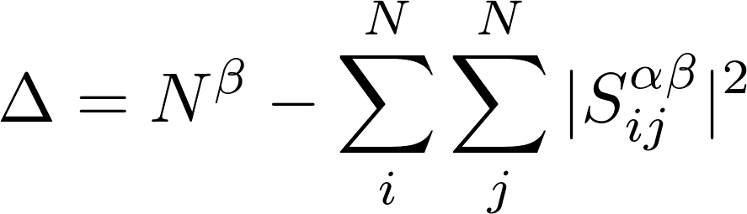
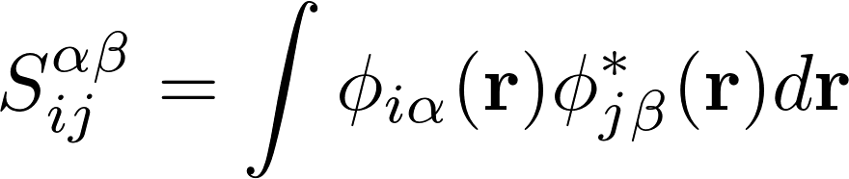
Correcting the spin-Zeeman term
Derived approximate correction for eigenvalues of g-tensor in the non-relativistic case:
With
This is the spin-contamination!

Slide 61
Adjusted Results
Molecule |  | ReSpect | ReSpect (adj.) | Experiment^{a,b}
H₂CO+ | g_{xx} | 0.9 | 4.9 | 4.6
 | g_{yy} | 11.0 | -0.0 | 0.2
 | g_{zz} | -0.9 | -0.9 | -0.8
H₂O+ | g_{xx} | 4.7 | 0.3 | 0.2
 | g_{yy} | 6.4 | 21.2 | 18.8
 | g_{zz} | 3.7 | 5.9 | 4.8
Table 1. g-shift values in ppt. The molecules are in yz-plane, where z is along the main rotation axis.
Experimental results:
ª H₂CO+ : L. B. Knight and J. Steadman, J. Chem. Phys. 80, 1018 (1984)
^{b} H₂O+: L. B. Knight and J. Steadman, J. Chem. Phys. 78, 5940 (1983)

Slide 62
Conclusion
Q) How well is g-tensor theory adapted to unrestricted and/or broken symmetry DFT?

Slide 63
Conclusion
Q) How well is g-tensor theory adapted to unrestricted and/or broken symmetry DFT?
A) OK, provided
New method is used for calculation of matrix elements.
Account for the impact of spin contamination.
P. J. Cherry, S. Komorovský, V. G. Malkin, and O. L. Malkina, Mol. Phys. (2017)

