Slide 1
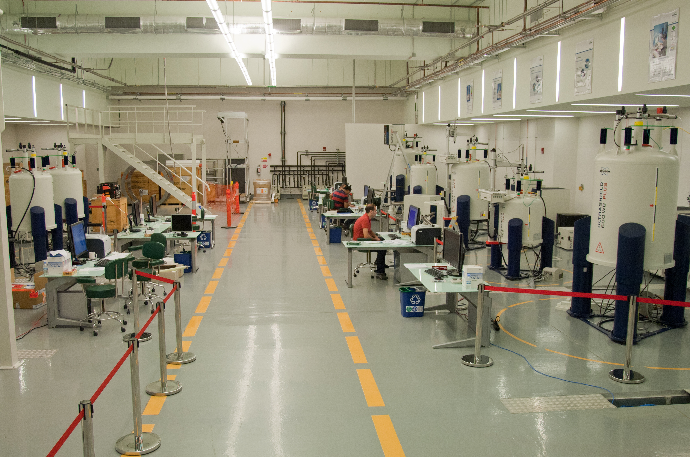
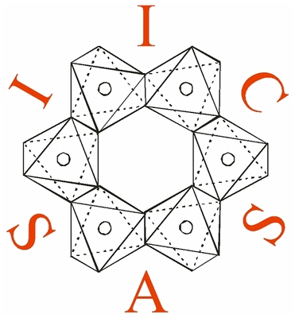
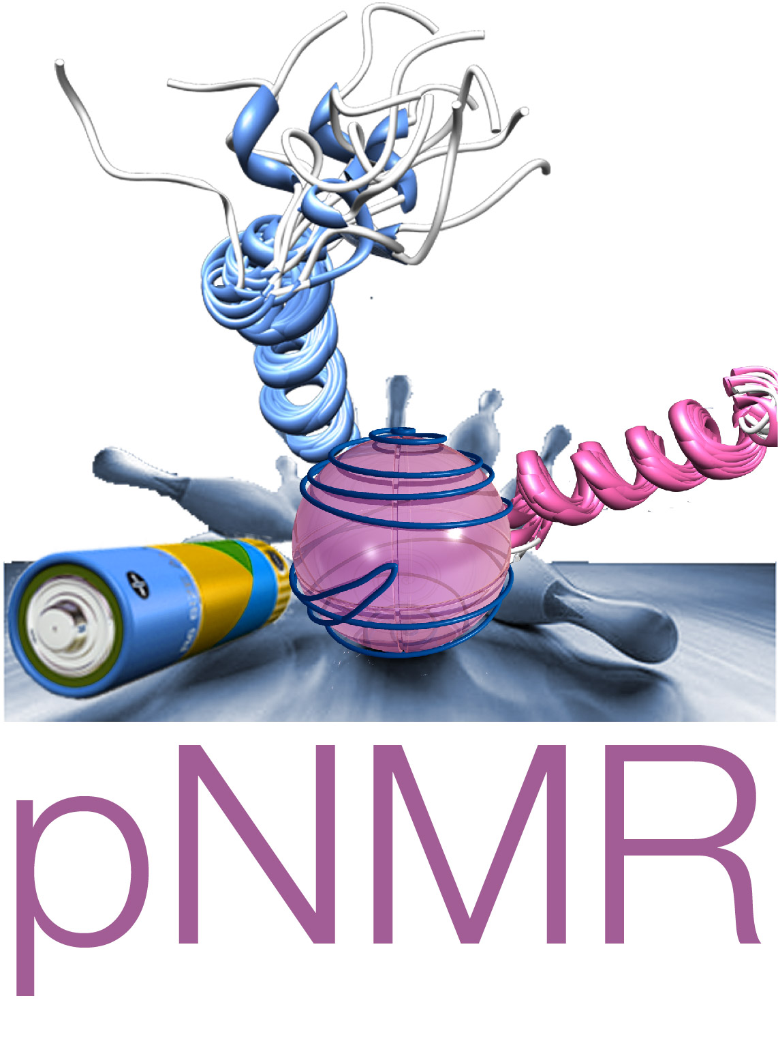
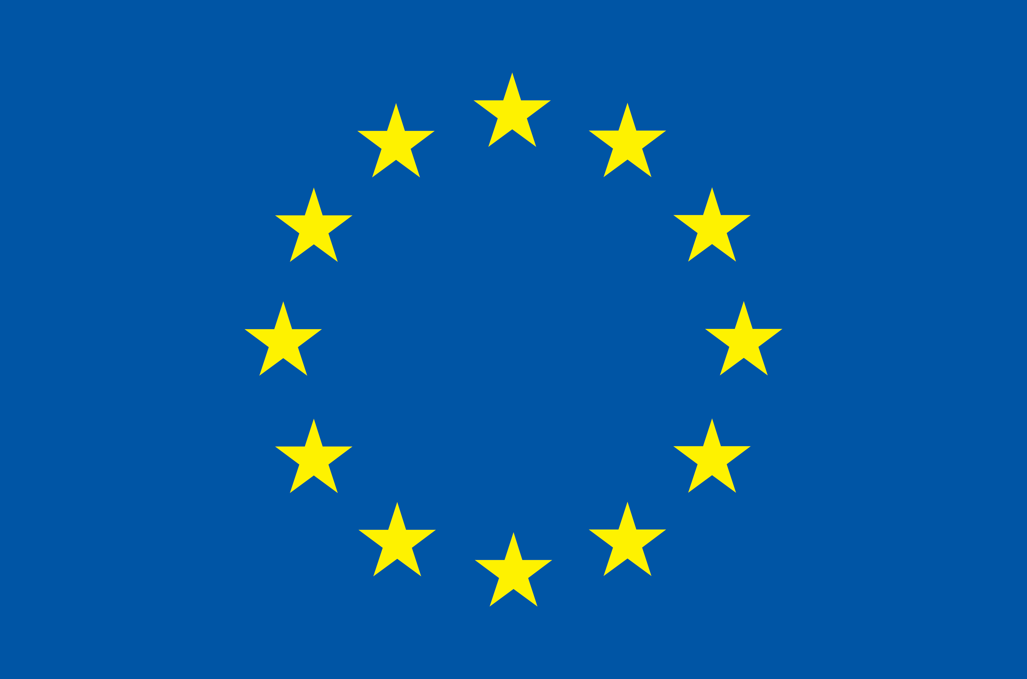
Fully Relatvistic Density Functional Theory :
Developments and Applications

Slide 2
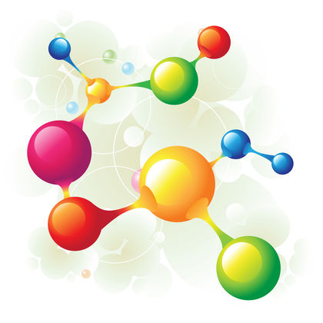
Talk Outline
Career History
Scientific Work
  Nuclear magnetic resonance applied to paramagnetic compounds.
  Automated code-generation for applying perturbation theory to multireference wavefunctions.
  Time-dependent density functional theory in a 4-component framework.

Slide 3
Career History
2013 - 2016 : PhD studies (Univ. Komenskeho, Univ. Stockholm, Giotto Biotech, Univ. Oulu)
  “Fully relativistic calculations of magnetic resonance parameters with application to paramagnetic NMR.”
2017 - 2018 : Postdoctoral Fellow (Northwestern Univ.)
  Theoretical development and implementation of quasi-degenerate 4-component perturbation theory.
2019 – present : Scientist (Slovak Academy of Sciences)
  Implementation of time-dependent density functional theory in a matrix-Dirac-Kohn-Sham framework.

Slide 4
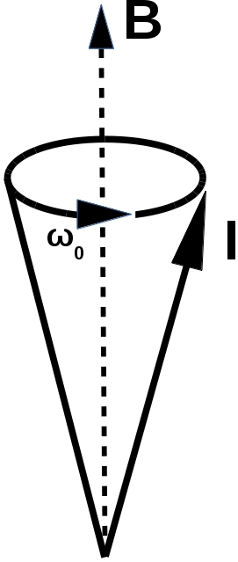
Nuclear Magnetic Resonance (NMR)
Characterize system based on its response to an external magnetic field.
Nuclear spins will precess about the magnetic field.
This is the Larmor precession, it is what experiments measure.
The frequency of the Larmor precession influenced by
    1) Nuclear isotope.
    2) Electron-nuclear interactions.
    3) Nuclear-nuclear interactions.
    4) And many others....
Fig. 1: Larmor precession cone.
Fig 2: Nucleon.

Slide 5
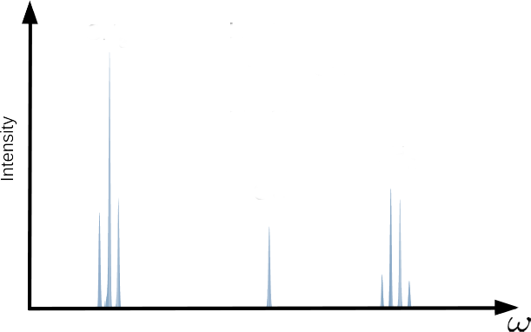
NMR
CH3
H
H
H
C
C
O
H
H
H
Fig. 3 : 90 MHz Proton NMR spectra for ethanol in CDCl₃. Data retrieved from the AIST spectral database for organic compounds [2].
CH2
OH
[2] http://sdbs.db.aist.go.jp/sdbs/cgi-bin/direct_frame_disp.cgi?sdbsno=13

Slide 6
J-coupling
Interaction is mediated by electron charge density:
Nuclear spin-spin interaction is mediated by the currents which the nuclear moments induce in the electron density.
e⁻
e⁻
e⁻
e⁻
e⁻
e⁻
e⁻
e⁻
e⁻
e⁻
e⁻
e⁻
e⁻
e⁻

Slide 7
J-coupling
CH3
H
H
Fig. 3 : 90 MHz Proton NMR spectra for ethyl alcohol in CDCl₃ .Data retrieved from spectral database for organic compounds[2].
H
C
C
O
H
H
H
CH2
OH
[2] http://sdbs.db.aist.go.jp/sdbs/cgi-bin/direct_frame_disp.cgi?sdbsno=13

Slide 8
J-coupling enhancement
Interaction is mediated by electron spin density:
Paramagnetic systems have unparied electrons and the nuclear spins can interact via the electron spins.

Slide 9
Paramagnetic J-coupling enhancement
New contribution to spectra: Paramagnetic enhancement of J-coupling.
J. Autschbach, J. Annu. Rep. Comput. Chem. (2015).
P. J. Cherry, S. A. Rouf, and J. Vaara, JCTC, 13 (3), 1275-1283 (2017)

Slide 10
Hyperfine terms
New contribution to spectra: Paramagnetic enhancement of J-coupling.
The hyperfine interaction couples nuclear spins to the electron spin density.
J. Autschbach, J. Annu. Rep. Comput. Chem. (2015).
P. J. Cherry, S. A. Rouf, and J. Vaara, JCTC, 13 (3), 1275-1283 (2017)

Slide 11
SS dyadic
New contribution to spectra: Paramagnetic enhancement of J-coupling.
The hyperfine interaction couples nuclear spins to the electron spin density.
Spin density then “transmits” interaction of nuclear spins.
J. Autschbach, J. Annu. Rep. Comput. Chem. (2015).
P. J. Cherry, S. A. Rouf, and J. Vaara, JCTC, 13 (3), 1275-1283 (2017)

Slide 12
Paramagnetic J-coupling enhancement
New contribution to spectra: Paramagnetic enhancement of J-coupling.
The hyperfine interaction couples nuclear spins to the electron spin density.
Spin density then “transmits” interaction of nuclear spins.
No dependence on distance between nuclei!
J. Autschbach, J. Annu. Rep. Comput. Chem. (2015).
P. J. Cherry, S. A. Rouf, and J. Vaara, JCTC, 13 (3), 1275-1283 (2017)

Slide 13
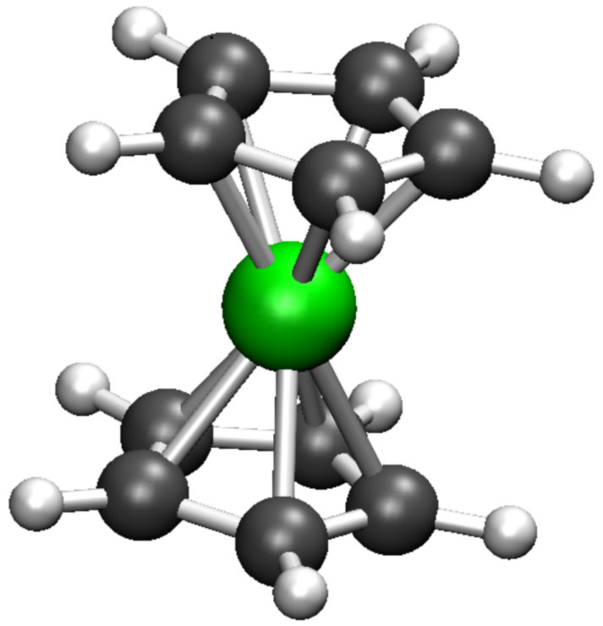
Test Systems: Metallocenes

Slide 14
Test Systems: Metallocenes
Fe
Ferrocene:
Diamagnetic.
No unpaired electrons.
No J enhancement.

Slide 15
Test Systems: Metallocenes
Fe
Cr
Ni
Ferrocene:
Diamagnetic.
No unpaired electrons.
No J enhancement.
Chromocene:
Paramagnetic.
Three unpaired electrons.
J enhancement.
Nickelocene:
Paramagnetic.
Three unpaired electrons.
J enhancement.

Slide 16
J-coupling Notation
Number of bonds seperating nuclei
³JHH
Coupled nuclei

Slide 17
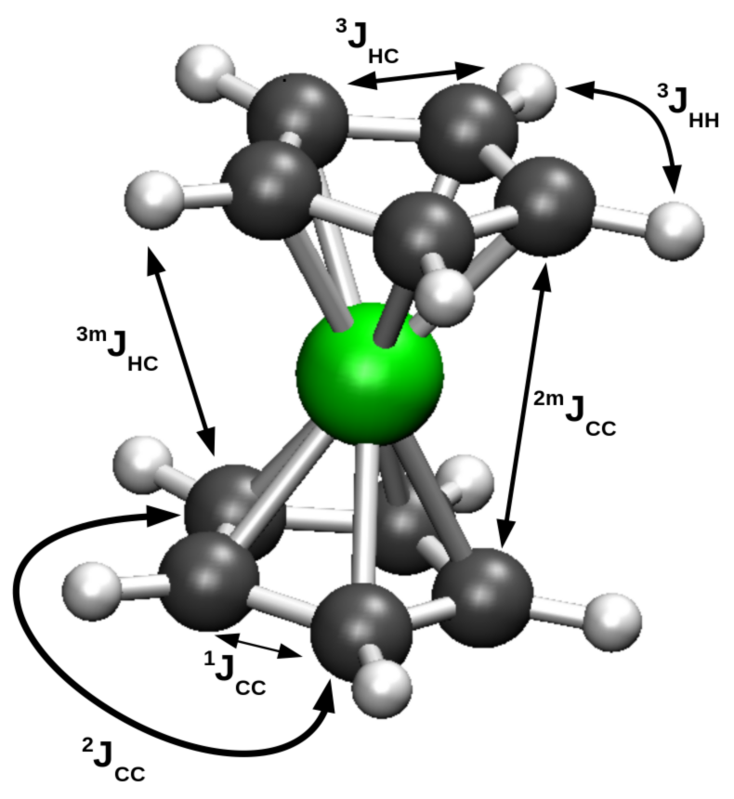
J-enhancement in metallocenes
 | J(Hz) | Enhancement (Hz)
 | FeCp2 | NiCp2 | CrCp2
 | (m=1) | (m=4) | (m=4)
³JHH
¹JCC
¹JCH
^{4m}JHH
^{2m}JCC
^{3m}JCH
Table 1: Comparison between unenhanced isotropic J-values for ferrocene, and the corresponding enhancement in nickelocene and chromocene.
Fig. 8: Metallocene structure. Hydrogens
→ white. Carbons → grey. Metal → green.

Slide 18
J-enhancement in metallocenes
 | J(Hz) | Enhancement (Hz)
 | FeCp2 | NiCp2 | CrCp2
 | (m=1) | (m=4) | (m=4)
³JHH | 8.0 | 0.65 | 1.50
¹JCC | 88.5 | 5.42 | -0.02
¹JCH | 172.9 | -1.17 | -0.04
^{4m}JHH
^{2m}JCC
^{3m}JCH
Same
Ring
Table 1: Comparison between unenhanced isotropic J-values for ferrocene, and the corresponding enhancement in nickelocene and chromocene.
Fig. 8: Metallocene structure. Hydrogens
→ white. Carbons → grey. Metal → green.

Slide 19
J-enhancement in metallocenes
 | J(Hz) | Enhancement (Hz)
 | FeCp2 | NiCp2 | CrCp2
 | (m=1) | (m=4) | (m=4)
³JHH | 8.0 | 0.65 | 1.50
¹JCC | 88.5 | 5.42 | -0.02
¹JCH | 172.9 | -1.17 | -0.04
^{4m}JHH | 0.0 | 1.24 | 1.79
^{2m}JCC | -0.3 | 5.66 | 0.11
^{3m}JCH | 0.0 | -1.66 | -0.48
Different
Ring
Table 1: Comparison between unenhanced isotropic J-values for ferrocene, and the corresponding enhancement in nickelocene and chromocene.
Fig. 8: Metallocene structure. Hydrogens
→ white. Carbons → grey. Metal → green.

Slide 20
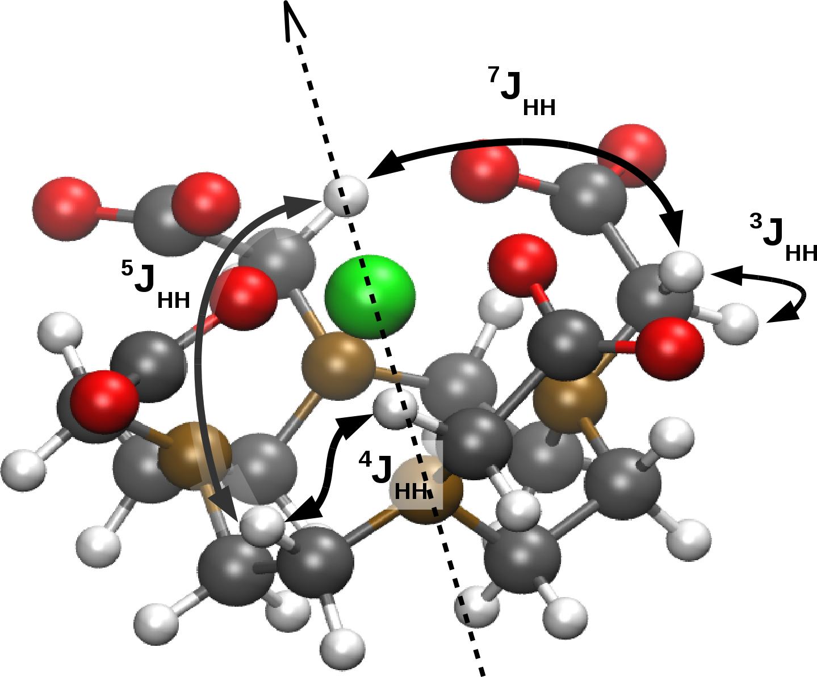
J-enhancement in Gd-DOTA
 | ∆J^{iso}(Hz) | ∆J^{aniso}(Hz)
³JHH | 2.40 | -1.35
⁴JHH | 2.58 | -1.99
⁵JHH | 6.59 | -5.4
⁷JHH | -3.27 | 9.41
Table 2: Enhancement to isotropic and anisotropic J-values for Gd-DOTA.
Fig. 9: Gd-DOTA structure. Oxygen → red. Nitrogen → brown. Other elements as before.

Slide 21
Paramagnetic spin-spin coupling enhancement
Q1) Is J-coupling qualitatively different in systems with unpaired electrons?
Q2) Do we need to account for it when analyzing pNMR spectra?

Slide 22
Paramagnetic spin-spin coupling enhancement
Q1) Is J-coupling qualitatively different in systems with unpaired electrons?
Q2) Do we need to account for it when analyzing pNMR spectra?
A1) Yes, nuclear spins are coupled by the electron spin-density, without explicit dependence on distance.
A2) Probably not at short distances, could be significant at long distances.

