Slide 1
A tool for property calculations using multireference wavefunctions
Peter John Cherry
Theory group meeting
March 13th 2018

Slide 2

MRPTool Outline
In most software, each property has a seperate implementation.
Problem : If you want a property which is not implemented... tough luck!
A significant issue when using multireference 4-component methods; there aren't many programs around.
Solution : Write a generic framework for applying perturbation theory to 4-component multireference wavefunctions.

Slide 3
MRPTool Outline
No specific properties programmed; the user inputs algebraic expressions;
Specify states, orbital indexes, operators, symmetries.
Handles specific equation forms, e.g., find coefficients which minimize the Hylleraas functional ;
Similar to code generation tools, but no programming necessary.
Adapted specifically for the relativistic framework.

Slide 4
Program Structure
Input
Driver
Mathematical task translator
Algebraic Manipulator
Linear algebra and CI routines

Slide 5
Advantages of relativistic multireference peturbation theory
Why do we need multireference methods and not, e.g., DFT ?
    Better suited for degenerate cases.
    Clearer treatment of spin.
Why should we bother with computationally expensive 4-component relativistic methods?
    2-electron spin-orbit effects.
    Core spectroscopy for heavy elements.
Why do we need this flexibility?
    Expressions are hard to implement by hand.
    Wish to test theories.
Why do we need to do extended multistate perturbation theory?
    CASSCF alone is often not enough.

Slide 6
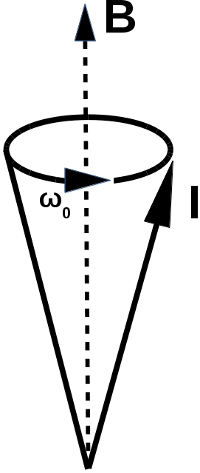
Nuclear Magnetic Resonance (NMR)
Characterize system based on its response to an external magnetic field.
Electron spins will precess about the magnetic field.
This is the Larmor precession, it is what experiments measure.
The frequency of the Larmor precession influenced by
    1) Nuclear isotope.
    2) Electron-nuclear interactions.
    3) Nuclear-nuclear interactions.
    4) And many others....
Fig. 1: Larmor precession cone.
Fig 2: Nucleon.

Slide 7
Electron Paramagnetic Resonance (EPR)
Characterize system based on its response to an external magnetic field.
The frequency of the Larmor precession influenced by interations with
    1) Nuclear potential
          Hyperfine splitting
          Spin-orbit coupling
    2) Other electrons:
          Spin-other-orbit interaction
          Orbit-orbit interaction
Fig. 1: Larmor precession cone.
Fig 2: Electron.

Slide 8
Advantages of relativistic multireference peturbation theory
Why do we need multireference methods and not, e.g., DFT ?
    Better suited for degenerate cases.
    Simpler treatment of high spin multiplets.
Why should we bother with computationally expensive 4-component relativistic methods?
    2-electron spin-orbit effects.
    Core spectroscopy for heavy elements.
Why do we need this flexibility?
    Expressions are hard to implement by hand.
    Wish to test theories.
Why do we need to do extended multistate perturbation theory?
    CASSCF alone is often not enough.

Slide 9
Spin Multiplets
In the non-relativistic case, the eigenstates of the Hamiltonian can be divided up into several degenerate spin-multiplets.
A magnetic field will split the energies of the states in the multiplet.
The frequency of the Larmor precession is the determined by the transitions between different states in the multiplet.
quartet
doublet
quartet
doublet

Slide 10
Multireference wavefunctions
Description of wavefunctions with spin multiplicity greater than often requires multiple determinants.
For example, the spin-0 state in a triplet requires at least two:
Single determinant methods can be extremely effective, but can run into problems (e.g., spin contamination).
Multi-determinant methods ensure we do not need to worry about this.

Slide 11
Single determinant method
Many particle wavefunction is described using an anti-symmetric tensor product of single particle wafunctions :
This is a determinantal wavefunction.

Slide 12
Complete active space self-consistent field (CASSCF)
virtual
active
closed

Slide 13
Complete active space self-consistent field (CASSCF)
virtual
active
closed

Slide 14

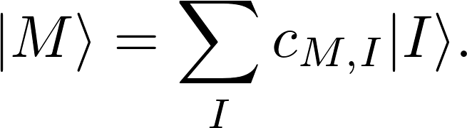






Non-relativistic CI-vector
The wavefunction is described by a linear combination of
determinants :
Conf.
There are a very large number of possible configurations; this is a significant computational bottleneck.
...
...
...
...
...
...
...
...
Non-relativistic CI-vector only has determinants from
a single spin sector:

Slide 15
Rough interpretation of EPR parameters
The Hamiltonian of system in the presence of a constant magnetic field can be written as the sum of a field free Hamiltonian and the Zeeman Hamiltonian :
The time-evolution of a wavefunction due to the magnetic field can be approximated by:
The Zeeman-Hamiltonian is parameterized in terms of the generators of transformations of the magnetic moment of the electron :
The coefficients, , parameterize the time evolution of the wavefunction, and hence the Larmour precession.

Slide 16
Interpretation of EPR parameters
Obtain from the representation of the Hamiltonian in the eigenstates of the field free Hamiltonian :
If the magnetic field is small, this matrix is roughly block diagonal:
Each of the blocks has the dimensions of one of the multiplets.

Slide 17
Advantages of relativistic multireference peturbation theory
Why do we need multireference methods and not, e.g., DFT ?
    Better suited for degenerate cases.
    Clearer treatment of spin.
Why should we bother with computationally expensive 4-component relativistic methods?
    2-electron spin-orbit effects.
    Core spectroscopy for heavy elements.
Why do we need this flexibility?
    Expressions are hard to implement by hand.
    Wish to test theories.
Why do we need to do extended multistate perturbation theory?
    CASSCF alone is often not enough.

Slide 18
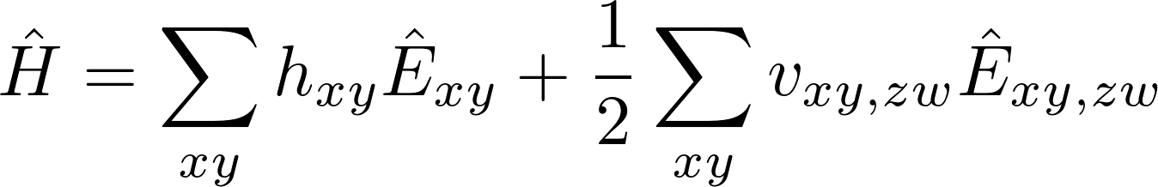
Relativistic electron-electron interactions
Interaction of electrons is different in a relativistic framework.
`

Slide 19
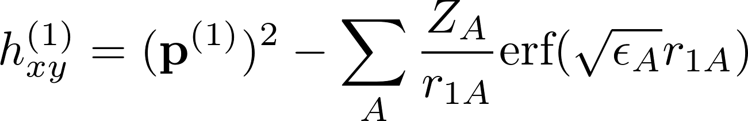
Relativistic electron-electron interactions
Interaction of electrons is different in a relativistic framework.
Non-relativistic one-electron terms
`

Slide 20
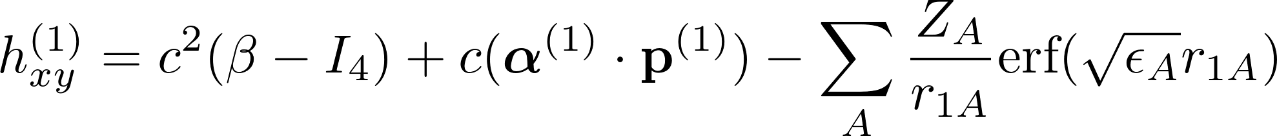
Relativistic electron-electron interactions
Interaction of electrons is different in a relativistic framework.
Non-relativistic one-electron terms
Relativistic one-electron terms
`

Slide 21
Relativistic electron-electron interactions
Interaction of electrons is different in a relativistic framework.
Non-relativistic one-electron terms
Relativistic one-electron terms
`

Slide 22
Relativistic electron-electron interactions
Interaction of electrons is different in a relativistic framework.
`

Slide 23
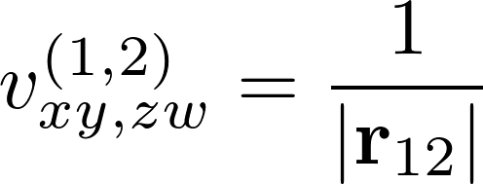
Relativistic electron-electron interactions
Interaction of electrons is different in a relativistic framework.
Non-relativistic two-electron terms
`

Slide 24
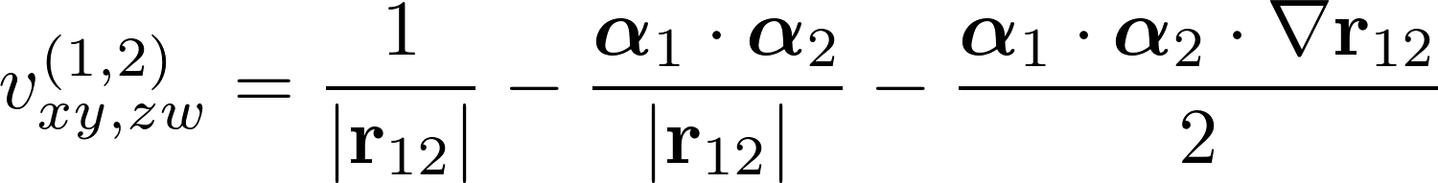
Relativistic electron-electron interactions
Interaction of electrons is different in a relativistic framework.
Non-relativistic two-electron terms
Relativistic two-electron terms
`

Slide 25
Relativistic electron-electron interactions
Interaction of electrons is different in a relativistic framework.
Non-relativistic two-electron terms
Relativistic two-electron terms
`

Slide 26
Spin Multiplets in a relativitic framework
In systems with strong spin-orbit coupling, spin multiplets mix:
Splitting even without a magnetic field (zero-field splitting).

Slide 27
Non-relativistic CI-vector
The wavefunction is described by a linear combination of
determinants :
Conf.
There are a very large number of possible configurations; this is a significant computational bottleneck.
...
...
...
...
...
...
...
...
Non-relativistic CI-vector only has determinants from
a single spin sector:

Slide 28
Relativistic electron-electron interactions
Interaction of electrons is different in a relativistic framework.
Non-relativistic two-electron terms
Relativistic two-electron terms
`

Slide 29








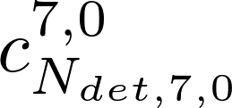
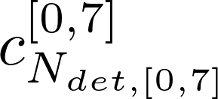
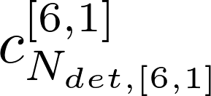
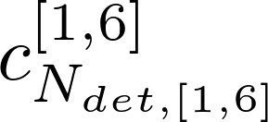
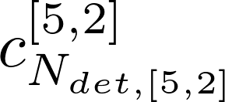
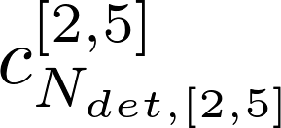
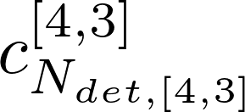
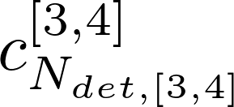
Relativistic CI-vector
Spin-orbit coupling terms results in contributions from determinants in different spin sectors:
 | Spin sectors
Conf. #
...
...
...
...
...
...
...
...
...
...
...
...
...
...
...
...
...
...
...
...
...
...
...
...
...
...
...
...
...
...
...
...
...
...
...
...
...
...
...
...
...
...
...
...
...
...

Slide 30

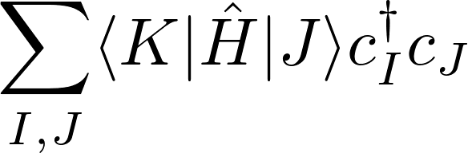

Non-interacting spin-sectors
Non-relativistic case:

Slide 31
Interacting between spin-sectors
Relativistic case :

Slide 32
Spin Multiplets in a relativitic framework
The representation of magnetic field term in a basis formed from pure spin states is generally not block diagonal:
Standard definitions of EPR parameters are not adequate for describing strong multiplet mixing.
Off diagonal blocks will correspond to mixing of spin-multiplets, and determine the zero-field splitting.

Slide 33
Spin Multiplets in a relativistic framework
Zero-field splitting is important for EPR and paramagnetic-NMR.
Used in determining spin-relaxation times, and identifying molecules for possible use as qubits.
Heavily influenced by two-electron interactions, which are best* described using Dirac-Coulomb-Breit Hamiltonian.
Hence we would like to use 4-component multi-determinant methods.

Slide 34
Advantages of relativistic multireference peturbation theory
Why do we need multireference methods and not, e.g., DFT ?
    Better suited for degenerate cases.
    Clearer treatment of spin.
Why should we bother with computationally expensive 4-component relativistic methods?
    2-electron spin-orbit effects.
    Core spectroscopy for heavy elements.
Why do we need to do quasi-degenerate perturbation theory?
    Interested in state crossing.
    CASSCF alone is often not enough.
Why do we need this flexibility?
    Expressions are hard to implement by hand.
    Wish to test theories.

Slide 35
Magnetic field derivatives
Non-relativistic EPR parameters can be interpreted as derivatives of the energy at zero field :
The splitting is approximately linear with respect to the magnetic field.

Slide 36


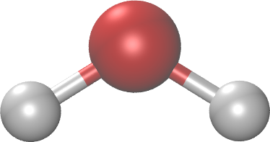


Linear Zeeman splitting
IrH₂

Slide 37
Magnetic field derivatives
Strong spin-orbit coupling and mixing of multiplets can result in transitions between spin states as the field increases.
This can result in non-linear behaviour, even at low fields:

Slide 38
Non-linear Zeeman splitting
cm⁻¹
160
0
IrH₂
-80
137 x 10⁻⁶ T

Slide 39
Magnetic field derivatives
Strong spin-orbit coupling and mixing of multiplets can result in transitions between spin states as the field increases.
This can result in non-linear behaviour, even at low fields:
To probe this phenomena, we need to calculate derivative properties for finite perturbations.
Potentially a huge number of distinct perturbations (magnitudes and directions of magetic field).

Slide 40
Magnetic fields in a relativistic framework
Typically do not introduce magnetic fields via an extra operator.
Introduce via replacement of the momentum operator (minimal coupling):
This can result in changes to the form of the derivatives, and requires use of a basis which is itself dependent on the magnetic field.

Slide 41
Complete active space self-consistent field (CASSCF)
CA space is optimized for the unperturbed Hamiltonian.
Accurate description of a perturbation to the Hamiltonian must account for change in this space.
virtual
active
Optimized for unpeturbed hamiltonian
closed

Slide 42
“Active determinants”
virtual
active
closed

Slide 43
Complete active space self-consistent field (CASSCF)
CA space is optimized for the unperturbed Hamiltonian.
Accurate description of a perturbation to the Hamiltonian must account for change in this space.
Attempt to describe this by adding in some determinants with excitations to orbitals in the virtual space.
virtual
active
closed

Slide 44
“External determinants”
virtual
active
closed

Slide 45
Multi-state multi-reference perturbation theory
R
S
X
R
R : Reference space
R+S : CASCI space
S
X : External space
X
in R
In S+X

Slide 46

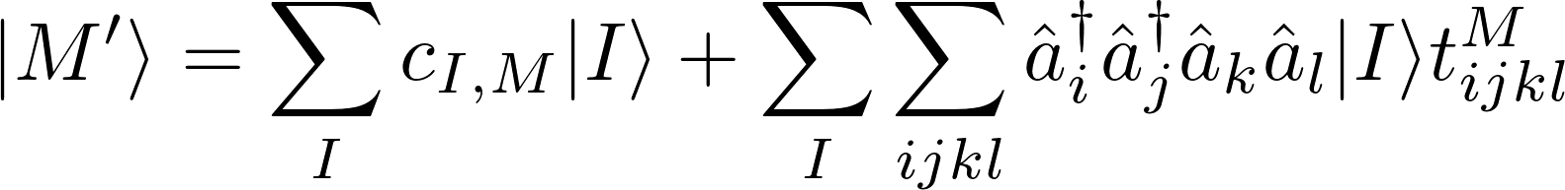
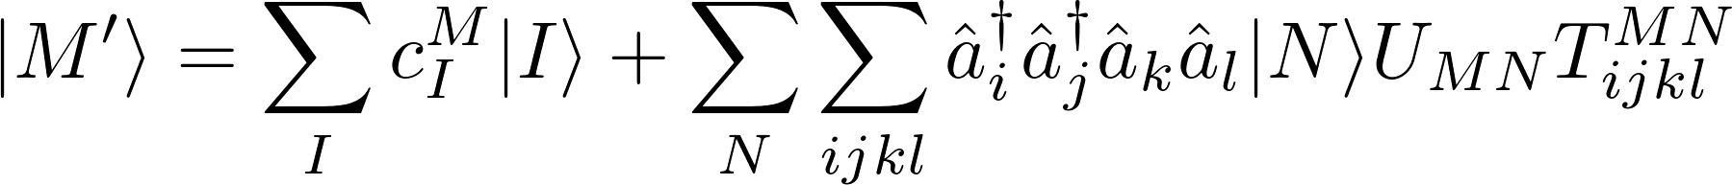
XMS-CASPT2
First order wavefunction :
Single state, CASPT2 wavefunction, no internal contraction :
XMS-CASPT, internally contracted :

Slide 47
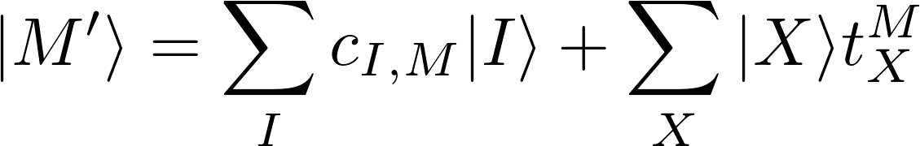
XMS-CASPT2
First order wavefunction :
Single state, CASPT2 wavefunction, no internal contraction :
XMS-CASPT, internally contracted :
external determinant
reference state

Slide 48
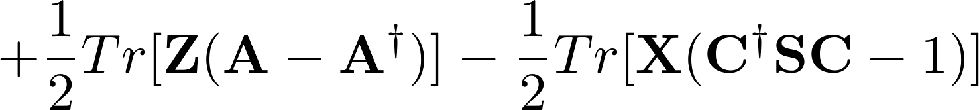
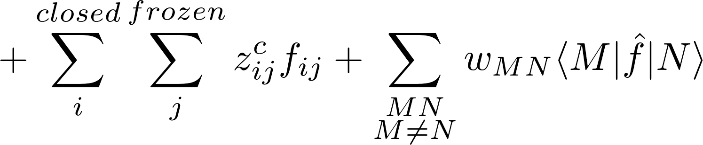
XMS-CASPT2 Lagrangian
The Lagrangian has several distinct terms:
Programming this seems feasible, however....

Slide 49
Program Structure
Input
Driver
Mathematical task translator
Algebraic Manipulator
Linear algebra and CI routines

Slide 50
Primary term types
Expectation value (“full”) type terms :
CI-derivative type terms :
Excitation derivative type terms:

Slide 51
Primary term types
Expectation value (“full”) type terms :
CI-derivative type terms :
Excitation derivative type terms:

Slide 52
Rearrangement of terms
CI derivatives are computationally expensive to calculate;
The indexes in the centre are not necessarily active indexes.

Slide 53
Rearrangement of terms
CI derivatives are computationally expensive to calculate;
The indexes in the centre are not necessarily active indexes.

Slide 54
“External determinants”
virtual
active
closed

Slide 55
“Active determinants”
virtual
active
closed

Slide 56
“External determinants”
virtual
active
closed

Slide 57
Rearrangement of terms
Computationally expensive to calculate
This sum over general indices can be rewritten as a sum over active indices:
Computationally efficient; can be evaluated without the need to store any eight index tensors.
This is Jae’s recent work:

Slide 58
Rearrangement of terms
These terms are very computationally expensive to calculate
This sum over general indices can be rewritten as a sum over active indices:
Computationally efficient; can be evaluated without the need to store any eight index tensors.
This is Jae’s recent work:

Slide 59



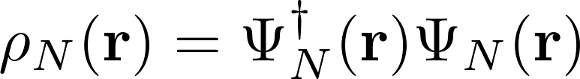

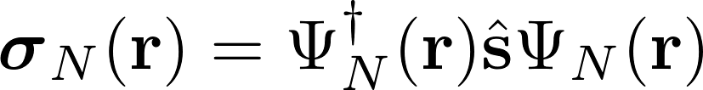

Significance of state averaging in relativistic XMS-CASPT2
The spin densities are typically very different for all states in a multiplet :
Charge density :
                Spin density :
Can split Fock-operator into spin-dependent and spin-independent terms :
It is not clear (to me) what the influence of the state averaging will be on the spin dependent terms.

