Slide 1
Chicago Taxi Trips and Weather
Jared Saeger, Peter Orphan, Stephen Seyer

Slide 2
Contents
Summary
Questions & Data
Data Cleanup & Exploration
Data Analysis
Discussion and Conclusions
Post Mortem
Q&A

Slide 3
Summary
Hypothesis: There is a positive correlation between inclimate weather and the popularity of taxis
Clear weather vs. bad weather?
More trips at extremes of temperature?
More trips with heavy precipitation?

Slide 4
Questions & Data
Taxi Data – publicly available csv from City of Chicago
Historical weather data – Dark Sky API

Slide 5
Data Cleanup & Exploration
Limited API calls
Extracting a sample from the huge CSV of Chicago taxi data
Removed unnecessary columns
Created Master DataFrame and summary CSVs
Could hypothesis be wrong?
Distribution of different types of weather for our time period?

Slide 6
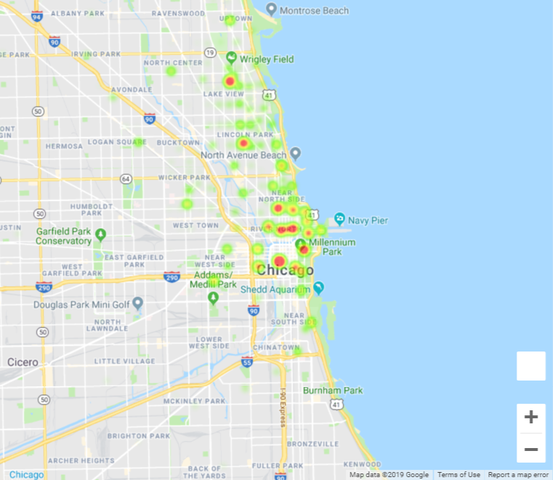
Trip Count Heatmap

Slide 7
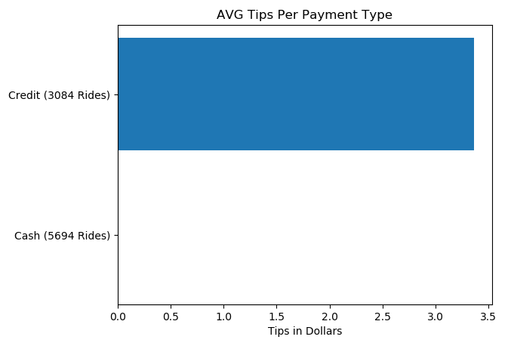
Tips by Payment Method

Slide 8
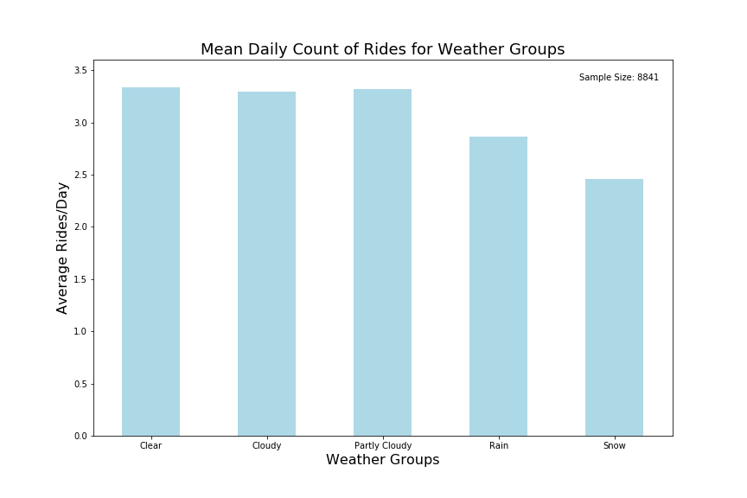
Average Trips by Weather Type

Slide 9
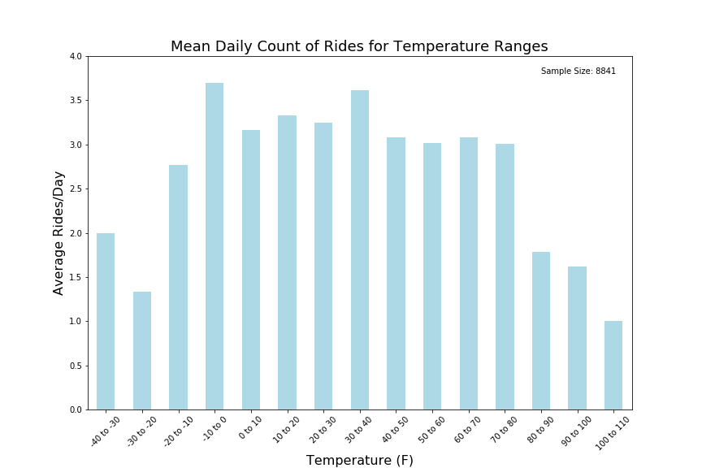
Average Trips by Temperature

Slide 10
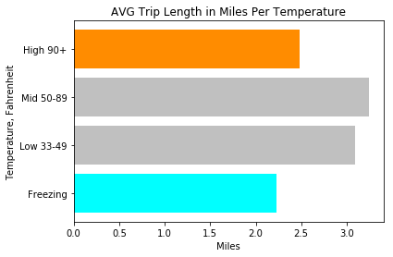
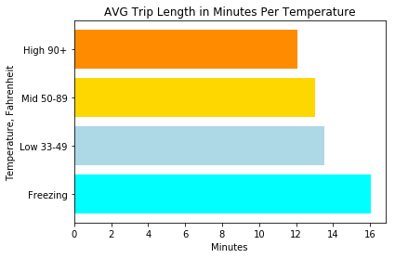
Average Trip Length by Temperature

Slide 11
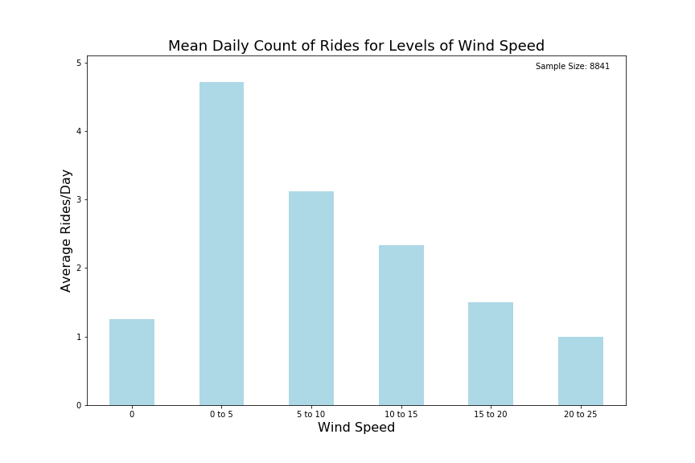
Average Trips by Wind Speed

Slide 12
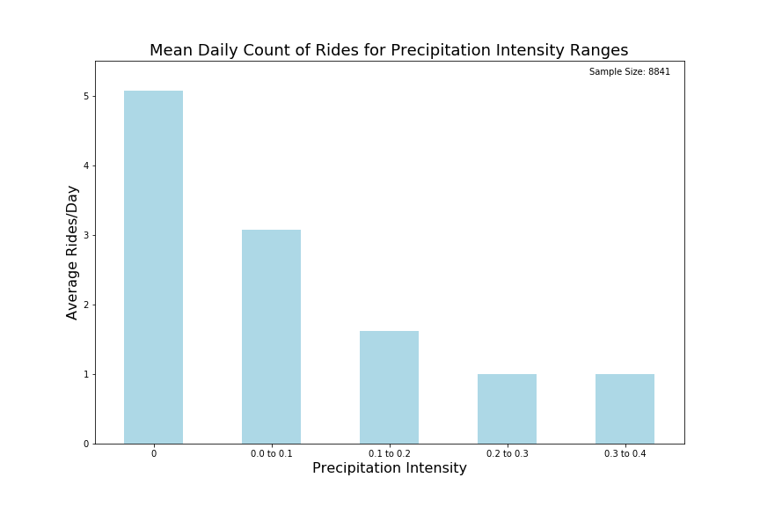
Average Trips by Precipitation

Slide 13
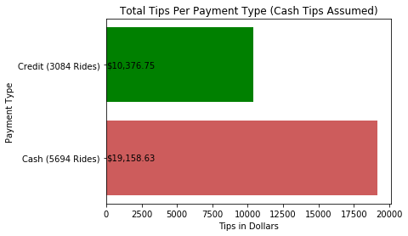
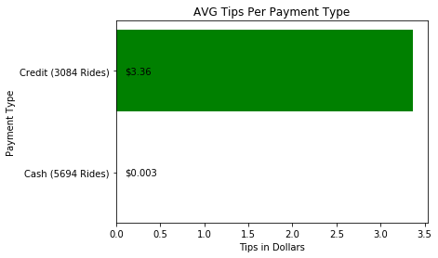
Tips per Ride

Slide 14
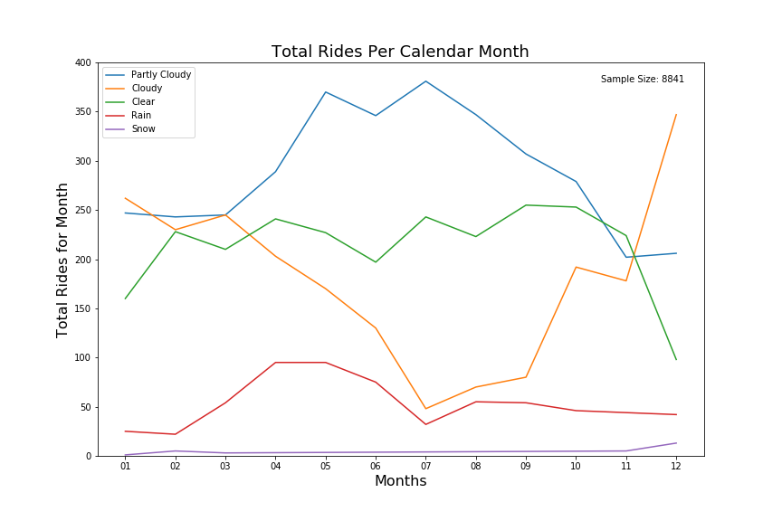
Total Trips by Month

Slide 15
Findings and Discussion
Hypothesis was dead wrong – more trips on days with good weather than those with bad weather
People going out more on clear days?
Public transit faster than cabs in bad weather?
Better moods in good weather?

Slide 16
Post Mortem
Difficulties:
Data normalization
Limited number of API calls
Pivoted scope from ride-sharing apps to taxis
Additional questions:
Examine data by year, month, day, etc. more granularly
Taxi popularity change over years as Uber / Lyft gained popularity?
More API keys, more weather data -> more accurate analyses
Trip length during bad / ideal weather?

Slide 17
Questions?

