Slide 1
Congress
How Old Are Members?
Data Analytics Bootcamp Project 2
Peter Orphan, Adam Feldstein, Brendan Donnelly, Renee O’Reilly

Slide 2
Business Objectives
Research Question
How old is Congress?
Analyze past 11 Congresses
Identify longitudinal trends in age of membership

Slide 3
Data Munging Techniques
API call from Propublica
Transform data
Created variables –Year, SwornInAge
Store data in SQLlite database
Transform data and return as JSON
Filter and grouped by

Slide 4
Coding Approach
Created Routes
JavaScript
Line – Shows longitudinal data of average age by selected state
Bar – Shows the average age for each state by selected year
Map – Clickable US map which shows the average age of all members state for the current year.
JavaScript Library
Jquery

Slide 5
App Architecture
Three Charts/Graphs
Bootstrap
JQuery

Slide 6
Live Demo
Age of Congress Dashboard

Slide 7
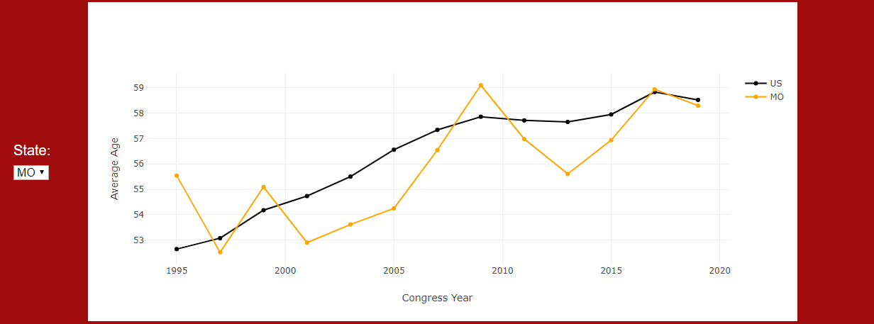
Screenshot of Line Chart

Slide 8
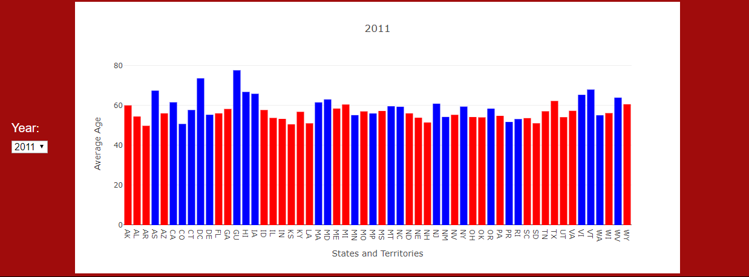
Screenshot of Bar Chart

Slide 9
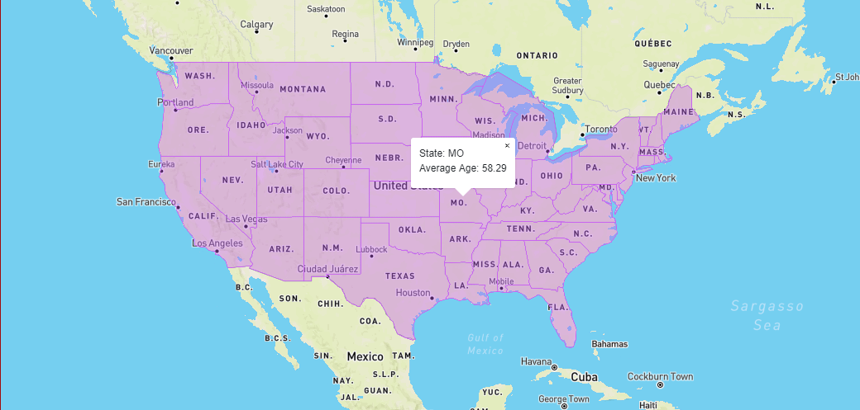
Screenshot of Map

Slide 10
Future Work
Click on state on the Map would change all Charts
Additional Filters and Charts
Deploy to Heruko
Introduce Legislation Decisions

