Slide 1
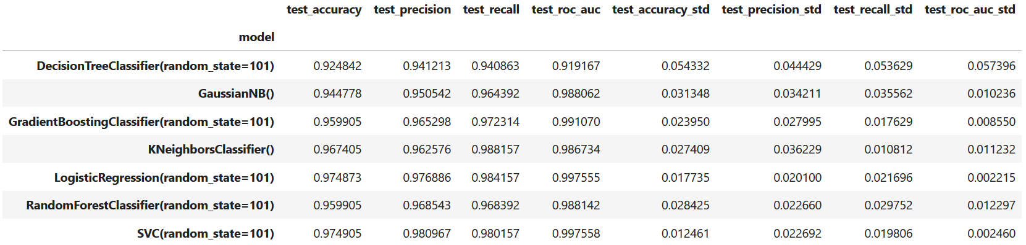
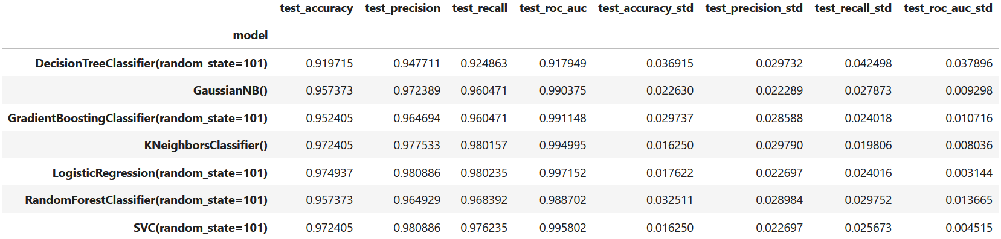
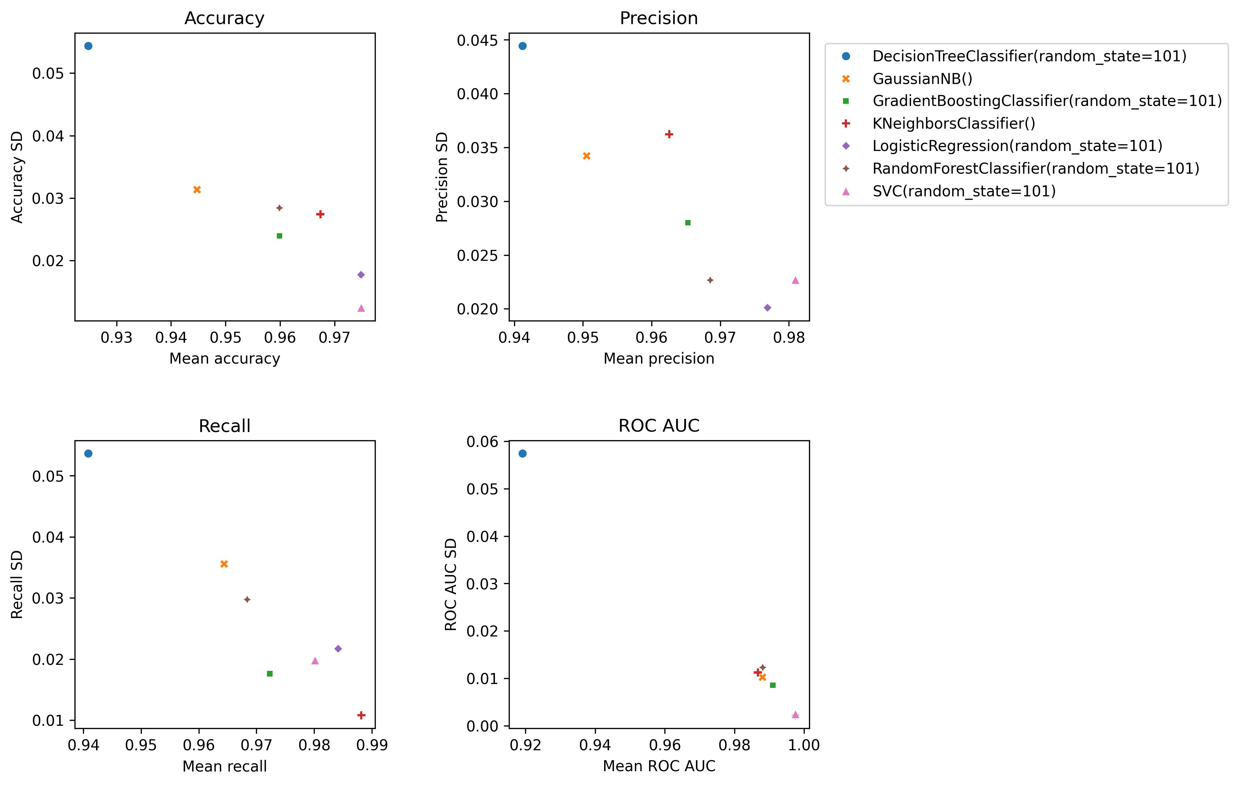
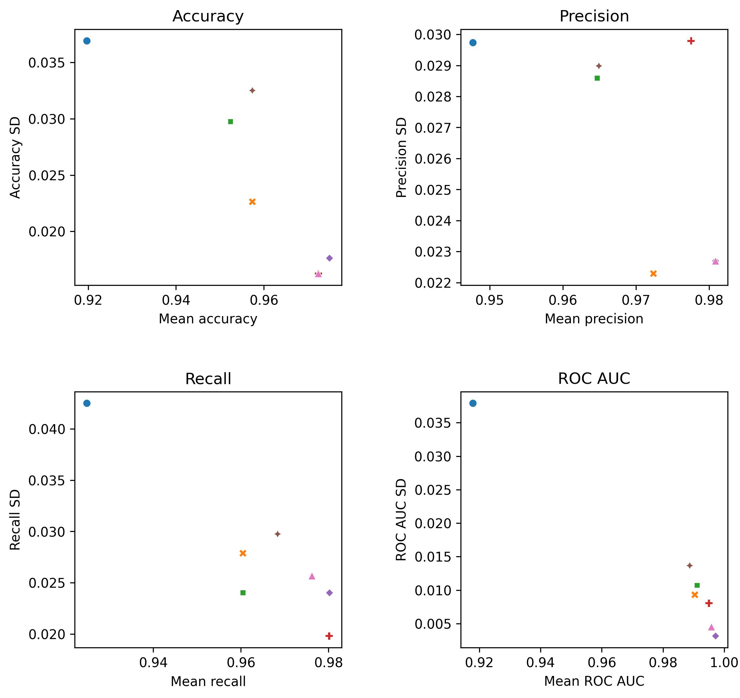
Comparison of different ML models and different sets of features
(Mean and SD values are calculated from the results of cross-validation)
1. All features
2. Top 10 features
Using only the top 10 features slightly increased the performance of logistic regression and KNN. SD values are notably smaller following feature selection (model performance is less affected by the random selection of instances).

Slide 2
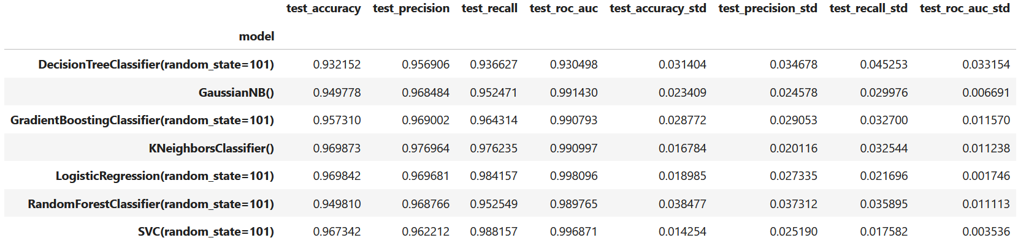
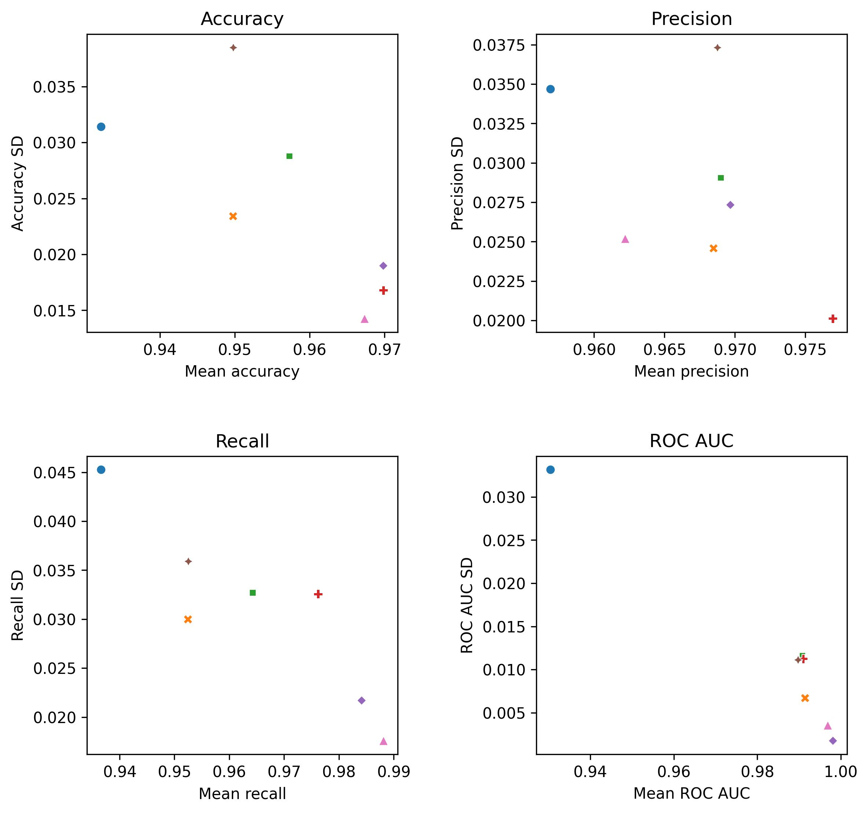
Comparison of different ML models and different sets of features
(Mean and SD values are calculated from the results of cross-validation)
1. All features
3. Selection of only worst features
With a selection of 6 features from the worst metrics, model performances showed only slight changes: in most cases a small decrease or no notable change.

Slide 3
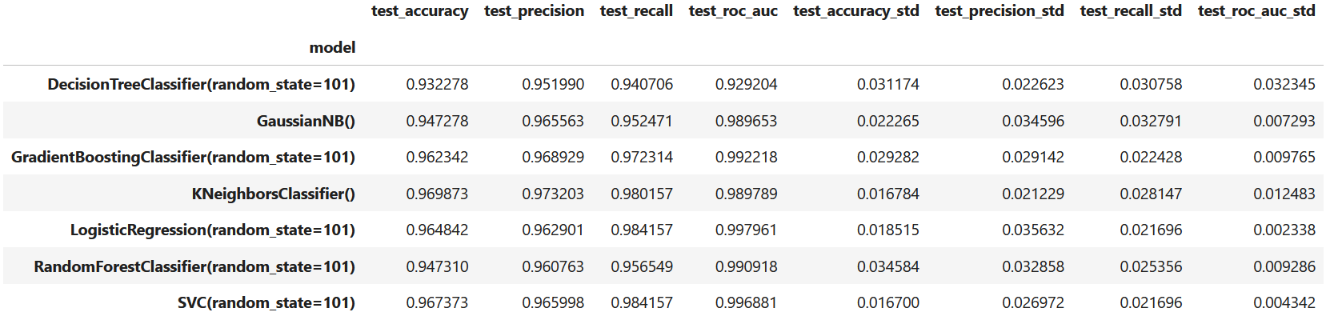
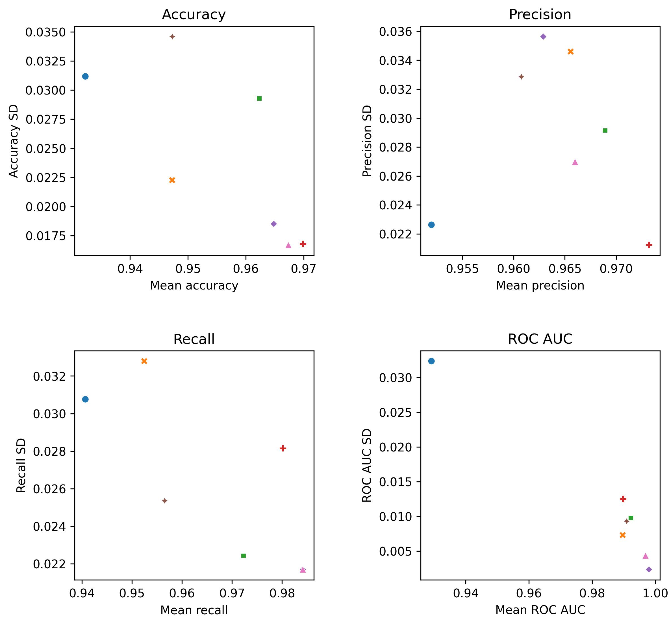
Comparison of different ML models and different sets of features
(Mean and SD values are calculated from the results of cross-validation)
1. All features
4. Smallest selection (only 4 features from worst metrics)
The removal of highly correlated features did not notably change model performance compared to selection no. 3. In addition, differences around 0.5-1% between no selection (all features) and selection no. 4 could be negligible. From a practical point of view, only a fraction of the features is able to predict disease outcomes as good as 30 of them.

