Slide 1
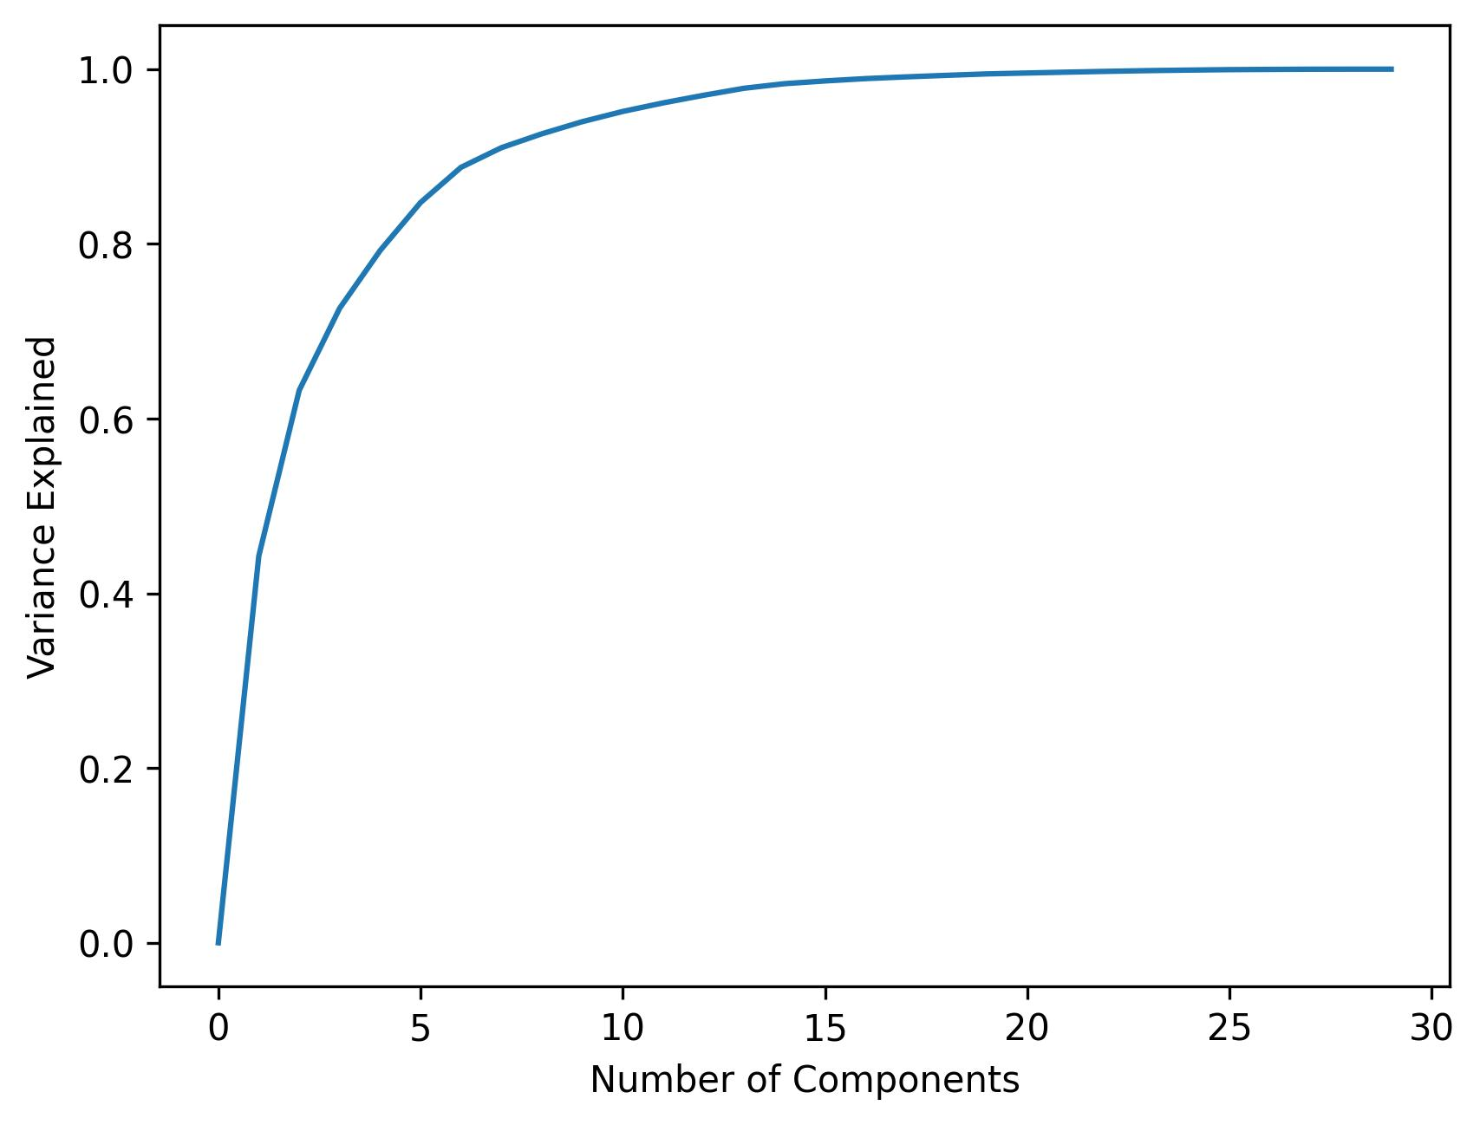
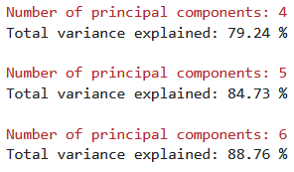
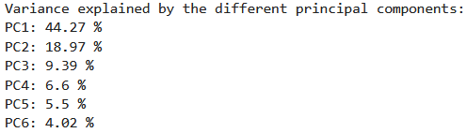
Examination of different numbers of principal components for PCA
4, 5 or 6 principal components represent the raw data in a relatively high degree (explained variance is about 75-90%).

Slide 2
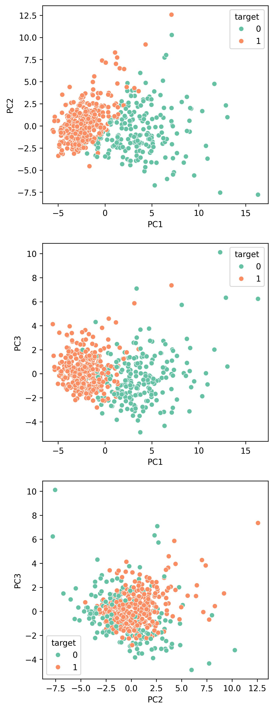
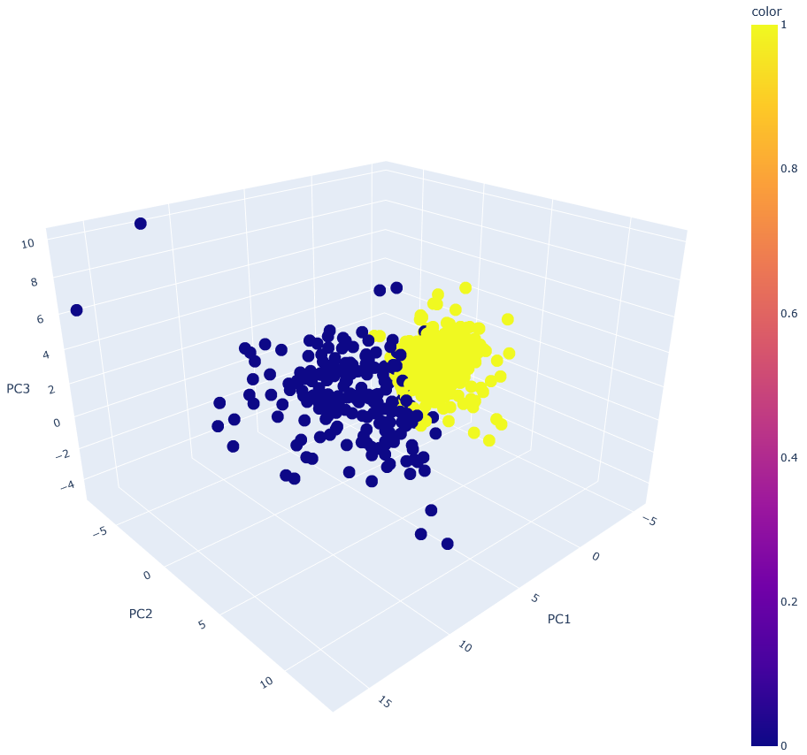
Visualization of the principal components (up until 3)
2D visualization
3D visualization
0 - malignant
1 - benign

Slide 3
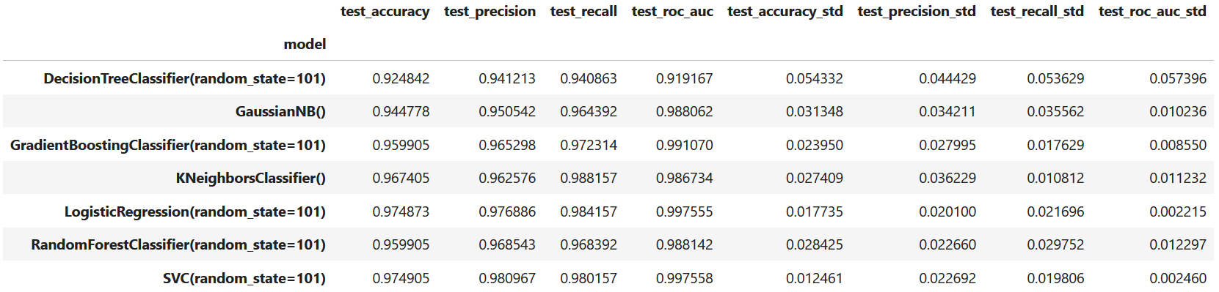
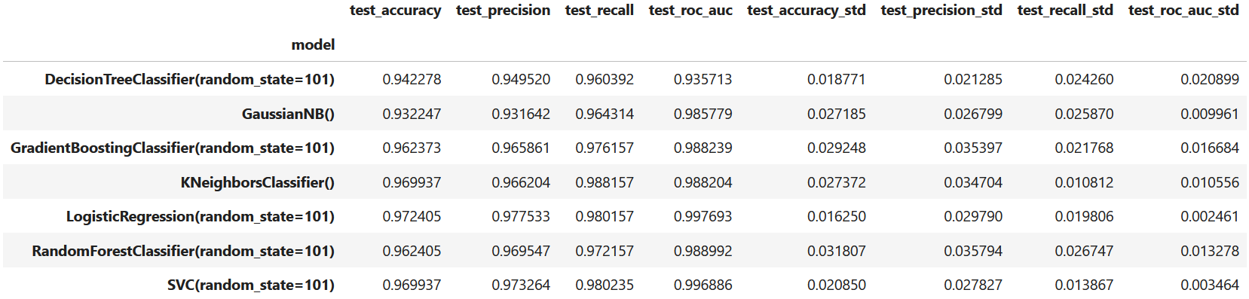
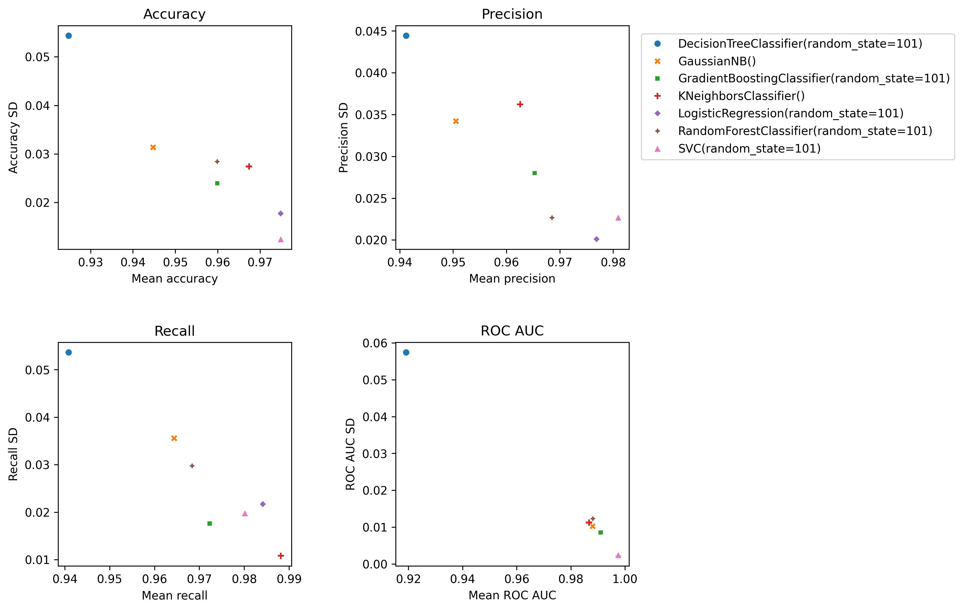
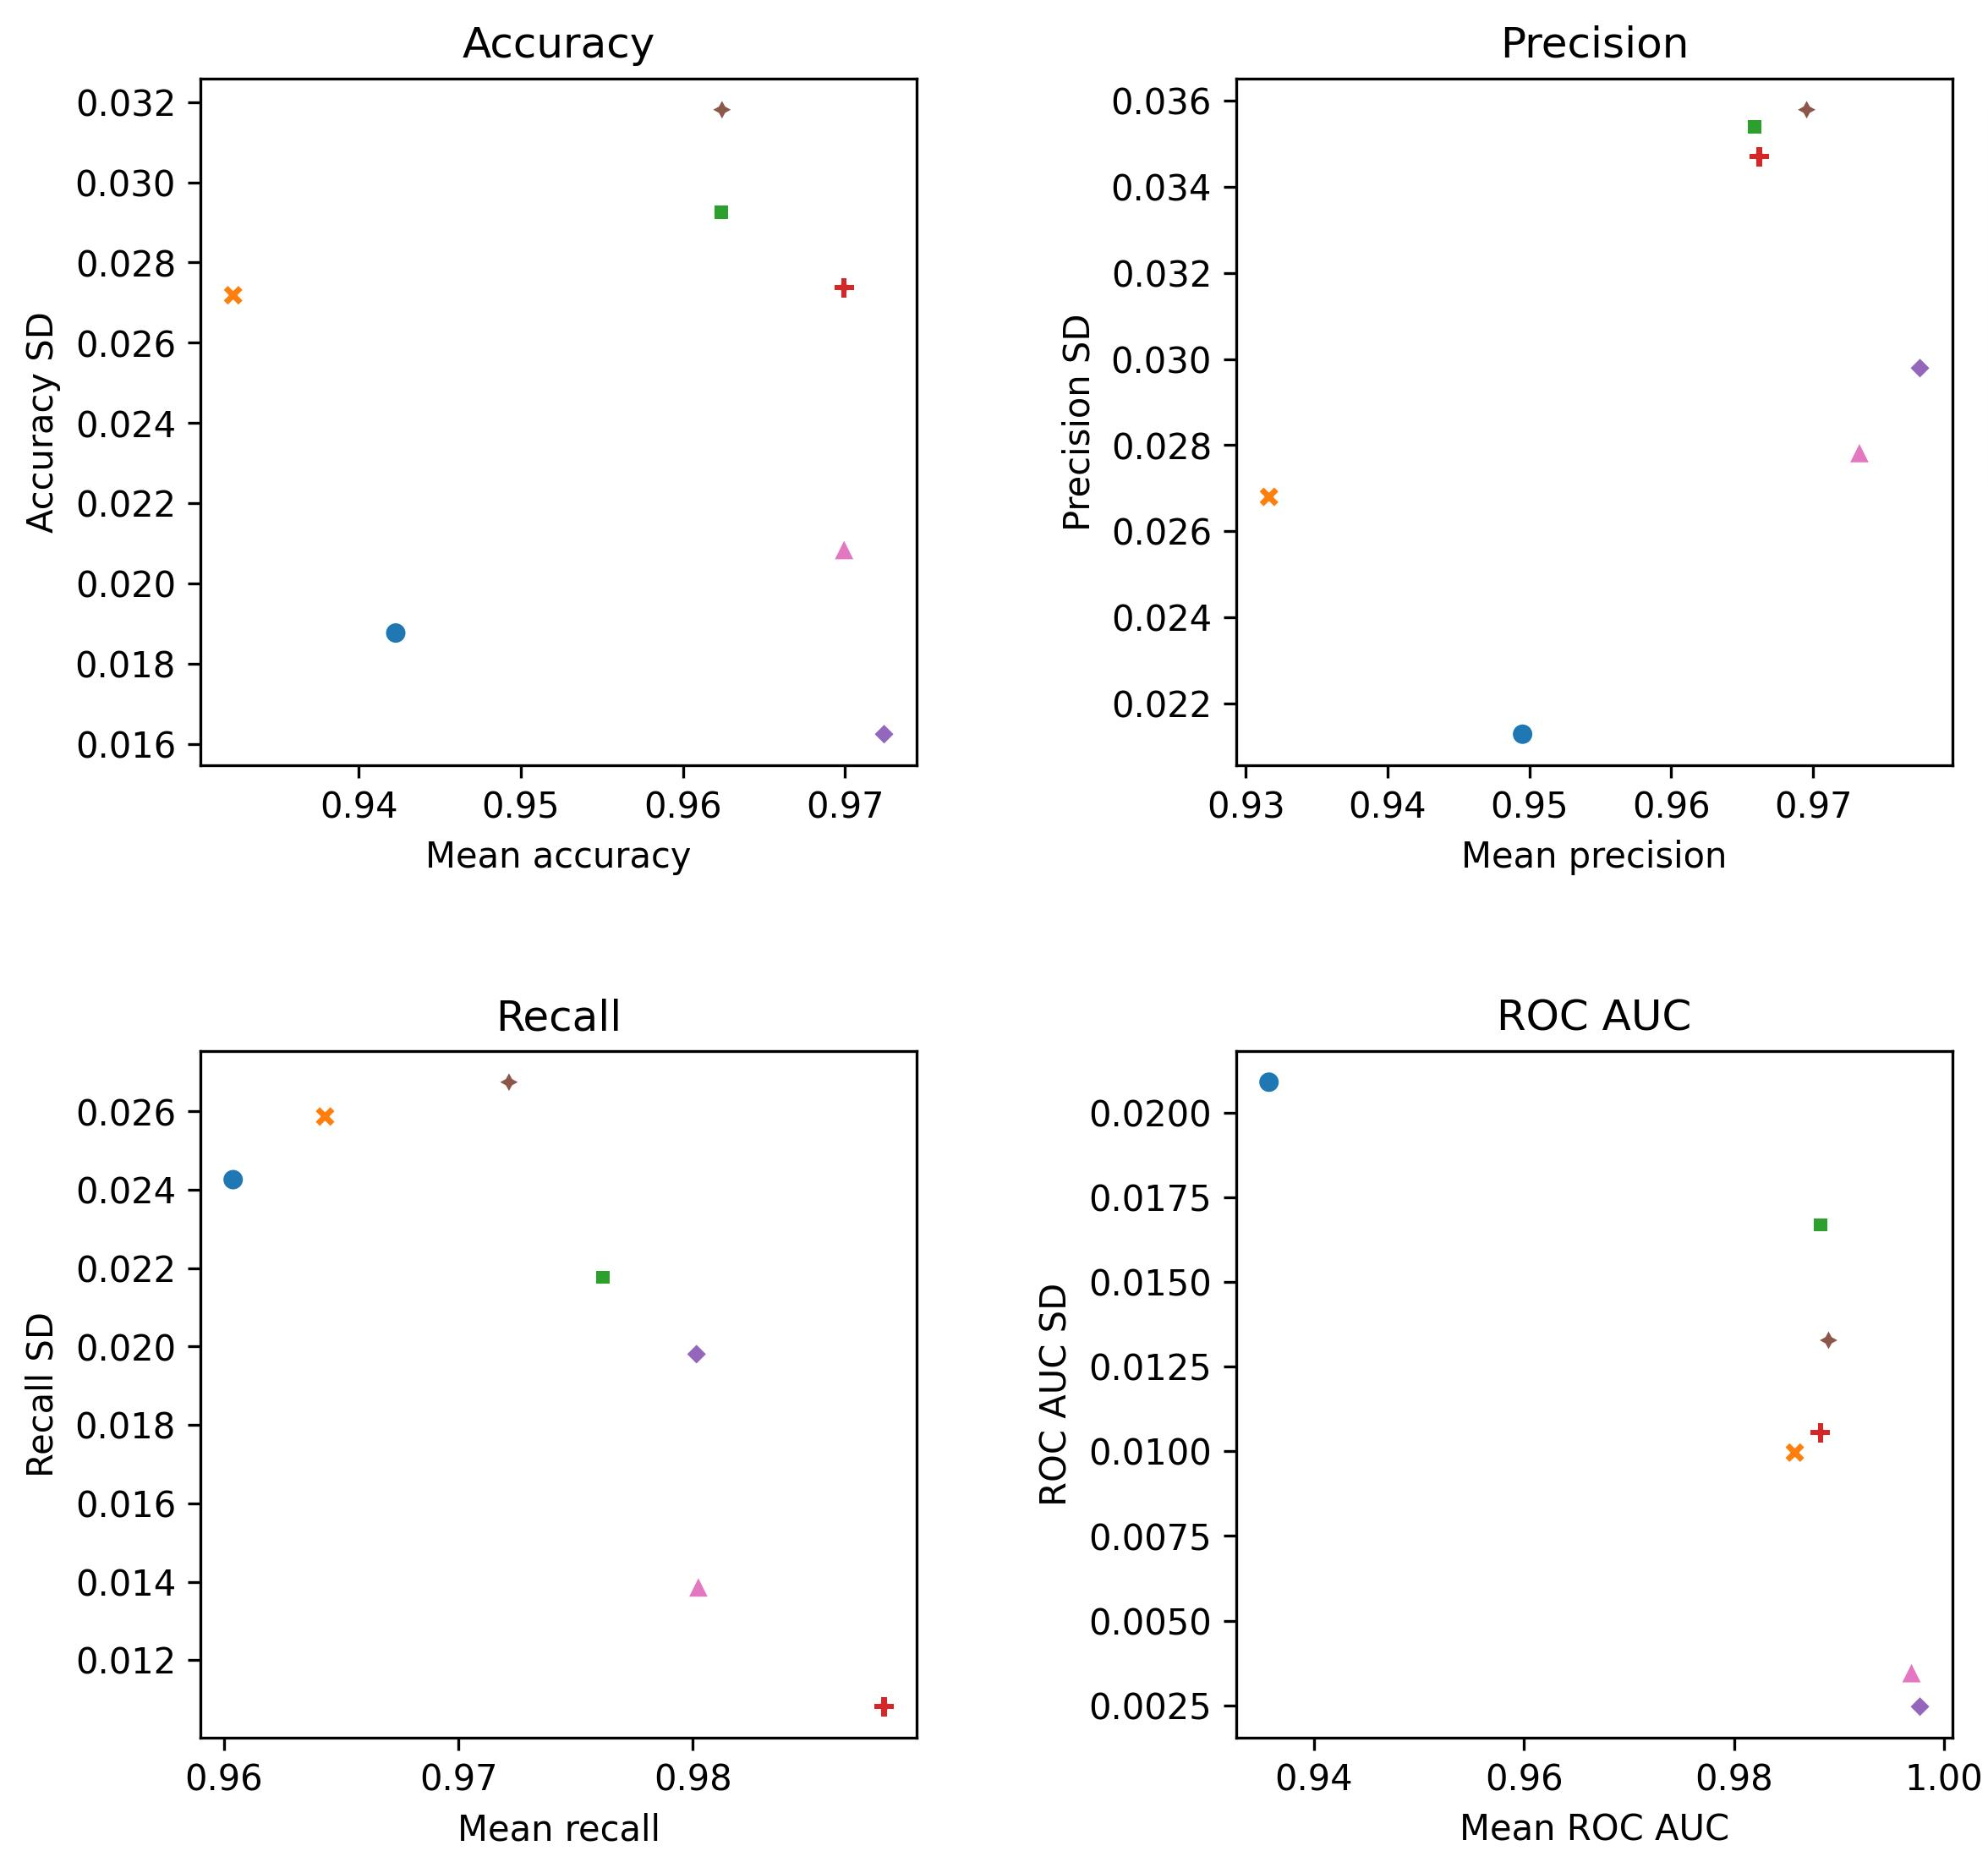
Comparison of different ML models – all features vs. PCA
(Mean and SD values are calculated from the results of cross-validation)
All features
5 principal components from PCA
Training the models with 5 principal components from PCA provided the highest overall performance from the tested options. Compared to using all features, a slight improvement can be observed in each case with PCA and standard deviations tend to be lesser. In general, model performances following PCA are as good as the results of feature selection.

